Slide 1
Multi-level perspective (MLP)
NEST Session for Newcomers to Sustainability Transitions Research
June 23rd, 2019
Lea Fuenfschilling

Slide 2
A little bit of history
Focus: understanding technological innovation and diffusion as well as industrial change from a socio-technical perspective
Combining insights from sociology of technology, STS, evolutionary economics
SCOT/ANT
Path-dependency, technological trajectories & paradigms
Co-evolution of technology and institutions
LTS
Development of central concepts: niche, regime, landscape

Slide 3
Early references
Kemp, R., 1994. Technology and the transition to environmental sustainability: the problem of technological regime shifts. Futures 26, 1023–1046.
Schot, J.W., Hoogma, R., Elzen, B., 1994. Strategies for shifting technological systems: the case of the automobile system. Futures 26, 1060–1076.
Rip, A. (1995). Introduction of new technology: making use of recent insights from sociology and economics of technology. Technology analysis & Strategic management, 7(4), 417-432.
Rip, A., Kemp, R., 1998. Technological change. In: Rayner, S., Malone, E.L. (Eds), Human Choice and Climate Change, Vol. 2. Battelle Press, Columbus, OH, pp. 327–399.
Kemp, R., Schot, J.W., Hoogma, R., 1998. Regime shifts to sustain- ability through processes of niche formation: the approach of strategic niche management. Technology Analysis and Strategic Management 10, 175–196.
Schot, J.W., 1998. The usefulness of evolutionary models for explaining innovation: the case of The Netherlands in the nineteenth century. History of Technology 14, 173–200.
Van den Ende, J., Kemp, R., 1999. Technological transformations in history: how the computer regime grew out of existing computing regimes. Research Policy 28, 833–851a.
Kemp, R., Rip, A., Schot, J.W., 2001. Constructing transition paths through the management of niches. In: Garud, R., Karnoe, P. (Eds.), Path Dependence and Creation. Lawrence Erlbaum, Mahwah, NJ, pp. 269–299.

Slide 4
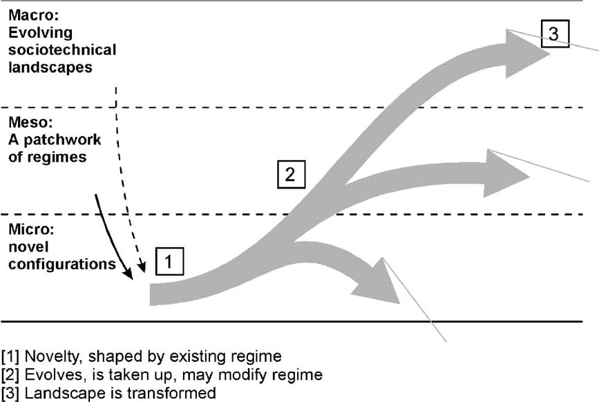
Rip and Kemp, 1996

Slide 5
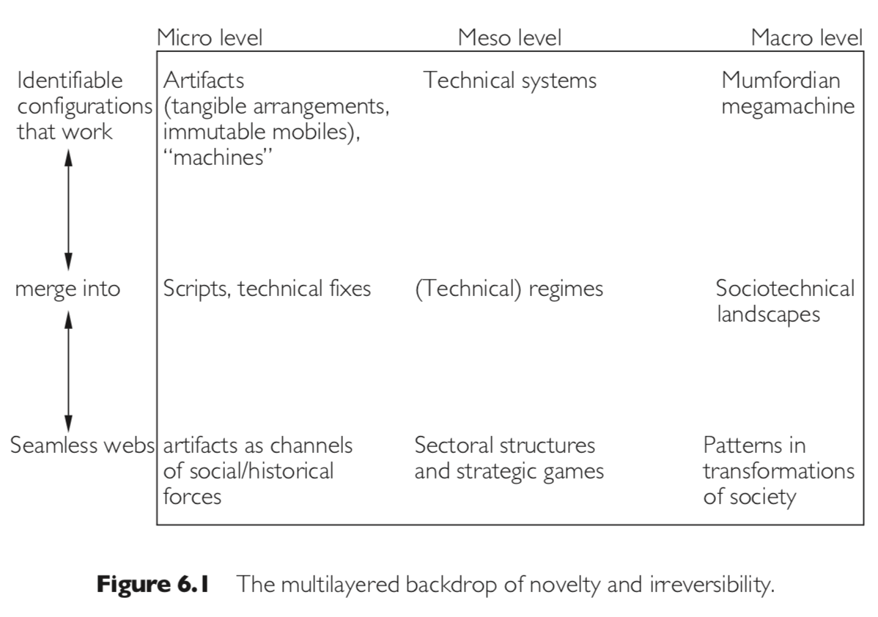
Rip and Kemp 1998

Slide 6
Geels, F. W. (2002). Technological transitions as evolutionary reconfiguration processes: a multi-level perspective and a case-study. Research policy, 31(8-9), 1257-1274.
Geels, F. W. (2004). From sectoral systems of innovation to socio-technical systems: Insights about dynamics and change from sociology and institutional theory. Research policy, 33(6-7), 897-920.
Geels, F. W., & Schot, J. (2007). Typology of sociotechnical transition pathways. Research policy, 36(3), 399-417.
Geels, F. W. (2010). Ontologies, socio-technical transitions (to sustainability), and the multi-level perspective. Research policy, 39(4), 495-510.

Slide 7
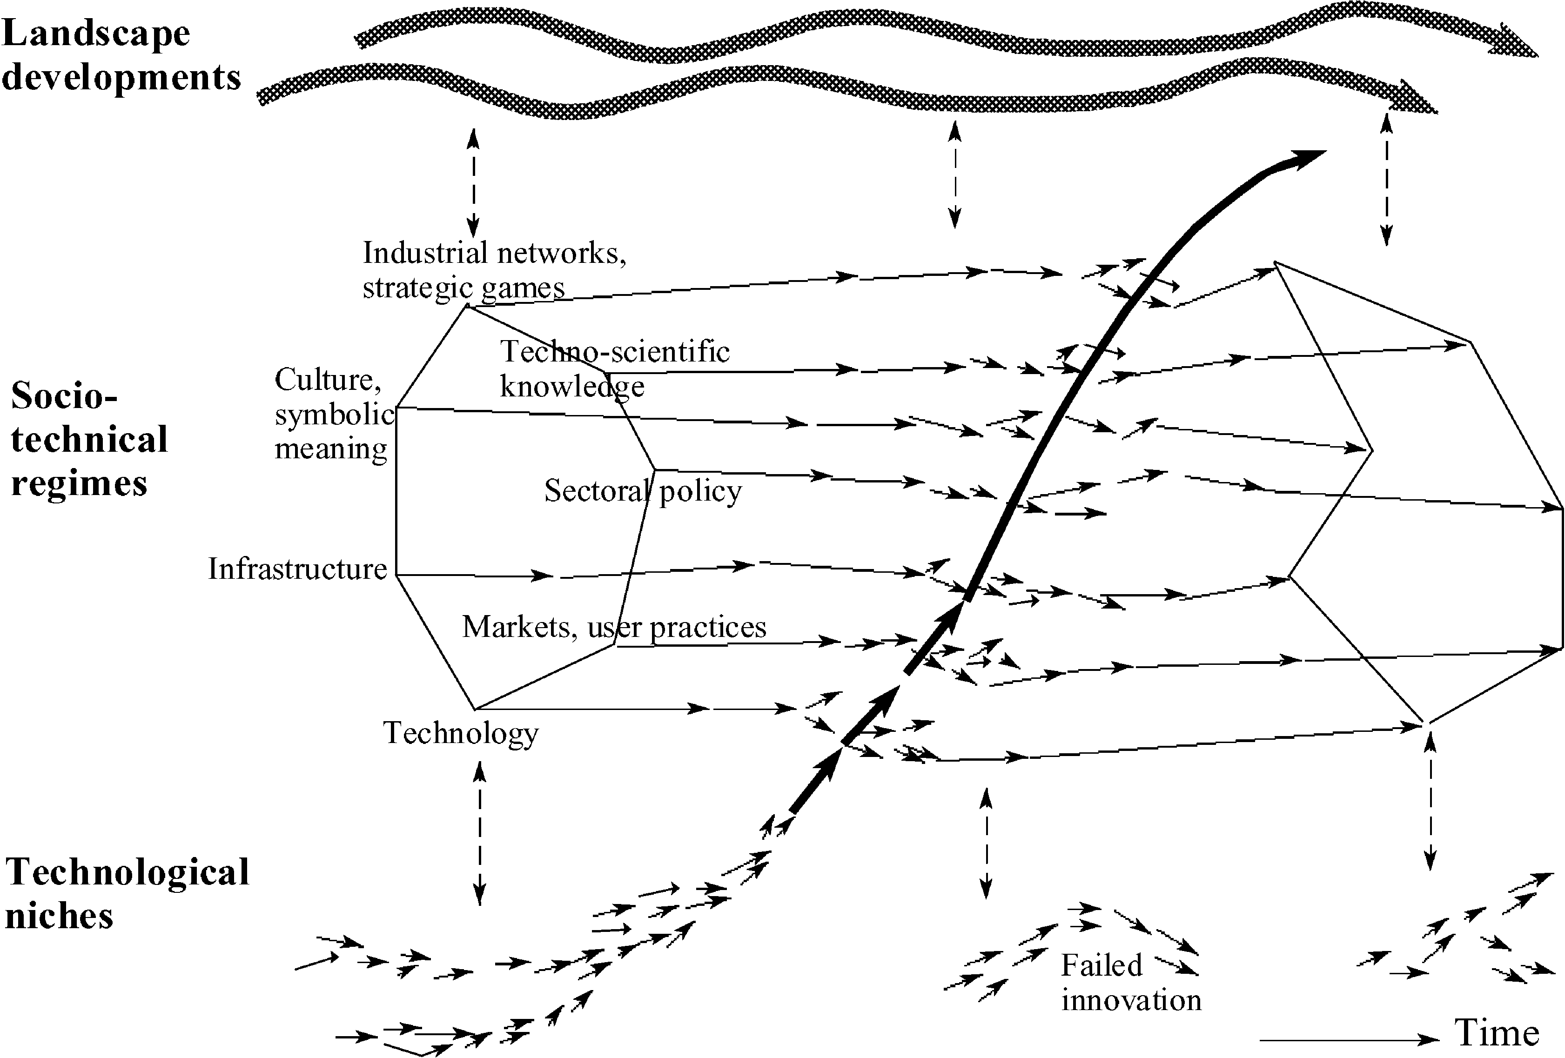
External factors
Socio-technical system
Co-evolution
Path-dependency
Stability
Innovation
Experimentation
Socio-technical alignment
Protection
Diffusion

Slide 8
Future research: MLP as heuristic
Don’t replicate frameworks for the sake of it, focus on relevant research questions, interesting empirical phenomena and exchange with other communities
Socio-technical, systemic perspective on transitions as ontology
Interplay between stability and change, structure and agency
Explaining path-dependency, co-evolution, persistence
Explaining deviation, novelty creation, innovation
Process perspective: Institutionalization and de-institutionalization
Factor in questions of space and time
Use different methodology and methods
Make use of vast case study repertoire: use secondary analysis for further theorization

