Slide 1
Transition Governance: A ‘crash course’
NEST Session for Newcomers to Sustainability Transitions Research @IST 2019
Ottawa, June 23rd
Dr Florian Kern
Head of research group Ecological Economics and Environmental Policy
IÖW – Institute for Ecological Economy Research, Berlin

Slide 2
Content
Why governance? What is it?
Seminal contributions about transition governance
Smith et al 2005: The governance of sustainable socio-technical transitions
Loorbach 2010: Transition management for sustainable development: a prescriptive, complexity‐based governance framework
Shove & Walker 2007: CAUTION! Transitions ahead: politics, practice, and sustainable transition management
Future research directions

Slide 3
Why governance? What is it?

Slide 4
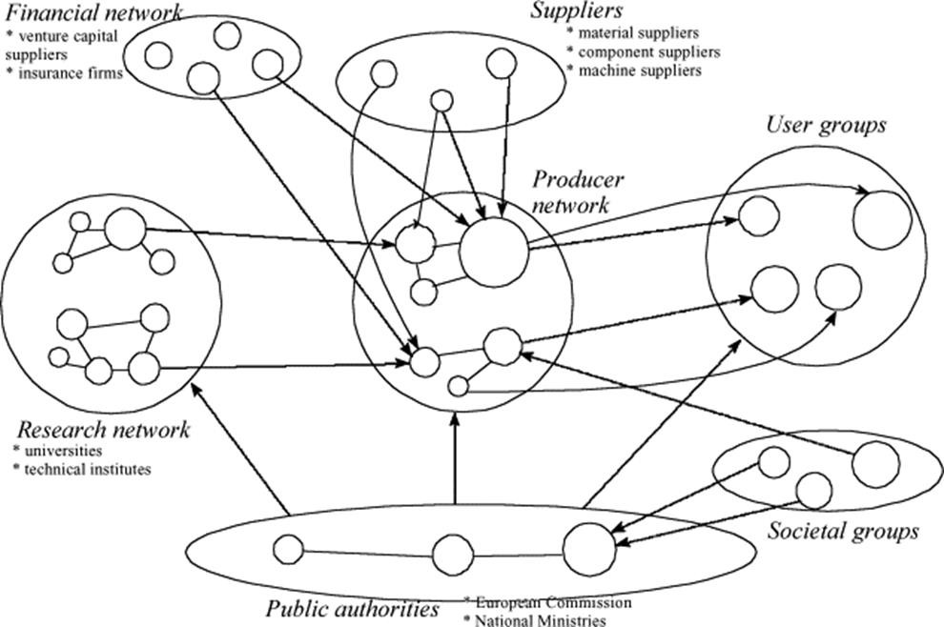
Why governance? What is it?
Transitions as multi-actor processes: no actor has unilateral control over socio-technical systems; variety of interests, competencies, resources, …
“Governing can be considered as the totality of interactions, in which public as well as private actors participate, aimed at solving societal problems or creating societal opportunities” (Kooiman 2003)
Governance = steering in a situation of a plurality of actors and levels of action
Source: Geels 2002

Slide 5
Seminal contributions about transition governance

Slide 6
Co-evolutionary perspective (I)
1811 citations

Slide 7
Co-evolutionary perspective (I)
Critique: transitions seen as a monolithic process, neglecting important differences in context
Transitions are enacted through the coordination and steering of many actors and resources
Transitions as functions of two processes:
Articulation of selection pressures: external pressure on actors that regime is unsustainable
Adaptive capacity: Degree to which responses are coordinated and whether they are based on resources inside or outside the regime
Availability of resources and coordination influences the form and direction of transition

Slide 8
Prescriptive, complexity-based perspective (II)
1101 citations

Slide 9
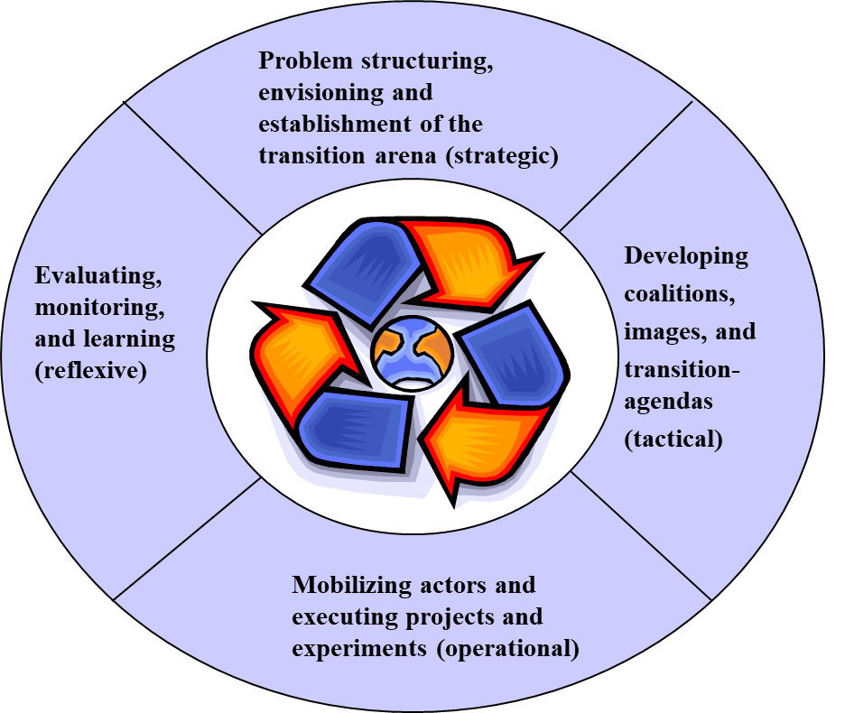
Prescriptive, complexity-based perspective (II)

Slide 10
Politics and practice perspective (III)
Elizabeth Shove and Gordon Walker
938 citations

Slide 11
Politics and practice perspective (III)
Caution 1: Transition Politics
If transitions can be deliberately managed, who are the transition managers, on what authority and on whose behalf do they act? No steering ‘from the outside’
Caution 2: Managing transition management
What are the new institutions of reflexively governed transition management, what are the mechanisms through which goals are to be reinvented and revised?
Caution 3: Missing transitions
How should those concerned with sustainability respond to the increasingly rapid, powerful, and expertly orchestrated diffusion of unsustainable technologies, practices and images?
Caution 4: Transitions in practice
What about practices and ordinary routines of everyday life and their dynamics of change? Possible to govern?
Notes:
Caution 1: Problem definition not neutral; contested commitments that go into making future visions; deep ambivalence of sustainability.
Caution 2: Danger is that conventional instruments are incorporated into political business-as-usual.
Caution 3: relation between competing systems and practices, how can decline of systems be engineered?
Caution 4:

Slide 12
Future research directions

Slide 13
Future research directions
Governing transitions section:
Forward-looking analyses and later stages of transitions
Investigate use of traditional policy instruments in transitions and their politics
Role of intermediary actors in different phases of transitions
More sophisticated analyses of experimentation (micro-politics, power, agency, geography, business, experimental governance)
…

Slide 14
Transition Governance: A ‘crash course’
Thank you for your attention
NEST Session for Newcomers to Sustainability Transitions Research @IST 2019
Ottawa, June 23rd
Dr Florian Kern
Head of research group Ecological Economics and Environmental Policy
IÖW – Institute for Ecological Economy Research, Berlin

Slide 15
References
Geels, F. W. (2002). Technological transitions as evolutionary reconfiguration processes: a multi-level perspective and a case-study. Research Policy, 31(8-9), 1257-1274.
Köhler, J., Geels, F. W., Kern, F., Markard, J., Onsongo, E., Wieczorek, A., ... & Fünfschilling, L. (2019). An agenda for sustainability transitions research: State of the art and future directions. Environmental Innovation and Societal Transitions. (31), 1-32.
Kooiman, J. (2003). Governing as Governance, SAGE, London, Thousand Oaks California.
Loorbach, D. (2010). Transition management for sustainable development: a prescriptive, complexity‐based governance framework. Governance, 23(1), 161-183.
Shove, E., & Walker, G. (2007). CAUTION! Transitions ahead: politics, practice, and sustainable transition management. Environment and Planning A, 39(4), 763-770.
Smith, A., Stirling, A., & Berkhout, F. (2005). The governance of sustainable socio-technical transitions. Research Policy, 34(10), 1491-1510.

