Slide 1
Introduction to Technological Innovation Systems Research
Bernhard Truffer
Newcomers session, IST Ottawa, 23.6.2019

Slide 2
1. Origin and ontological assumptions of TIS research
Guiding research question of IS research
What conditions are essential for successfully generating innovations by companies, regions, countries? Especially in phases of early industry formation.
Origin of the broader innovation systems perspective
New realities in the 1980ies about Japan gaining industrial competitivness over US and Germany
Counter theory against neo-liberal explanation: it is all in the institutions!
First analysis of National Innovation Systems (OECD, Freeman, Lundvall)
Later formulation of variants: regional , sectoral, technological innovation systems
Sharif 2006; Weber and Truffer 2017
Core assumptions compared to a neo-classical approach
Core actors: companies/consumers vs. broad range of actors
Coordination: through markets vs. through networks, institutions and intermediation
Barriers: state/market failures vs. system failures (capability, coordination, institutional)

Slide 3
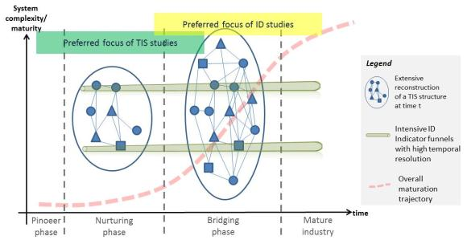
2. Core elements and assumptions of TIS studies
Conceptual Dimensions of TIS
System elements (structures)
Actors, networks, institutions
System boundaries and resources
Core processes (functions)
Knowledge production &diffusion
Entrepreneurial experimentation
Resource mobilization
Guidance of the search
Market formation
Legitimacy
Enables systemic assessment of industry formation
System failures: capabilities, coordination and institutions
Dynamic account over different development stages
Actors
Networks
Institutions

Slide 4
3. Criticisms
Ontological narrowness
Systems ontology builds on engineering logic and complex systems theory
Promotes implicitly a rather linear view of innovation diffusion
Is more of a descriptive framework and doesn’t add much to explanation
Unsuitable for “truly” analyzing transitions
It’s only about the provision side of technologies (pet tech perspective)
Ignores feedback between emerging technologies and institutional contexts
Too harmonious: Ignores power and politics
New realities not well covered by typical application cases (PV, biogas, Evs,…)
Growing maturation and globalization of cleantech industries
Growing importance of value chains or systemic technologies
Not suitable for developing countries

Slide 5
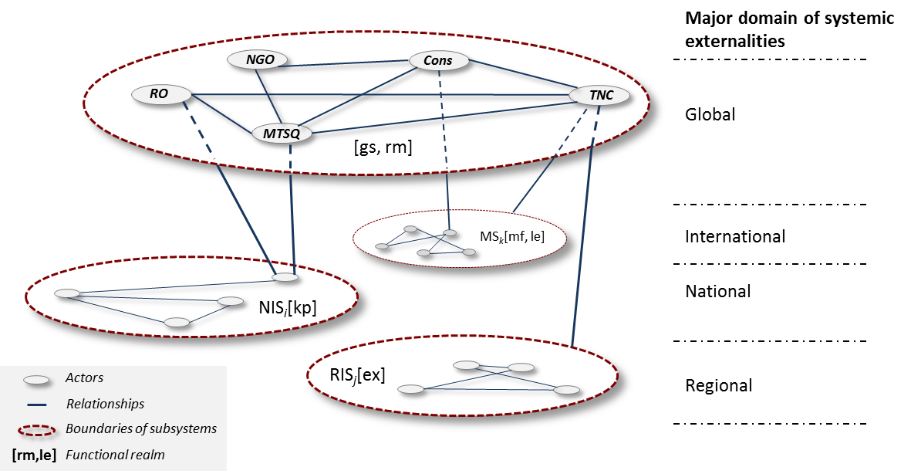
4. Recent Developments
TIS in context (Bergek et al. 2015)
Geography: Global IS (Binz and Truffer 2017) and TIS in development (Tigabu et al. 2015; Blum et al. 2016)
TIS for value chains & technological systems (van Welie et al. 2019; Stephan et al. 2016)
Explanatory turn in reinterpreting the different functions: Market formation, guidance of search, legitimation, …
Policy: Mission oriented IS: Hekkert (2019)
… And many more…
➔ Continues to be a vibrant field of research

Slide 6
Thanks
Newcomers session, IST Ottawa, 23.6.2019

