Slide 1
Inclusion is not bringing people into what already exists; it is making a new space, a better space for everyone. - George Dei (2006)

Slide 2
Adolescent Developmental milestones
Identity
Autonomy
Relationships
Vocation
“Who am I?”
Own individuation, including moral, religious and sexual identities
Notes:
Self-concept - adolescent’s perception of self—one’s talents, goals, and life experiences.
Self-esteem - how one evaluates selfworth
Adolescents may experiment with different peer groups or different styles of dress or behavior as a way of searching for their identity. Some degree of rebellion away from the family’s image is part of the adolescent’s search for identity.

Slide 3
The Binary

Slide 5
LGBTQQ2SIA+
Lesbian
Gay
Bisexual
Transgender
Queer
Questioning
2 Spirited
Intersex
Asexual
+

Slide 7
Prevalence… the tip of the iceberg
Previous estimates on prevalence based on gender reaffirmation surgery rates): 1/10,000 assigned males & 1/30,000 assigned females
Research now indicates that between 0.5% - 1.2% of youth identify as trans
Canadian Gender Referral Stats (projected for 2015)
Notes:
Steve

Slide 8
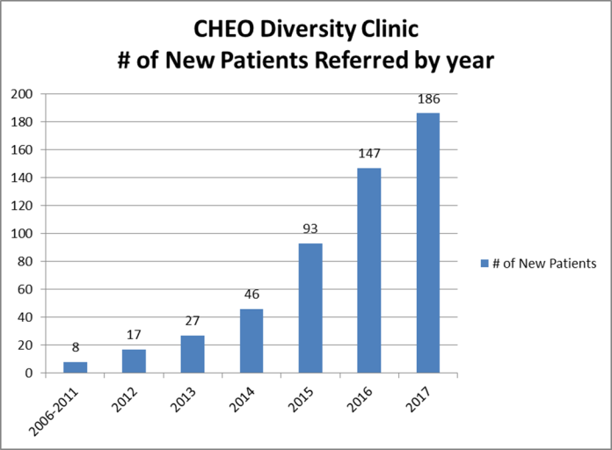

Slide 9
Principles of care
Establish a safe, supportive and informed care environment
Use their preferred name and gender markers
Goal is to empathize with and respect where they are at and individualize a path based on their realities

Slide 10
Transitional care
Every individual’s transition is unique
Social transition can include change of name, gender pronoun and gender presentation. Legal.
Medical transition can include:
Puberty hormone blockers
Cross-sex hormones
Gender-affirming surgeries

Slide 11
Where Do Adolescents Go?
CHEO/YouthNet
YSB Spectrum
Kind Space
FSO Social Group
Rainbow Health Ontario
SAEFTY

Slide 12
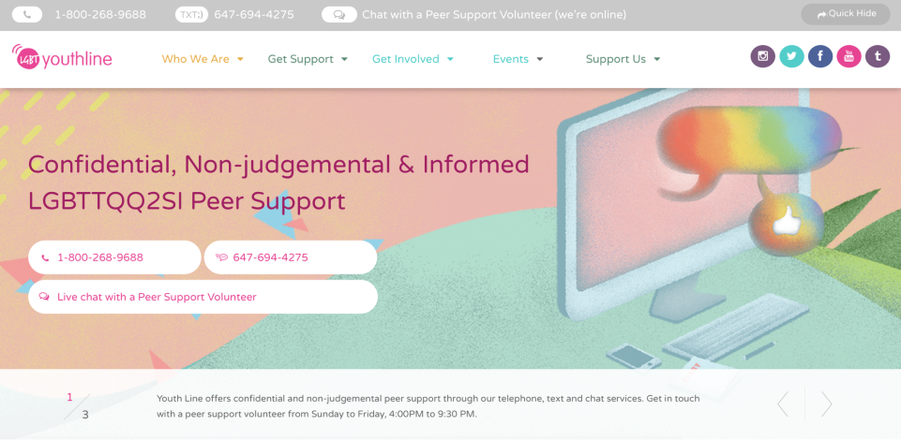

Slide 14
Where Do Parents Go?
CHEO/Family Services Ottawa
Monthly parent support group that is partnered with the CHEO Diversity Clinic
PFLAG Canada
Rainbow Health Ontario
Gender Creative Kids
Trans Parent Canada
Families in Transition

Slide 15
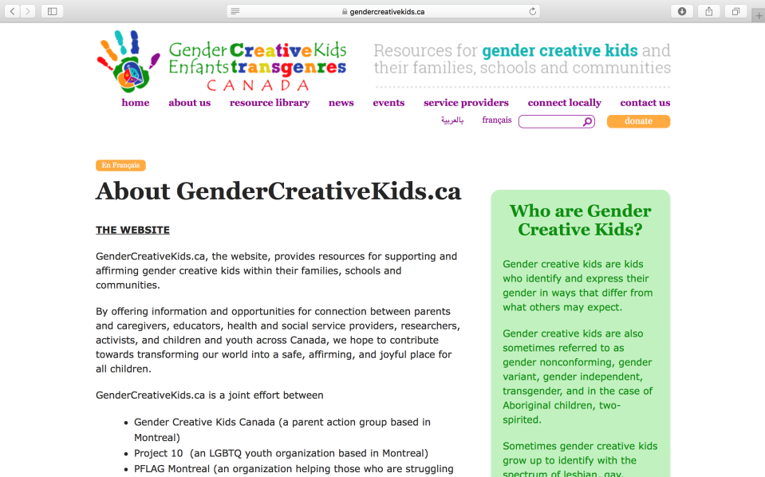

Slide 18
bennett@cheo.on.ca
Notes:
Thank you and Merci

