Slide 1



Carleton.ca/Law
@cuLegalStudies
Facebook.com/cuLegalStudies
Academic
Orientation Day
2023 / 2024
Notes:
Steve
Hello and welcome everyone!
My name is Steve Tasson, and I’m the Undergrad Supervisor
This presentation will be posted to the orientation website, but you can find more info on our departmental website and by following us on Instagram, Twitter, and Facebook

Slide 2

Welcome to the Faculty of Public Affairs – Department of Law and Legal Studies
Academic Orientation Day!
Law & Legal Studies
Notes:
Steve
We are thrilled you chose Carleton and our department for your studies!
Our goal today is to:
1) Introduce you to our department and the discussion of law;
2) Highlight our exciting programs, faculty and staff;
3) Flag campus services and resources available to you as a Carleton student
We know you’re receiving a lot of info at the start of term, so we will stay focused

Slide 3
Agenda
10:00am – 10:30am
T-shirt handout and snacks
10:30am – 12:30pm
Law & Legal Studies Presentation
12:30pm – 1:30pm
Faculty BBQ
1:00pm – 4:00pm
Expo Carleton
Notes:
Steve
((agenda basics))

Slide 4
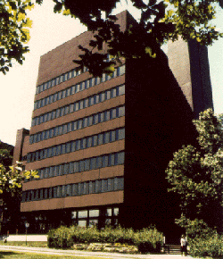
Faculty of
Public Affairs
DEPARTMENT OF LAW & LEGAL STUDIES
Zeina Bou-Zeid
Chair
Steve Tasson
Undergraduate Supervisor
Cole Labelle
Undergraduate Administrator/Advisor
MAIN OFFICE: Loeb C473
PHONE: 613-560-3690
EMAIL: Law@Carleton.ca
Law & Legal Studies
Notes:
Steve
We’ve got a great team leading our department and supporting you as students:
Chair – Zeina – we have a welcome speech from her in a minute
Me – Undergrad Supervisor
Cole Labelle, Undergrad Administrator – he and I are key contacts for you to remember
We’re also going to hear from some of our experienced faculty members who will be your first year Law professors, then we’ll look at what our department offers in more detail
If you ever need to speak with us, our department’s main office is located at C473 in the Loeb building, but there are other ways to keep in touch including phone, email, and Zoom

Slide 5

Chair’s Welcome
Zeina Bou-Zeid, PhD
Research Interests
C
2023 / 2024 Courses
LAWS 2908
Law & Legal Studies
Notes:
Steve
Our attending faculty members will now take a few minutes to share some tips and insights, starting with Professor Vincent Kazmierski

Slide 6

First Year Professors
Vincent Kazmierski, PhD
Research Interests
Constitutional Law
Legislation and Accountability
Disability and Law
Interdisciplinary Teaching
2023 / 2024 Courses
LAWS 1001: Introduction to Legal Studies I
LAWS 4503: Law, Disability, and Society
Law & Legal Studies
Notes:
Steve
Our attending faculty members will now take a few minutes to share some tips and insights, starting with Professor Vincent Kazmierski

Slide 7

First Year Professors
Sebastien Malette, PhD
Research Interests
Law and Indigeneity
Foucault’s ‘Government and Power’
Métis and ‘Mixed Heritage’ Communities
Exclusionary Narratives and Lateral Violence
2023 / 2024 Courses
LAWS 1001: Introduction to Legal Studies
LAWS 1002: Introduction to Legal Studies II
LAWS 3504: Law and Aboriginal Peoples
LAWS 4106: Law and Violence
Law & Legal Studies

Slide 8

First Year Professors
Professor Steve Tasson
Research Interests
X
Y
Z
2023 / 2024 Courses
LAWS 1001: Introduction to Legal Studies
LAWS 1002: Introduction to Legal Studies II
FYSM 1502: First Year Seminar
Law & Legal Studies

Slide 9
Law Break
What comes to mind when you
think of the word “law”?
Notes:
Steve
((general discussion of responses))

Slide 10
Faculty of
Public Affairs
Department of
Law and Legal Studies
Canada’s premier program for the interdisciplinary study of law
Law: It’s not just for lawyers
Carleton University
Notes:
Steve
Our approach is captured by the saying “Law: It’s not just for lawyers”
By this we mean that if you think about society’s most pressing challenges in Canada and abroad, from racism to poverty and war, law is usually part of the broader story behind these challenges
And it’s not just the formal rules that matter, but the broader context in which law shapes and is shaped by political, economic and cultural forces

Slide 11
Highlights of the Department of Law and Legal Studies
Our program will help you address today’s most
pressing legal and social challenges
Biggest and most vibrant centre for
interdisciplinary legal studies in North America!
More courses than any other related program
We foster and celebrate student research
Carleton University
Notes:
Steve
Our program will therefore help you address today’s most pressing legal and social challenges
It is the biggest and most vibrant centre for interdisciplinary legal studies in North America!
More undergrad courses than any other related program, so that gives you interesting choices
We also foster and celebrate student research – there are opportunities to get involved, particularly in fourth year for students in the 20 credit program

Slide 12
Highlights of the Department of Law and Legal Studies
Our Department is interdisciplinary
This approach shapes your courses and our teaching
Award-winning teaching staff
We have an active student-run Moot group
Take advantage of exchanges, co-op, placements, and extensive support services
Carleton University
Notes:
Steve
Our courses and faculty examine law and legal studies from a truly interdisciplinary perspective, drawing from many academic backgrounds and models
This approach shapes your courses and our teaching, and it will empower you to:
critically analyze problems,
communicate your ideas clearly,
and - we hope - act to affect positive change in the world
We have award-winning teachers who will deliver these courses, with diverse backgrounds in law, philosophy, history, sociology, critical race studies, political science, communications – the list goes on
We also have an active student-run moot group to help you develop analysis and clear argumentation
You should also take advantage of potential opportunities including exchanges, co-op, internships, and extensive support services

Slide 13
Presentation Highlights
There are many opportunities at Carleton, and
within the Department of Law
2) Have GOALS and plan ahead to meet your program requirements
3) You are not alone!
Carleton University
Notes:
Steve
At the end of our presentation, here are the three key things we want you to remember!
1) There are many opportunities at Carleton, and within the Department of Law– but you need to make the most of them! Get involved and be active in the community
2) Have GOALS and plan ahead to meet your degree requirements
3) You are not alone! As a member of our campus you’re an important part of the Carleton community, and we’re here to help
The most important take-away is that there are people, tools, and services to make your Carleton experience the best it can be, but as a university student you must also advocate and care for yourself by engaging with us

Slide 14
Career Paths
Government Departments/Agencies
Educational Institutions
Federal/Provincial Courts
Media Corporations
Non-governmental Organizations (NGOs)
Private Companies, small and large
Law & Legal Studies
Notes:
Steve
So, you’ve studied hard, gotten involved, connected with your fellow students and favourite teachers over the course of your studies… what now?
What can you do with your degree? There are lots of great options!
Government Departments/Agencies
Educational Institutions
Federal/Provincial Courts
Media Corporations
Non-governmental Organizations (NGOs)
Private Companies, small and large
We run alumni and career events throughout the year, so keep your eyes open
Another way to connect with potential employers is through summer employment, and internships and co-ops in your later years of study
Remember to be nice to your profs, because you may need to ask them for employment reference letters later!

Slide 15

Career Services
Understanding the job market
Understanding your skills, how to apply them
Resume (CV) writing and reviews
LinkedIn writing and reviews
Practice interviews
Networking
Law & Legal Studies
Notes:
Steve
So, you’ve studied hard, gotten involved, connected with your fellow students and favourite teachers over the course of your studies… what now?
What can you do with your degree? There are lots of great options!
Government Departments/Agencies
Educational Institutions
Federal/Provincial Courts
Media Corporations
Non-governmental Organizations (NGOs)
Private Companies, small and large
We run alumni and career events throughout the year, so keep your eyes open
Another way to connect with potential employers is through summer employment, and internships and co-ops in your later years of study
Remember to be nice to your profs, because you may need to ask them for employment reference letters later!

Slide 16
Key Resources
Law and Legal Studies Website
Orientation FAQ
Course Outlines
Undergraduate Administrator
  (how to complete your degree)
Undergraduate Supervisor
  (what you can do with your degree)
Law & Legal Studies
Notes:
Steve
So, you’ve studied hard, gotten involved, connected with your fellow students and favourite teachers over the course of your studies… what now?
What can you do with your degree? There are lots of great options!
Government Departments/Agencies
Educational Institutions
Federal/Provincial Courts
Media Corporations
Non-governmental Organizations (NGOs)
Private Companies, small and large
We run alumni and career events throughout the year, so keep your eyes open
Another way to connect with potential employers is through summer employment, and internships and co-ops in your later years of study
Remember to be nice to your profs, because you may need to ask them for employment reference letters later!

Slide 17

Building
Your Future
Law & Legal Studies
Notes:
Cole
Building a secure future
Consider yourselves architects, trying to build a home for a secure and comfortable future
I’m the engineer you can contact to ask whether adding, removing, or changing something about your home will work on a structural level (this includes the various program elements and course selection)
I can also refer you to other specialists who can help solve different problems you may encounter
But ultimately, your vision will be what guides the shaping of your house

Slide 18
Departmental Advising
Program Elements
  Major, Concentration, Minors, General vs. Honours
Course Selection
  Year Standing, Prerequisites, Electives/Free Electives
Degree Progress
  Breadth Requirements, Regulations, Graduation
Departmental Permissions
  Research Essays (4908), Placements (4905/06/07), Tutorials (4901/02)
Law & Legal Studies
Notes:
Cole
Some key topics I can advise on include:
program elements (major, minor, concentration), as well as the General program vs. the Honours program
course selection (year standing, prerequisites, electives and free electives)
degree progress (breadth requirements, regulations, graduation)
and departmental permissions for Honours students to access some of our unscheduled courses (HRE, placements, tutorials)

Slide 19
Our Programs
B.A. Law (15.0 credits)
  Usually takes 3 academic years to complete
B.A. Honours Law (20.0 credits)
  Usually takes 4 academic years to complete
B.A. Combined Honours (20.0 credits)
  Also referred to as a ‘double major’
Mention: Français
Law & Legal Studies
Notes:
Cole
B.A. General (15 credits)
Usually takes app. 3 academic years to complete
B. A. Honours (20 credits)
Usually takes app. 4 academic years to complete
B.A. Combined Honours (20 credits)
‘double major’ – reduces flexibility (more focus on majors, fewer electives)
Mention: Francaise (letter of permission with Ottawa U)

Slide 20
What We Offer
Variety of courses for your degree
Three areas of Concentration:
  Business Law
  Law, Policy and Government
  Transnational Law and Human Rights
Co-op and placement opportunities
International exchange options
Law & Legal Studies
Notes:
Cole
Variety of course topics
Increasing specialization of topics as you advance through years
Concentration option: flexibility vs. specialization– concentrations can be useful for post-graduation academic careers or law school
Co-op: paid experiential learning, study:work sequence, and Service learning placements: for credit, theory applied to practice, good option for those who are career-focused
International exchanges: cultural engagement, understanding different legal systems, experiencing new academic contexts
*

Slide 21
International Exchange
Many opportunities to study for 1 or 2 terms on a student exchange in many countries including Australia, England, France, South Africa
Generally in third year but needs some advance planning
If you’re interested, attend an information session (October is the next one)
Law & Legal Studies
Notes:
Cole
Many opportunities to study for 1 or 2 terms on a student exchange in countries including Australia, England, France, South Africa
Generally in third year but needs some advance planning
If you’re interested, attend an information session (October is the next one)

Slide 22

Co-op
Caitlin MacGregor
Assistant Manager
Notes:
((Ideally, we’ll have a guest speaker of some sort here-- Co-op or otherwise))

Slide 23
Law Break
Which aspect of law
are you most excited to study?
Notes:
Steve
((this can be a different question or activity))

Slide 24
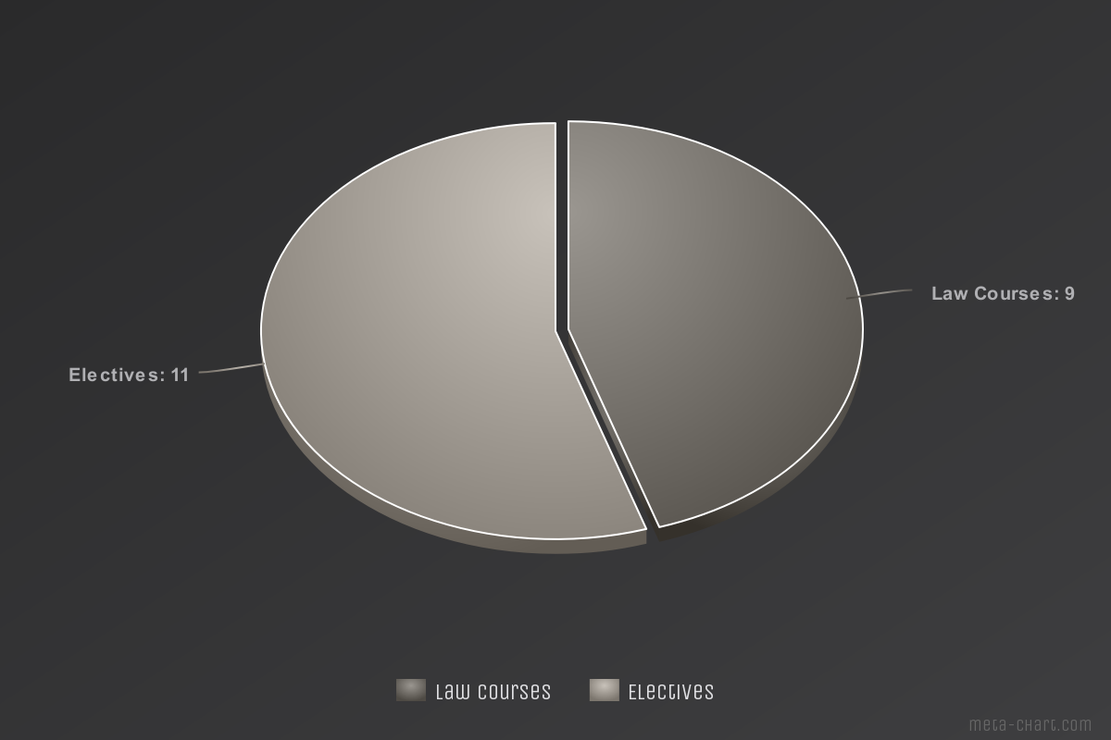
Program Overview
-
BA Honours Law
Law & Legal Studies
Notes:
Cole
Explain major vs. electives

Slide 25
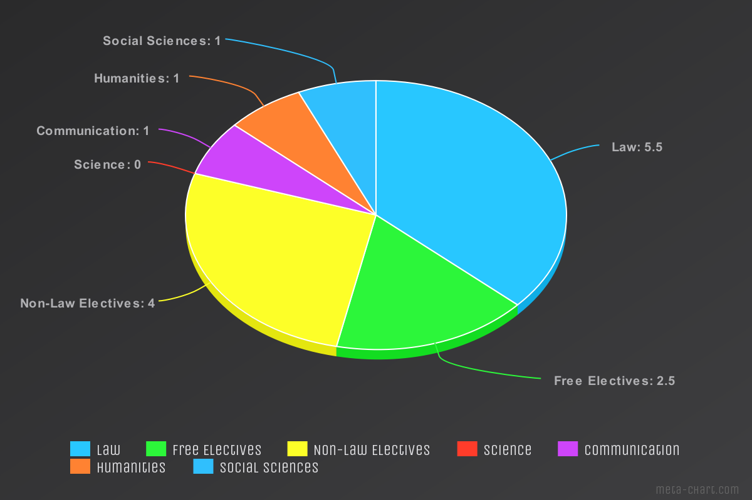
Program Overview
-
Elective & Breadth Credits
Law & Legal Studies
Notes:
Cole
Explain elective types & breadth requirement

Slide 26
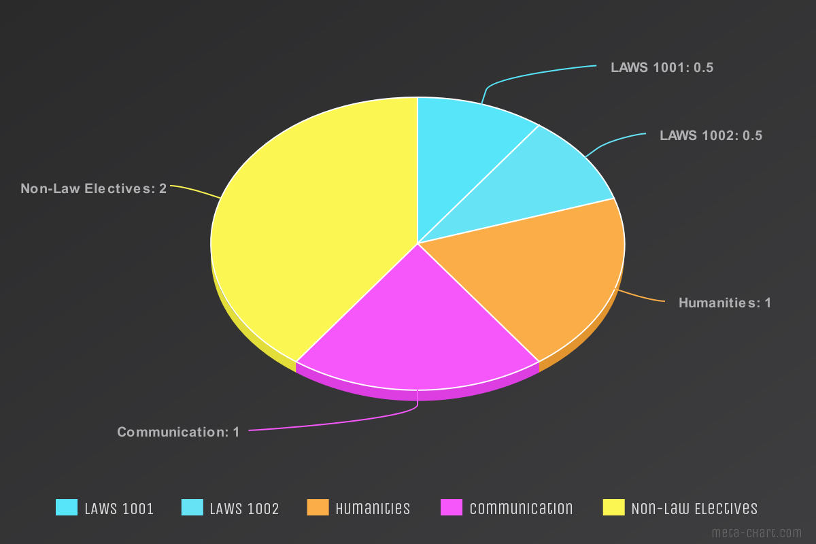
First Year Schedule
-
Course
Selection
Law & Legal Studies
Notes:
Cole
Explain first year reg

Slide 27
Course Prerequisites
A required course (or courses) that must be completed successfully before taking the course that requires the prerequisite.
LAWS 4802 [0.5 credit]
Criminal Jury Trials
Critical analysis of the criminal jury system including its history and context, the role of the judge, jury dynamics and jury composition. Perspectives and roles of the accused, victims, police, defence counsel, Crown attorney, judges, juries, media, politicians and the public.
Prerequisite(s): LAWS 2908, LAWS 2301, LAWS 2302 and fourth-year Honours standing.
Law & Legal Studies
Notes:
Cole
Define prerequisite
Describe example: LAWS 4802 (undergraduate calendar)
Emphasize planning ahead to ensure you meet prerequisites for courses

Slide 28
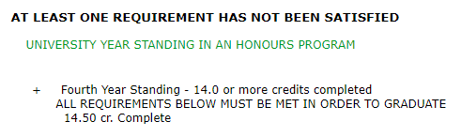
Year Standing
Prerequisite
First Year: 0 through 3.5 credits
Second Year: 4.0 through 8.5 credits
Third Year: 9.0 through 13.5 credits
Fourth Year: 14.0 or more credits (only for students in 20.0 credit programs)
Example:
Law & Legal Studies
Notes:
Cole
Describe Year Standing (emphasize that it is based on credits)
Point out that fourth year is only for those in 20 credit program
Related: You don’t always need to be in X year to take Y course

Slide 29
Law Break
How do you plan on
succeeding in university?
Notes:
Steve
((this can be a different question or activity))

Slide 30



Student
Support
REGISTRARS OFFICE
300 Tory Building
Manages the academic activities of all undergraduate students.
Services Offered
  Transcripts
  Letters of enrolment
  Registration assistance
Law & Legal Studies
Notes:
Cole
Okay, let’s wrap up by briefly highlighting the extensive resources on campus for you
We won’t go over these in detail, so check the orientation website
Main message: if you have a problem and can’t find an answer yourself, there is likely someone out there who can help!
Registrar’s Office:
Registration assistance
Transcripts
Letters of enrolment

Slide 31




Student
Support
ACADEMIC ADVISING CENTRE
302 Tory Building
Meet one-on-one with an academic advisor to discuss your path to academic success
Discussion topics:
Changing program elements
Develop a plan to stay on track
Review your academic audit
Understand academic rules
Law & Legal Studies
Notes:
Cole
Academic Advising Centre
CGPA
Academic evaluation
Study plans
Academic regulations
Audits and change of program elements (advisor can help too)

Slide 32
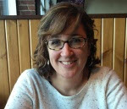

Student
Support
MacOdrum Library
Library Services Desk
  Answer any questions you may have related to the library
  Help find library materials
Research Help
  Specialists help you navigate the library archives to find journals or resources to help with your research or studies
Julie Lavigne
Legal Studies Librarian
Office: ML 238
Phone: ext. 2544
Email: julie.lavigne@carleton.ca
Law & Legal Studies
Notes:
Cole
Library Services Desk
Answer any questions you may have related to the library
Help find library materials
Research Help
Specialists help you navigate the library archives to find journals or resources to help with your research or studies
Julie Lavigne, Legal Studies Librarian

Slide 33

Student
Support
HEALTH AND COUNSELLING
Counselling Services
Open Monday to Friday 8:30 a.m.– 4:30 p.m.
Counselling for personal, emotional and mental health concerns
2600 CTTC Building
Law & Legal Studies
Notes:
Cole
Health and Counselling Services (HCS):
multidisciplinary healthcare facility that provides medical services and counselling services to Carleton University students

Slide 34
Kahoot Trivia and Raffle Prize Winners
Law & Legal Studies

Slide 35
Kahoot Trivia and Raffle Prize Winners
The Winners Are…
Law & Legal Studies

Slide 36
SEO
Feedback
Survey
*Chance for Prizes
Notes:
!!
((Get the code from
https://carleton.ca/csas/academic-orientation-day-resources/))
!!

Slide 37
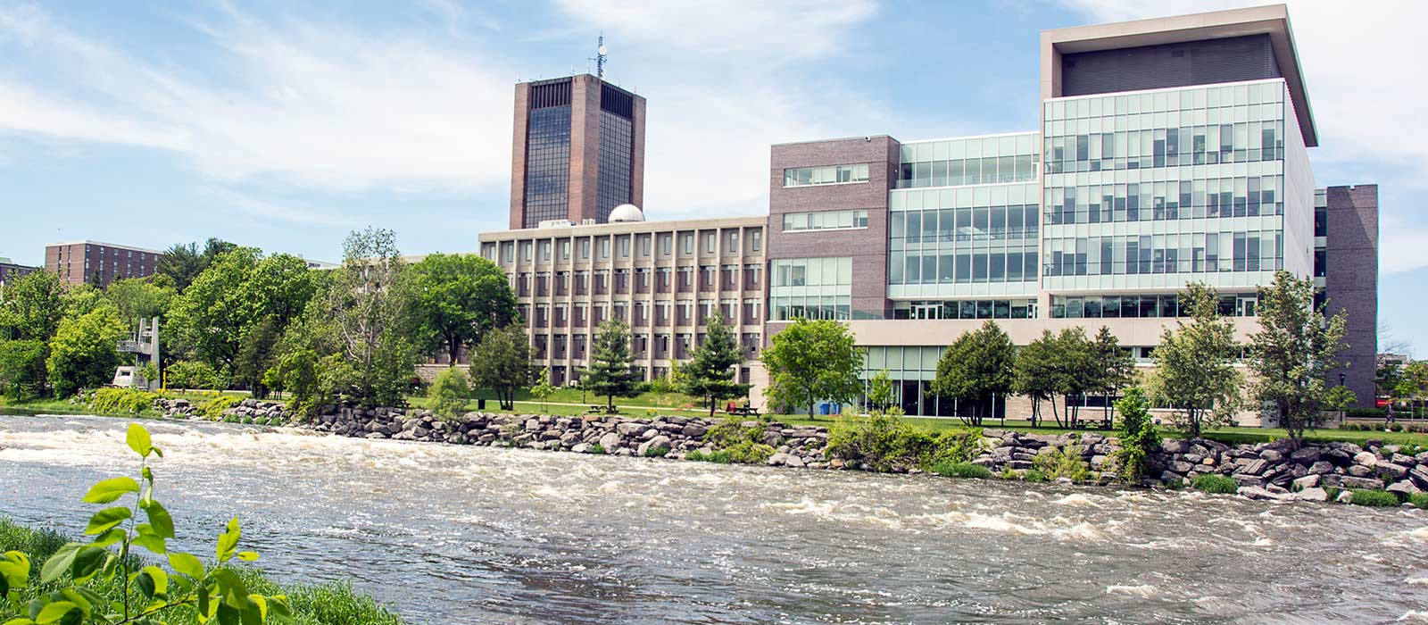

THANK YOU!
Carleton.ca/Law
@cuLegalStudies
Facebook.com/cuLegalStudies

