Slide 1
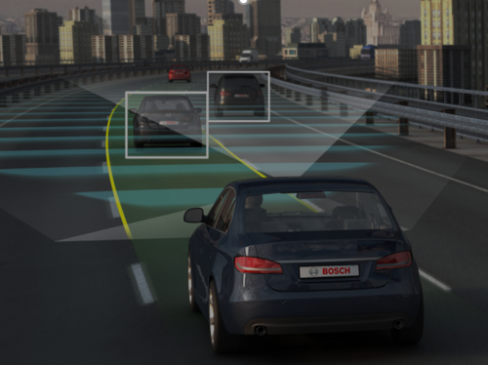
Autonomous Navigation Project

Slide 2
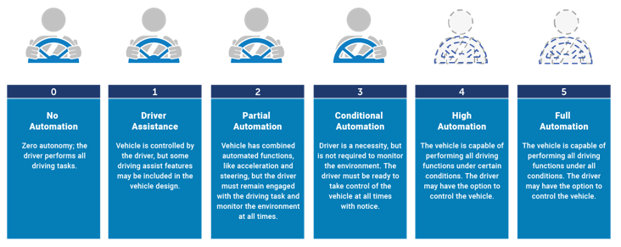
Introduction to Autonomy
Currently, we have level 2 autonomous vehicles (Tesla)
Notes:
These levels defined by SAE
Level 1 is vehicles with 1 autonomous system – braking – backup breaking, automated accelerating cars
Level 2 is vehicles with multiple system but hand it off to drivers sometimes (sharp turn, traffic etc) - Tesla
Level 3 is vehicles with all parts of driving automated but may need human to respond
Level 4 and 5 are all parts of driving needed, no human intervention needed (4 is in certain conditions, 5 is in all conditions)

Slide 3
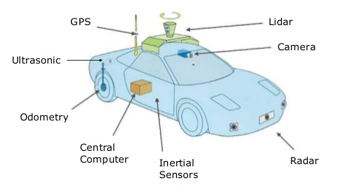
Introduction to Autonomy
Sensor Fusion
Combine multiple sources of information about cars surroundings
Machine Learning
Create smart algorithms to translate sensor information into navigation controls

Slide 4
2017-2018 Accomplishments
Lane Detection
See and maneuver between lane boundaries
Object Classification
Detect stop signs, traffic lights, vehicles, and pedestrians
Sonar Distance Detection
Emergency breaking if vehicle approaches too close to any object
Encoder, Gyroscope & Accelerometer Sensors
Gather real time information about car’s position and motion

Slide 5
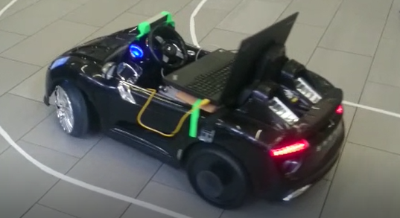
Next Year’s Goals
Create original lane detection and object classification algorithms
Increase the role of sensor fusion for more accurate navigation
Create Simulink model and PID controller for steering and throttle commands

Slide 6
Testing in University Center

