Slide 1
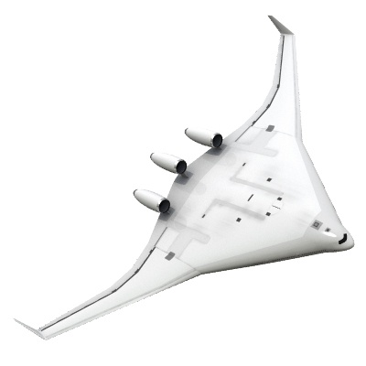





Blended Wing Body Unmanned Aerial Vehicle
Professors Jason Etele and Mostafa El Sayed
2017-2018

Slide 2
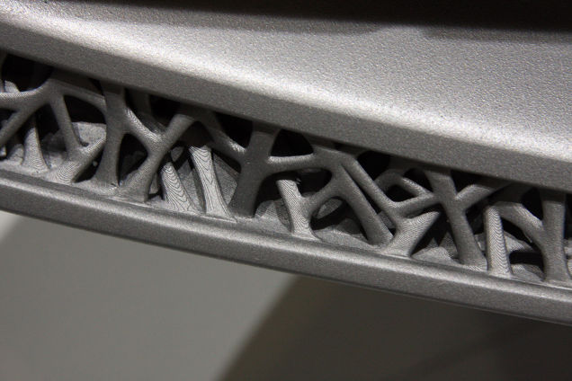
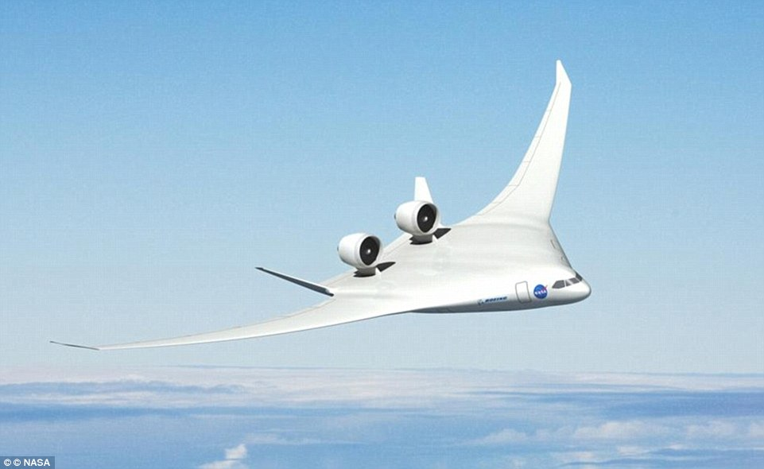
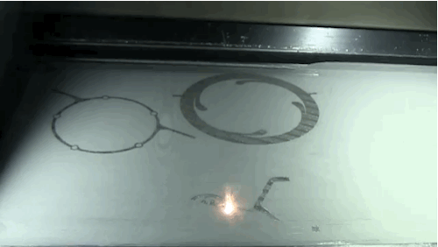
Blended Wing Body Unmanned Aerial Vehicle
Mission:
Design
Build
Test
Fly
3D printing
Multiscale Design Optimization
BWB configuration
Peregrine-1 UAV
Peregrine-2 UAV

Slide 3
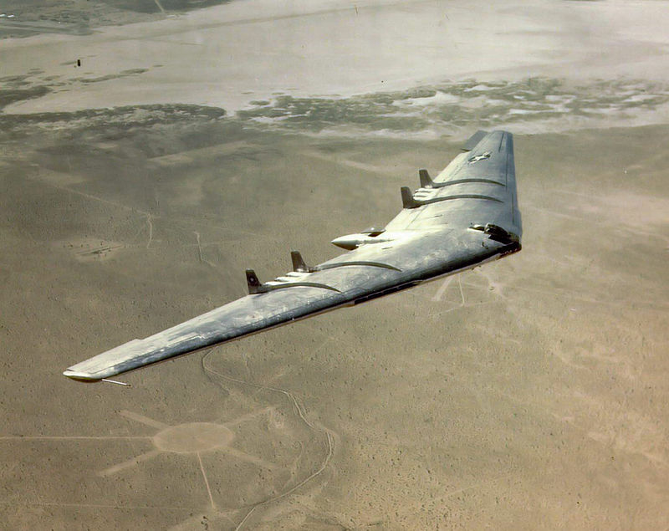
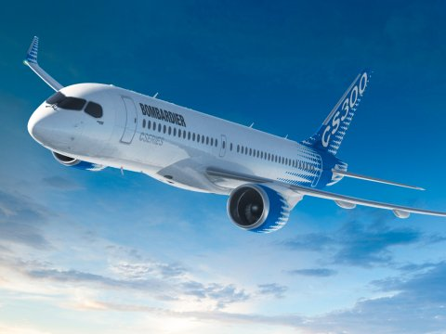
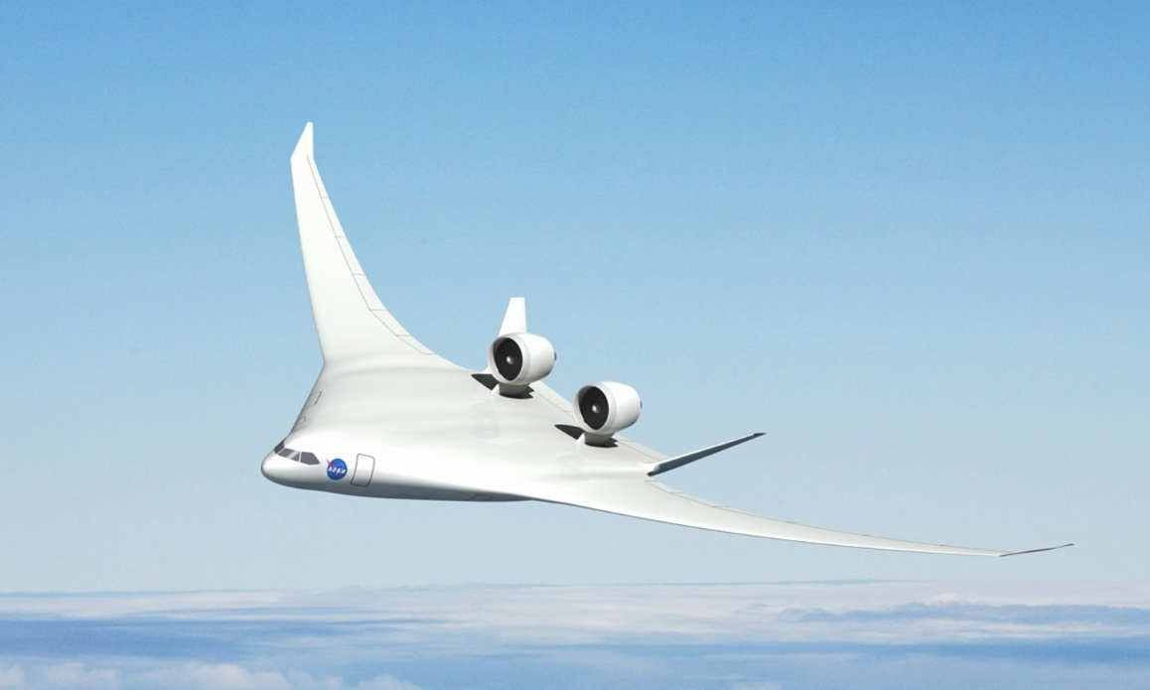
Blended Wing Body (BWB) Configuration
Blending
Flying Wing
Bombardier CSERIES
Boeing and NASA BWB X-48C

Slide 4
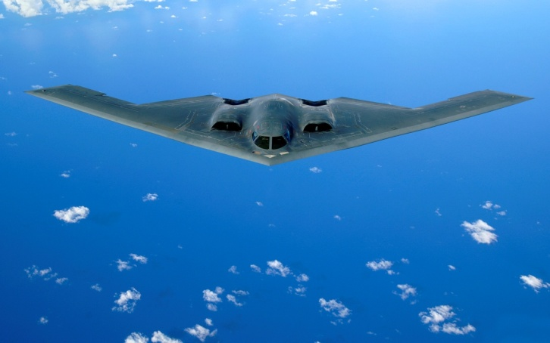
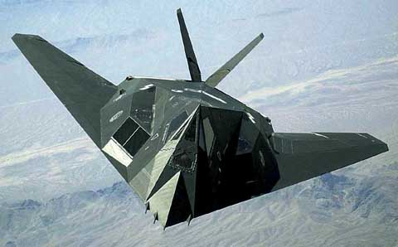
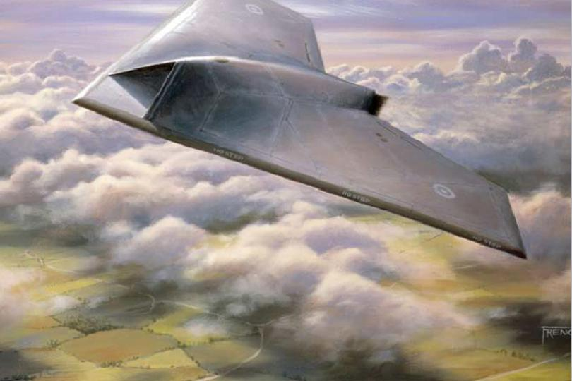
Blended Wing Body (BWB) Configuration
Military Applications:
  B-2 Spirit - Northrop Grumman
  First Flight: 17 July 1989
F-117 Nighthawk - Lockheed
First Flight: 18 June 1981
Conceptual UAVs:
BAE systems PLC (LON:BA) Taranis drone

Slide 5
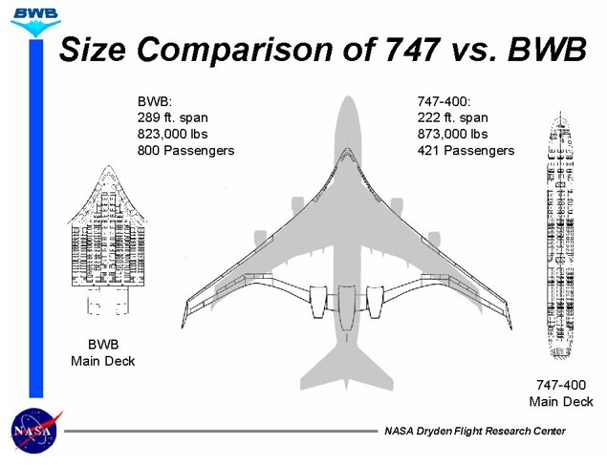
Blended Wing Body (BWB) Configuration
Potential Benefits for Civil Aviation:
Al Bowers, NASA, 2000

Slide 6
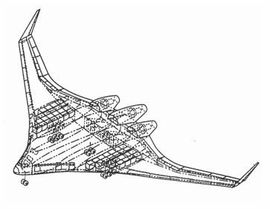
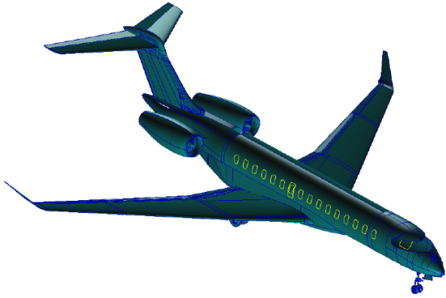
Blended Wing Body (BWB) Configuration
Potential Benefits for Civil Aviation:
Reduced wetted area to volume ratio by up to 33%:
friction drag fuel burn environmental impact Direct Operational Cost (DOC)
Increased lifting surface: about 20% increase in maximum Lift/Drag (L/D) ratio
Reduced noise: engines placement above the wing and streamlined geometry
Increased PAX capacity: Reduced Airport-Airspace congestion and reduced Fairs
12% DOC, 21% Fuel efficiency, 6% Gross weight, 17% Greenhouse gas emission
R.M. Martínez, 2014

Slide 7
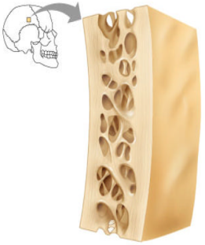
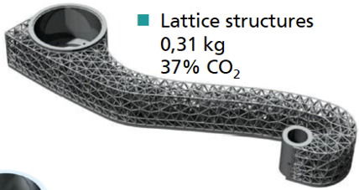
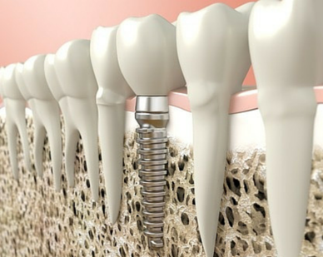
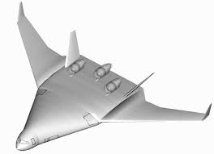
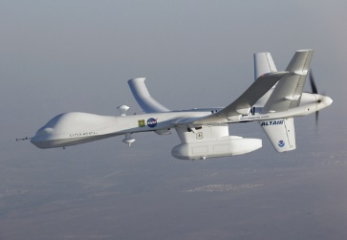
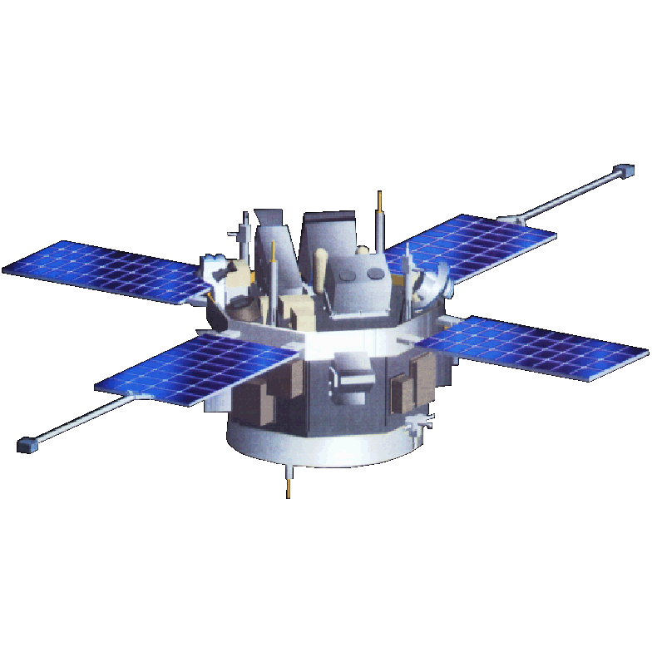
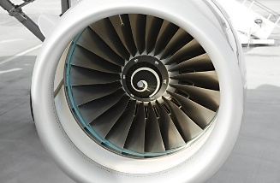
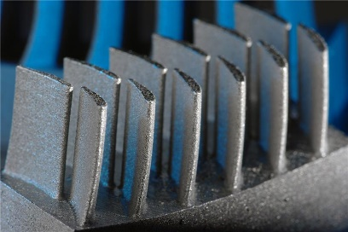
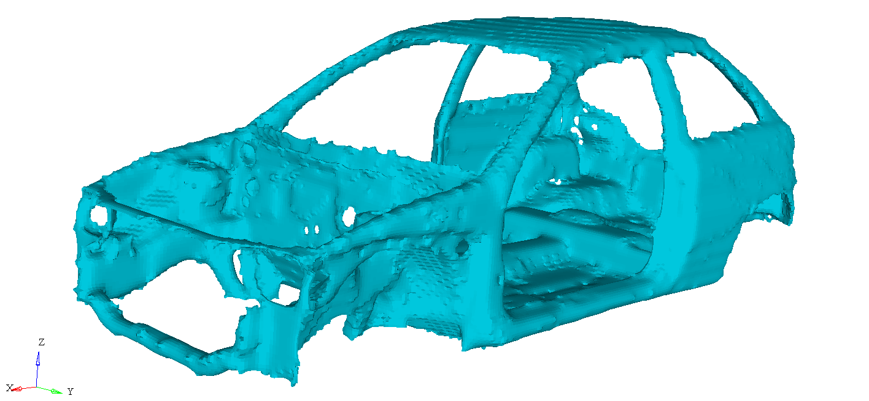
Multiscale Mechanics of Advanced Materials and 3D Printing
Applications
Manufacturability
Aerospace: Aircraft, Spacecraft, UAVs
Automotive
Biomedical

Slide 8
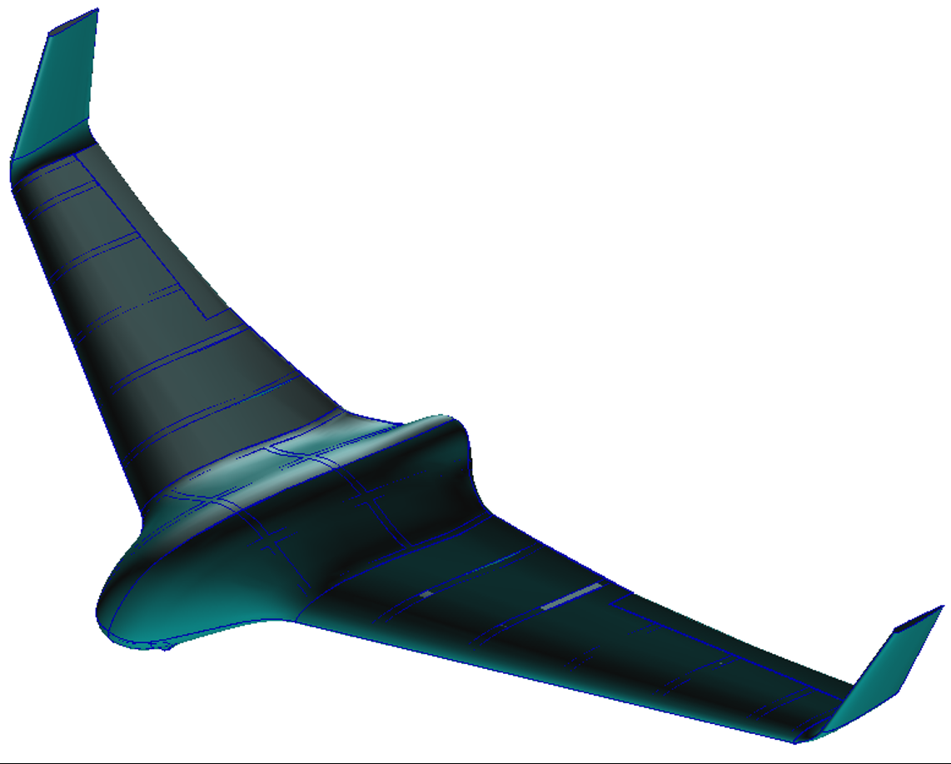
Peregrine-1 UAV Concept

Slide 9
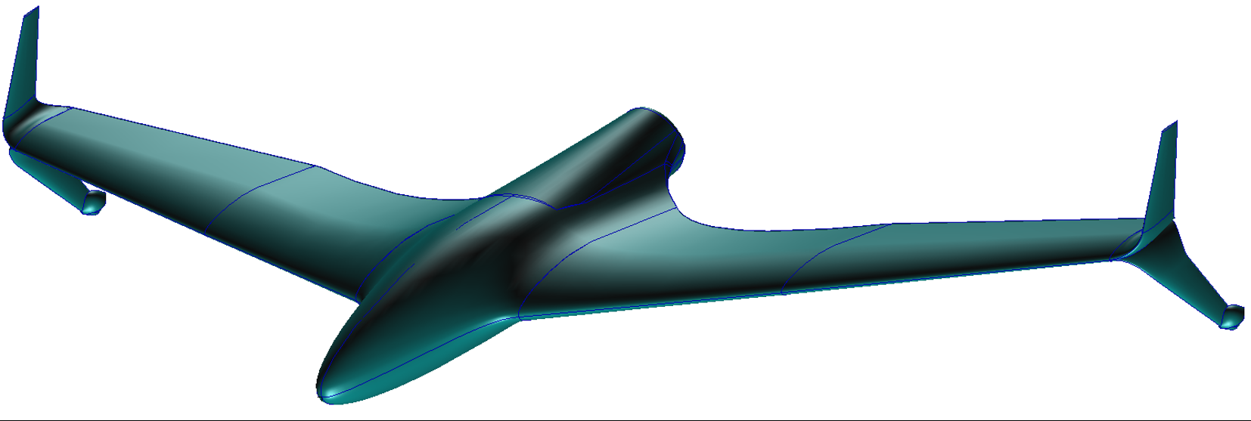
Peregrine-2 UAV Concept

Slide 10
Blended Wing Body Unmanned Aerial Vehicle
Milestones:
Year 1 (completed): (1) Design and analyze Peregrine-1 (2) Design Peregrine-2
  Mission profile:
    Peregrine-1: 300 ft, Mach 0.1
    Peregrine-2: 1700 ft, Mach 0.2
  Airframe: Composite skin/3D printed lattice structure
Year 2: Build, test, fly Peregrine-1. Design and analyze Peregrine-2
Year 3: Addition of VTOL capability to Peregrine-1. Build, test and fly Peregrine-2.
Year 4: Expanding payload capability and modify design accordingly, exploring VTOL for Peregrine-2

Slide 11
Questions

