Slide 2
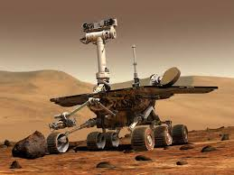
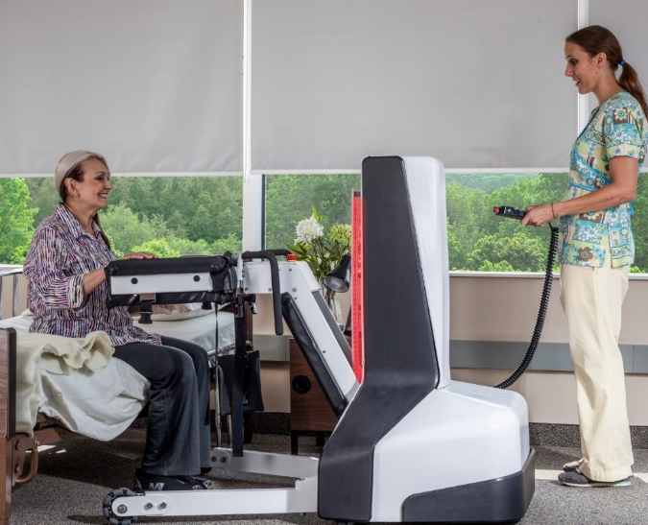
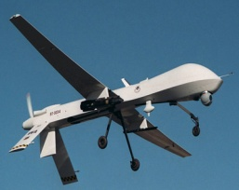
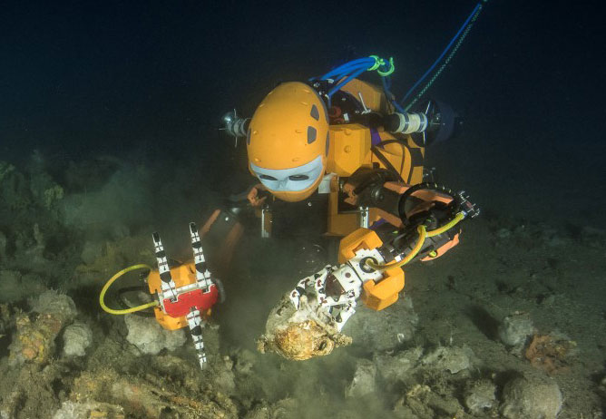
Robotics Today
Notes:
Telepresence in healthcare system: To be used as a tool to enable more effective ER, stroke response, doctor visitation, nurse-patient-doctor-visitor assistance, medication dispensing and delivery, instrumentation carrying, and health and equipment monitoring.
Increase accessibility of medical staff and patients

Slide 3
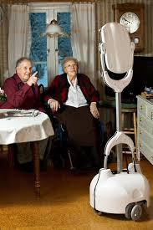
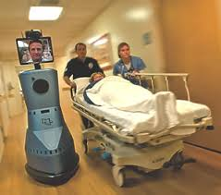
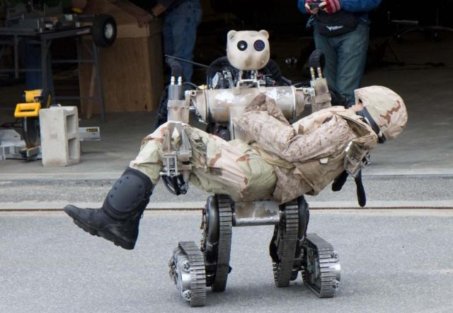
iTAD Project Timeline
Hospital Environment
Y1 –Y3
Health and Independent Living
Y3 – Y4
Search and Rescue
Y4 – Y6
Notes:
Telepresence in healthcare system: To be used as a tool to enable more effective ER, stroke response, doctor visitation, nurse-patient-doctor-visitor assistance, medication dispensing and delivery, instrumentation carrying, and health and equipment monitoring.
Increase accessibility of medical staff and patients
Motivation: develop a multi-faceted assistant
Make healthcare more accessible
Novel Design base + arm + head + touch …
Intelligent plus suitable autonomy
Work with healthcare and perform site experiments
Carry instruments or other items

Slide 4
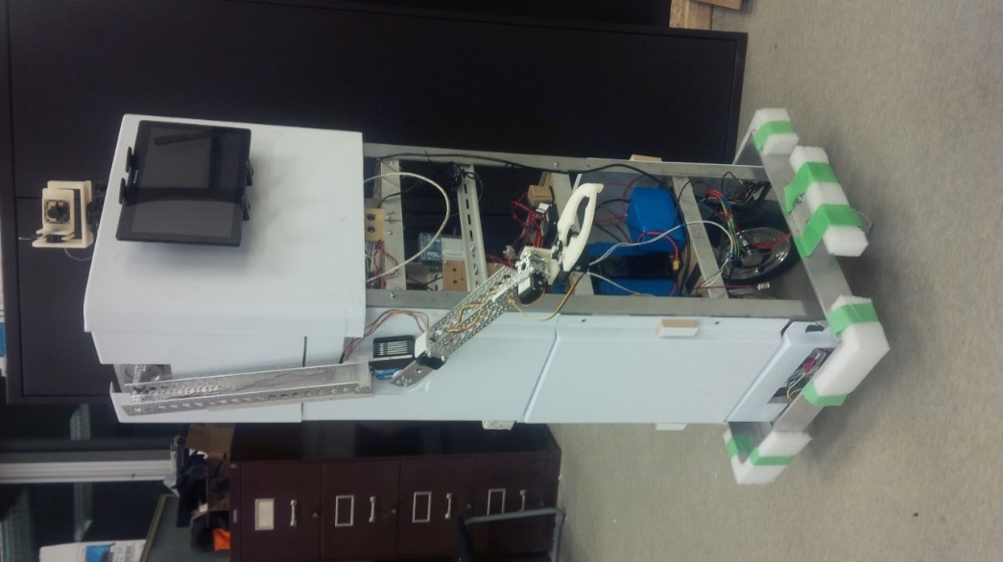
Our History: iTAD 1.0 (2016 – 2017)
Year 1: Explore
Interact with end users
Learn from basics
Define and implement modules
Integrate the first generation

Slide 5
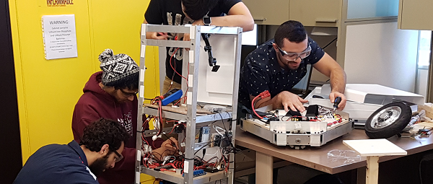
Current iTAD Design (2017 – 2018)
Year 2: Refine
Improve/redesign system
Seamless integration of all parts
Autonomous navigation
Facial tracking
Integrated safety features
Notes:
Improve/redesign: STR, CTL – update control architecture

Slide 6
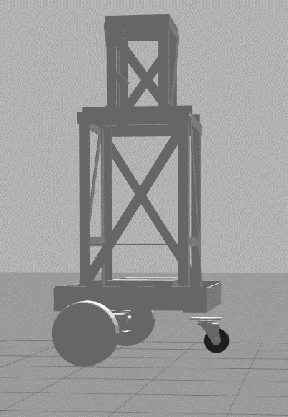
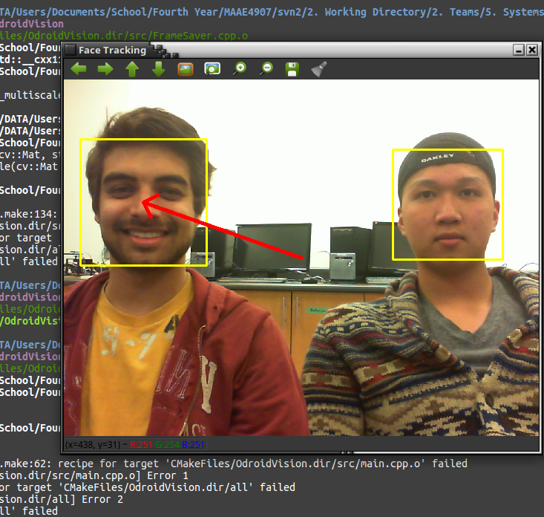
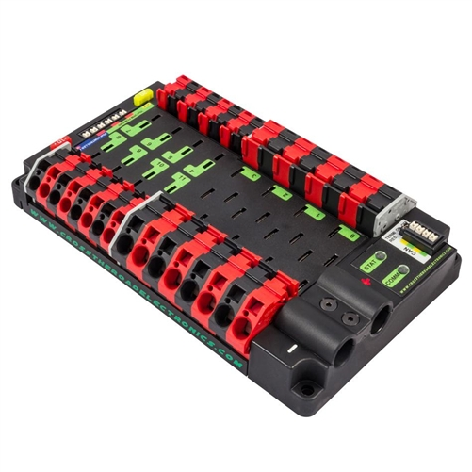
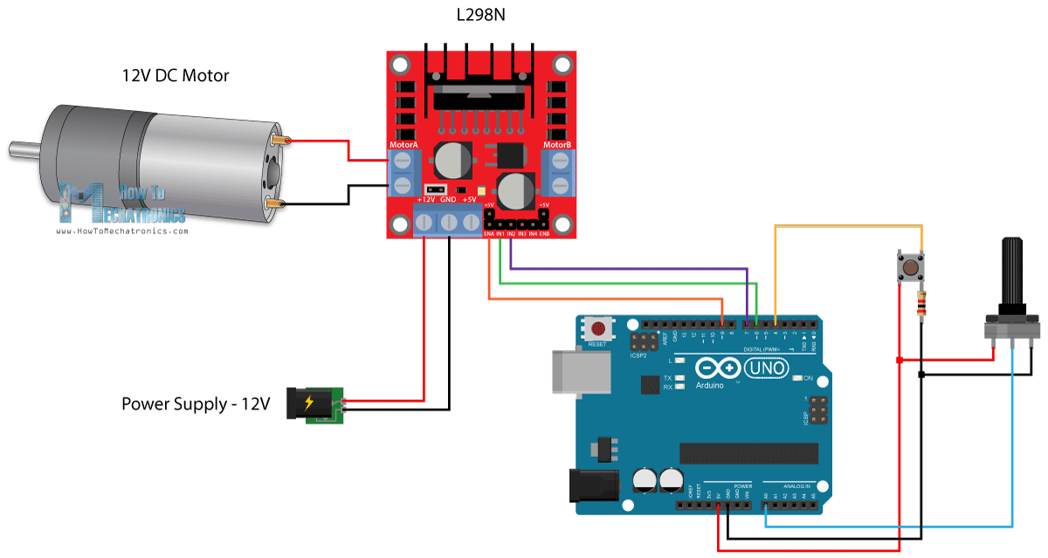
Project Areas
Programming: Facial Recognition
Computer Modelling and Simulations
Mechanical Design
Testing, Interviews and Analysis
Electrical System Design and Power Monitoring
Motor Feedback Control
Notes:
Improve/redesign: STR, CTL – update control architecture

Slide 7
Group/Team Structure
Mobility
Arm
Interactions
Group:
Structures
Dynamics
Controls
Human Factors
Systems
Teams:
Possibility of addition/removal of teams or groups for future innovations
Notes:
Functional teams: STR, DYN, CTL, SYS
Technical Groups: MBL, ARM, INT

Slide 8
iTAD Team (2018-2019)
Number of Students | Engineering Streams
8 – 10 | Mechanical Engineering
8 – 10 | Biomedical and Mechanical Engineering
3 – 5 | Aerospace Engineering (Stream C)
2 – 5 | Electronics Engineering
4 – 6 | Software and Computer Systems Engineering
Notes:
Functional teams: STR, DYN, CTL, SYS
Technical Groups: MBL, ARM, INT

Slide 9
Project Team
Project Manager:
Dr. Mojtaba Ahmadi: Dynamics and Instrumentation lead
Lead engineers:
Dr. Rong Liu: Structures Lead
Dr. Peter Liu: Controls Lead
Dr. Adrian Chan: Software (Navigation and mobility)
Dr. James Green: Software (Communication and Interactions)
Dr. Ala Qadi: Interactions (volunteer from Algonquin College)
Collaborators:
Ottawa Hospital, Tetra Society, Brueyer Hospital, and others.
Notes:
Functional teams: STR, DYN, CTL, SYS
Technical Groups: MBL, ARM, INT

Slide 10
Thank you!
We will be happy to answer any of your questions

