Slide 1
Building-Integrated Thermal Energy Systems (BITES)
Professors: Jean Duquette
Kristen Schell
Ian Beausoleil-Morrison
Industry Partner: Chris Weissflog

Slide 2
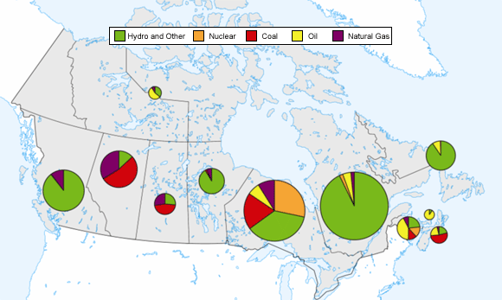
Hydro
Nuclear
Coal
Natural gas and oil
Non-hydro renewables
Canada’s Energy Mix
Canada is the fifth largest energy producer in the world and the eighth largest consumer of energy
Buildings account for 28% of secondary energy use in Canada and represent a large source of GHGs
Approximately 80% of residential use is attributed to space heating and hot water demands
Current strategies to reduce building loads typically consider heating, cooling and hot water needs separately

Slide 3
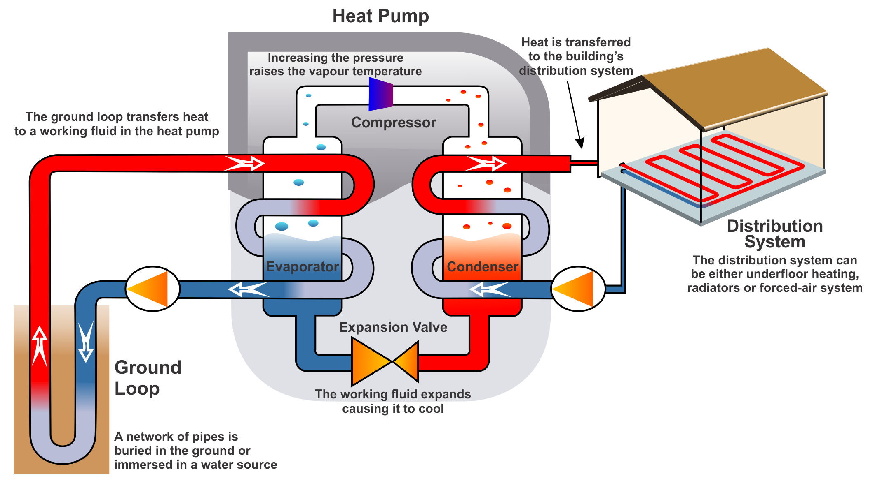
Overall project focus is on an integrated approach for heating, cooling, ventilation, dehumidification, and domestic hot water heating for high efficiency low-rise multi-unit residential buildings (MURBs)
Design and optimization is required, including:
Passive solar architecture
High-performance envelope
Multi-function heat pumps
Heat recovery
Geothermal storage
Control strategies
Goal is to design a building integrated thermal energy system (BITES) that is replicable and delivers net-zero-energy-ready levels of performance

Slide 4
Year 1 (2018-19): Simplified full-system design and analysis
Analyze performance of BITES prototype (single-family residential scale) and identify opportunities for improving design
Size key components (heat pumps, thermal storage, hydronic floor, geothermal field, thermal mass, windows) using simplified models for low-rise MURB

Slide 5
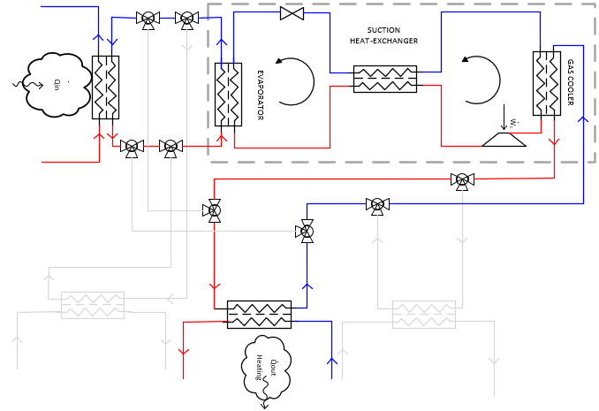
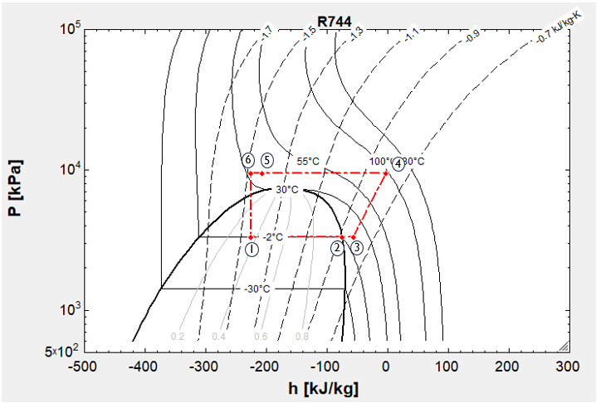
Year 2 (2019-20): In-depth heat pump design and analysis
Design, develop and analyze new heat pump cycles for use in heating, cooling and domestic hot water applications
Develop heat transfer models of heat pump cycles in EES software
Evaluate system feasibility based on seasonal performance, energy and exergetic efficiencies, system economics, environmental analysis, safety, noise, originality, esthetic of design, practicality, etc.
Provide overall justification of design and performance, including assumptions and strategies

Slide 6
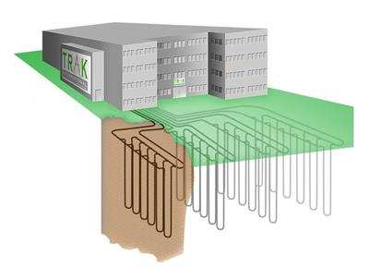
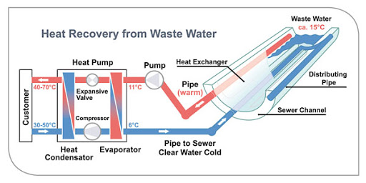
Year 3 (2020-21): In-depth effluent heat recovery and geo-exchange design and analysis
Investigate effluent waste heat recovery system types, layouts, and control strategies
Investigate geo-exchange system types, layouts, and control strategies
Develop simulation models to assess techno-economic performance of components and overall system

Slide 7
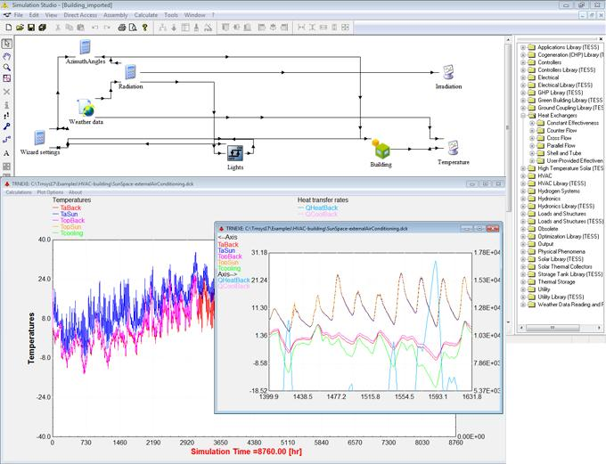
Year 4 (2021-22): Detailed system design and numerical model development
Design optimization of dehumidification/ventilation system (Year 1 design work used as basis)
Design optimization of state-of-the-art multi-function transcritical CO₂ heat pump (Year 2 design work used as basis)
Design optimization of effluent heat recovery and geo-exchange systems (Year 3 design work used as basis)
Detailed integrated system modeling and simulation using TRNSYS software (student training opportunities available)

Slide 8
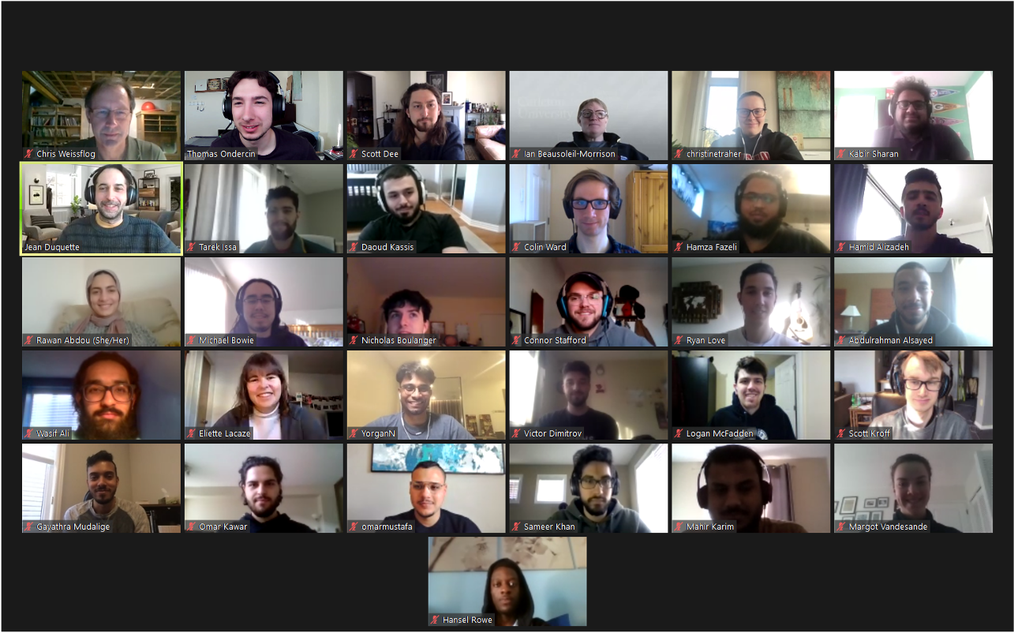
Thank you for your interest in BITES!
For more information, contact: Jean.Duquette@Carleton.ca

