Slide 1
Satellite Design Project
(2022 – 2023 version)
Presenter: Bruce Burlton

Slide 2
Today’s Discussion
Mission Statement
What is CuSAT
Work to Date
Future Work
Questions

Slide 3

Mission Statement
CuSAT is a demonstrator satellite designed to locate and report forest fires within the Canadian Boreal Forest
Figure 1: Representation of Canada with only Boreal forests visible

Slide 4
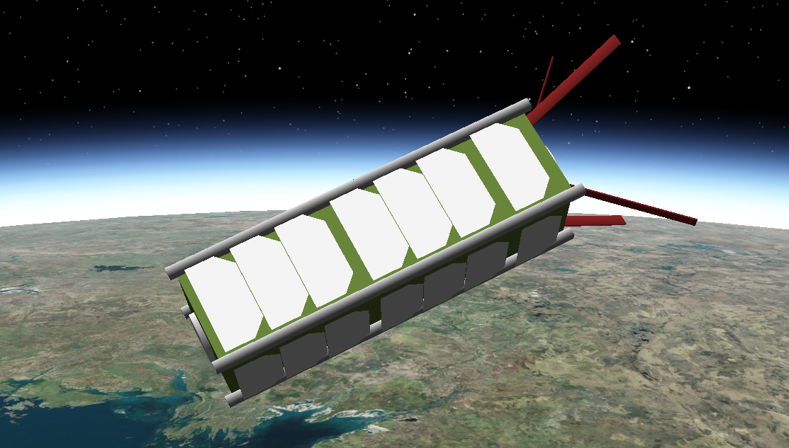
Satellite Design Project (SDP)
Design and implementation of a 3U CubeSat
10 cm x 10 cm x 30 cm satellite
Mass of 4 kg
CubeSat concept originated at CalPoly and Stanford in 1999
Figure 2: CuSAT model in STK

Slide 5
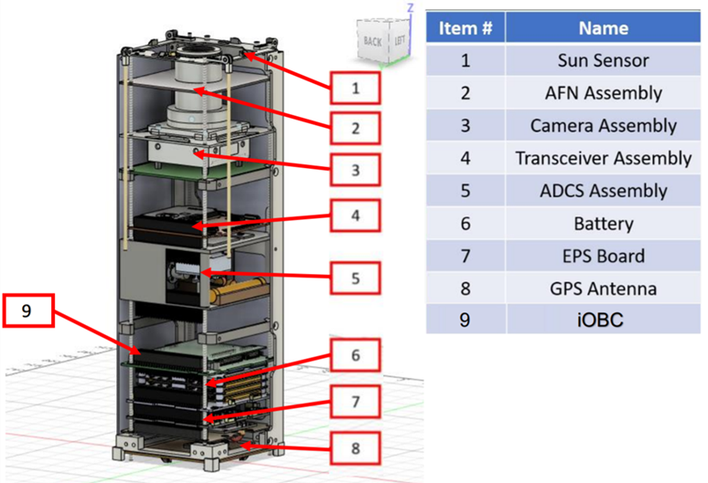
CuSAT
  CuSAT uses an IR camera to locate and image hotspots
  Transmits fire locations to Ottawa within 24 hours
Figure 3: CuSAT CAD model

Slide 6
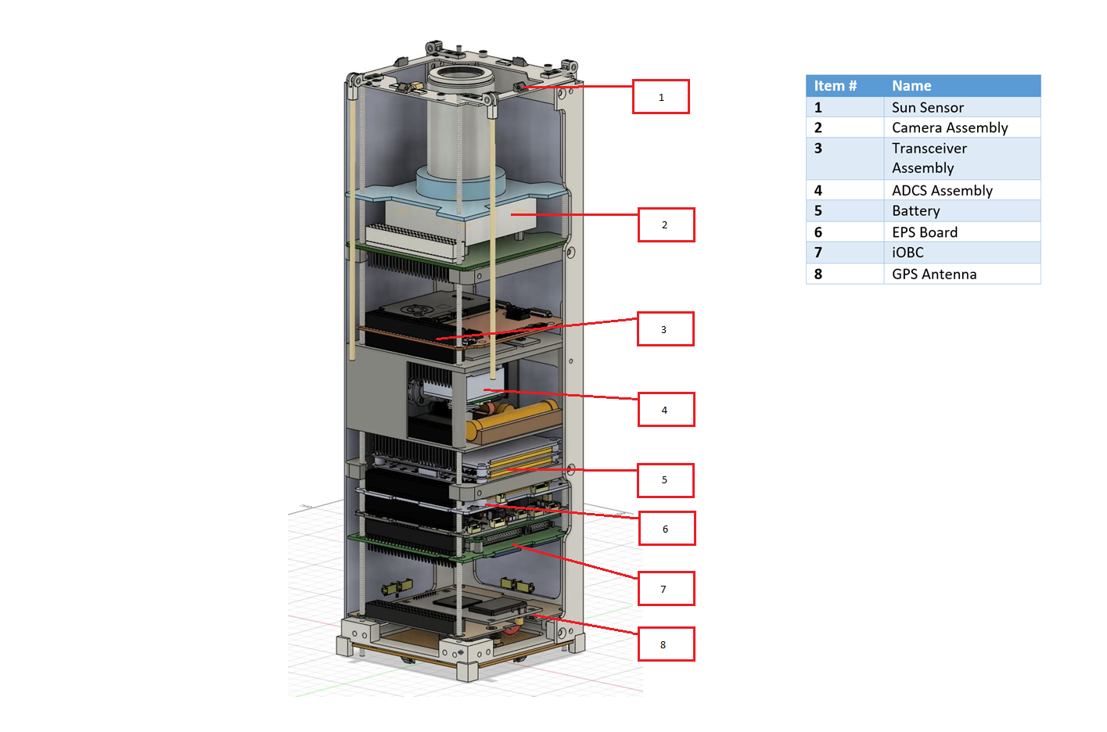
CuSAT - 2022

Slide 7
CuSAT

Slide 8
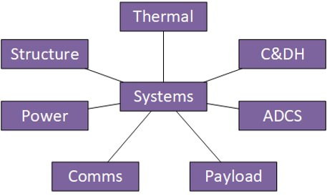
Project Organization
Eight student teams
  Systems
  Payload
  ADCS
  C&DH
  Comms
  Power
  Thermal
  Structures
Lead Engineers from MA&E and Industry (8+)

Slide 9
Work this year
Attitude simulator development
Satellite emergency protocols while in-orbit
Thermal camera testing
Procured items (2021-2022):
  Circularly polarized antenna
  Antenna polarity switch kit
  Gyroscope
  Magnetometer
  FPGA for payload
  Solar arrays

Slide 10
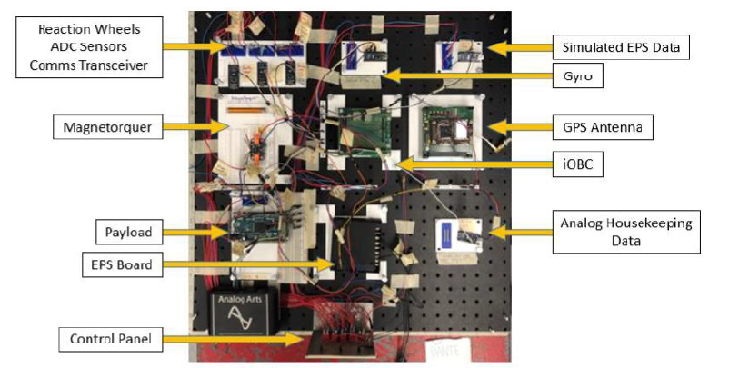
Work this year
FlatSat testing
Thermal simulation model development
Resolved serial protocol hardware incompatibilities
Development of AFN board & ground-station
Updated CAD model with accurate moments of inertia
Figure 4: Old FlatSat design

Slide 11
2022 - 2023 Work
Completion and Testing of ADCS Simulator
Evaluation and Testing of ADCS sensors and actuators
Further development of the C&DH code
Conversion of the Simulation into Flight code
Development and testing of the S/C comms antenna and system
Refinement of the structure. Build prototype
Refinement of the thermal model

Slide 12
2022 – 2023 work
Development and testing of the replacement FPGA for the camera
Development and Procurement of the Payload and telescope
Integration and testing of the subsystems and spacecraft
Another more detailed round of FLATSAT testing
Emphasis on “Doing, Building and Testing”

Slide 13
Questions?

