Slide 1
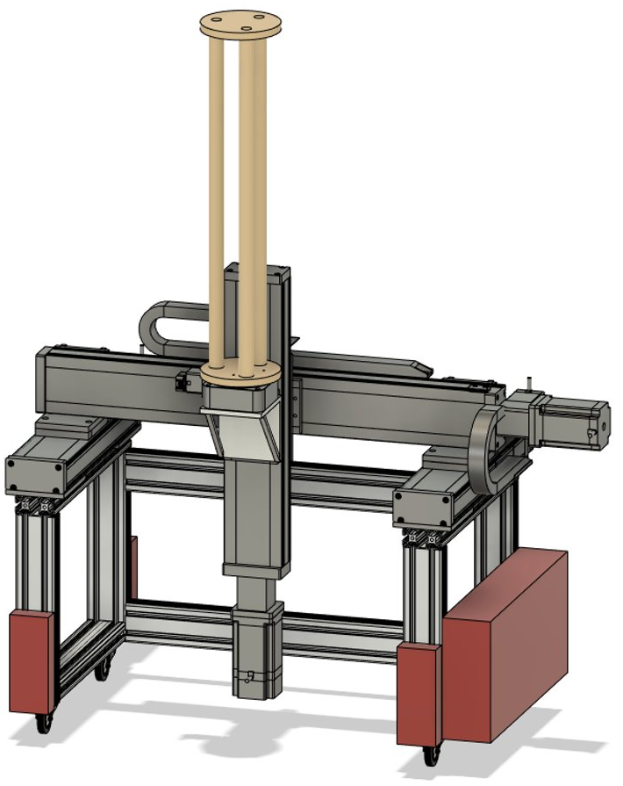
Capstone Design Project: Mechatronic Dosimetry System (MEDS)
Mechanical and Aerospace Engineering Department
By Prof. Robin Chhabra, P.Eng. MEDS’s Project Manager March 22, 2022

Slide 2
Outline
History of MEDS
Motivations of MEDS
Objectives of MEDS
Progress To Date
Next Year’s Plans
Team Structure

Slide 3
History of MEDS
Founded in 2021-2022
In collaboration with Health Canada:
Ionizing Radiation Physical Sciences Division (IRPSD): Dr. Sarah Cuddy-Walsh
Ionizing Radiation Health Sciences Division (IRHSD): Dr. Lindsay Beaton-Green
6 highly-motivated Carleton students

Slide 4
Motivations of MEDS
Many medical devices emit ionizing radiation for inspection, e.g., dental X-rays and cone-beam computed tomography
Ionizing radiation can induce stochastic effects, such as hereditary disorders and cancer risks
Cone-beam CT system with a human head analogue phantom

Slide 5
Motivations of MEDS
Physical dosimetry: Quantifying ionizing radiation dose absorbed by an object
Biological dosimetry: Quantifying genetic damage to biological tissues for a given ionizing radiation dose
Consumer and Clinical Radiation Protection Bureau (CCRPB): Administration of the radiation emitting devices
IRPSD & IRHSD assess, monitor and reduce health and safety risks

Slide 6
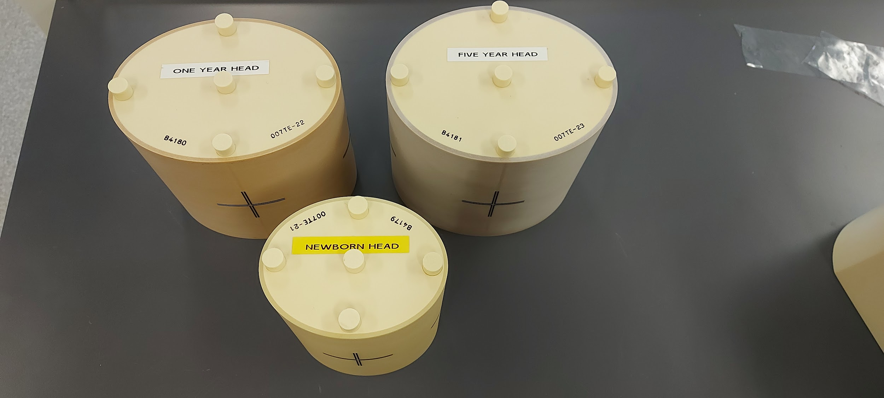
Motivations of MEDS
Measurements are performed by placing different human-body-analogue phantoms (normally made of PMMA) in the radiation field
(Left) cylindrical computed tomography dose index phantom. (Middle) head phantoms for newborn, 1-year-old, and 5-year-old children. (Right) skull phantom

Slide 7
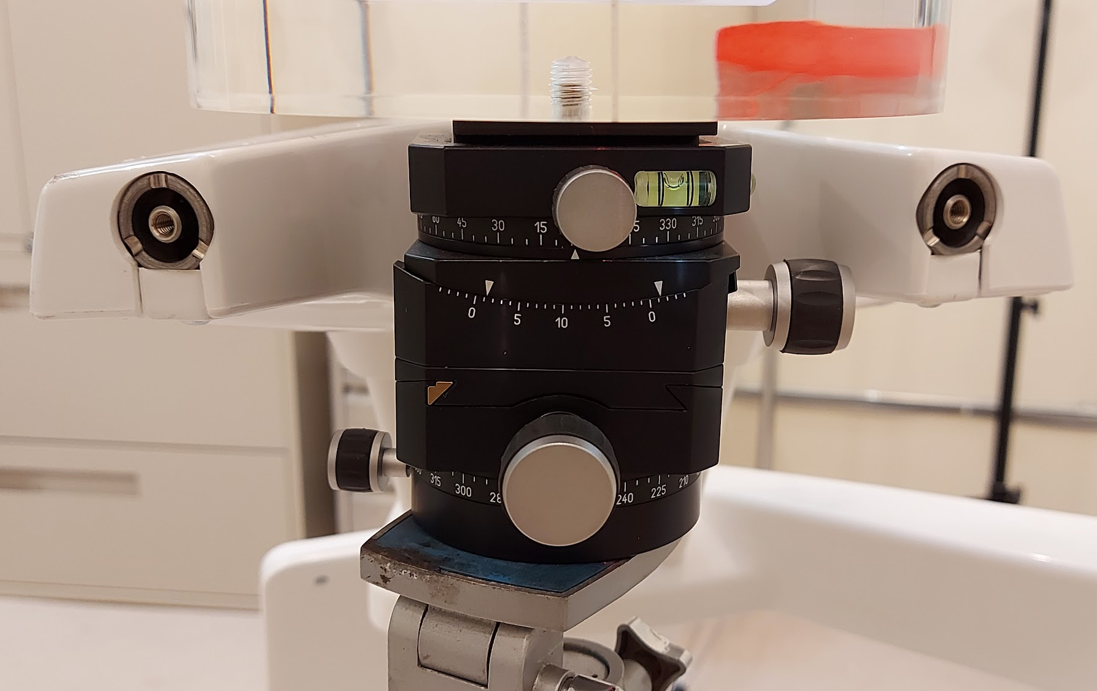
Motivations of MEDS
Blood tubes and ion chambers are placed inside phantoms and the table is levelled manually
Existing ion chambers
Positioning table and the leveling mechanism

Slide 8
Objectives of MEDS
Goal: Design and develop robotic and manufacturing solutions for precise and repeatable radiation dosimetry systems.
Objective 1: Design and manufacture phantoms that are biologically equivalent to human body and can contain both ion chambers or blood samples,
Objective 2: Design and develop an automated robotic stage to allow for accurate phantom positioning in radiation domains.
Objective 3: Validate the test facilities through comparing their results with Monte Carlo simulations.

Slide 9
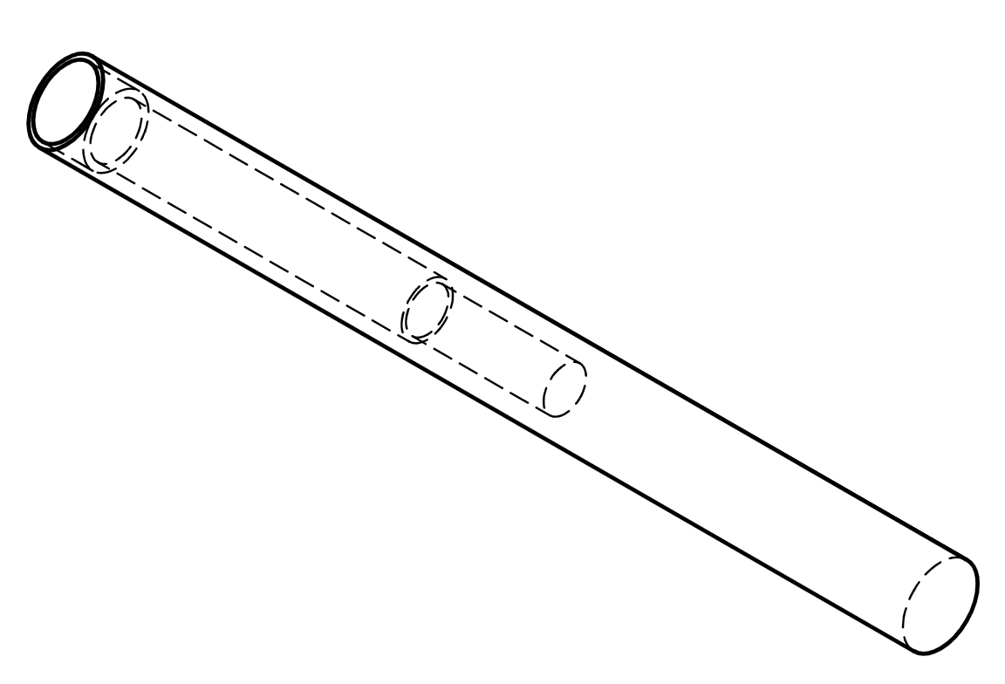
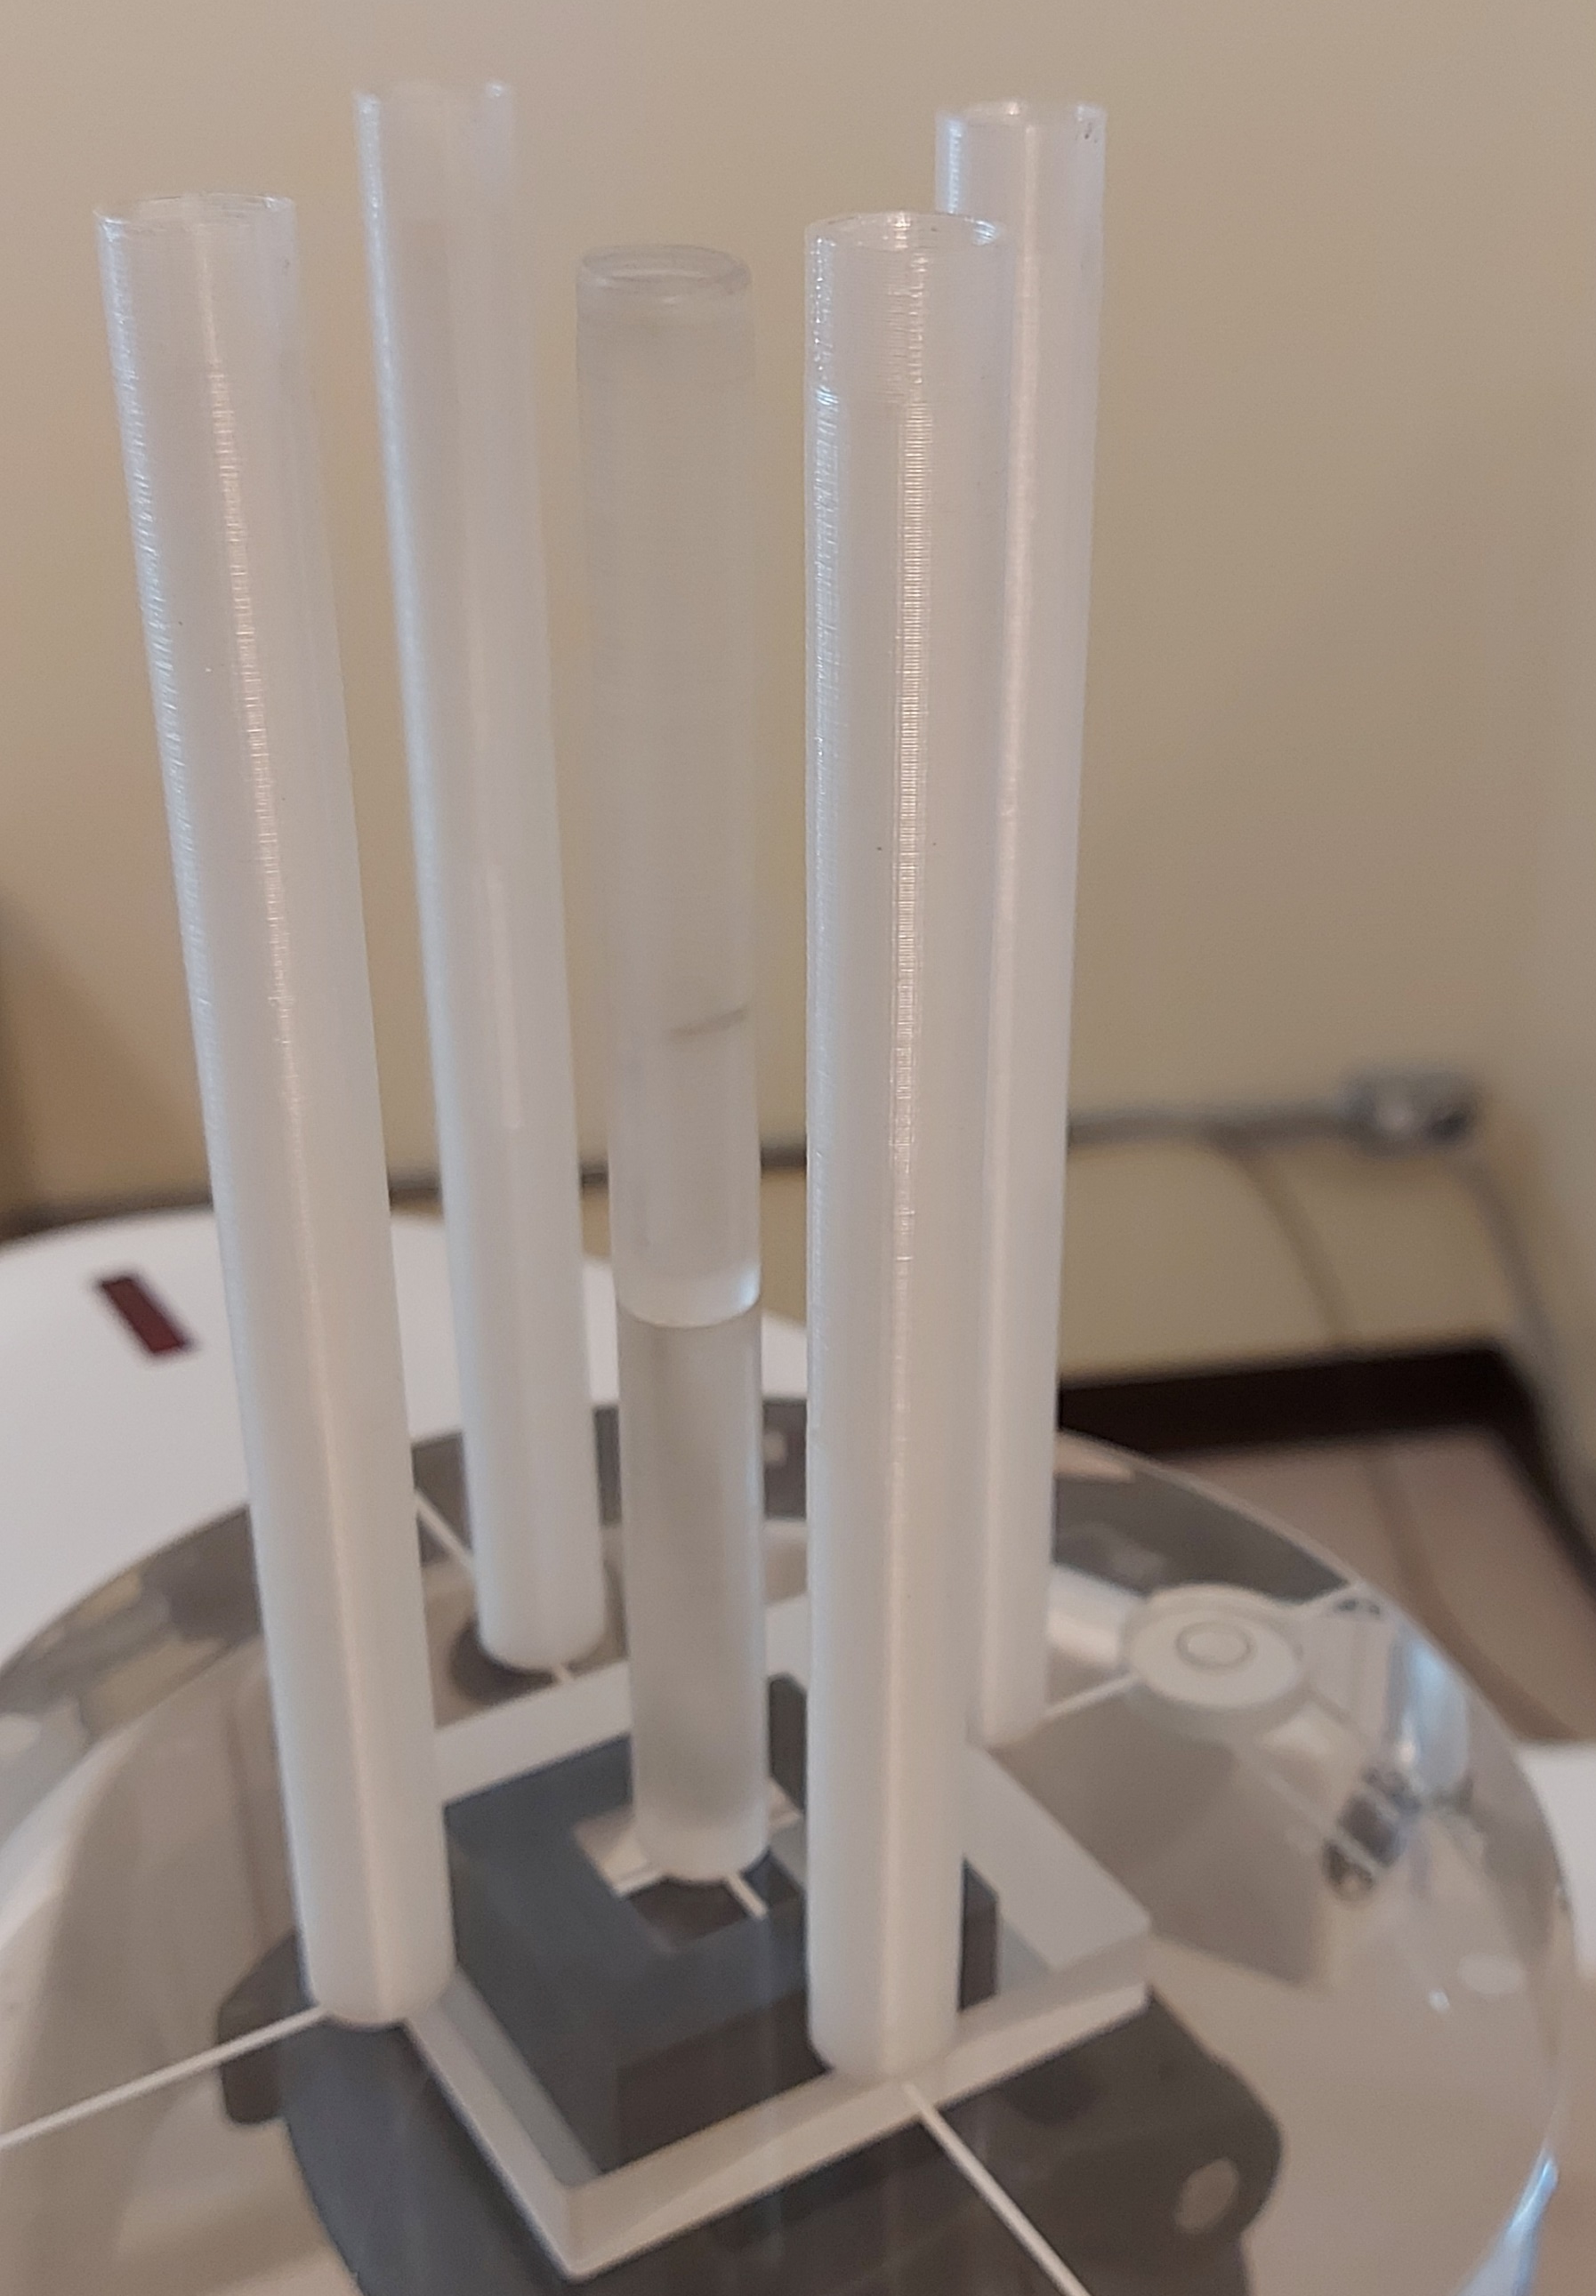
Progress To Date
The ion chamber needs to fit snugly in the phantom
Designed and 3D-printed phantom adapters from PMMA for Farmer chamber costing <$10 per adapter

Slide 10
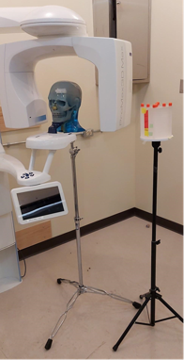
Progress To Date
A four-degree-of-freedom robotic stage has been designed and assembled for automatic phantom positioning
A four-degree-of-freedom robotic stage has been designed and assembled for automatic phantom positioning
Robotic stage includes:
Programmable translational and rotational motion

Slide 11
Progress To Date
3 translational DoF (XY:30cm, Z:40cm)
1 rotational DoF (360 degrees)
Load capacity: 40Kg
Adjustable leveling caster wheels
Tall PMMA stage to ensure 30cm clearance from metallic materials in radiation field
Incremental and absolute positioning for testing

Slide 12
Next Year’s Plans
Developing full electromechanical model of the stage for path planning and control proposes
Exhaustive testing and anomaly identification
Automating levelling mechanism
Adding control options
Obstacle detection and mitigation
Optimizing the power terrain
Developing the emergency and homing protocols
Linking controller to Monte Carlo simulation

Slide 13
Team Structure
Mechanics (2): refining mechanical design and manufacturing of pieces
Electronics (2): improving sensory and power systems
Software (3): improving path planning and control, and linking with Monte Carlo simulation platform
Dynamics and Controls (1): dynamical analysis and control design
Mechatronics (1): integration, assembly, and testing
Biomechanics (2): radiation simulation and designing human-body-analogue phantoms

Slide 14
Thank You!
Questions?
Please do not hesitate to contact
Email: robin.chhabra@carleton.ca

