Slide 1
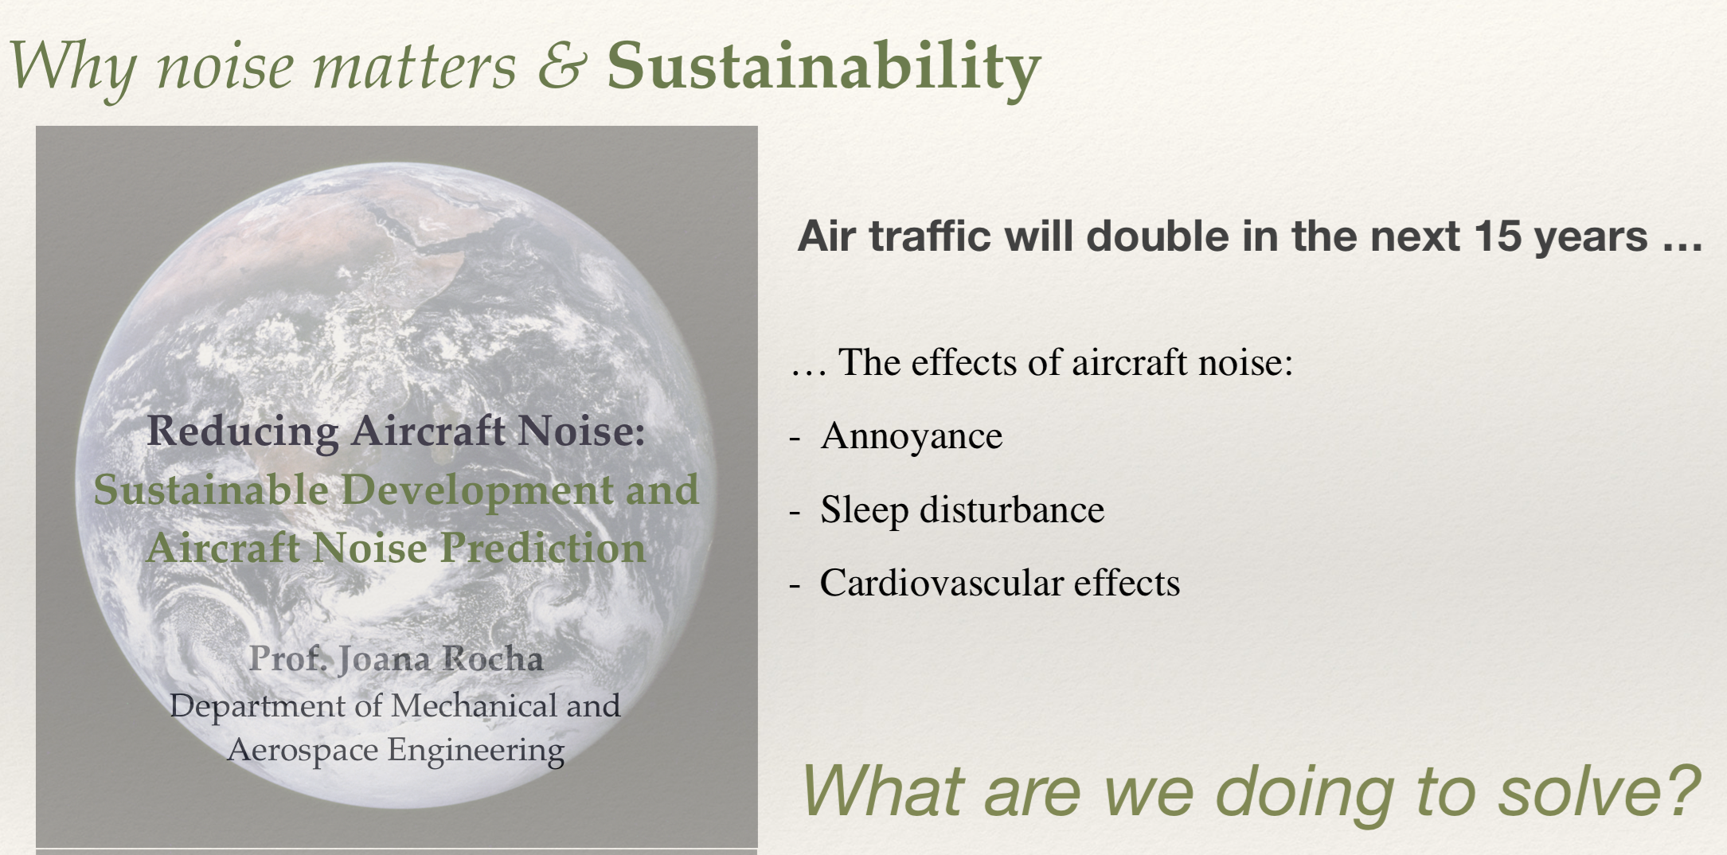
Aeroacoustics - Dr. Joana Rocha

Slide 2
What we do at Carleton?
In our research group our main focus is aeroacoustics, structural-acoustics, and turbulence modelling with applications in aerospace. Through our research, we aim to design and develop new concepts of aircraft that are quieter.
Before joining Carleton University, Dr. Rocha was a Visiting Researcher at NASA Langley Research Centre and National Institute of Aerospace, in Virginia, USA, and holds a Ph.D. and a M.A.Sc., both from the Department of Mechanical Engineering, at University of Victoria, Victoria, British Columbia. Her extensive experience in the area of Aeroacoustics has contributed to the expansion and growth of Carleton University research in the area of aircraft noise.
The Aeroacoustic High-Speed Wind Tunnel is part of Dr. Rocha’s research: a newly developed facility at Carleton, unique in Canada, which enables the ideal testing conditions that closely reproduce Mach conditions during flight, to improve existing acoustic prediction models and help develop novel and quieter aircraft structures.
Graduate research positions are currently open in the area of experimental testing (wind tunnel), for application in aircraft design for noise reduction, and turbulence modelling. Students interested in pursuing research leading to M.A.Sc. or to a Ph.D. please contact Dr. Joana Rocha at: Joana.Rocha@carleton.ca.

Slide 3
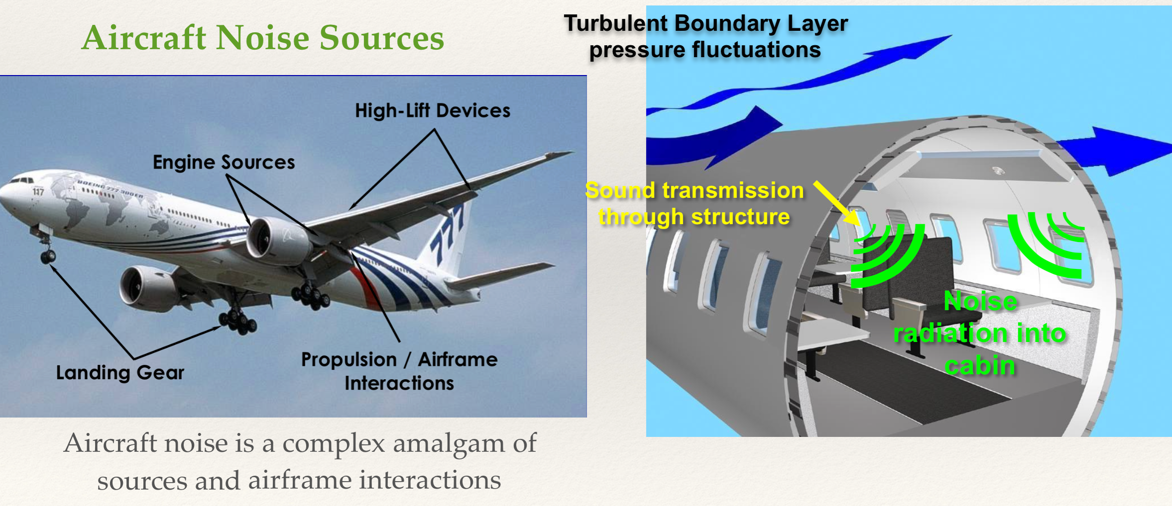
Aircraft noise reduction

Slide 4
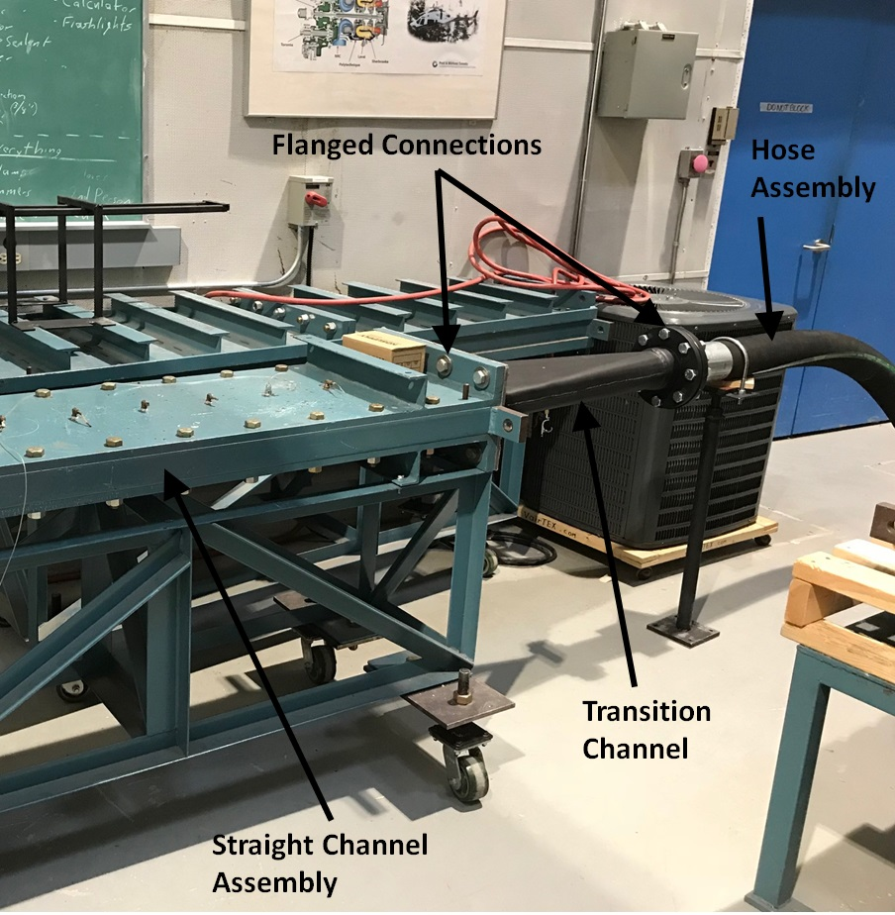
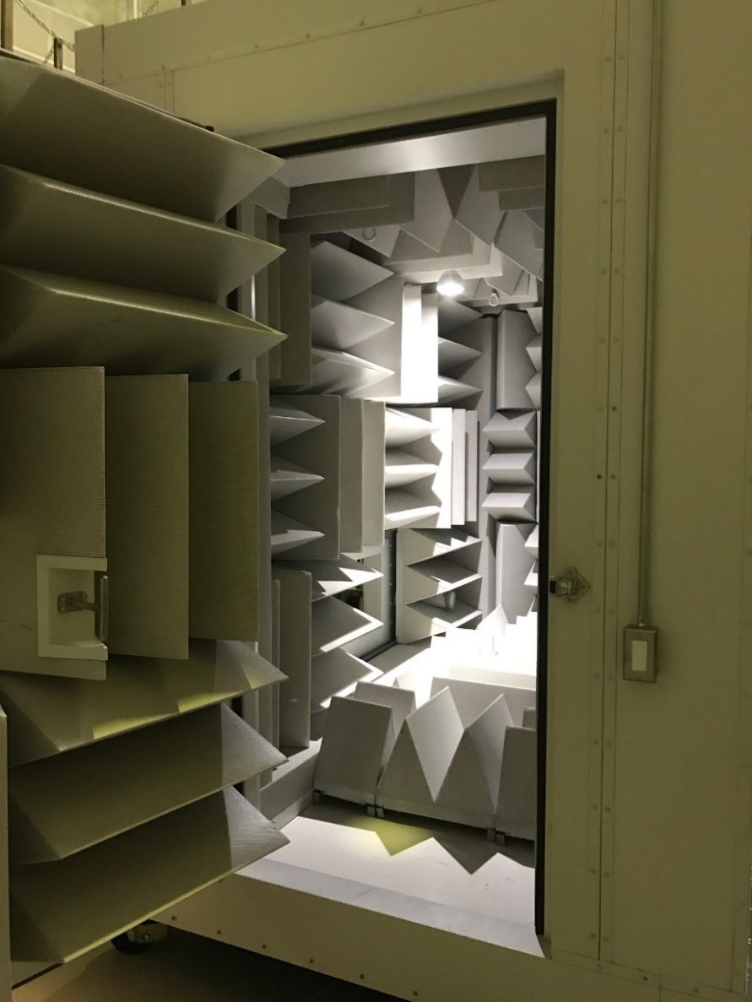
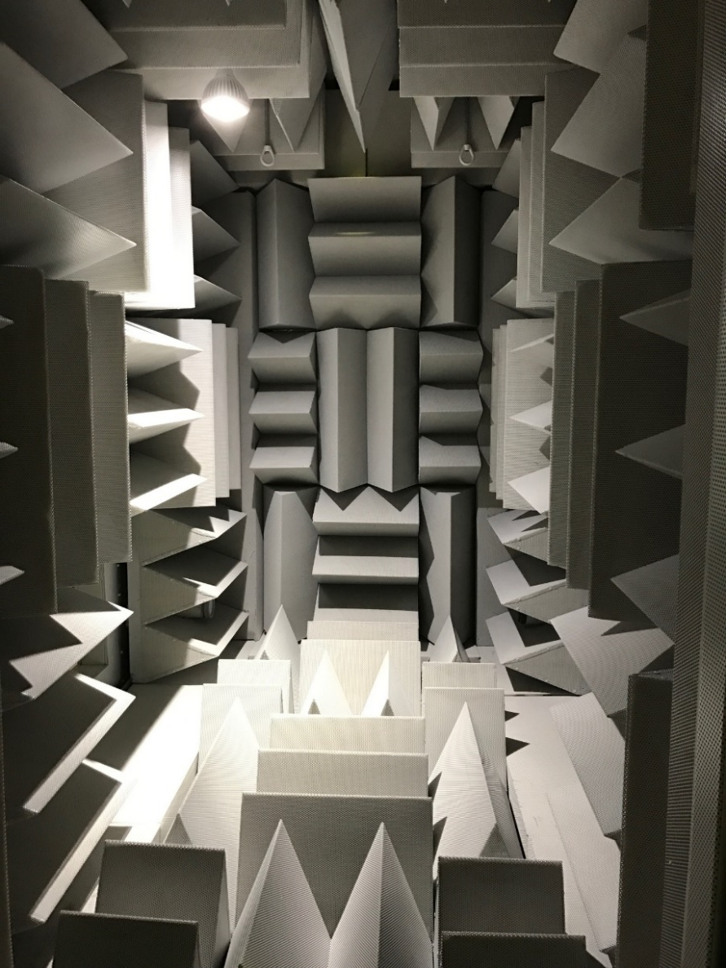
Carleton Aeroacoustics High-Speed Wind Tunnel

Slide 5
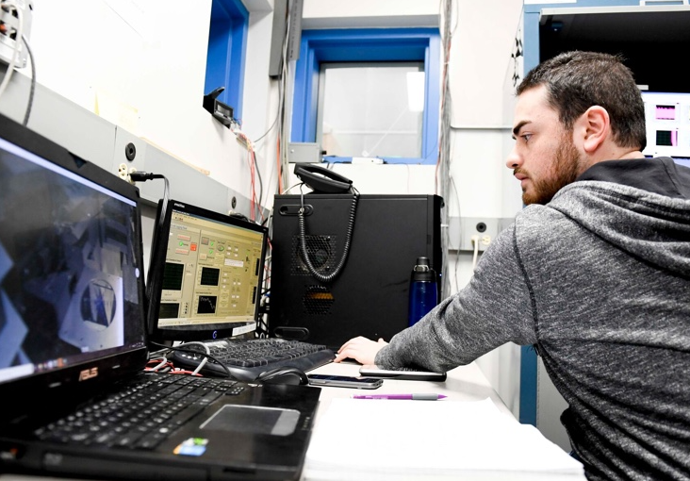
Our research team
There’s a lot of potential for our team to develop new models that can predict turbulence-induced noise during flight.
Students and collaborators work together to do tests using wind tunnel and extrapolate the results to replicate flight conditions.
Ultimately, this will help us develop better aircraft structures, such as more efficient wing shapes, fuselage panels and landing gear.
Students in our team will be doing design work, testing ideas, taking measurements and processing signals — all very valuable skills, which will not only be helpful for Canada’s aerospace industry but also their future careers.

Slide 6
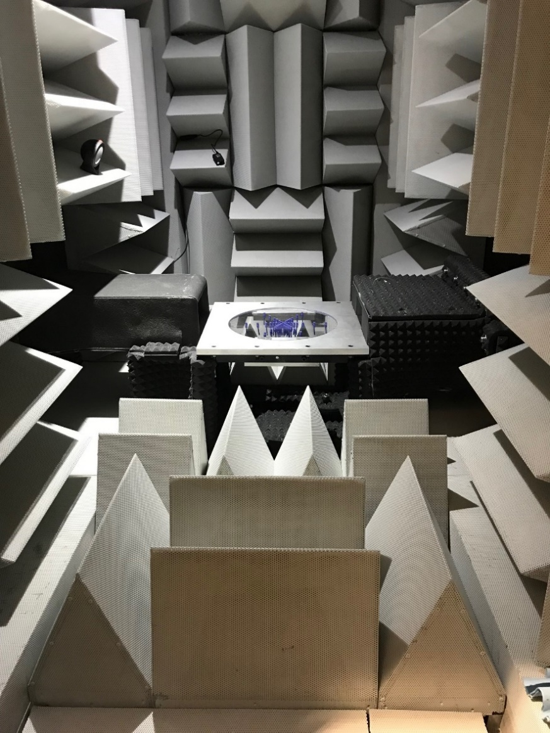
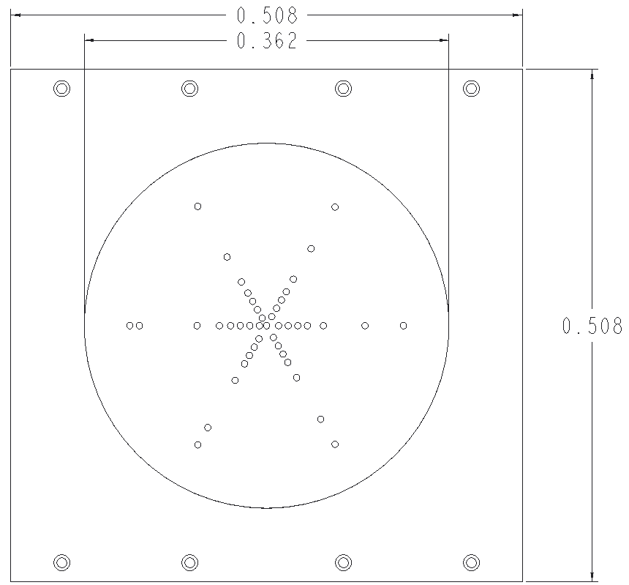
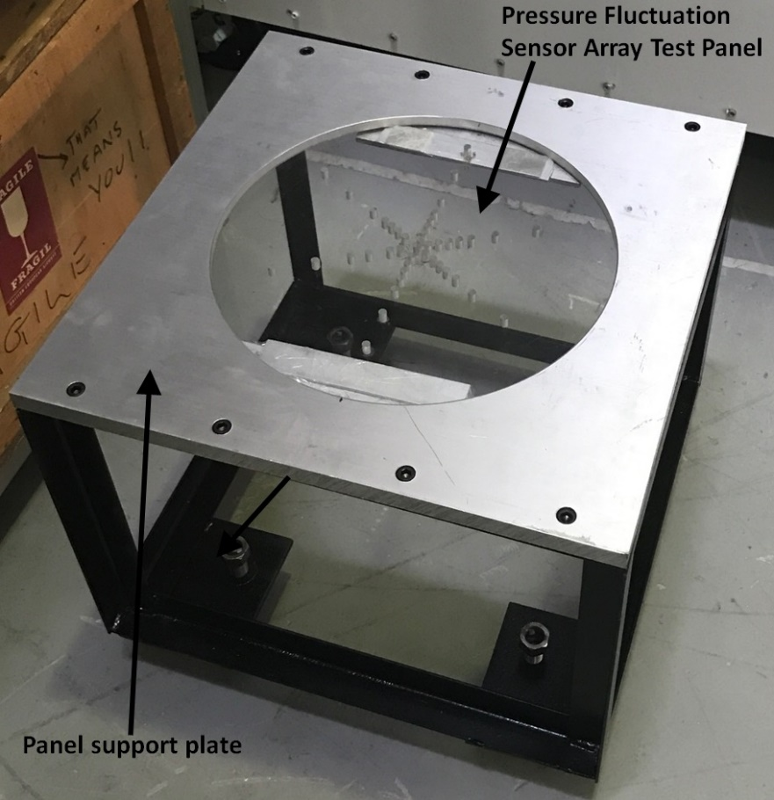
Aeroacoustic test section
Instrumented test panels are used for testing of turbulent flow-induced noise in aircraft

