Slide 1
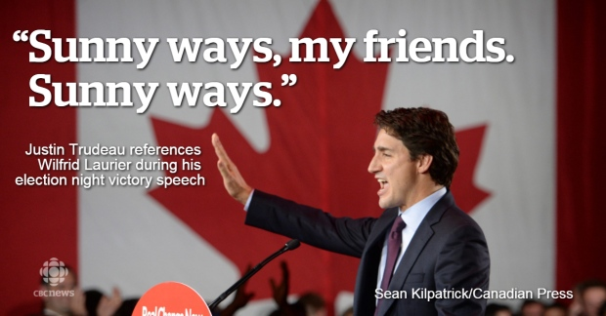
2015>The political landscape

Slide 2
September 25, 2018 @niknanos Chief Data Scientist, Nanos Research Chair, Board of Governors, Carleton University Global Scholar, Wilson Center, Washington DC Author, Age of Voter Rage
The political landscape

Slide 3
Painting by artist Duarte Vitoria
Age of Voter Rage
Disconnect
> With macro economic data
> With the establishment
> Anxiety about the future

Slide 4
Creeping Populism
French Presidential Election 2017
66% Macron
34% Le Pen (Daughter)
French Presidential Election 2002
82% Chirac
18% Le Pen (Father)
Dutch Election 2017
21% Rutte (People’s Party for Freedom and Democracy) 8 seats lost
13% Wilders (Party for Freedom)
5 seats gained
German Election 2017
32.9% CDU/CSU
12.6% Alternative for Germany (AfD)
German Election 2013
41.5% CDU/CSU
4.7% Alternative for Germany (AfD)
Italian Election 2018
Right
33% Five Star Movement (+7)
17% League (+13)
Centre Left
19% Democratic Party (-7)
14% Forza Italia (-8)
Mexican Election 2018
Anti-establishment Obrador 53%
Swedish Election 2018
Sweden Democrats 13% to 18%
MAXIME BERNIER
Notes:
http://elezioni.interno.gov.it/camera/scrutini/20180304/scrutiniCI
http://elezionistorico.interno.gov.it/index.php?tpel=C&dtel=24/02/2013&tpa=I&tpe=A&lev0=0&levsut0=0&es0=S&ms=S

Slide 5
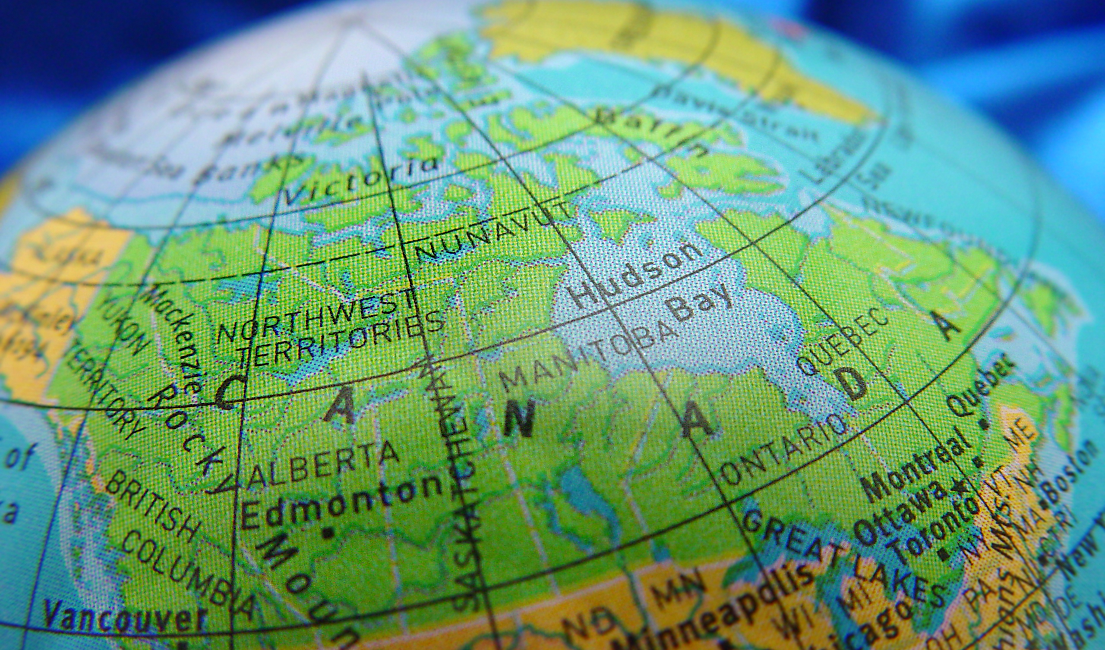
Creeping Populism
Is Canada susceptible?

Slide 7
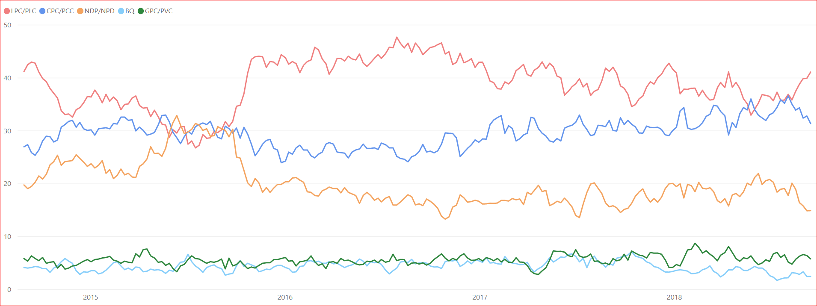
> POLITICAL TRACKING

Slide 8
Is Canada susceptible?

Slide 12
Canadians are re-examining their natural and historic continental affinities
One should not dismiss the potential rise of populist politics in Canada
Think of the Liberals as being perceived as the least imperfect choice from a series of imperfect choices

