Slide 1
Welcome to
PMC Fall Orientation!
Hosted by Hunter Calder, Student Support Officer

Slide 2
Agenda
Director’s Welcome
Faculty Presentation – Transitioning to University
Breakout Session Instructions
Break
Breakout Sessions (3 rounds)
Announcements
Break
Student Panel
Wrap-Up

Slide 3
Welcome
Bruce Hamm
Director, Paul Menton Centre for Students with Disabilities

Slide 4



Guy Lacroix
Department of Psychology
PMC Orientation
Richcraft Atrium
Thursday, August 28, 2025

Slide 5

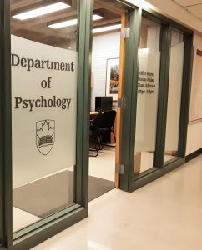
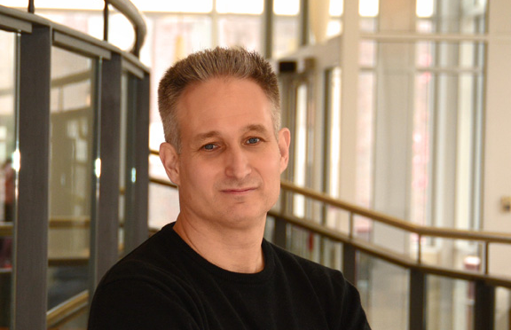
Dr. Guy Lacroix
I am an Associate Professor and the Chair for the Department of Psychology
I have been at Carleton since 2006
I study adult attention, learning, & memory

Slide 6

I want to focus on the challenges that all students experience when they begin their academic journey
Here are five tips that will help you succeed!

Slide 7

Being an undergraduate university student is not easy!
Academic success is important:
  Academic Continuation Evaluation (ACE), scholarships & OSAP, admission to other programs
  Better grades are related to better recall (Bahrick, 1984; Conway, Cohen, & Stanhope, 1991)
To excel, students can easily spend up to 2 hours working outside of class for every hour spent in class:
5 courses = (5 x 3-hour lectures) + (5 x 6 hours work) = 45 hours!
Guy Lacroix – Carleton University – August 28, 2025

Slide 8
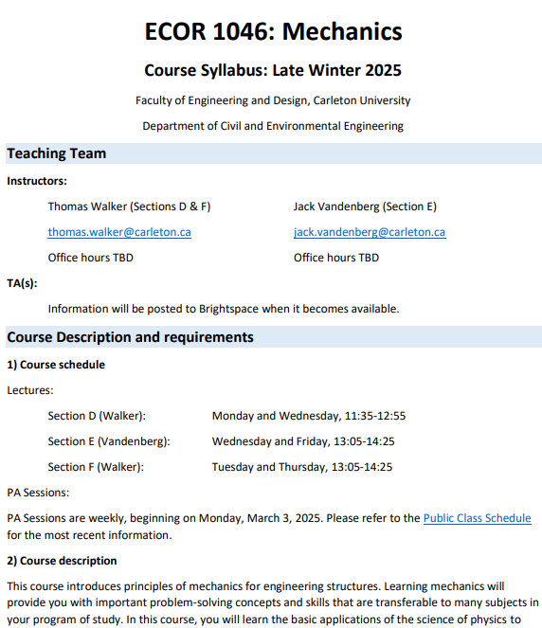
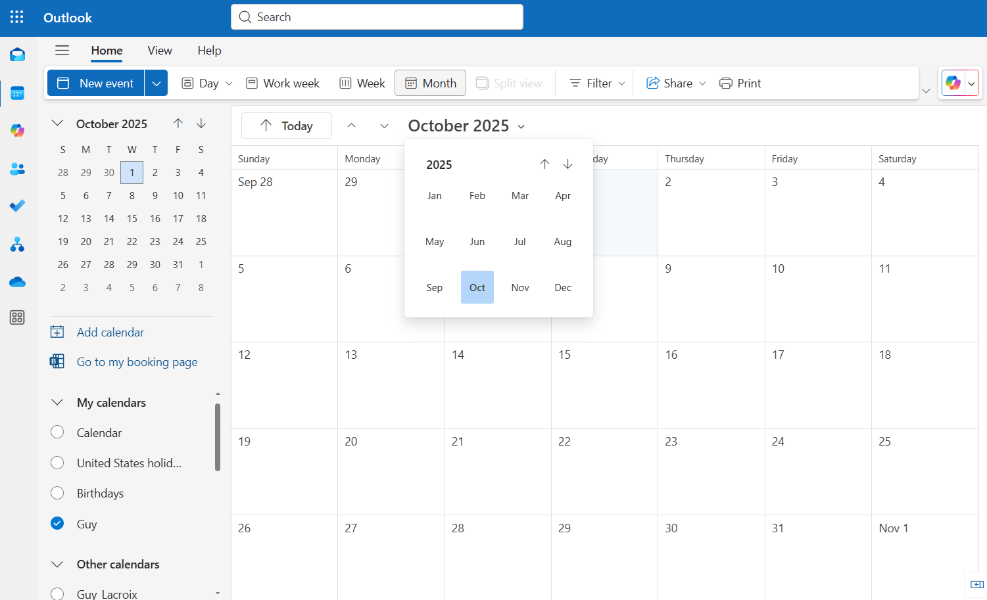
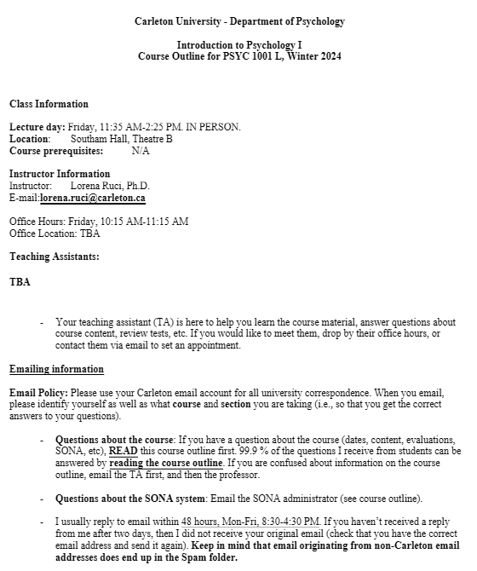
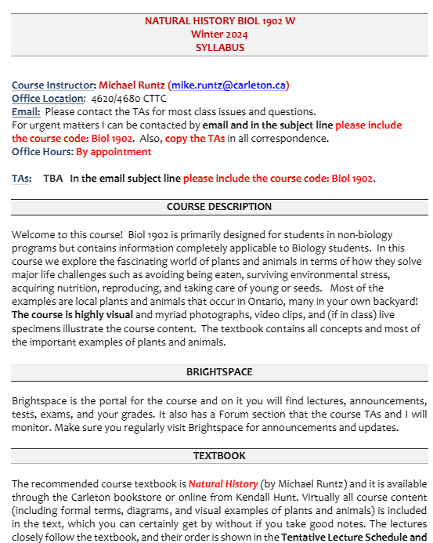
Schedule your time
My exam goes here!
At the beginning of each term, review all your syllabi, note all evaluations and deliverables, schedule everything well in advance, and make room for the rest of your life!
Guy Lacroix – Carleton University – August 28, 2025

Slide 9

Not so trick questions…
What happens if you set a date with a romantic partner, but simply don’t show up?
What happens if you are on competitive sports team, but you don’t go to practice?
What happens if you have a part-time job, but you don’t go to work without telling anyone?
What happens if you skip class?
Guy Lacroix – Carleton University – August 28, 2025

Slide 10


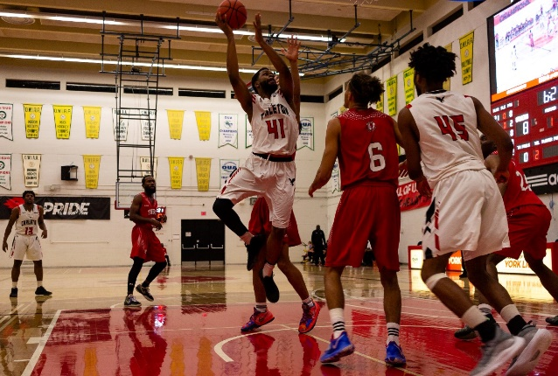

The consequences for missing these activities are immediate, but they are not for your classes
It requires commitment, but students who meet their goals do find it rewarding
Guy Lacroix – Carleton University – August 28, 2025

Slide 11
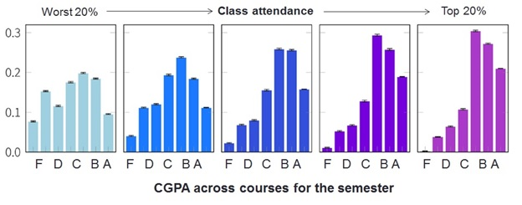
Attend Class
Kassarnig et al. (2017)
Encoding hypothesis (Kiewra, 1991)
Keep up to date with materials and evaluations
Opportunities for networking
Guy Lacroix – Carleton University – August 28, 2025

Slide 12

Hopefully, you have loftier goals than not failing…
Just being there is not enough
Guy Lacroix – Carleton University – August 28, 2025

Slide 13



Engage with the course content
Follow your course programs
Do the assigned preparatory work in advance (e.g., the readings)
In class, take notes if possible – Avoid distractions
After class, review your notes – Help yourself - Seek support if needed
Guy Lacroix – Carleton University – August 28, 2025
Roeddiger et al. (2016)

Slide 14

Embrace the struggle -
Sometimes your courses will be hard

Slide 15

Know how you are being evaluated
Work diligently to meet them
Seek feedback
Understand the evaluation criteria
Guy Lacroix – Carleton University – August 28, 2025

Slide 16

Take responsibility for your academic experience
Carleton has an exceptionally rich set of resources available to help you succeed, but it is up to you to seek them out when needed:
Peers, TAs, and Professors
Departmental advising, Academic Advising Centre & Registrar’s Office
Centre for Student Academic Support (CSAS)
The Paul Menton Centre
Health and Counselling Services
Guy Lacroix – Carleton University – August 28, 2025

Slide 17

Five tips for a successful academic journey
Schedule your time
Attend class
Be engaged
Know how you are being evaluated
Take responsibility for your academic experience

Slide 18

Thank you! guy.lacroix@carleton.ca

Slide 19
Breakout Session Schedule
Time | Tables: 1, 2, 3, 4 (Group A) | Tables: 5, 6, 7, 8 (Group B) | Tables: 9, 10, 11, 12 (Group C)
1:35 – 1:58 PM | RB 2228 | RB 2224 | RB 2220
2:05 – 2:28 PM | RB 2224 | RB 2220 | RB 2228
2:35 – 2:58 PM | RB 2220 | RB 2228 | RB 2224
Session Topics:
RB 2220 – Thriving in Your First Year: Skills, Tools, and Supports for Mental Health & Wellness
RB 2224 – Learning Strategies & Managing Your Academic Course Load
RB 2228 – PMC 101: Your Guide to Academic Accommodations

Slide 20
Break
Please return to your seat by 3:20 PM

Slide 21
Student Panel and Q&A
Jasmina Molloy
Sydney Weaver
Gerardo Maldonado-Jiminez

Slide 22
Thank you for attending PMC Orientation!

