Slide 1
Make the Most of University:
Learning Strategies & Managing Your Academic Load
Presented by: Amanda blais
📍 Room 501 Nideyinan | 📞 613-520-6608 | ✉️ pmc_ls@carleton.ca
Notes:
30-45 minute presentation

Slide 2
Overview
What is Learning Strategies
How to Get Started
Skill Development Areas
Three Levels of Time Management
Managing Your Courseload
Questions

Slide 3
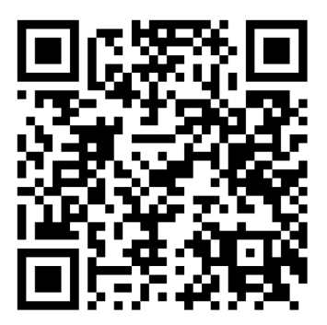
Welcome & Icebreaker
What do you think are the biggest differences between going to school in high school and university?
Scan Wooclap QR Code (below) to bring you to the poll:
Notes:
https://app.wooclap.com/TLKHLF?from=event-page
- Structured time to self-directed
- Built in reminders to set your
own priorities
Bells to indicate class is over
Parents/care-givers to speak on your behalf when needed

Slide 4
The Shift: Learning in University
High School | University
Structured Day | Build your own schedule
Teachers Track You | You’re expected to self-monitor
Re-teaching & reminders | One-time lectures & big deadlines
Notes:
Your independence is your superpower — with the right tools.

Slide 5

How to get started

Slide 6

You’re Not Alone – Build Your Support Team
Explore the University’s resources developed to support you!
Disability Coordinators
Departmental Contacts (A-Z)
Professor and Teaching Assistants (TA)
Student Success Specialists
Residence Advisors or Rez Fellows

Slide 7
What is Learning Strategies Support?
One-on-One support with trained professionals
Focus on how you learn, not just what you learn
We help with time, organization, reading, studying, exam prep, and more
Accessing supports is not required, BUT
is recommended for success!
Notes:
Students who tend to struggle are the ones who do not seek supports.

Slide 8
Skills Development Areas
Reading
Writing
Time & task management
Problem solving
Organization
Studying
Note-taking
Test-taking
and more…
We aim to incorporate assistive technology and software in each area

Slide 9

The puzzle piece that holds everything together!
Notes:
L

Slide 10

Time Management
Three levels of planning:
    Term Calendar (4 visible months)
    Weekly Schedule
    To-Do Lists

Slide 11
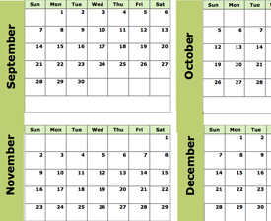
Term Calendar > Big Picture
Once you receive all your course outlines (or syllabus):
Write down ALL due date, tests, and exams
Include the percentage that each is worth
Colour code by course
Create goal dates to complete large assignments
See all four months at once
MAKE SURE IT IS VISABLE!

Slide 12
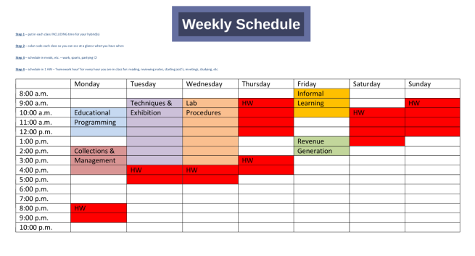
Weekly Schedule > Your Routine
Create a weekly schedule with your class and work schedules
Each week add additional appointments, activities, work, reading, and studying
Notes:
I believe there is a link that will be published for Free Passion Planner Downloads

Slide 13
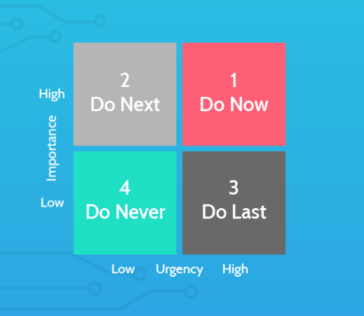
To-Do List > Daily Action
Make a list of what to do during the week
Prioritize what needs to get done first
Check off tasks as they are completed
Enjoy the satisfaction of completing them!
Notes:
Other time management trackers.
Don’t Break the Chain Tutorial
🍅 Pomodoro Tutorial
⚙️Productivity Directory
Apps Recommendations for Pomodoro:
FocusBooster
Clockwork Tomato
Be Focused - Focus Timer
Apps Recommendations for Don’t Break the Chain:
Goal Tracker & Habit List & Workout Calendar Free
Don't Break The Chain

Slide 14

Why start with Time Management
Because, if you can see a problem before it happens you have time to find a solution!
Where to look first?
Your outline/syllabus
Your Professor/TA
Your Coordinator/Learning Strategist

Slide 15
Managing your courseload
Plan Ahead
Prioritize Wisely
Create a study schedule
Find an organization system that works for you
Ask for help
Create Balance
Choose a date to cut back
Know these Key Dates!
Sept. 30 - Last day for financial withdrawal (Fall 2025 Term)
Nov. 15 – Last day for Academic Withdrawal (Fall 2025 Term)
Notes:
1. Plan Ahead: Use a planner or digital calendar to track deadlines, exams, and assignments.
Break down large tasks into smaller, manageable steps with mini-deadlines.
2. Prioritize Wisely: Use the Eisenhower Matrix or ABC prioritization to decide what needs immediate attention.
Focus on high-impact tasks first (e.g., assignments worth more of your grade).
3. Create a Study Schedule
Allocate specific time blocks for each course.
Stick to a consistent routine to build momentum and reduce procrastination.
4. Stay Organized
Keep your notes, files, and materials sorted by course.
Use tools like Notion, OneNote, or Google Drive for digital organization.
5. Don’t Be Afraid to Ask for Help
Reach out to professors, TAs, or classmates if you're struggling.
Join or form study groups for collaborative learning.
6. Take Care of Yourself
Schedule breaks and downtime to avoid burnout.
Get enough sleep, eat well, and make time for exercise or relaxation.
7. Know When to Cut Back
If you're overwhelmed, consider dropping a course or reducing extracurriculars.
It's better to do fewer things well than to stretch yourself too thin.

Slide 16

Write down one thing you’ll do differently this year!

Slide 17

Questions?

Slide 18
Contact Us
    📍 Room 501 Nideyinan
    📞 613-520-6608
    ✉️ pmc_ls@carleton.ca
    🌐 carleton.ca/pmc

