Slide 1
PMC 101
Candice Kavanagh, Disabilities Coordinator

Slide 2
What does PMC help with?
Academic Accommodations and Services
Learning and Wellness Support
Other Disability-Related Matters

Slide 3
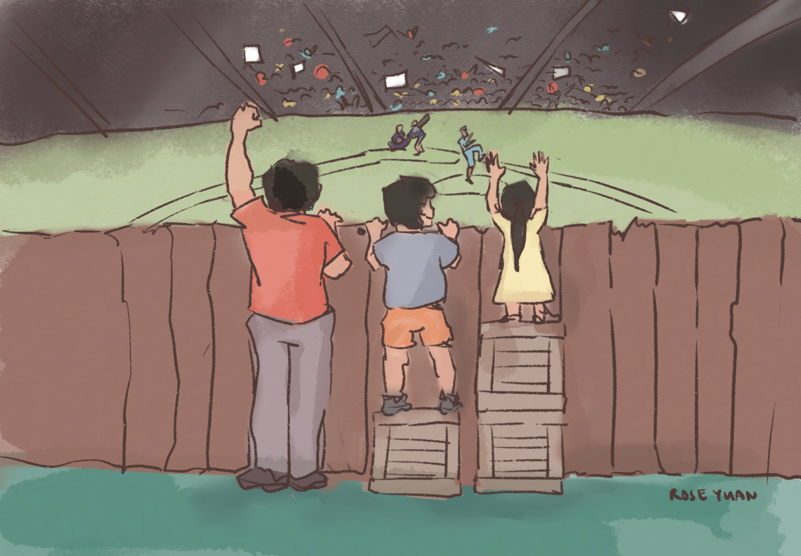
Academic Accommodations
Academic accommodations are supports and services provided to help students access the curriculum and validly demonstrate learning.
They are intended to level the playing field without compromising essential requirements in a course or program or academic standards.

Slide 4
Academic Accommodations and Services
Academic Accommodations
Test/exam accommodations
Online and in-person
e.g. extra time, quiet location
Classroom accommodations
e.g. audio record lectures
Services
Volunteer supplemental notetaking service
Referrals to alternate format
ASL interpreting
Captioning of multimedia materials
Assistive technology training
Tutoring support

Slide 5
Requesting Accommodations
In your first term, you set up your accommodations with your Coordinator.
In subsequent terms, if your accommodations still meet your needs, you can request accommodations online through Ventus.
Each accommodation is either self-serve (pre-approved) or requires Coordinator approval.
  Self-serve accommodations are applied to your courses immediately.
  For others, your Coordinator may follow up with you.

Slide 6
Pro Tips
Important Reminder: Request accommodations for every course at the start of each term.
Review course outlines first
  Identify evaluation types for each course (e.g., exams, presentations)
Select only the accommodations that apply each course
  Avoid selections that do not apply (e.g. do not request a quiet location for exams in a course with only online exams)
Submit accommodation requests at the start of the term
  This ensure accommodations are in place in time for your exams.

Slide 7
Important Reminder
Request accommodations for every course at the start of each term.

Slide 8
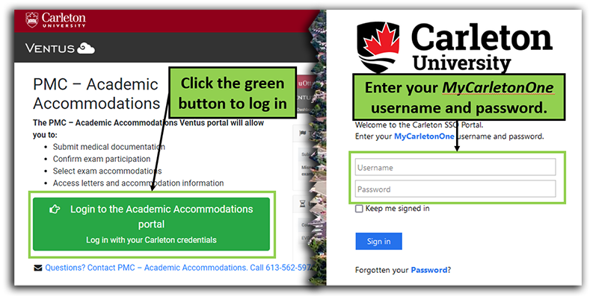
Step-by-Step: How to Request Accommodations (1)
Login to Ventus Student Portal using your MC1 credentials.

Slide 9
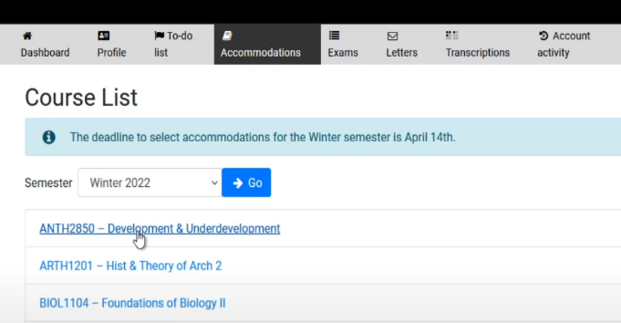
Step-by-Step: How to Request Accommodations (2)
Click the Accommodations tab to open your course list.
Select a course in which you want to request accommodations.

Slide 10
Step-by-Step: How to Request Accommodations (3)
Select accommodations to request by checking the relevant boxes for teaching and exam accommodations.
Click “Submit for approval” and confirm your submission.
After submission, you’ll see a banner confirming submission and Status updates:
  “Opted Out” = unchecked
  “Approved” = green checkmark
  “Pending” = awaiting review

Slide 11
After Requesting Accommodations
Reach out to your professors, lab instructors and/or TAs to:
Introduce yourself,
Confirm they can see you on their class accommodation list,
Discuss any questions or concerns you have about the course, and
Review how your accommodations will be implemented (e.g., extra time for online exams, booking the McIntyre Exam Centre, classroom accommodations).
You are not required to disclose the nature of your disability.

Slide 12
Managing Your Exam Accommodations
Once your instructor submits a Notice of Examination (NoE) to the McIntyre Exam Centre, you are responsible for managing your accommodations.
Verify your accommodations are correct for the test/exam.
Opt out if they are not needed.
Check your exam and accommodation details in Ventus 3 days before each test/exam.
Attend the test/exam on the scheduled date.
Report any issues to your Coordinator.

Slide 13
Roles & Responsibilities
Your Coordinator will:
Create your accommodations template in Ventus
Approve your accommodations for each course, if necessary
Make arrangements for accommodations (when professor requests it)
Post your exam accommodation details in Ventus (3 days prior to exam)
Your professor will:
View your classroom and exam accommodations in Ventus
Submit a Notice of Examination (NoE) for each quiz, test, midterm, and exam
The McIntyre Exam Centre will:

Slide 14
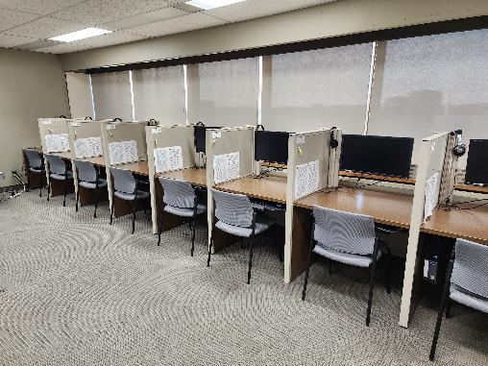
McIntyre Exam Centre
The McIntyre Exam Centre (MEC) supports students and instructors by providing test and exam accommodations.
They have two main sites
  Nideyinàn – Room 133
  Dunton Tower Rooms – 7th floor
Exams at MEC: Student FAQ

Slide 15
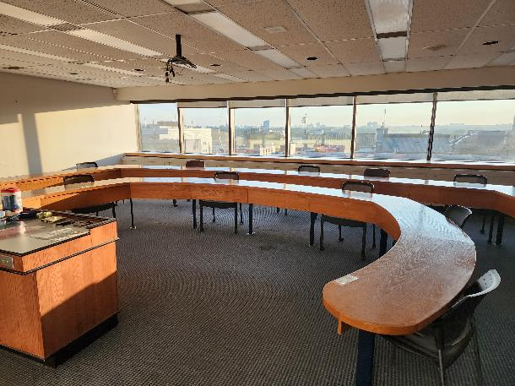
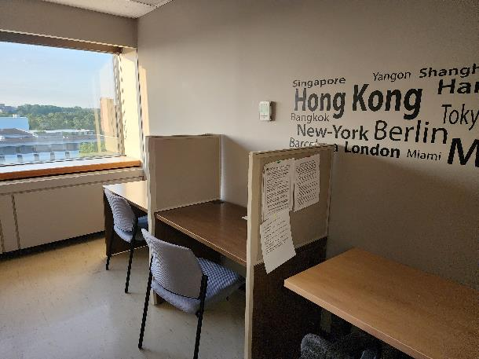
McIntyre Exam Centre

Slide 16
Volunteer Notetaking Service
Click the Lecture Notes tab to open your list of courses in which you requested volunteer notes.
To view available notes for a course, click on the blue "Notes" button to the right-hand side.
Click on a file link in the Downloads column to open the file, then download it to your device.

Slide 17
Learning and Wellness Support
Learning & Wellness Strategies: One-on-one appointments and online modules to help you work more effectively and efficiently.
Assistive Technology: Learn about tools and technologies that can enhance your academic performance.
Psychoeducation & Support Groups: Groups include ADHD, Chronic Medical Disability Support, Social Groups, and Graduate Student Writing Groups.
Wellness Coaching: Counselling and guidance for stress, anxiety, and managing mental health symptoms.
Mentorship: Peer mentors provide support during your transition to university and throughout your academic journey.

Slide 18
Other Disability-related Matters
Referrals for Services
New Sun Joy Maclaren Adaptive Technology Centre (JMC)
Accessible Career Transitions (ACT)
Alternate Formats
Disability-related Financial Supports
Navigating funding applications for equipment and/or services
Administering disability-related scholarships/bursaries
Reduced Course Load and Equivalent to Full-time Status
Opting-in to medical benefits
Opting-in or opting-out of the U-Pass
Residence
Scholarships

Slide 19
Follow-up with Your PMC Coordinator
Stay connected throughout the term!
Advise your PMC Coordinator of any problems with your accommodations right away.
Monitor your academic progress and mental health during the term and reach out for help.

Slide 20
Stay Up-to-date
Check your Cmail regularly for communication from your professors, TAs, PMC, MEC, and other student services you are using
Live feed on PMC website
PMC’s monthly newsletter
Follow us on Instagram – @CarletonPMC
Your PMC Coordinator will send check-in emails

