Slide 1
Office of Associate Vice President Student Health and Wellness
Notes:
As AVP student and health and wellness my vision is always guided by a desire to support student health and well-being

Slide 2
Who we are
Paul Menton Centre(PMC) for students with disabilities
Health and Counselling services(HCS)
From intention to action (FITA) program
Attendant Care program
Care and Support Team
Mental Health Strategies and Initiatives, including Pet Therapy, Health Promotion, Wellness Desk in the Library and Spirituality Centre
Student at risk evaluation team (SARET)
Student Mental Health Framework (SMHF)
Notes:
In the last 3 years our health and wellness programs have expanded and access to these programs is unprecedented. These areas often work together and independent of each other in supporting our students.

Slide 3
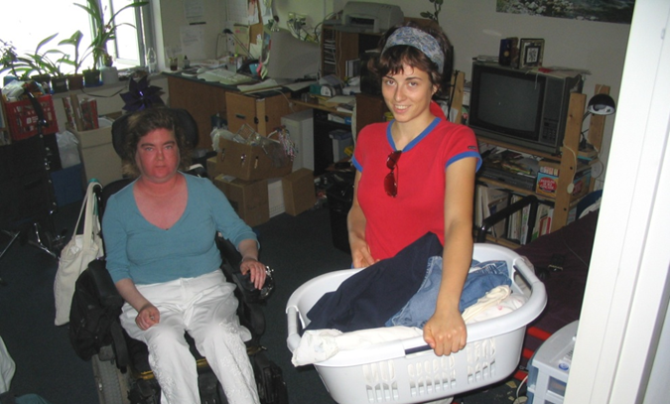
Attendant Care Program
Carleton University offers personal care services, like a long-term care centre but is located on campus in our residence community.
The service operates 24/7 365 at no cost to Ontario students with physical disabilities and is funded from Ontario Health and Long-Term Care.
Notes:
Students with varying levels of disability can live and study on campus with the assistance of staff who will assist them with activities of daily living such as rising and retiring, toileting, personal hygiene, and dressing.
Attendants also assist with tasks such as laundry, light housekeeping, setting up books and computers, and eating in the cafeteria. Students live in specially designed suites which complement the very accessible nature of the campuses.

Slide 4

Health Clinic Services
Health Services is a multidisciplinary healthcare facility that provides medical services to Carleton University students, faculty and staff
Health Services includes a team of professionally trained patient care coordinators, nurses, lab technician, physicians and psychiatrists
Services include access to same-day appointments, primary care appointments, nursing visits and lab testing
Types of services and more information can be found on the website
Website: wellness.carleton.ca/health/health-clinic-services
Call: 613-520-6674 ext. 0 to book an appointment or through the CHR Connect App or CHR Connect Website
Location: 2600 Carleton Technology and Training Centre
Monday to Friday 8:30 a.m. to 4:30 p.m.
Notes:
Goal is to support students in achieving academic success by working collaboratively with them to overcome barriers, build resilience, and promote wellness
Specialized counsellors:
Indigenous
Sexual Assault and Trauma
Athletic
Racialized
Trans/2SLGBTQ+
International
Graduate
Multidisciplinary healthcare facility that provides medical services to Carleton students, faculty, and staff
Located at 2600 CTTC
Monday – Friday, 8:30am – 4:30pm
Walk-in and appointments as needed
Appointments suggested for: STI testing, birth control, prescription renewals, and referrals to specialists

Slide 5

Counselling Services
Counselling Services provides a wide range of accessible mental health services that align with the Stepped Care approach to student wellness
Mental health services include Single-Session counselling, brief individual counselling, group counselling, psycho-educational events and programs, workshops, and online resources
Counselling Services does not have the capacity to support students long-term due to the high demand for mental health services
Website: wellness.carleton.ca/counselling
Location: 2500 Carleton Technology and Training Centre
Book: through the CHR Connect App or through the CHR Connect website.
Phone: 613-520-6674 ext. 2.
If you live in Residence, please call 613-520-2600 ext. 8061 to book a session.
Notes:
Goal is to support students in achieving academic success by working collaboratively with them to overcome barriers, build resilience, and promote wellness
Specialized counsellors:
Indigenous
Sexual Assault and Trauma
Athletic
Racialized
Trans/2SLGBTQ+
International
Graduate
Multidisciplinary healthcare facility that provides medical services to Carleton students, faculty, and staff
Located at 2600 CTTC
Monday – Friday, 8:30am – 4:30pm
Walk-in and appointments as needed
Appointments suggested for: STI testing, birth control, prescription renewals, and referrals to specialists

Slide 6
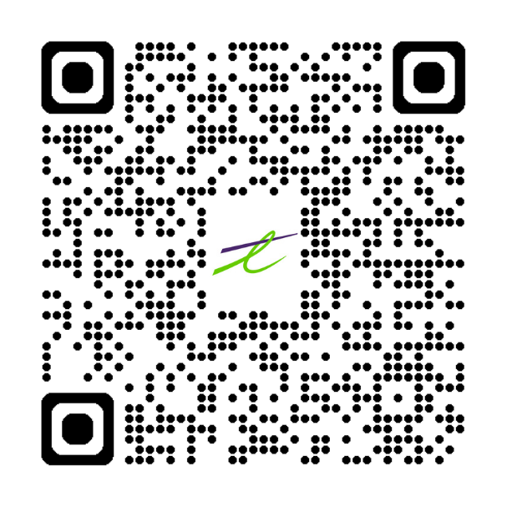
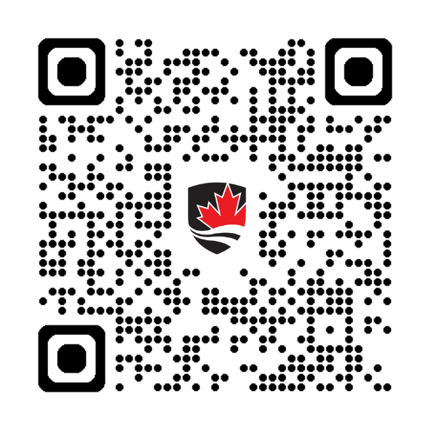
Health and Counselling QR Codes
Download the ‘TELUS CHR Connect’ app
Visit the HCS Wellness Website
Notes:
Go through wellness navigator

Slide 7
From Intention To Action (FITA)
T: 613-520-2600 x1028
E: fitaction@Carleton.ca
What is FITA?
Mental health support program with 5-10 sessions of counselling/psychotherapy for registered students
Three categories of students in the program: Academic Warning, Overwhelmed, or Both
Typical presenting concerns: anxiety, depression, perfectionism, shame, self-worth/esteem, procrastination, learning disabilities, disordered eating, grief, relational concerns, sexuality, culture, health
Notes:
Students book intake session, demonstrate commitment, sign contract, no shows removed from program
FITA consists of 3 permanent staff members and 8-10 “coordinators” who are masters' students in counselling-related programs fulfilling their program internship requirements
Students meet with their assigned “coordinator” weekly

Slide 8

Care and Support
Case Managers work one-on-one with students to
identify and assess their various needs
facilitate access to supports
follow-up with students, as needed
Students can be referred to the Care and Support team by accessing the online Care Report Form: wellness.carleton.ca/care-report
Email: wellness@carleton.ca
Location: 3600 Carleton Technology and Training Centre
Website: wellness.carleton.ca/mental-health/student-care-and-support-team

Slide 9





Health Promotion
The Health Promotion team provides opportunities for students to build "wellness toolbox"
Awareness, knowledge and skills
Mental health, sexual health, substance use health and healthy living choices
Educational content through workshops, events and media
Follow
@Carletonwellness
Website: wellness.carleton.ca/health-promotion
Email: wellness@carleton.ca
Notes:
A student team led by the Health Promotion Coordinator to increase awareness, knowledge, and skill-building of health-related topics such as;
Mental Health
Sexual Health
Healthy Lifestyles (sleep, stress, movement, nutrition)
Substance Use Health
Health Promotion provides free resources, events, and workshops
Offers opportunities for students to build their own wellness toolbox on subjects such as mental health, sexual health, substance use health, and healthy living choices.
The Health Promotion team is dedicated to making health information clear and accessible to all Carleton students.
The Health Promotion team empowers students to take control over their health by improving knowledge, skills, and awareness in all areas of student wellness.

Slide 10

Spirituality Centre
Support for exploring and cultivating spiritual wellbeing and identity
Welcoming space for all, regardless of faith affiliation
Meet the Chaplains by office hours or by appointment
Website: wellness.carleton.ca/spirituality
Location: Tory Building T27
Notes:
Support for all students regardless of faith affiliation
Spirituality website also provides list of spirituality resources
Religious plurality

Slide 11




Therapy Dogs
Mental health and wellness support
Dogs are handled by professional staff and faculty members
Handlers work to create welcoming, supportive and low intensity environments
Aristotle
Website: wellness.carleton.ca/mental-health/therapy-dogs
Email: wellness@carleton.ca
Location: Office hours on website
Porter
Notes:
Carleton’s in-house Therapy Dog program
The handlers are Carleton staff and faculty members
Weekly office hours and special events
Get those pet cuddles in!

Slide 12
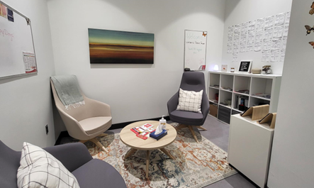
Wellness Desk
Not sure where to start? The Wellness Desk can help!
We understand it might be a little overwhelming when trying to find support
Our team of Wellness Navigators can help you work through what resources might be of most help for your current situation
Engage in wellness activities and programming in the space
You can pop into the Wellness Desk any time during its hours of operation – no appointments necessary!
Online: wellness.carleton.ca/wellness-desk
Location: 204A MacOdrum Library
Email: wellness@carleton.ca
Notes:
Through a partnership between MacOdrum Library and the Office of the Associate Vice President Student Health and Wellness.
Located at 204A MacOdrum Library, it is a space for students to learn about resources, connect with our Wellness Coordinator, and decompress during stressful times of the year.
The Wellness Desk is overseen by the Wellness Coordinator as well as a team of dedicated student staff.
You can pop into the Wellness Desk any time during its hours of operation – no appointments necessary!
You can chat with the team about what areas you need support on, explore resources with the team, and walk away with services and/or resources to better support you.
You can also register for workshops that are hosted by the Wellness Desk! Available workshops and registrations can be found on the Wellness Website.

Slide 13

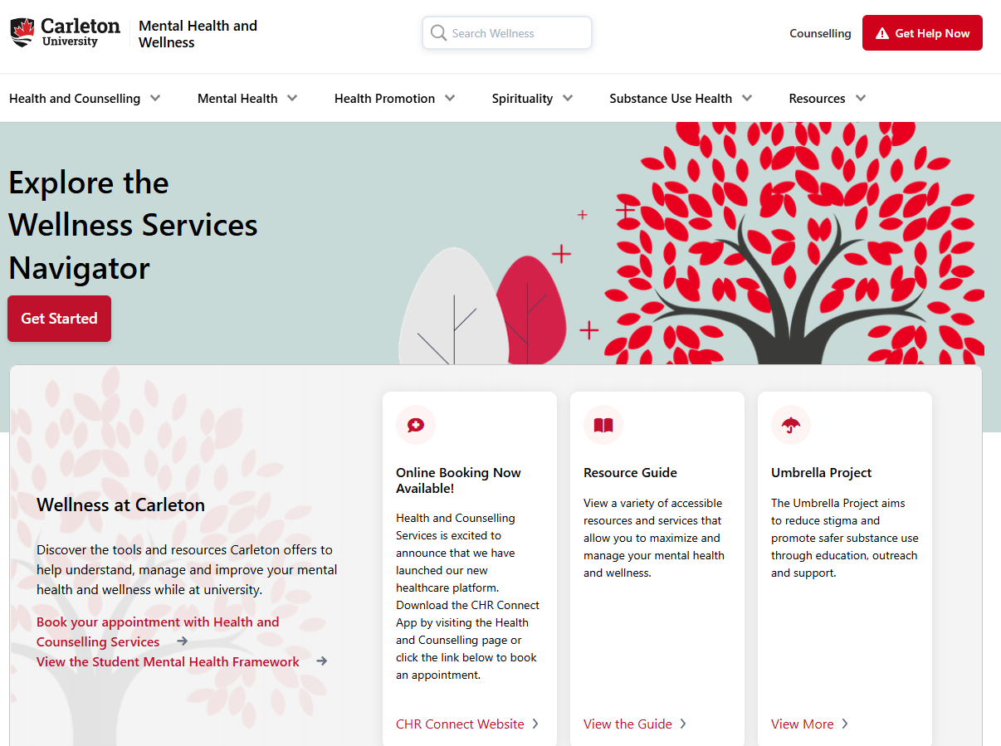
Wellness Services Navigator
Online tool designed to provide user a curated list of relevant mental health and wellness resources
Wellness.carleton.ca/navigator
Not suitable for crisis or urgent support
Notes:
Go through wellness navigator

Slide 14
SARET
The Student-at Risk-Evaluation Team (SARET) plays a key role in ensuring that these responses are carried out in a timely, compassionate, and effective manner. This policy serves as a guiding framework for the University's approach to supporting students who may be identified as potentially at risk.
A student is considered at risk when such factors hinder their ability to engage with the academic curriculum and/or lead to violations of university policies.
The SARET reviews matters where a student’s actions have caused harm to oneself and/or others—or have the potential to cause—physical, emotional, or psychological harm to the student or to the safety and well-being of the broader university community.

Slide 15
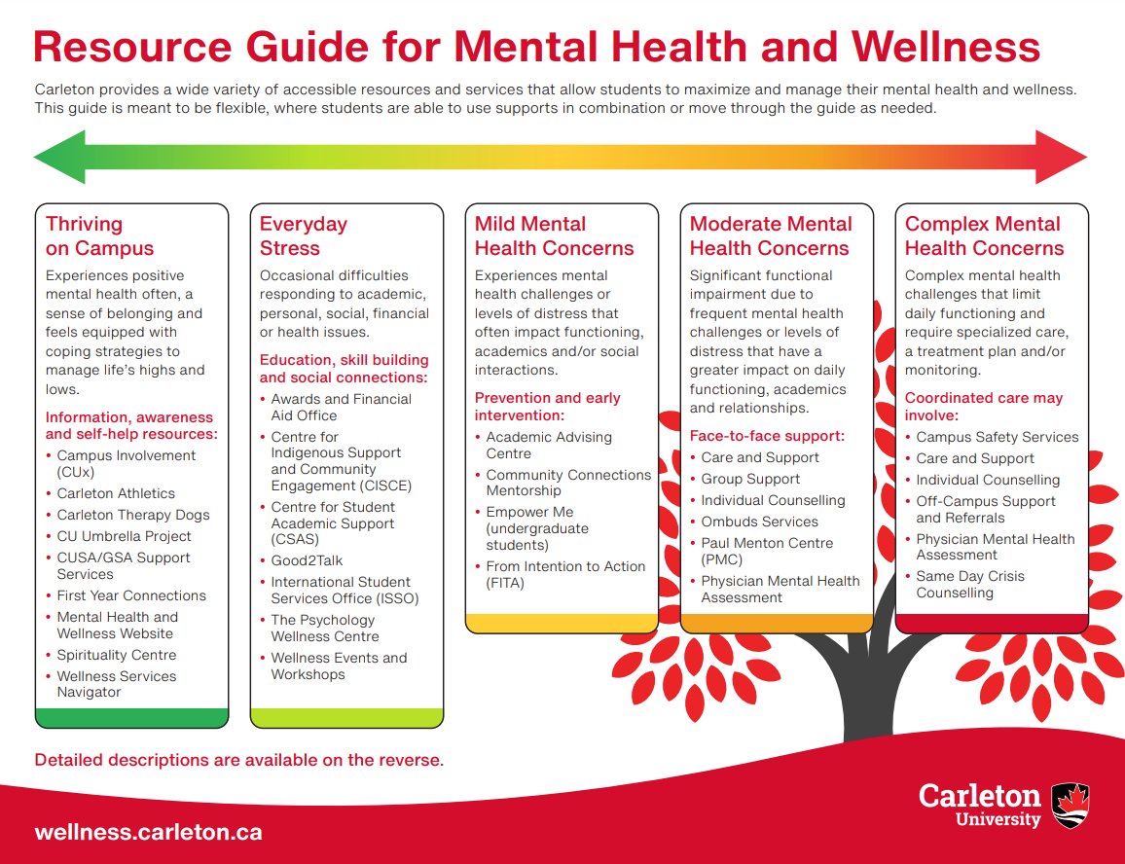
Resource Guide for Mental Health and Wellness
Thriving on Campus
Everyday Stress
Mild Mental Health Concerns
Moderate Mental Health Concerns
Complex Mental Health Concerns
Notes:
https://carleton.ca/studentsupport/supporting-our-students/resource-guide-for-mental-health-and-wellness/
The continuum provides a helpful visual of looking at the different levels of wellness and their relevant resources
The continuum also encourages emotional literacy as we look to think about how we feel and consider our needs

Slide 16
SMHF 2022-2026
The Student Mental Health and Wellness Framework(2022-2026) is a guideline intended for our whole community to use in creating, promoting or engaging students in mental health and wellness
Our Areas of Focus include:
Student Engagement (6 recommendations)
Building Skills and Strengthening Resilience (7 recommendations)
Coordinated student support and services (7 recommendations)
Campus culture of wellness (10 recommendations)
Notes:
When we empower students and teach them to value, prioritize and advocate for their health and wellness, we help students reach their full potential and build resilience
30/30 complete we will now engage the community in the fall through consultations on creating a new 2026-2030 plan

Slide 17
Upcoming Next Steps and Priorities
MOU with CUSA to run Health Promotion collaboratively with them in their wellness space in the Nideyinan building.
“Rethinking Resilience” is an online, interactive, self-paces course using videos, interactive activities, and reflections. This course will be offered as CCR credit this Fall/Winter, for any student who wants to take it!
Development of faculty/staff toolkit that supports you in addressing concerning behaviours or actions by students and gives you the resources and knowledge on who to refer them to for support (Roll out Fall 2025)
Increasing group therapies and workshops in an effort to support rising access demands on our support services

Slide 18
Q & A and Thank you
Notes:
My hope is that as our community becomes familiar with the work within my office and the amazing work happening simultaneously within the community and how we can create pathways to help each other in supporting student health and wellness.
Thank you

