Slide 1
PMC 101
Candice Kavanagh, Disabilities Coordinator

Slide 2
What does the Paul Menton Centre (PMC) help with?
Academic Accommodations and Services
Learning and Wellness Supports
Other Disability-Related Matters

Slide 3
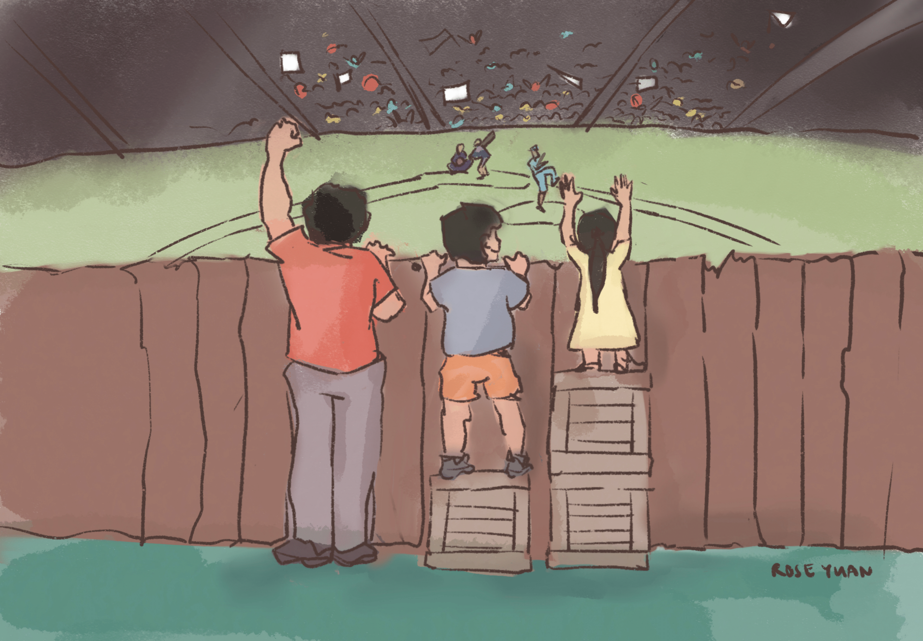
Academic Accommodations
Academic accommodations are supports and services provided to help students access the curriculum and validly demonstrate learning.
They are intended to level the playing field without compromising essential requirements of a course or program or academic standards.

Slide 4
Academic Accommodations and Services
Academic Accommodations
Exam accommodations (includes quizzes, tests, midterms, etc.)
Online and in-person
e.g. extra time, quiet location
Classroom accommodations
e.g. comfortable padded chair
Services
Volunteer supplemental notetaking service
Referrals to alternate format
ASL interpreting
Captioning of multimedia materials
Assistive technology training
Tutoring support

Slide 5
Learning and Wellness Supports
Learning Strategies: One-on-one support and online resources to help you improve your study skills and learning strategies.
Assistive Technology: Tools and technologies to support your learning.
Wellness Coaching: Support for stress, anxiety, and mental health.
Psychoeducation & Support Groups: ADHD Coaching Group, Graduate Student Writing Group, and a Neurodiversity Group (collab with Health & Counselling Services).
Mentorship: Peer support for your transition to university and academic success.

Slide 6
Other Disability-related Matters
Referrals for Services
New Sun Joy Maclaren Adaptive Technology Centre (JMC)
Accessible Career Transitions (ACT)
Alternate Formats
Disability-related Financial Supports
Navigating funding applications for equipment and/or services
Administering disability-related scholarships/bursaries
Reduced Course Load and Equivalent to Full-time Status
Opting-in to medical benefits
Opting-in or opting-out of the U-Pass
Residence
Scholarships

Slide 7

Request accommodations
Manage exam accommodations and find exam locations
View and download volunteer supplemental notes

Slide 8
Requesting Accommodations
In your first term, you will work with your Coordinator to set up your accommodations.
In future terms, if your accommodations still meet your needs, you can request them online through Ventus.
Some accommodations are self-serve (pre-approved), while others need approval from your Coordinator.
  Self-serve accommodations are approved and added to your courses immediately.
  For accommodations that require approval, your Coordinator may contact you for more information.

Slide 9

Pro Tips
Review your course outlines first.
  Identify the evaluation types in each course (e.g., exams, presentations).
Select only the accommodations that apply for each course.
  Do not request accommodations that do not apply (e.g. do not request a quiet location for exams in a course with only online exams).
Submit your accommodation requests at the start of the term.
  This helps ensure your accommodations are in place in when needed.

Slide 10
Important
Request accommodations for every course at the start of each term.

Slide 11
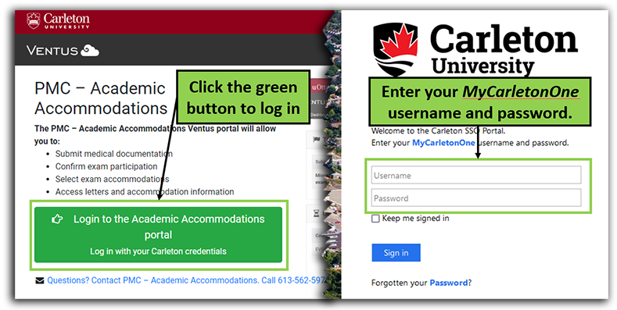
Requesting Accommodations (1)
Login to Ventus Student Portal using your MC1 credentials.

Slide 12
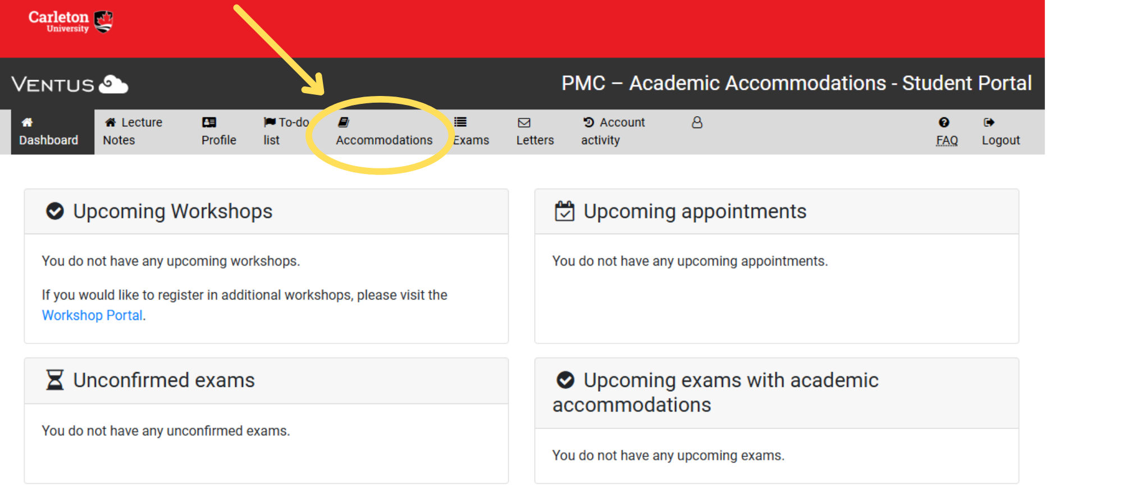
Requesting Accommodations (2)
Click the Accommodations tab to open your course list.

Slide 13
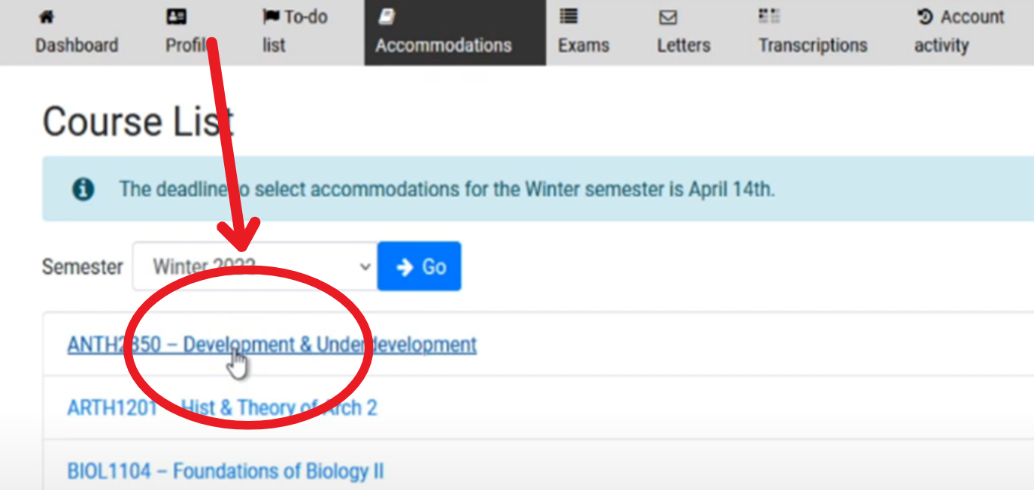
Requesting Accommodations (3)
Select the course for which you want to request accommodations.

Slide 14
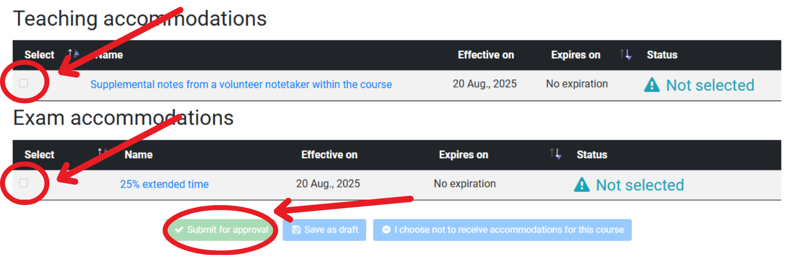
Requesting Accommodations (4)
Check the boxes for the teaching and exam accommodations that apply to the course that you want to request, then click “Submit for approval” and confirm your request.

Slide 15
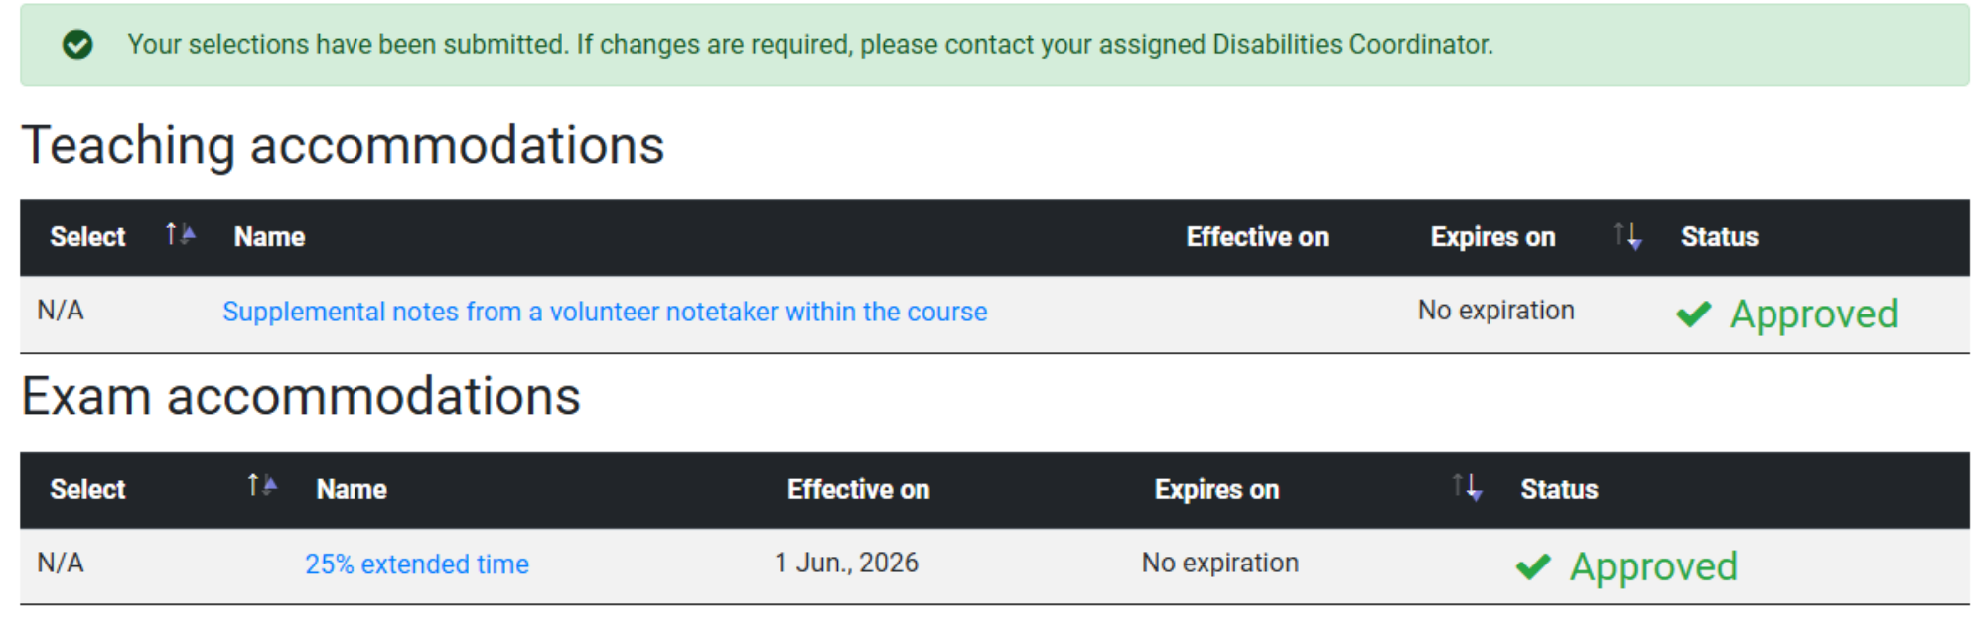
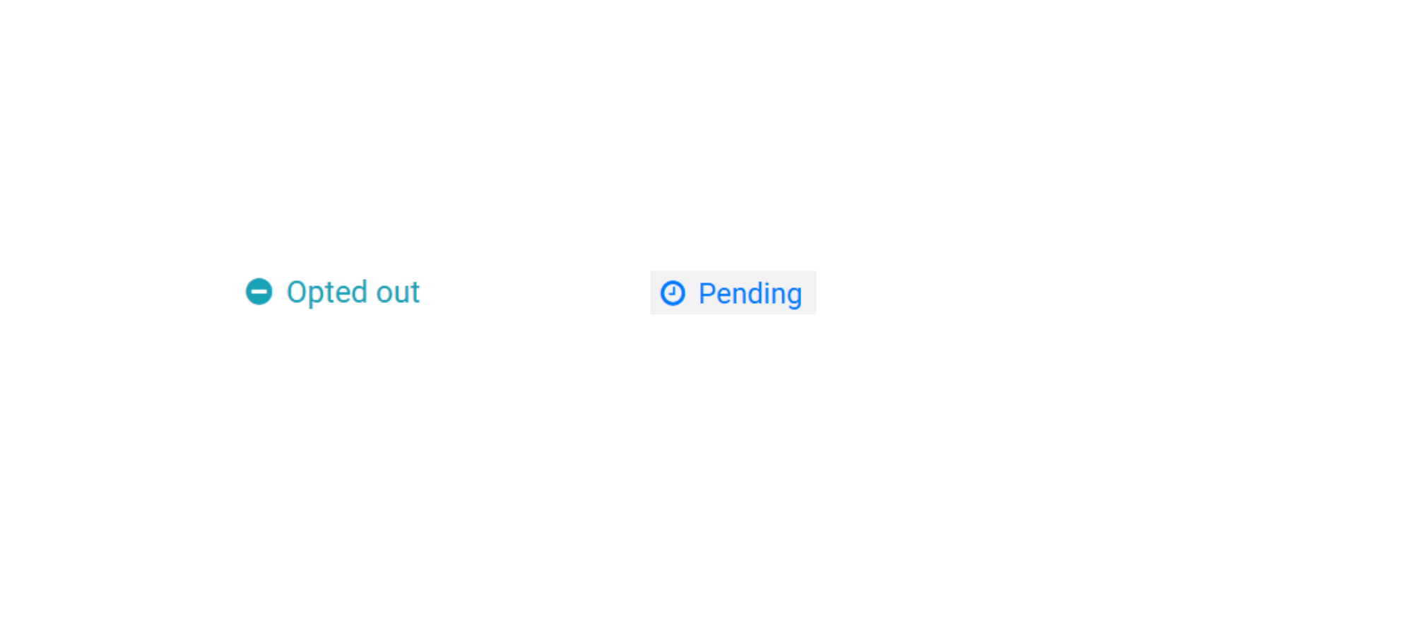
Requesting Accommodations (5)
Confirm your submissions.

Slide 16
After Requesting Accommodations
Contact your professors, lab instructors and/or TAs to:
Introduce yourself.
Confirm that your accommodations are listed for the course.
Discuss any questions or concerns you have about the course.
Review how your accommodations will be provided (e.g. extra time for online exams, booking the McIntyre Exam Centre, or classroom accommodations).
You are not required to disclose the nature of your disability.

Slide 17
Exam Accommodations
You are responsible for managing your accommodations.
In Ventus, quizzes, tests, midterms, and final exams are all called exams.
For each in-class exam, Course Instructors submit a Notice of Examination (NoE) through Ventus to the McIntyre Exam Centre (MEC).
For exams during the final exam period, scheduling is handled by Scheduling and Exam Services.

Slide 18
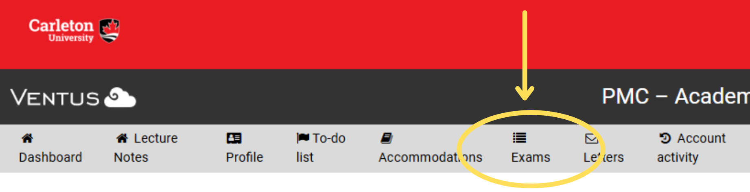
Managing Exam Accommodations (1)
Click on the Exams tab in Ventus.

Slide 19
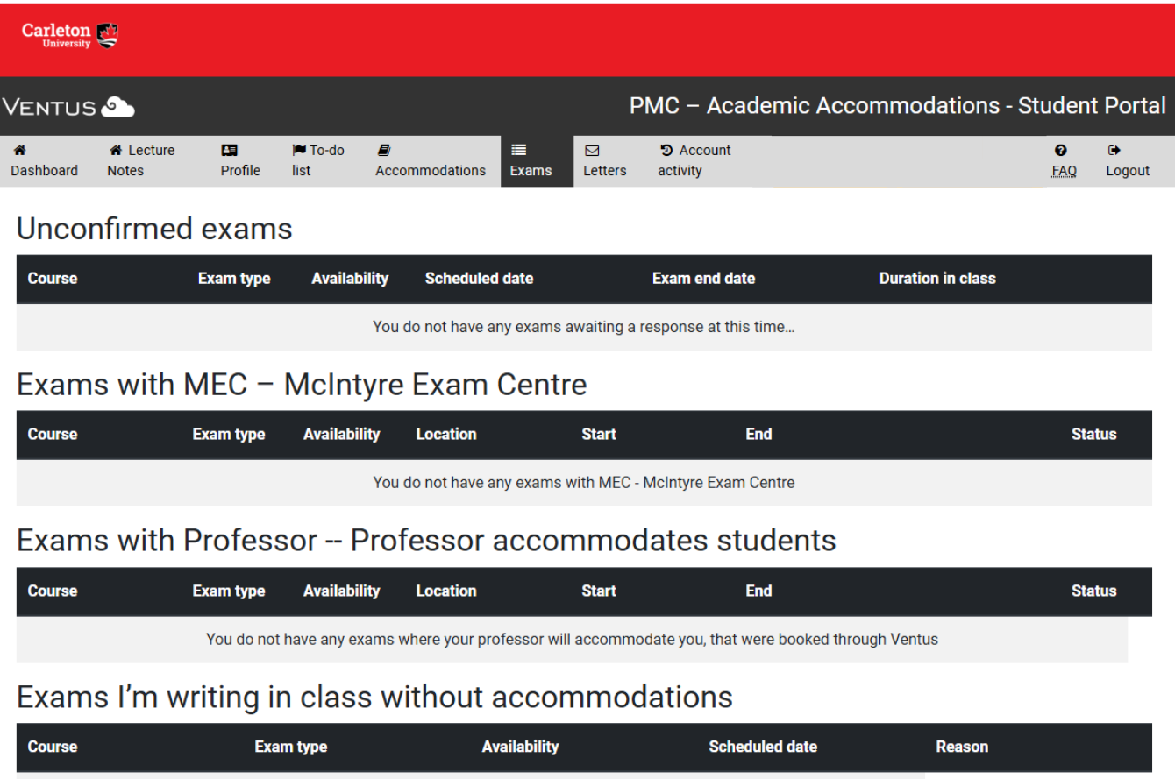
Exams Tab

Slide 20
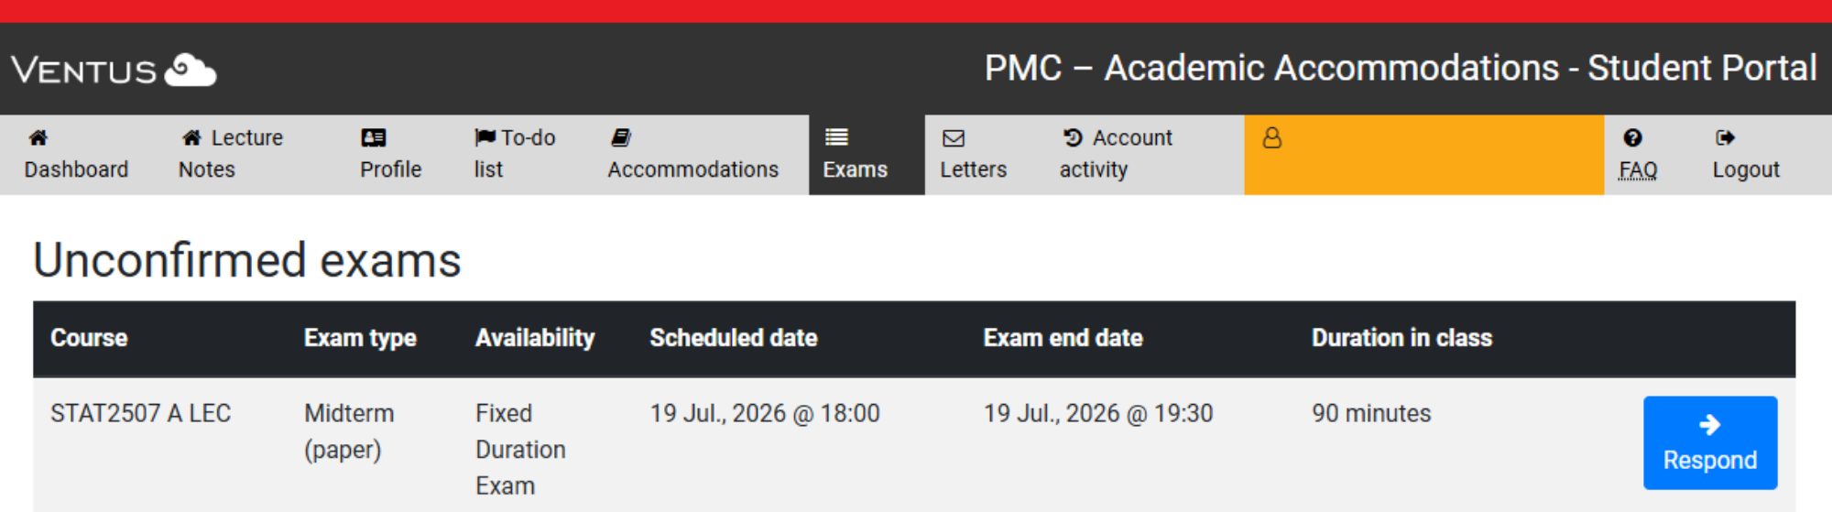
Unconfirmed Exams (1)
An exam appears in Unconfirmed Exams when:
Your instructor has submitted an NoE through Ventus.
You have approved exam accommodations for that course.

Slide 21
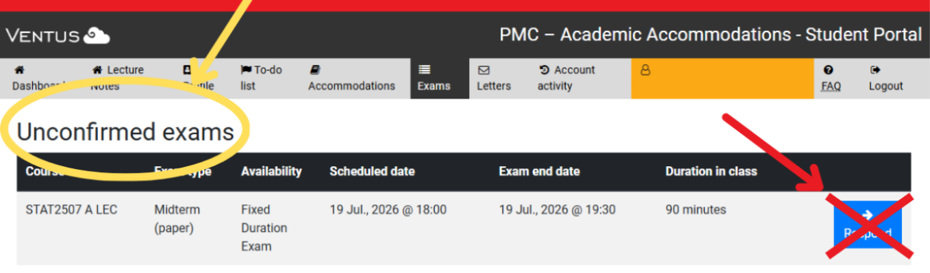
Unconfirmed Exams (2)
If you want to use your approved accommodations for the exam, no action is required. Your accommodations will be applied automatically.

Slide 22
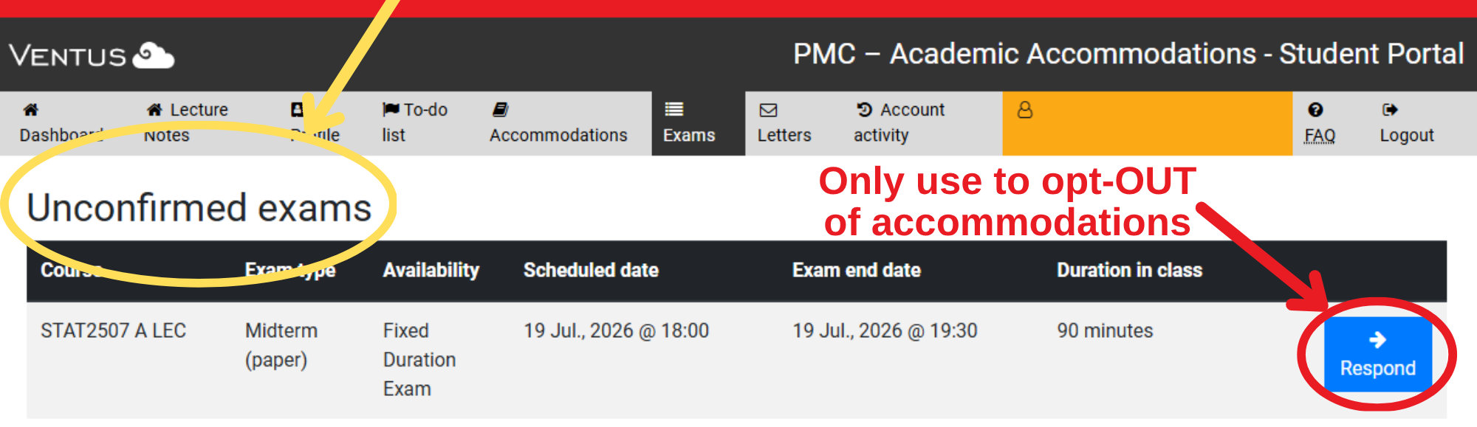
Unconfirmed Exams (3)
If you do not want to use your accommodations for a specific exam, click the blue “Respond” button.

Slide 23
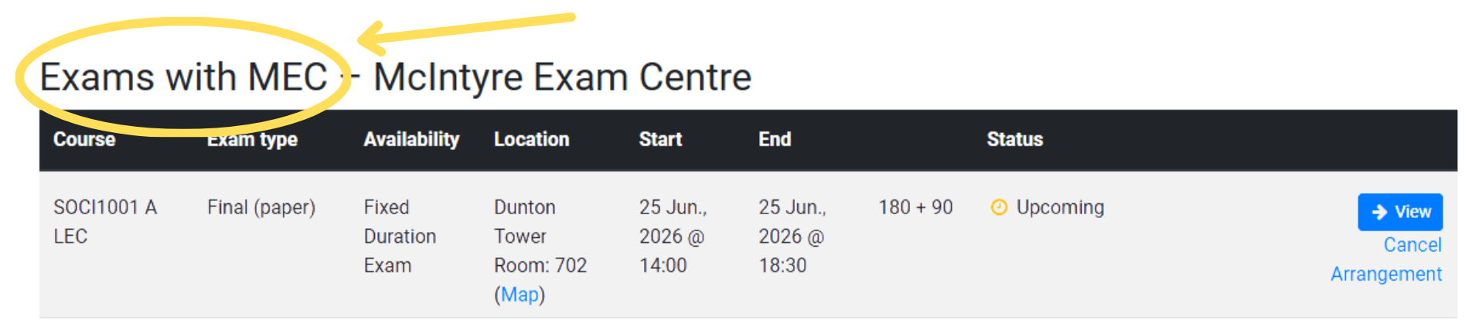
Exams with MEC – McIntyre Exam Centre (1)
Your approved exam accommodations are automatically applied to each exam.
10 business days before your exam, it will move to the “Exams with MEC – McIntyre Exam Centre” section.

Slide 24
Exams with MEC – McIntyre Exam Centre (1.5)
The blue “View” button shows the accommodations approved for that exam.
The exam location will show as “Waiting” until MEC assigns your seat.
Do not click “Cancel Accommodations” unless you plan to write the exam without accommodations.

Slide 25
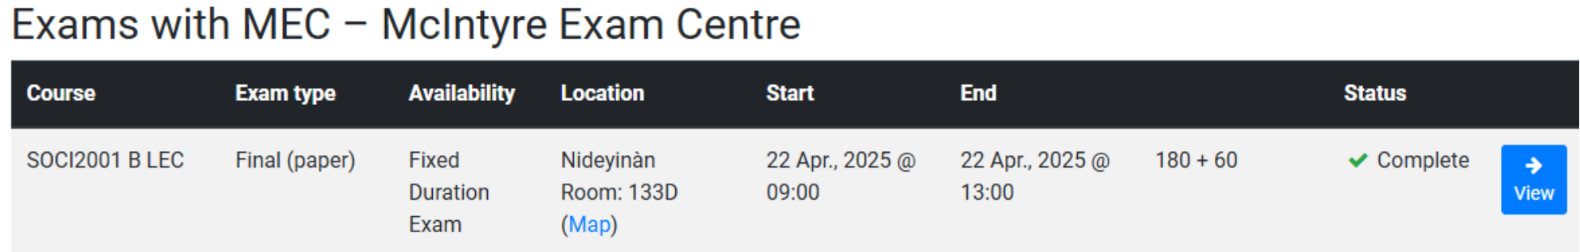
Exams with MEC – McIntyre Exam Centre (2)
3 business days before your exam, login to Ventus to check your exam location and accommodations.
If you see any problems with your exam accommodations, contact your Coordinator immediately.

Slide 26
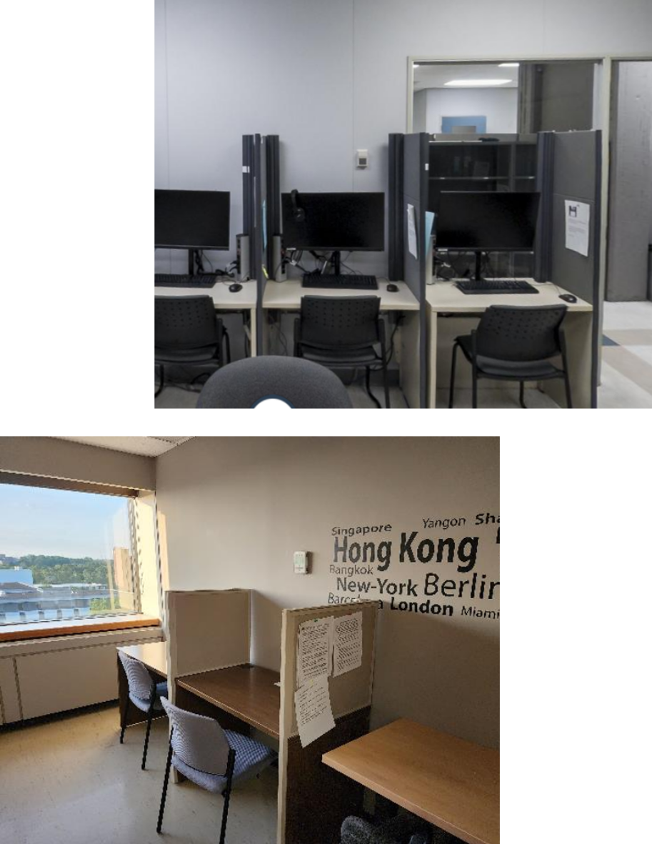
McIntyre Exam Centre
MEC supports students and instructors by providing test and exam accommodations.
They have two main sites
  Nideyinàn – Room 133
  Dunton Tower Rooms – 7th floor
Exams at MEC: Student FAQ

Slide 27
Roles & Responsibilities
Your Coordinator will:
Create your accommodations template in Ventus
Approve your accommodations for each course, if necessary
Make arrangements for accommodations (once an NoE is received)
Post your exam location and accommodation details in Ventus
Your Course Instructor will:
View your classroom and exam accommodations in Ventus
Submit a Notice of Examination (NoE) for each exam
The McIntyre Exam Centre will:

Slide 28
Volunteer Notetaking Service
Click the Lecture Notes tab to view courses where you have requested volunteer notes.
Click the Notes button beside a course, then select a file name to view and download the notes.
If notes are missing or unclear, click “+Contact Notetaking Team” to report the issue.

Slide 29
Follow-up with Your PMC Coordinator
Stay connected throughout the term!
Advise your PMC Coordinator right away of any problems with your accommodations.
Monitor your academic progress and mental health during the term and reach out for help.

Slide 30
Stay Up-to-date!
Check your CMAIL regularly
Live feed on PMC website
Follow us @CarletonPMC

