Slide 1
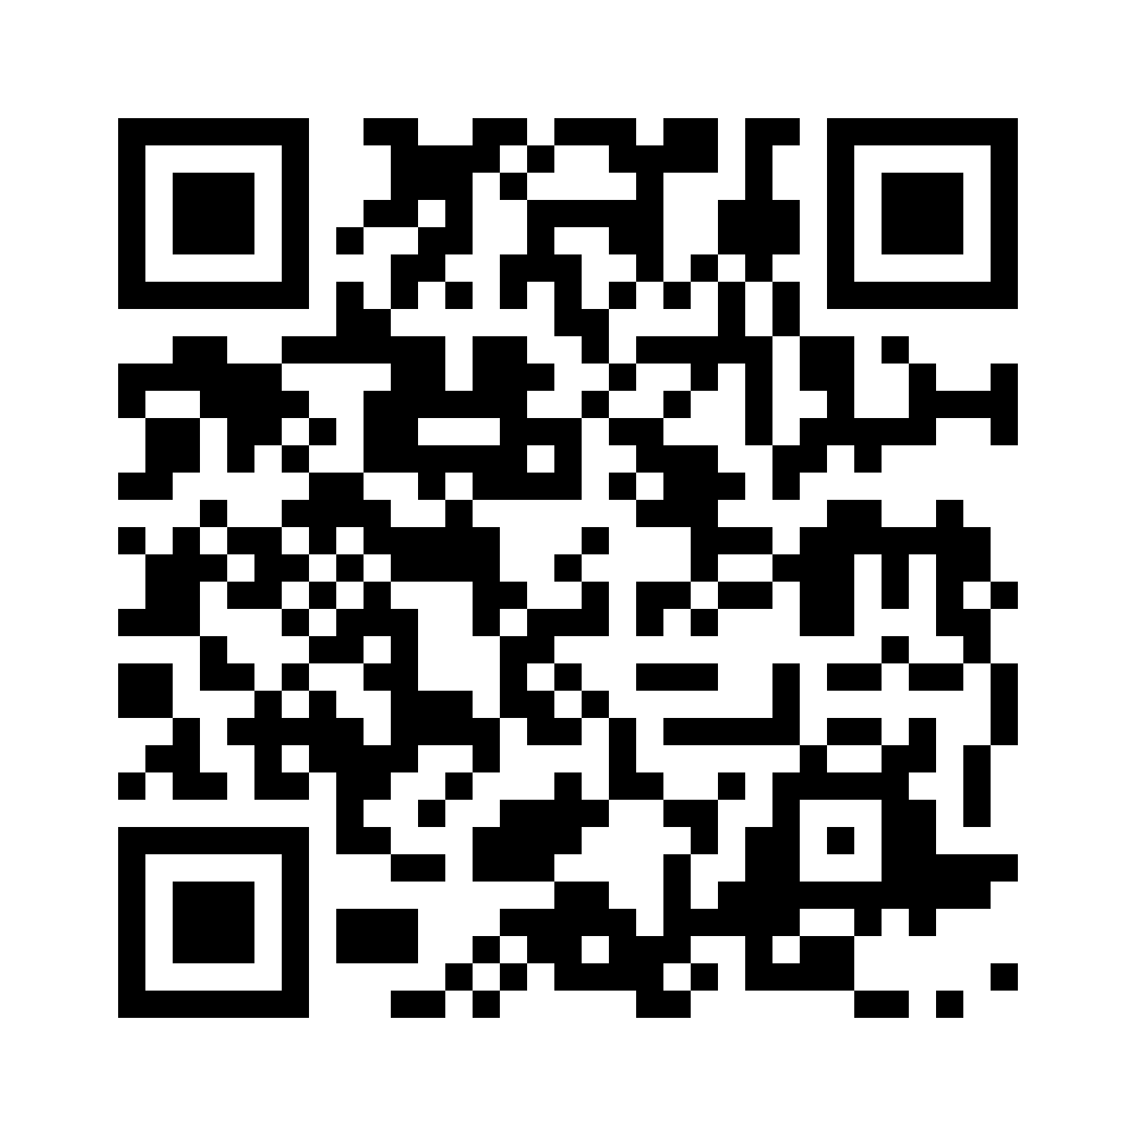
Welcome to
PMC Orientation!
The event will begin at 9:00 AM
Scan here for event resources:
Scan here for live captions:

Slide 2
Agenda
Director’s Welcome
Faculty Presentation – Transitioning to University
Breakout Session Instructions
Break
Breakout Sessions (3 rounds)
Announcements
Break
Student Panel
Wrap-Up & Mini-Fair

Slide 3
Welcome
Bruce Hamm
Director, Paul Menton Centre for Students with Disabilities

Slide 4
Faculty Session
Rylee Oram
Assistant Professor (Psychology)

Slide 5


Slide 6
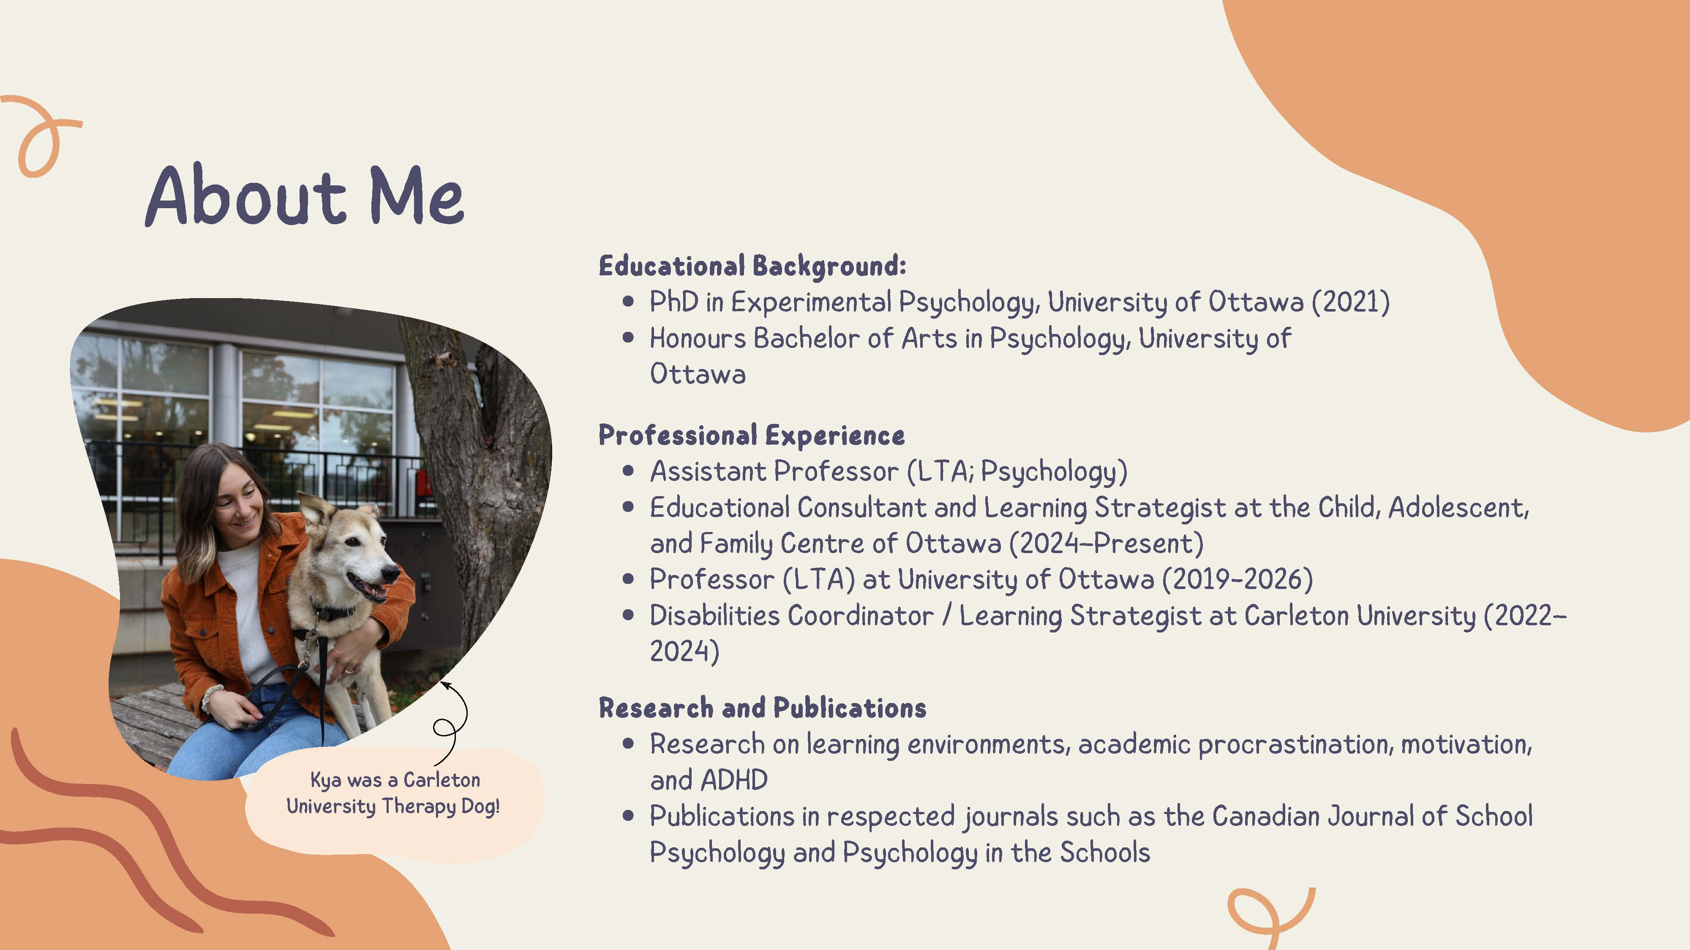

Slide 7
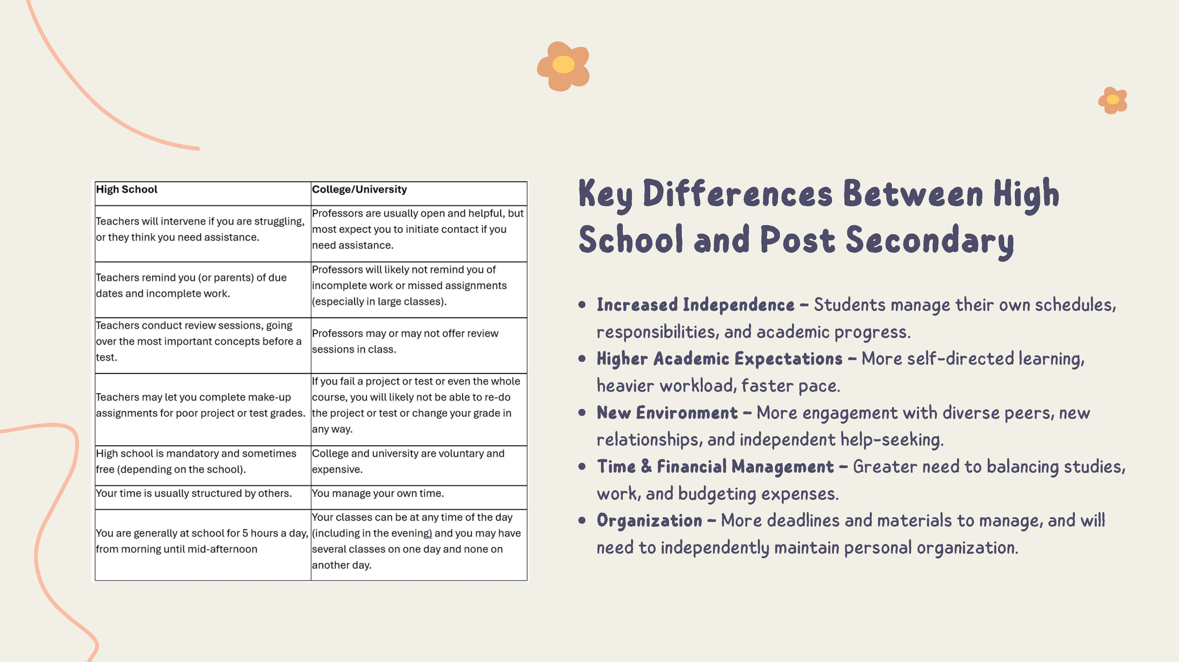

Slide 8


Slide 9
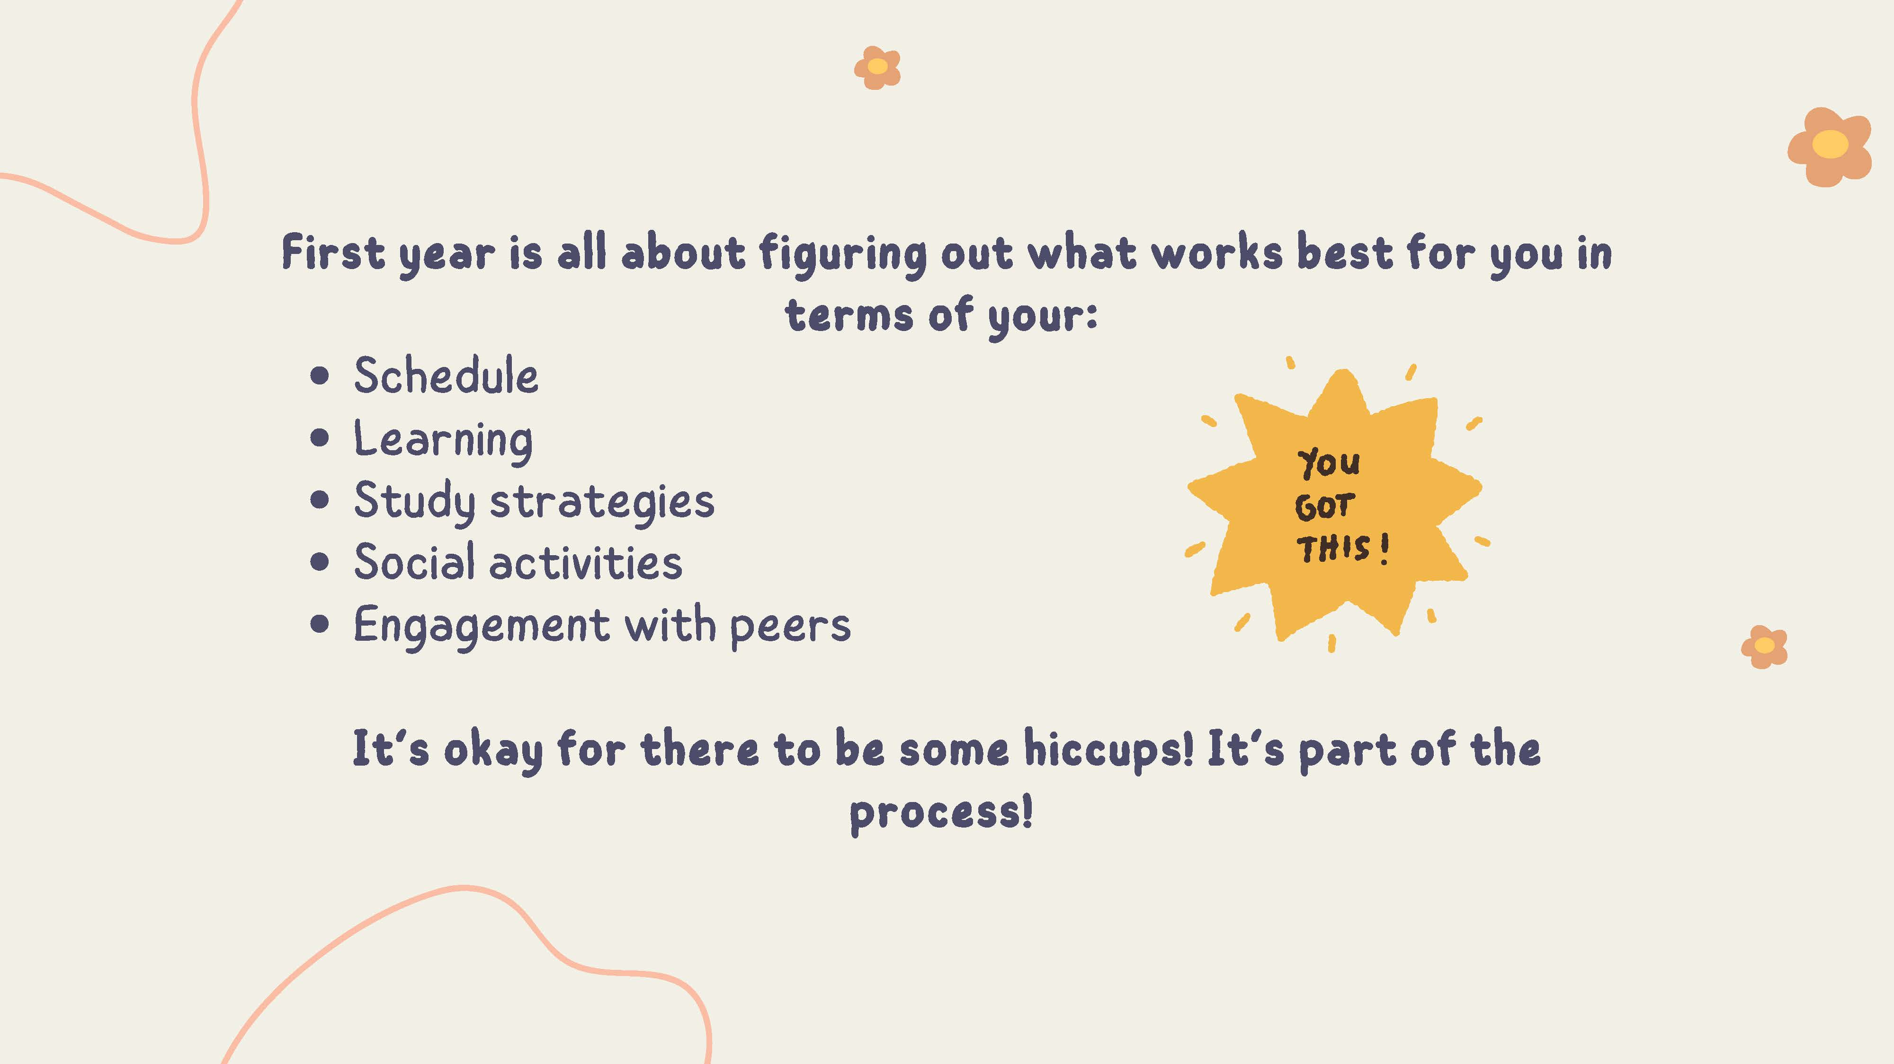

Slide 10
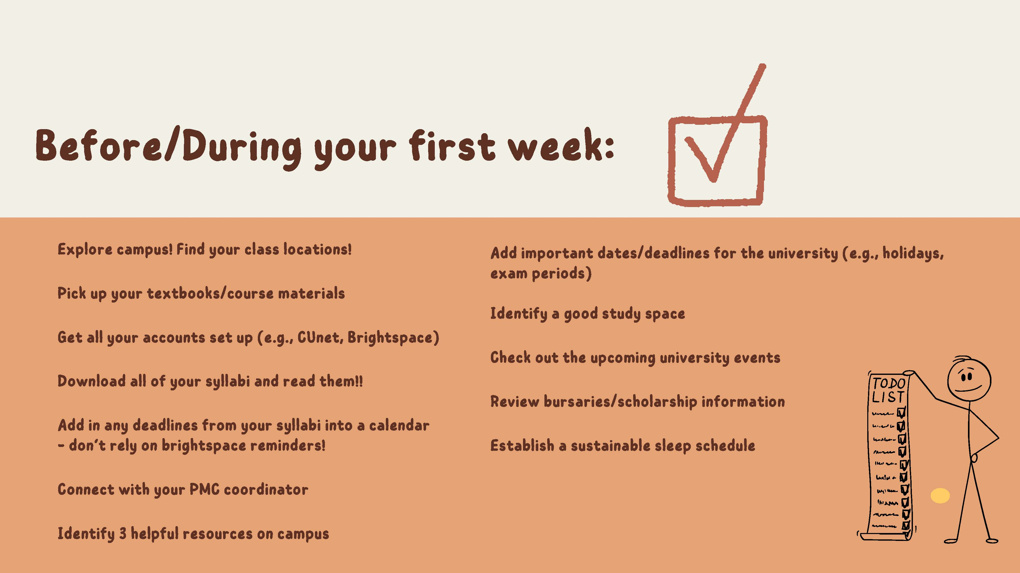

Slide 11


Slide 12
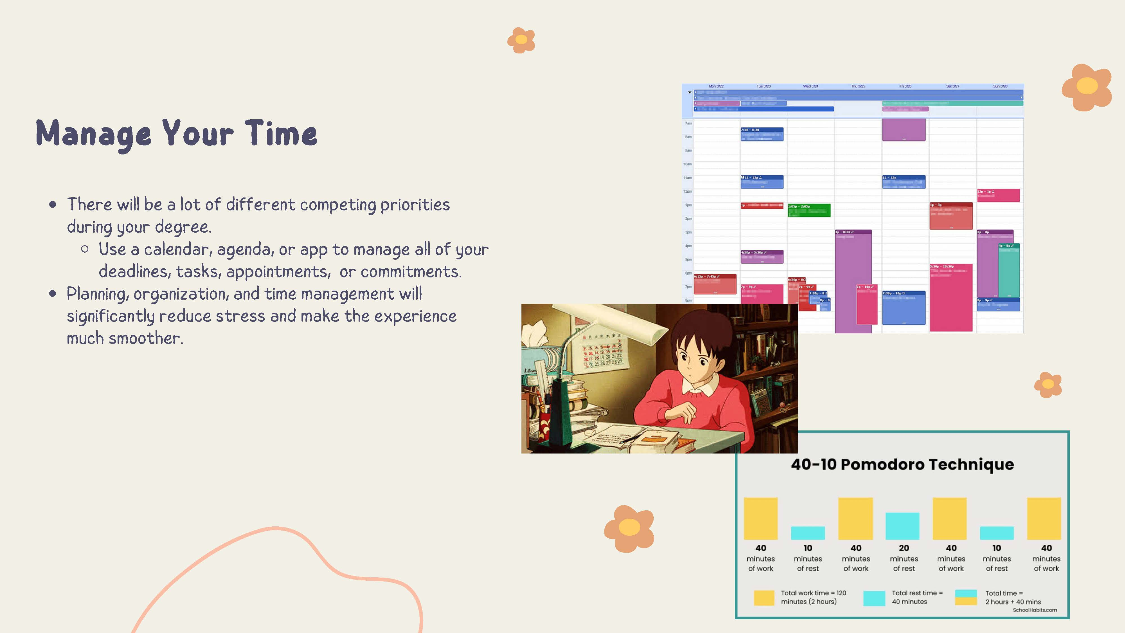

Slide 13
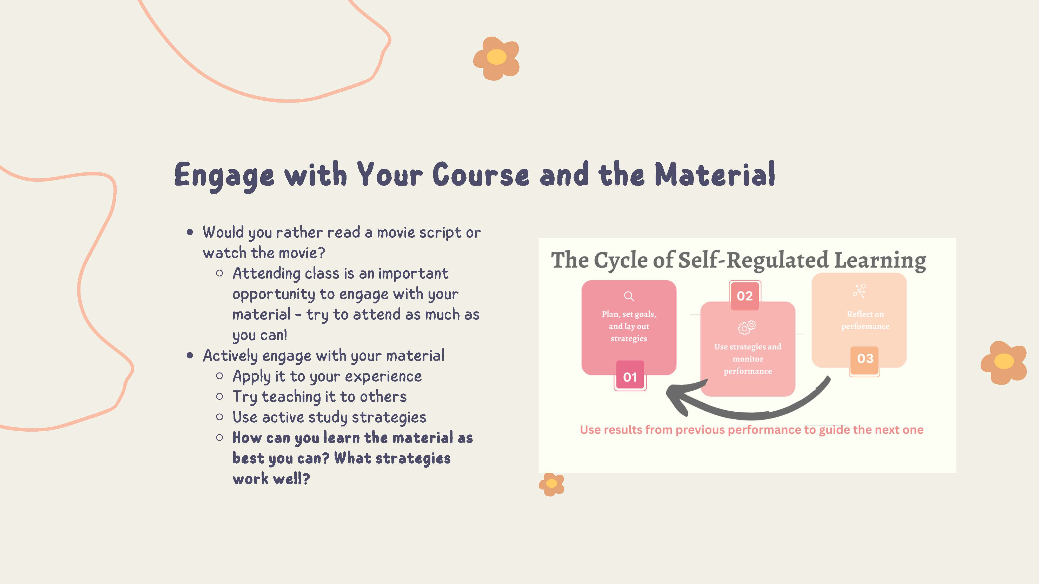

Slide 14


Slide 15


Slide 16
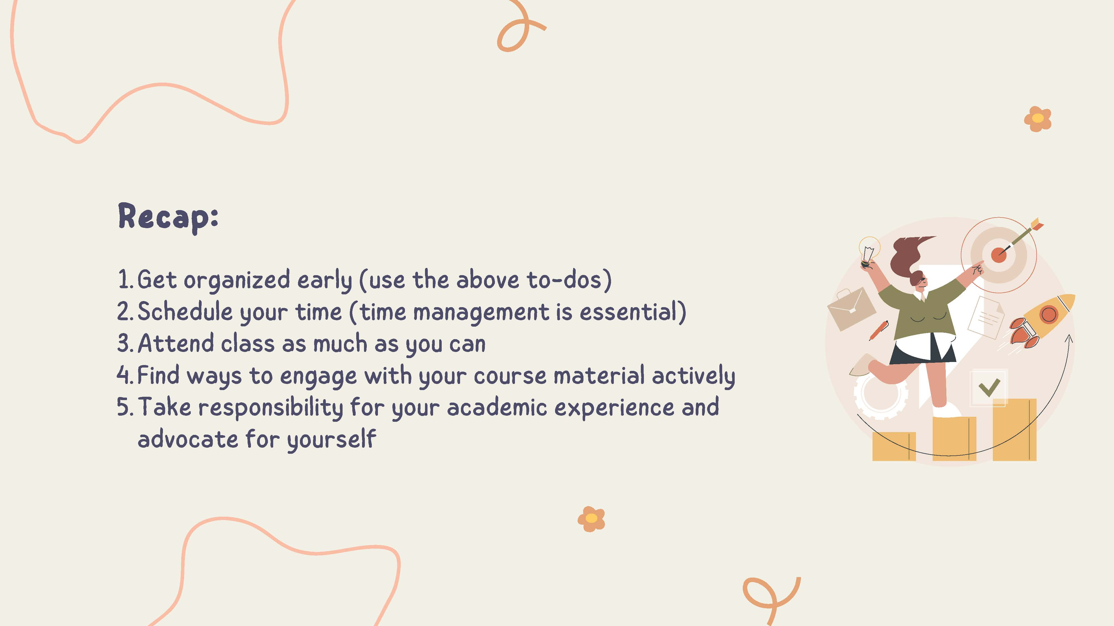

Slide 17


Slide 18
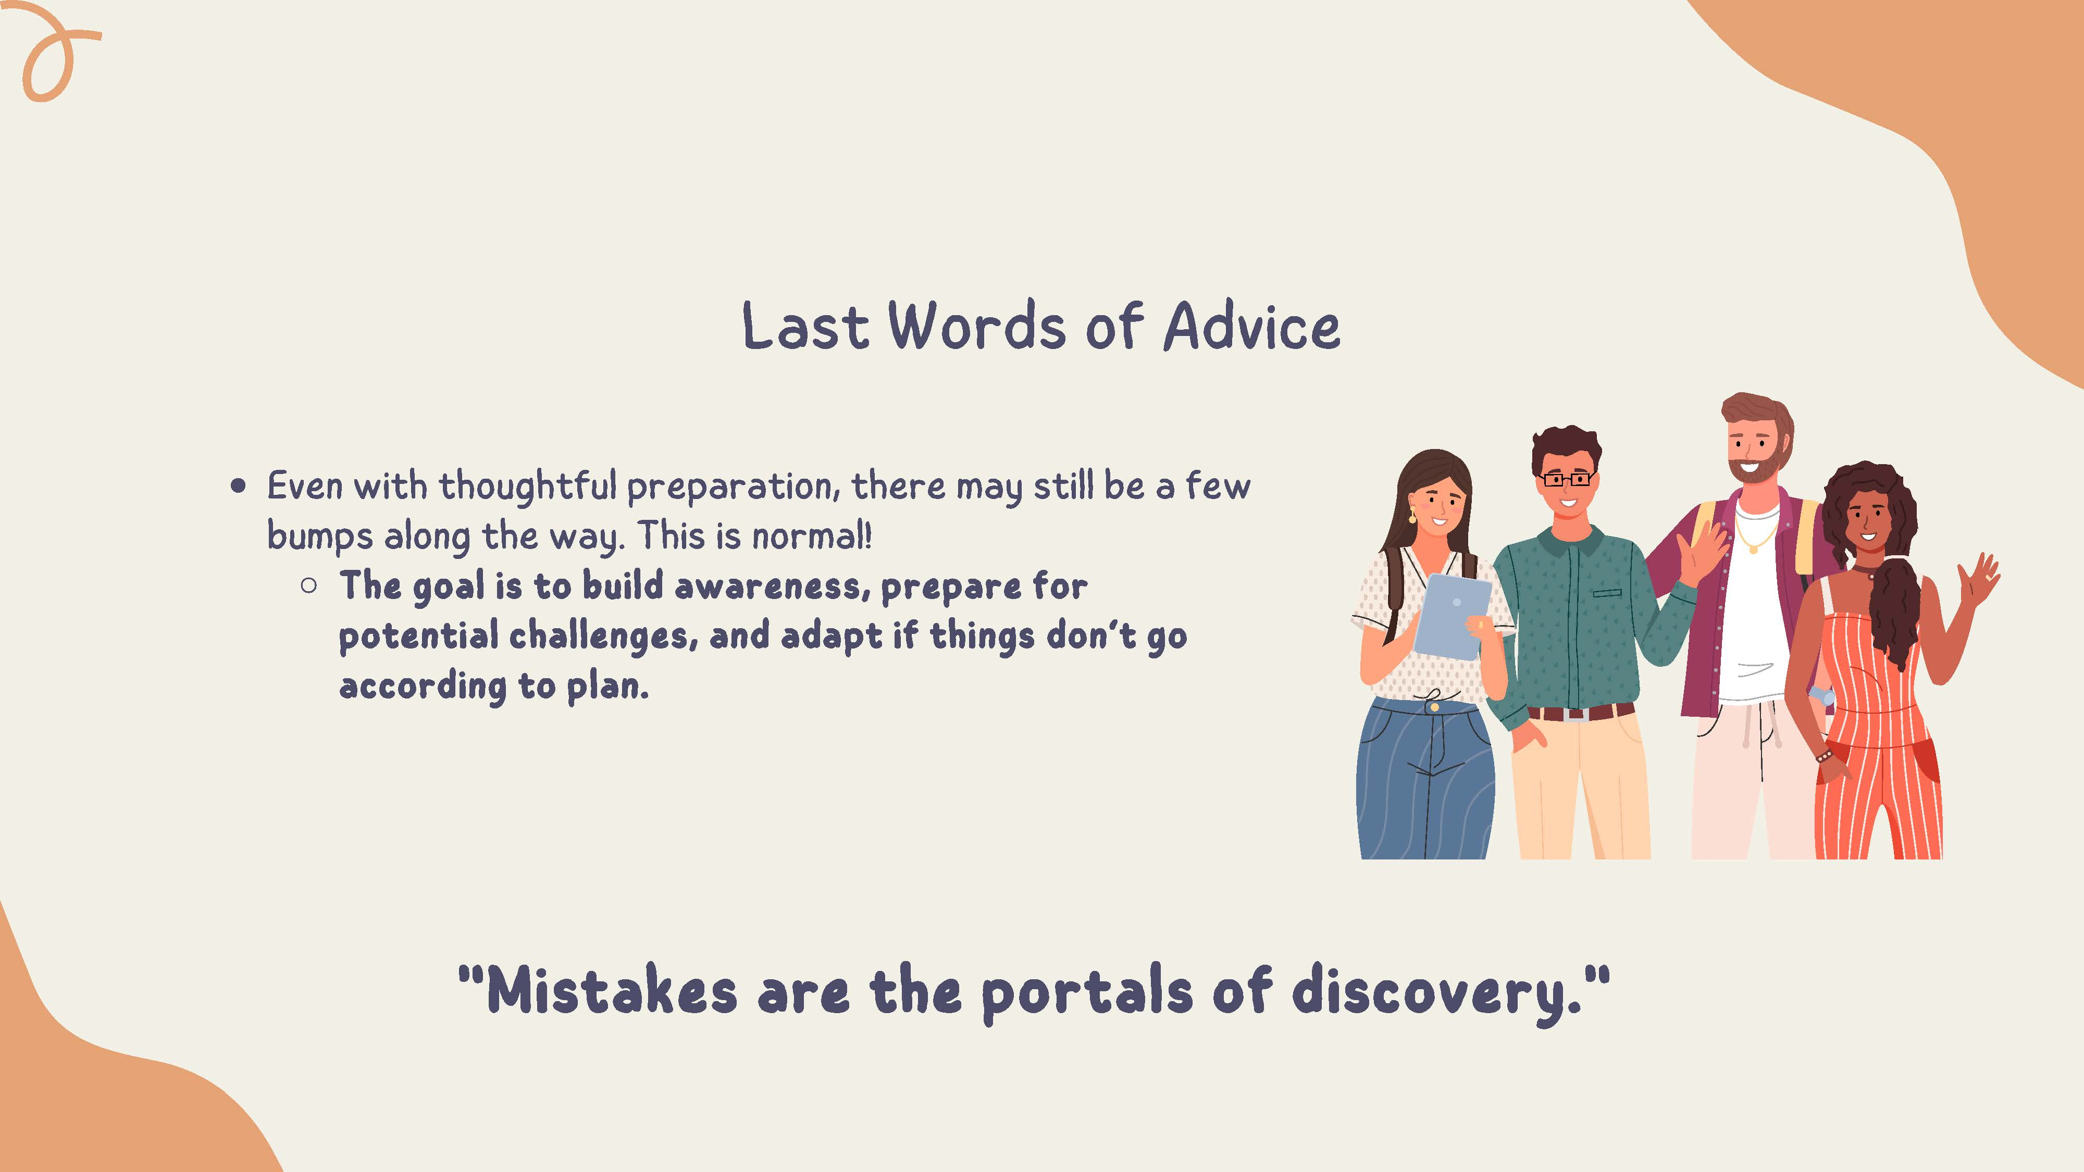

Slide 19


Slide 20


Slide 21
Breakout Session Schedule
Time | Tables: 1, 2, 3, 4 (Group A) | Tables: 5, 6, 7, 8 (Group B) | Tables: 9, 10, 11, 12 (Group C)
9:43 – 10:06 AM | RB 2228 | RB 2224 | RB 2220
10:11 – 10:34 AM | RB 2224 | RB 2220 | RB 2228
10:39 – 11:02 AM | RB 2220 | RB 2228 | RB 2224
Optional sessions for Graduate Students (RB 3228) and Parents/Support Persons (RB 3224) will take place during the first two rounds of Breakout Sessions.

Slide 22
Break
Please return to your seat by 11:10 AM

Slide 23
Student Panel and Q&A
Jasmina Molloy
Elliot Rizzo
Annie Loubier

Slide 24
Thank you for attending PMC Orientation!
The Mini-Fair runs until 12:30 PM

