Slide 1
Office of Associate Vice President Student Health and Wellness

Slide 2
Who we are
Paul Menton Centre(PMC) for students with disabilities
Health and Counselling services(HCS)
From intention to action (FITA) program
Attendant Care program
Care and Support Team
Mental Health Strategies and Initiatives, including Pet Therapy, Health Promotion, Wellness Desk in the Library and Spirituality Centre
Student at risk evaluation team (SARET)
Student Mental Health Framework (SMHF)

Slide 3
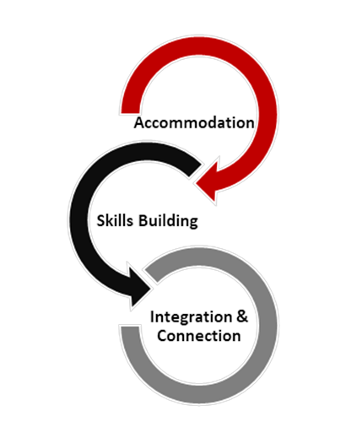
PMC’s Mandate & Core Functions
Provide individualized disability accommodations and support services while maintaining academic standards.
Provide skills building opportunities to foster independence and resilience in university and beyond.
Foster integration and connection to the greater-Carleton community by working with campus partners to build capacity to support students with disabilities.

Slide 4
Health Clinic Services
Health Services is a multidisciplinary healthcare facility that provides medical services to Carleton University students, faculty and staff
Health Services includes a team of professionally trained patient care coordinators, nurses, lab technician, physicians and psychiatrists
Services include access to same-day appointments, primary care appointments, nursing visits and lab testing
Types of services and more information can be found on the website
Website: wellness.carleton.ca/health/health-clinic-services
Call: 613-520-6674 ext. 0 to book an appointment or through the Telus Health Connect App or Website
Location: 2600 Carleton Technology and Training Centre
Monday to Friday 8:30 a.m. to 4:30 p.m.

Slide 5
Counselling Services
Counselling Services provides a wide range of accessible mental health services that align with the Stepped Care approach to student wellness
Mental health services include Single-Session counselling, brief individual counselling, group counselling, psycho-educational events and programs, workshops, and online resources
Counselling Services does not have the capacity to support students long-term due to the high demand for mental health services
Website: wellness.carleton.ca/counselling
Location: 2500 Carleton Technology and Training Centre
Book: through the Telus Health Connect App or website.
Phone: 613-520-6674 ext. 2.
If you live in Residence, please call 613-520-2600 ext. 8061 to book a session.

Slide 6
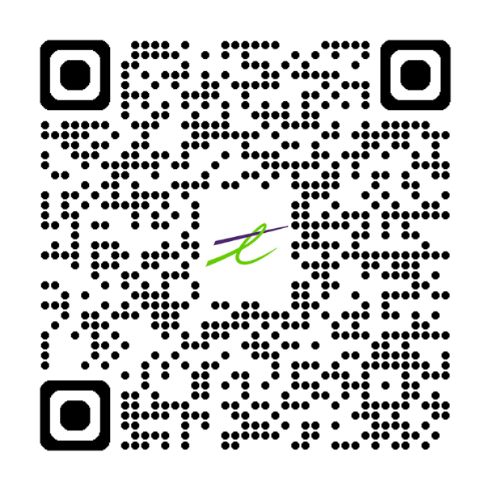
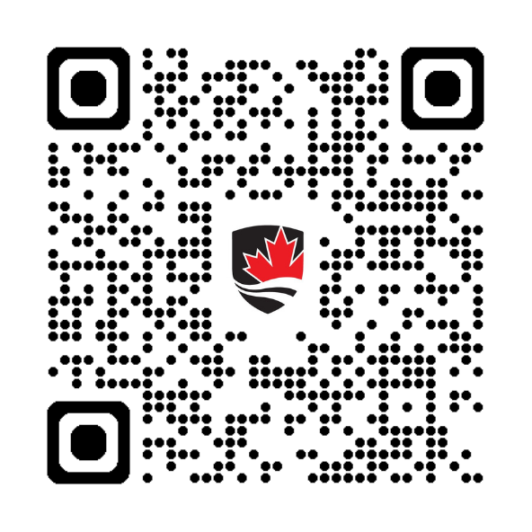
Health and Counselling QR Codes
Download the ‘TELUS Health Connect’ app
Visit the HCS Wellness Website

Slide 7
From Intention To Action (FITA)
T: 613-520-2600 x1028
E: fitaction@Carleton.ca
What is FITA?
Mental health support program with 5-10 sessions of counselling/psychotherapy for registered students
Three categories of students in the program: Academic Warning, Overwhelmed, or Both
Typical presenting concerns: anxiety, depression, perfectionism, shame, self-worth/esteem, procrastination, learning disabilities, disordered eating, grief, relational concerns, sexuality, culture, health

Slide 8
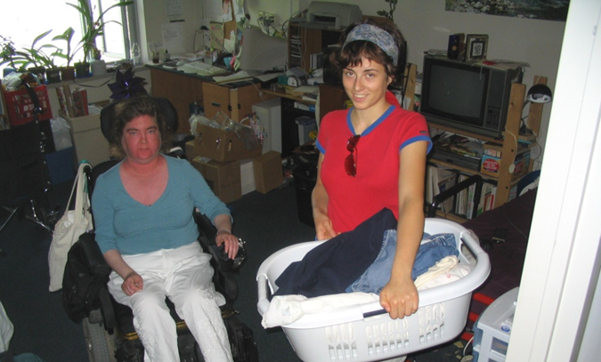
Attendant Care Program
Carleton University offers personal care services, like a long-term care centre but is located on campus in our residence community.
The service operates 24/7 365 at no cost to Ontario students with physical disabilities and is funded from Ontario Health and Long-Term Care.

Slide 9
Care and Support
Case Managers work one-on-one with students to
  identify and assess their various needs
  facilitate access to supports
  follow-up with students, as needed
Students can be referred to the Care and Support team by accessing the online Care Report Form: wellness.carleton.ca/care-report
Email: wellness@carleton.ca
Location: 3600 Carleton Technology and Training Centre
Website: wellness.carleton.ca/mental-health/student-care-and-support-team

Slide 10
Health Promotion
The Health Promotion team provides opportunities for students to build "wellness toolbox"
  Awareness, knowledge and skills
Educational content through workshops, events and media at various locations on campus
CUSA Wellness Centre Staff and Carleton’s Health Promotion Team will be available at the Wellness Centre, Monday through Friday. Students can engage in peer support, skill building opportunities, and health promotion activities in a student-centered environment to increase multiple dimensions of well-being. Grad students are welcome to attend.
Website: wellness.carleton.ca/health-promotion
Email: wellness@carleton.ca

Slide 11

Spirituality Centre
Support for exploring and cultivating spiritual wellbeing and identity
Welcoming space for all, regardless of faith affiliation
Meet the Chaplains by office hours or by appointment
Website: wellness.carleton.ca/spirituality
Location: Tory Building T27

Slide 12

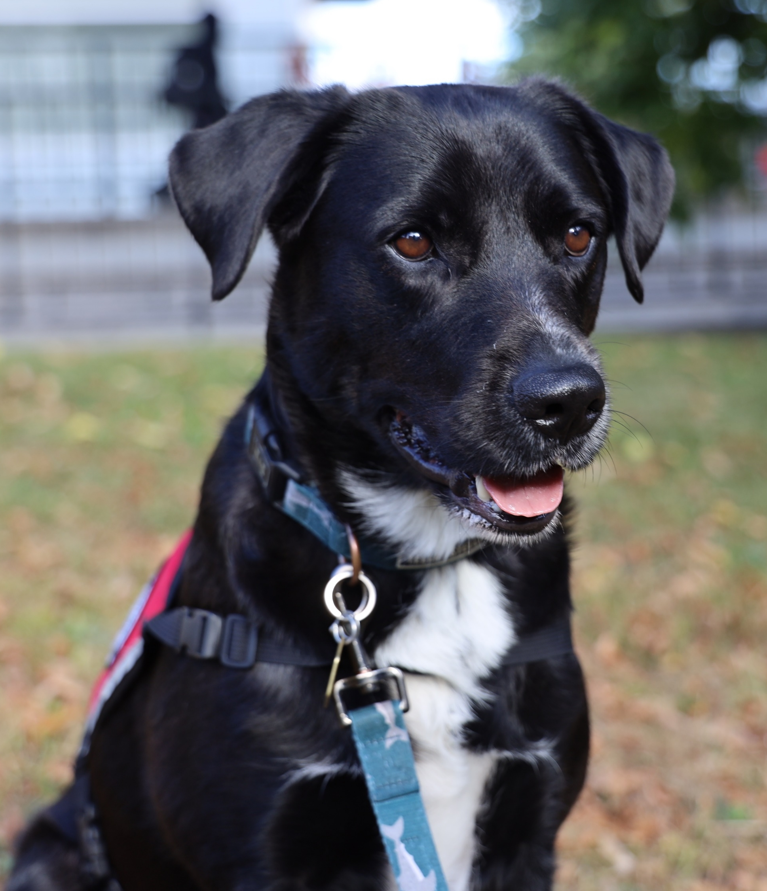

Therapy Dogs
Mental health and wellness support
Dogs are handled by professional staff and faculty members
Handlers work to create welcoming, supportive and low intensity environments
Aristotle
Website: wellness.carleton.ca/mental-health/therapy-dogs
Email: wellness@carleton.ca
Location: Office hours on website
Porter

Slide 13
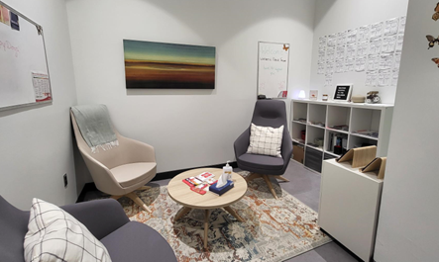
Wellness Desk
Not sure where to start? The Wellness Desk can help!
We understand it might be a little overwhelming when trying to find support
Our team of Wellness Navigators can help you work through what resources might be of most help for your current situation
Engage in wellness activities and programming in the space
You can pop into the Wellness Desk any time during its hours of operation – no appointments necessary!
Online: wellness.carleton.ca/wellness-desk
Location: 204A MacOdrum Library
Email: wellness@carleton.ca

Slide 14
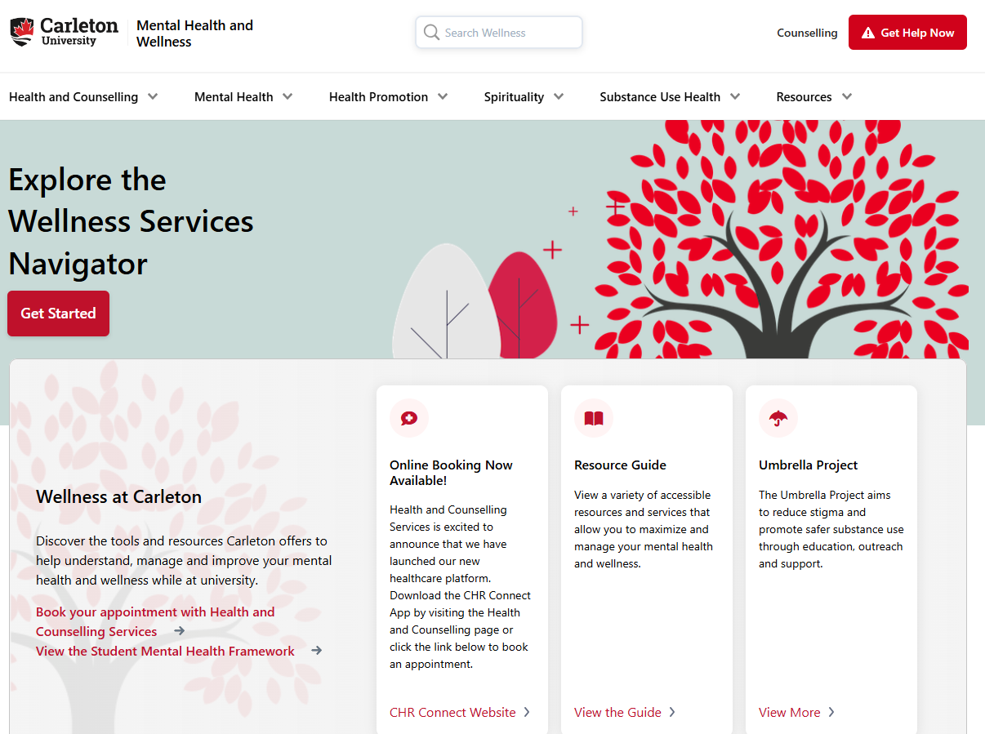
Wellness Services Navigator
Online tool designed to provide user a curated list of relevant mental health and wellness resources
Wellness.carleton.ca/navigator
Not suitable for crisis or urgent support

Slide 15
SARET
The Student-at Risk-Evaluation Team (SARET) plays a key role in ensuring that these responses are carried out in a timely, compassionate, and effective manner. This policy serves as a guiding framework for the University's approach to supporting students who may be identified as potentially at risk.
A student is considered at risk when such factors hinder their ability to engage with the academic curriculum and/or lead to violations of university policies.
The SARET reviews matters where a student’s actions have caused harm to oneself and/or others—or have the potential to cause—physical, emotional, or psychological harm to the student or to the safety and well-being of the broader university community.

Slide 16
Great Resource
“Rethinking Resilience” is an online, interactive, self-paces course using videos, interactive activities, and reflections. This course will be offered as CCR credit, for any student who wants to take it!
Complete the module to earn CCR credit and boost both your well-being and your résumé.
Rethinking Resilience Module is discoverable! https://brightspace.carleton.ca/d2l/le/discovery/view/course/392715
If you go to Brightspace -> Discover --> Rethinking resilience, you should be able to find it.

Slide 17
SMHF 2022-2026
The Student Mental Health and Wellness Framework(2022-2026) is a guideline intended for our whole community to use in creating, promoting or engaging students in mental health and wellness
Our Areas of Focus include:
  Student Engagement (6 recommendations)
  Building Skills and Strengthening Resilience (7 recommendations)
  Coordinated student support and services (7 recommendations)
  Campus culture of wellness (10 recommendations)
This fall we are embarking on our new Framework that will take us through to 2031

Slide 18
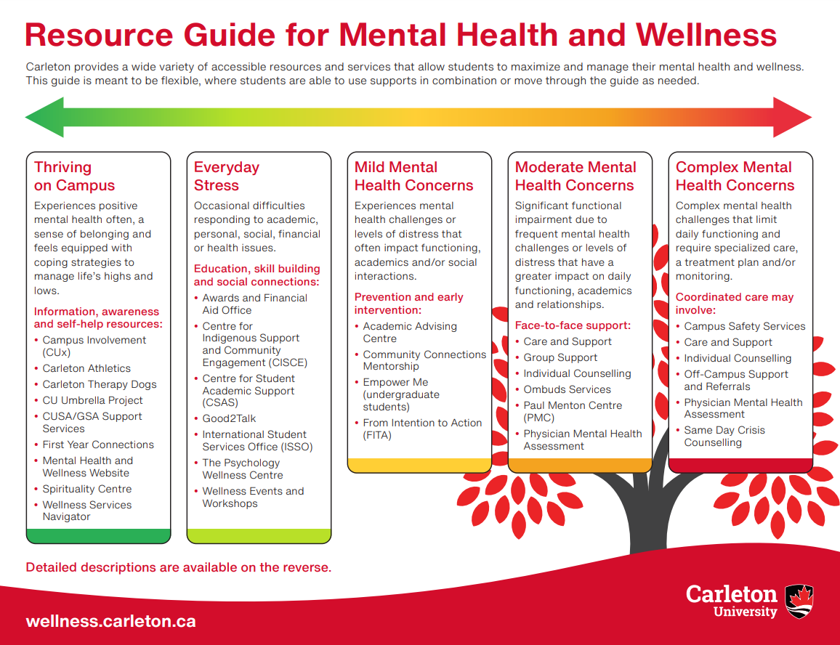
Resource Guide for Mental Health and Wellness
Thriving on Campus
Everyday Stress
Mild Mental Health Concerns
Moderate Mental Health Concerns
Complex Mental Health Concerns

Slide 19
Q & A and
Thank you

