Slide 1
FIPPA & You
Student Privacy Awareness

Slide 2
Legislation
Purposes

Slide 3
Legislation
Freedom of Information and Protection of Privacy Act (FIPPA)
Two purposes:
Provides right of access to institutional information
Protects personal information held by institutions and provides right of access to personal information
Oversight through an officer of the Ontario Legislature, the Information and Privacy Commissioner of Ontario (IPC)

Slide 4
Legislation - Purposes
FIPPA Purpose #1
Right of Access to General Info
Any ‘record’ in our custody or control is subject to be requested
$5 application fee; other fees may apply
Limited exemptions/exclusions

Slide 5
Legislation - Purposes
FIPPA Purpose #2
Privacy Protection and Right to Personal Information
Legal authority to collect: Carleton University Act, others may apply
Sets minimum retention rules (one year)
Rules for legal uses and disclosures
Right of Access and Correction to own Personal Information (but not deletion)

Slide 6
Policies

Slide 7
Policies - ATIP
Access to Information and Privacy Policy, Sept. 2019
Goals/Objectives
Repeals all former privacy policies
Codifies employee responsibilities
New, expanded ‘Notice of Collection’
So… what’s changed?
Nothing – your obligations are the same now as before

Slide 8
Policies - Others
Anti-Spam Compliance Policy, Sept 2024
Regulates sending of commercial electronic messages
Personal Health Information Processing Policy, Sept 2024
Regulates the handling of PHI (primarily for HCS, PMC, FiTA, but applies to any unit that collects PHI for admin (e.g. sick leave) or research purposes
Data Protection and Risk Management Policy, Nov 2023
Regulates all cloud computing purchases regardless of cost and data type
Mandates Data Protection Risk Assessments
ITS oversight, but broad Privacy overlap

Slide 9
Definitions

Slide 10
Definitions
Personal Information
Record information about an identifiable individual including, but not limited to;
race, age, sex, marital/family status, educational and employment history, financial transactions
any identifying number assigned to you (a.k.a. SIN, CUID #), phone number, address, fingerprints, blood type
your personal opinions and views, except where they relate to another individual, and views and opinions of another individual about the individual
Does not include business contact information.

Slide 11
Definitions
Record
Any record of information however recorded, whether in printed form, on film, or by electronic means or otherwise.
Hard Copy records include notebooks, binders, paper files, sticky notes
Electronic records include e-mails, PDFs, Excel or CSV documents, databases
Anything that is machine-readable (i.e. carpet samples)

Slide 12
Privacy “Inside” the Classroom

Slide 13
Attendance
Attendance is now tracked through a variety of sources via student’s username;
Brightspace
PollEV
Teams
Zoom
If course requirement, inform student via syllabus or through introductory message

Slide 14
Grades
Grades/marks should be posted to secure environments (e.g. Brightspace, departmental websites).
Pay attention to how grades are entered/shared;
E.g.: If uploading a “public” grade sheet, remove personal identifiers and use only last five of student ID (CUID)

Slide 15
Privacy between Classrooms

Slide 16
Discussing student academic information
If you do not have student consent, you may still discuss student information, but only with other employees whose duties/responsibilities extend to the student.
Known as the “Right to Know and Need to Know” Rule. Both criteria need to be met in order to discuss student information with others.

Slide 17
Discussing student academic information (cont’d)
Examples:
Instructor discusses student’s performance with the department chair to get advice on how to help the student succeed.
Undergrad admin provides list of students meeting honour roll requirements to the department chair to ensure students are appropriately recognized.
Instructor submits CARE report to Student Affairs as they’re concerned about the student’s well-being

Slide 18
Privacy Outside the Classroom

Slide 19
Student Services & Administration
Students will interact with various services throughout their academic journey with Carleton
Similar to academic-related data, admin-related data should only be shared either with consent from the student, or on a need-to-know and right-to-know basis.

Slide 20
Student Services & Administration
In addition to academic-related data, some Student Services or Administration Units collect these additional data elements;
Health data (accommodations, allergies)
Demographic data (address, nationality)
Collect information via secure methods only (CMAIL, over the phone*, secure web upload)

Slide 21
Student Services & Administration (Cont’d)
Examples of permissible disclosures;
Parent calls to find out information about their student. As the parent is identified on third party release form, the disclosure is permitted as consent has been received from the student.
Academic Advising Centre refers student to Departmental Advisor. Disclosure of AAC notes to DA is permitted as they require history of discussion to assist student with course selections. Need-to-know and Right-to-know criteria met.

Slide 22
Forms, Procedures and Tools

Slide 23
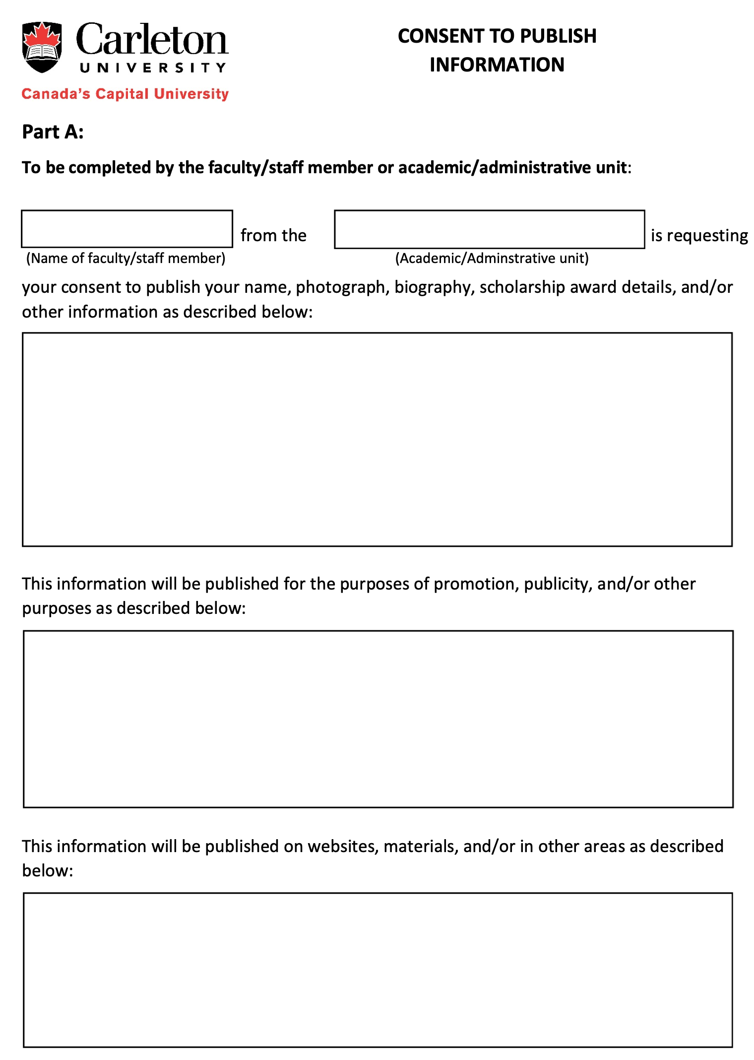
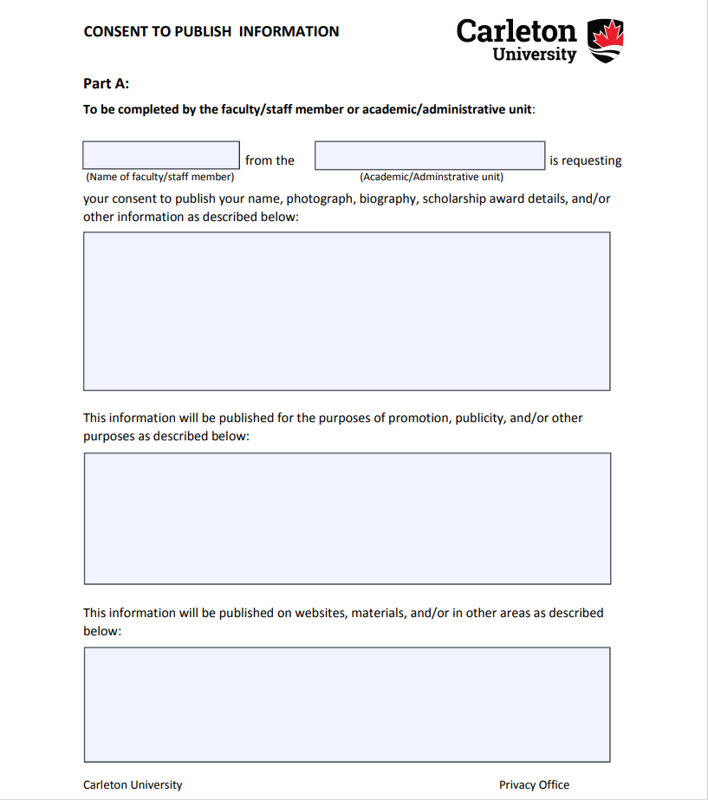
Publishing Student Info & References
Consent is always required to publish student info or to provide references.
This includes student biographies, research, etc.
Consent can be obtained;
Via e-mail through CMAIL
Using a “Consent to Publish Information” form
Typed consent letter
Verbally, over the phone
Duty to Document

Slide 24
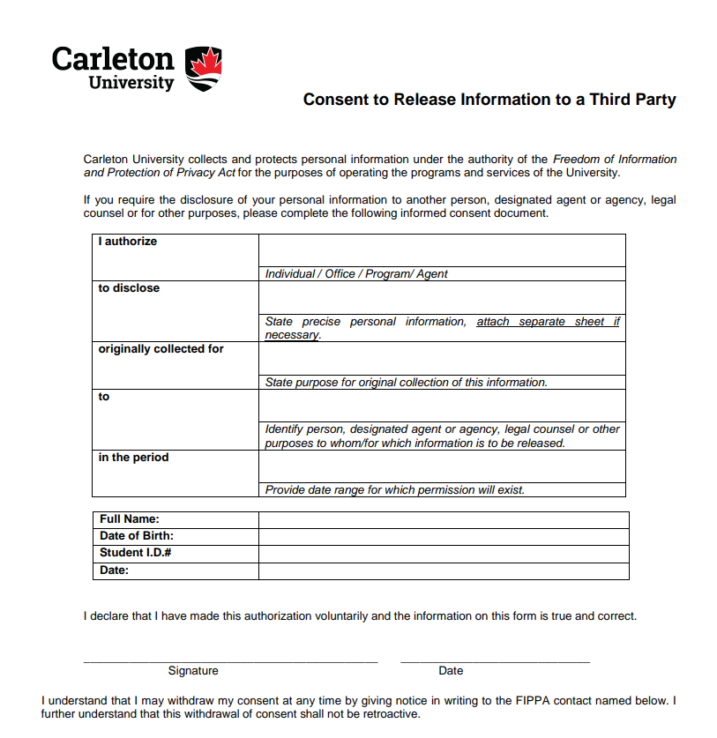
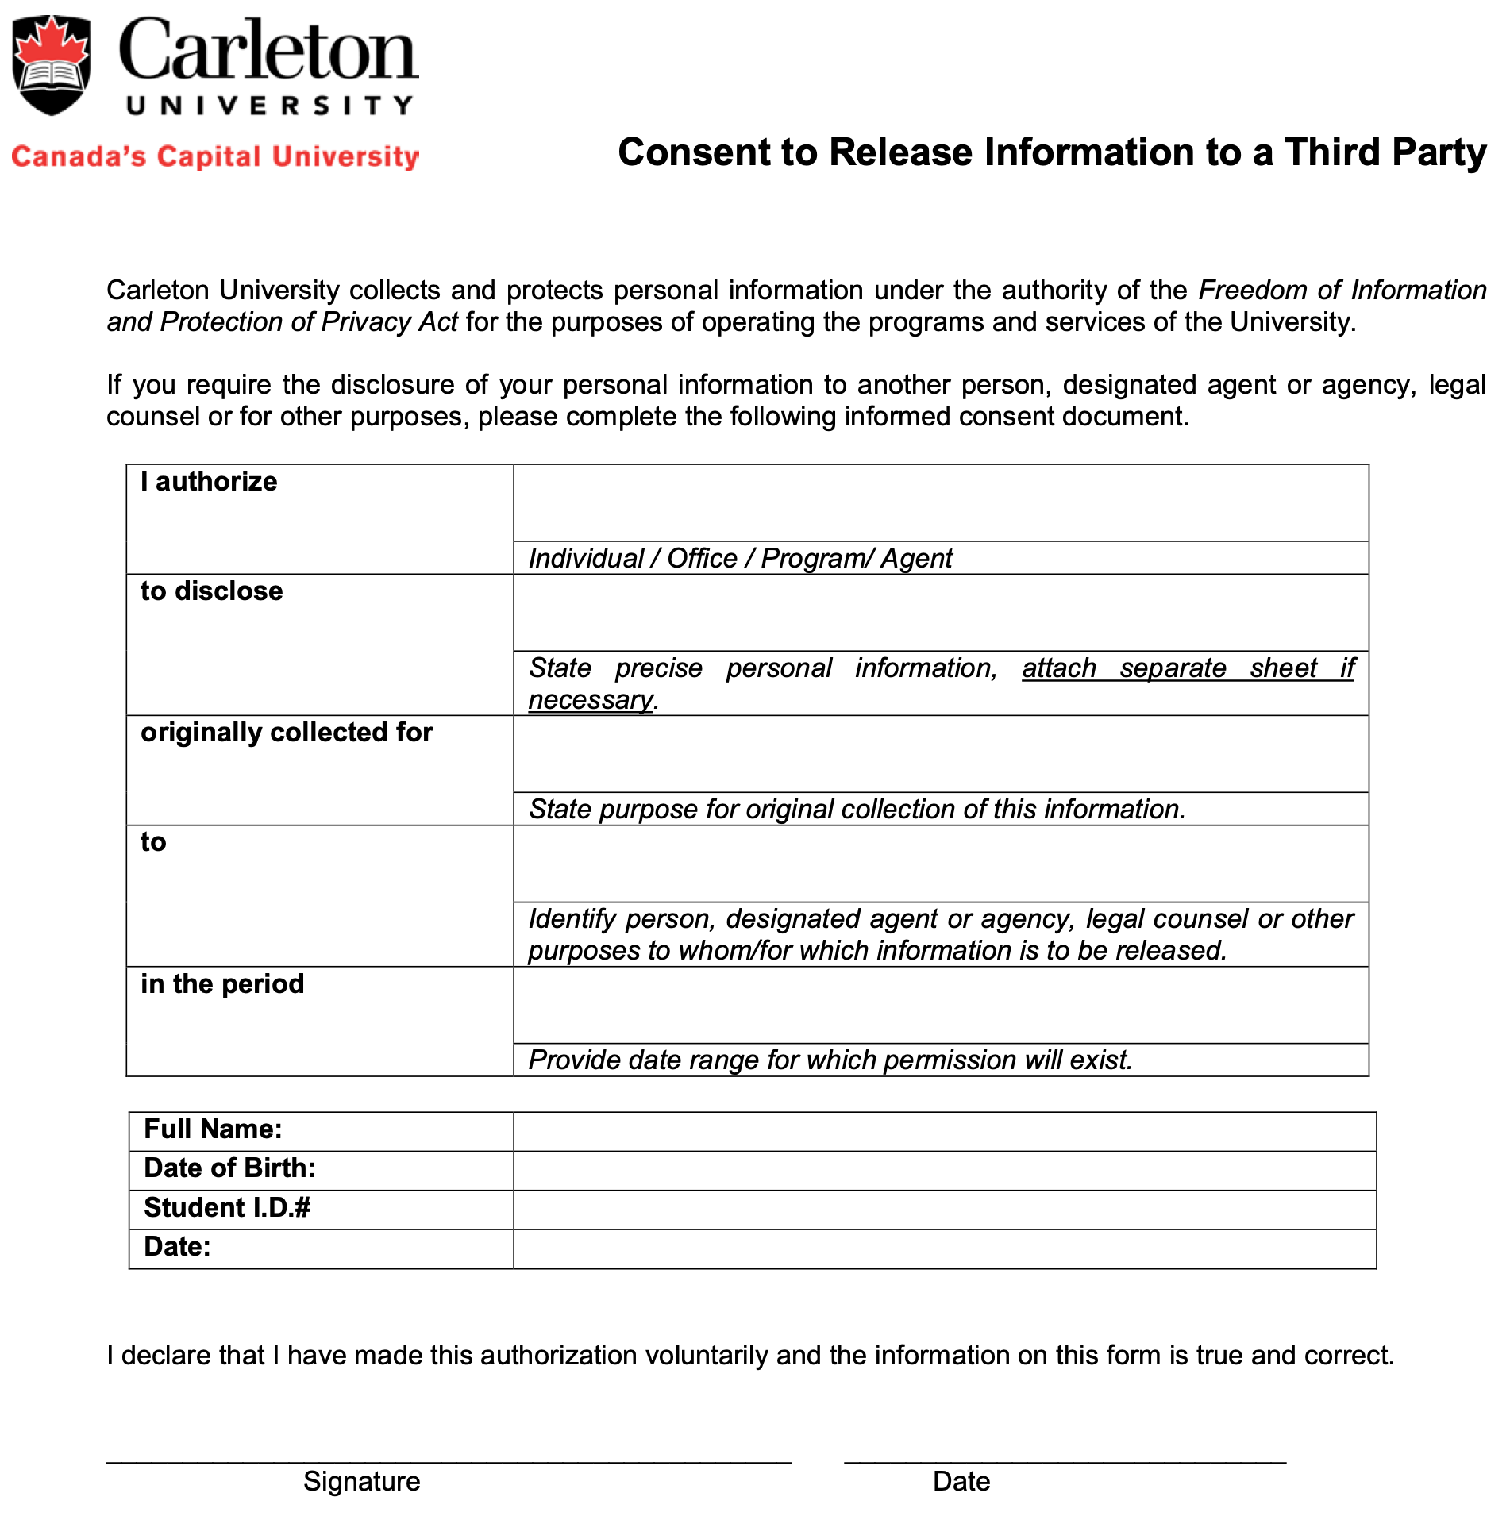
Third Party Release Authorization
FIPPA does not allow the disclosure of Personal Information to third parties without the consent of the individual involved.
Occasionally, students require disclosure of their Personal Information to a Third Party.
E.g. Employment verification, academic reference, tuition fee balances.
Students can use the following;
Electronically via the Carleton360 portal, or
In writing using a Third Party Release Authorization Form

Slide 25
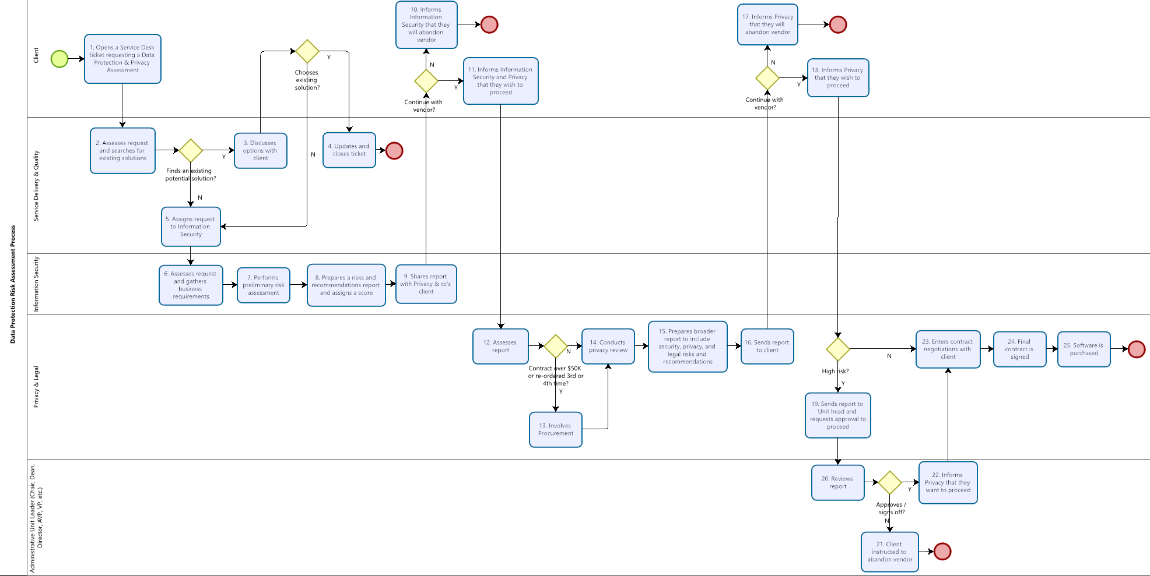
Data Protection Risk Assessments
Data Protection and Risk Management Policy Requirement
DPRAs are a joint initiative between the Privacy Office and ITS Security Governance team.
Required for ANY cloud computing (SaaS, IaaS, etc.) products regardless of cost, data processed and use-case.
Based on university’s Risk Management Policy and associated risk frameworks.
Should be completed at the start of a project, not the end.

Slide 26
Statutory Requirements

Slide 27
Government/Law Enforcement
Can I disclose personal info to government or law enforcement officials?
Yes, but only with consent of the student, or if they have the authority to collect the information.
If no consent, they must present a written request for the information. Written request must cite their legal authority to collect the information.
E.g. Canada Revenue Agency authority is the Income Tax Act
If in doubt, re-direct government/law enforcement official to Privacy Office.

Slide 28
Emergencies
Can I disclose personal info in an emergency situation?
YES. Where the health and safety of the individual is in jeopardy, consent is not required to disclose.
Example: If you need to call 4444 (Campus Safety) or 9-1-1, you are permitted to disclose the facts present (student name, aged x, male/female, reason for call).

Slide 29
Emergencies
Can I disclose personal info in an emergency situation? (cont’d)
Additionally, disclosure to the emergency contact is also allowed due to two reasons;
At time of collection, student provided consent to Carleton to contact emergency contact in emergencies involving the student; AND
At time of emergency, info is disclosed to emergency contact under “compassionate circumstance” rule in FIPPA.

Slide 30
Privacy Office Services
Advice & Guidance
Drafting and Reviews of Privacy Notices
Policy and Procedure Reviews
Privacy Audits
Privacy Breach Investigations and Reporting
Privacy Impact Assessments
Training and Awareness

Slide 31
Questions? Thank you!
If ever you have any questions or concerns relating to privacy management, you can contact the Privacy Office via;
E-mail: University_Privacy_Office@carleton.ca
Phone: 613-520-2600, extension 2047
Twitter: @CarletonPrivacy
In-person: 607 Pigiarvik
Please allow up to 5 business days for a response

Slide 32
Privacy Office Contacts
James Gamble
Manager, Privacy & Access to Information
607 Pigiarvik
Ext. 2047
James.Gamble@carleton.ca
Richard Sinclair
General Counsel
607 Pigiarvik
Ext.4479
Richard.Sinclair@carleton.ca
Christine Page
Legal Administrator
607 Pigiarvik
Ext. 5095
Christine.Page@carleton.ca

