Slide 1
Info Session for 2nd and 3rd year students
Feb 7, 2018

Slide 2
Agenda
Program requirements for Honours program
Concentrations
Choosing an Honours Seminar
Honours thesis or project stream?
Experiential Learning opportunities

Slide 3
PSYC Honours Programs
4th-year capstone experience (Thesis or Project)
Research Design & Analysis (PSYC 3000)
3rd-year Honours Seminar (if doing a Thesis)
Required for entry to graduate school programs (M.A. & Ph.D.) in Psychology
Require a higher CGPA than General degrees
Required for Concentrations (B.A., B.Sc.) & Co-op (B.A)

Slide 4
3rd-Year: Honours Seminar
In-depth consideration of theory & research in one of Cognitive, Developmental, Forensic, Health, Organizational, Social, Personality
Prepare students to conduct a Thesis
1.0 credit course; 3 hours class, 3 hours lab
3rd-year standing, PSYC 2001/2002, major CGPA 9.0, specific 2nd-year prerequisite course(s)
Submit application with ranked choices

Slide 5
Concentrations
Available in each departmental research area
Formal recognition on the degree
Completing specific courses that are thematically related

Slide 6
Concentration in Health PSYC
Mandatory Course (0.5 credit)
PSYC 2301 (0.5) | Introduction to Health Psychology
Choose 3.0 credits from
PSYC 3300 (1.0) | Health & Illness Honours Seminar
PSYC 3301 (0.5) | Sport & Performance Psychology
PSYC 3302 (0.5) | Positive Psychology
PSYC 3403 (0.5) | Addiction
PSYC 3604 (0.5) | Clinical Psychology & Mental Illness
PSYC 3901-3902* (0.5) | Practicum in Community Psychology
PSYC 4001* (0.5) | Special Topics
PSYC 4900-4902* (0.5) | Independent Study
PSYC 4907-4908* (1.0) | Honours Thesis
PSYC 4909-4910* (1.0) | Honours Project

Slide 7
Concentrations
Must be registered in B.A. Honours or B.Sc. Honours program
May be added at any time, but…
Carleton Central & changing program elements
Importance of academic advising

Slide 8
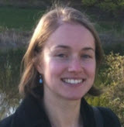
Social Psychology (PSYC 3100)
Seminar (3hrs/week)
Read and discuss current research
Learn about recent debates and controversies in the field
Lab (3 hrs/week)
Design & conduct experiments
Write up mini-thesis
Sample topics:
-Ego-depletion
-Stereotype threat
-Priming
-Self & identity
-Attraction and close relationships
-Recent ‘crisis’ in social psychology
*no tests/exams

Slide 9
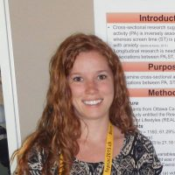
Health and Illness (PSYC 3300)
Goal: Preparation for honours thesis in health psychology
Health Psychology: Science of the psychosocial factors related to health and illness
Promote and maintain health; Prevent and treat illness
Improve health care systems and policy
Identify correlates of health, illness, and dysfunction
Example Course Activities
Participate in discussions about health psychology research
Lead a class discussion
Develop a literature review, research question, hypothesis, and ethics proposal
Collect and analyze data; present results (written and oral)

Slide 10
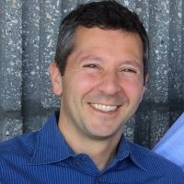
Forensic Psychology (PSYC 3400)
“Mini-thesis" on the relationship between criminal behaviour and one of four variables: criminal attitudes, alcohol use, low self-control, or psychopathy
Reading and interpreting research; data management and statistics; and scientific writing

Slide 11
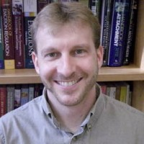
Developmental Psychology (PSYC 3500)
Fall Semester
Meet/Learn about Developmental Faculty
Mini-Thesis: choose topic, review literature, Introduction
Winter Semester
Ethics in Dev Research
Mini-Thesis: Method, Results,
Discussion

Slide 12
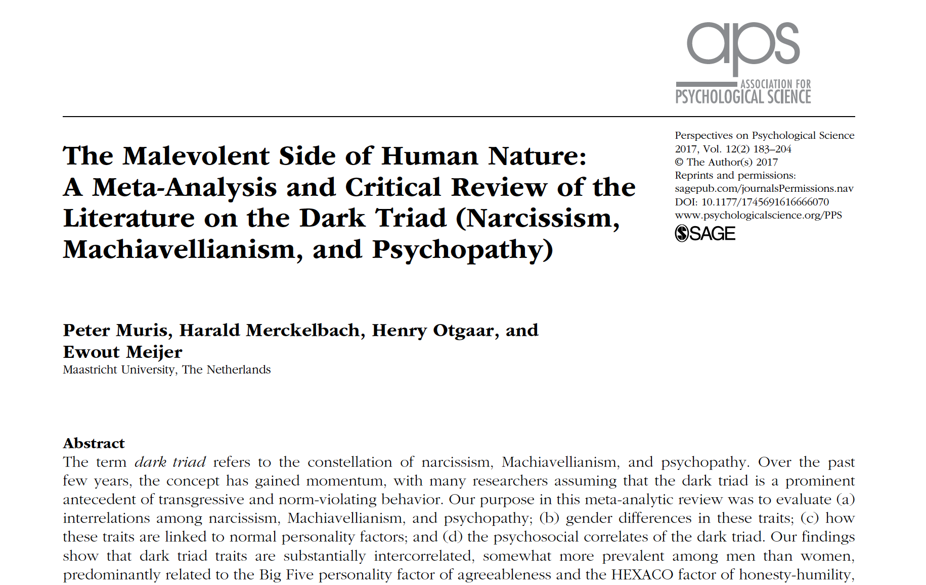
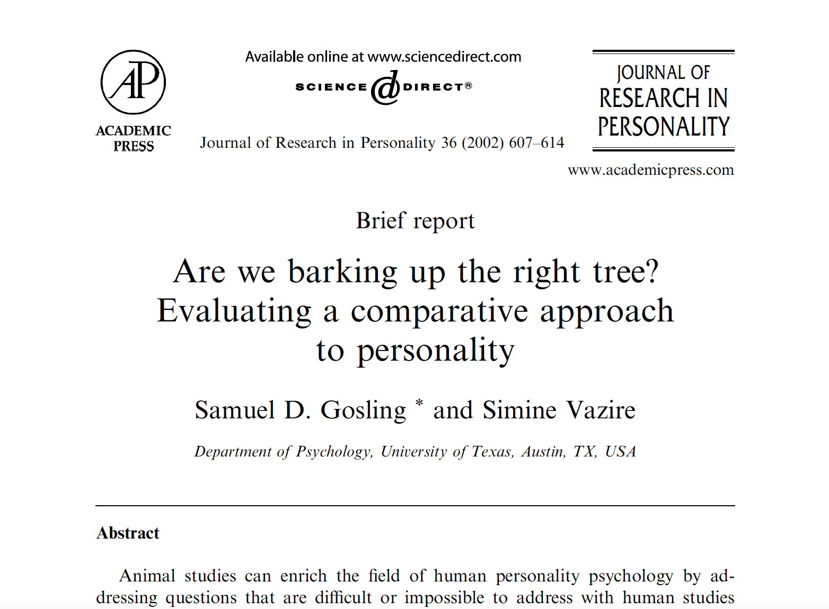
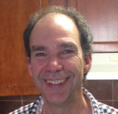
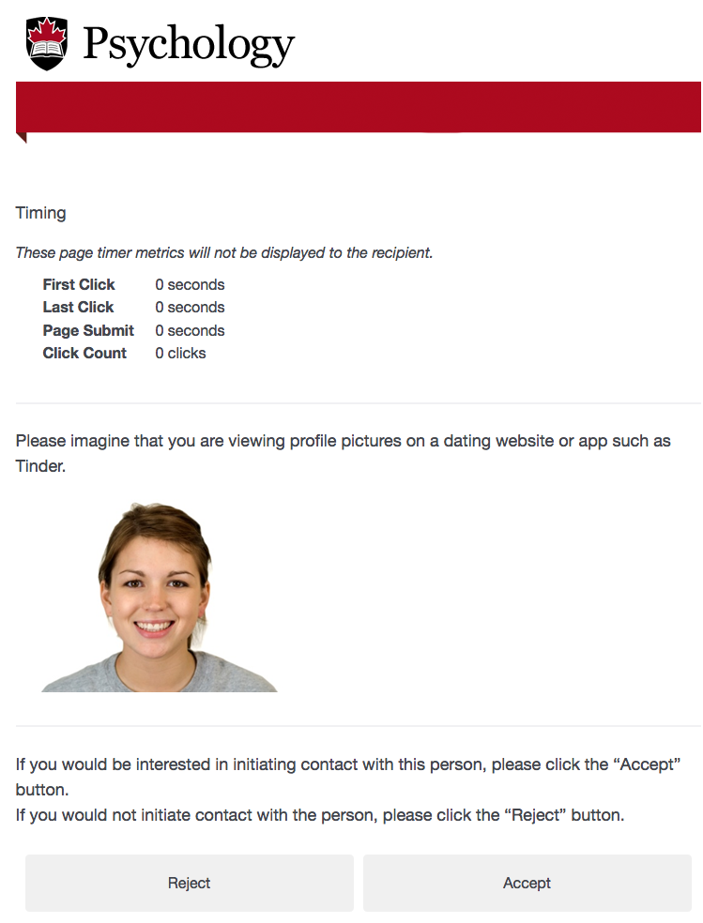
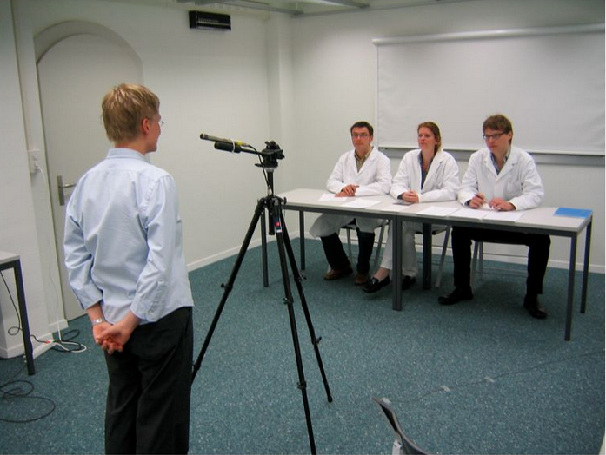
Personality Psychology (PSYC 3600)
Seminar (3 hrs/wk)
Read & discuss current research
no tests/exam
Lab (3 hrs/wk)
Design & conduct experiments
Write up mini-thesis

Slide 13
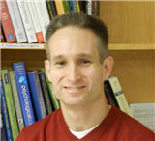
Cognitive Psychology (PSYC 3700)
4 research modules (Attentional Blink, Is Psychology a Science?, Perception of time, and Function learning)
Simulated research participation
Data analyses using SPSS
APA style research reports
Critically review of peer-reviewed journal articles
Seminar and conference style presentations (oral and poster)
Ethics proposal
Vocational questions (graduate studies and more)

Slide 14
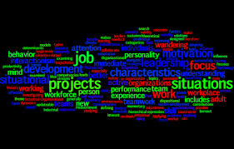
Organizational Psychology (PSYC 3805)

Slide 15
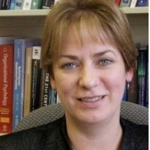
Organizational Psychology is…
Many Terms!
Organizational, Occupational, Personnel, Human Resources, Work, Industrial Organizational…
The branch of psychology that applies the principles of psychology to workplaces
Researchers study human behavior in work settings, and the interplay between people & organizations
Practitioners use scientific findings to inform organizational practice, ultimately improving employees well-being and performance

Slide 16
Organizational Psychology Topics
Globalization and the virtual workplace
Internet based recruitment and selection
Defining limits for online searches of personal information
How sleep affects employee performance
Proactive approaches to improving mental health at work
Great leadership
Introversion vs extroversion at work
How to build effective work teams
Facilitating the work-life merge
Designing safe workplaces that minimize injuries
Minimizing bullying and violence at work
Eliminating unfair discrimination in the workplace

Slide 17
Organizational Psychology Honours Seminar
Prepares students to complete an honours thesis in any discipline
Focus on development of skills and knowledge related to empirical & theoretical literature, research methods, critical thinking, academic dialogue, scientific writing, & statistics
Broadens and diversifies exposure to seminal readings and current and emerging issues in Organizational Psychology
Students participate in (1) class discussions focusing on empirical research, and (2) lab sessions concentrating on skills needed to conduct an honours thesis/research study
Discuss empirical & theoretical research
Individual & group work to analyze research findings
Critique research & identify areas for future research
Conduct a research project
Literature review; Design study; Write research proposal; Ethics proposal;
Collect & analyze data; Present study and findings; Write research paper

Slide 18
4th-Year: Honours Thesis
Conducting research under the supervision of a faculty member
PSYC CGPA of 10.0 for B.A., 9.0 for BSc.
PSYC 3000, Honours Seminar, 4th-year standing
Secure a supervisor
Must submit an application
Literature Review
Data collection & analysis
Preparation of a substantial document

Slide 19
4th-Year: Honours Project
Regularly scheduled class with course instructor (1.0 credit)
Active learning exercises
Writing, critical thinking, presenting skills, etc.
Choose an area of psychological research & explore that area throughout the course

Slide 20
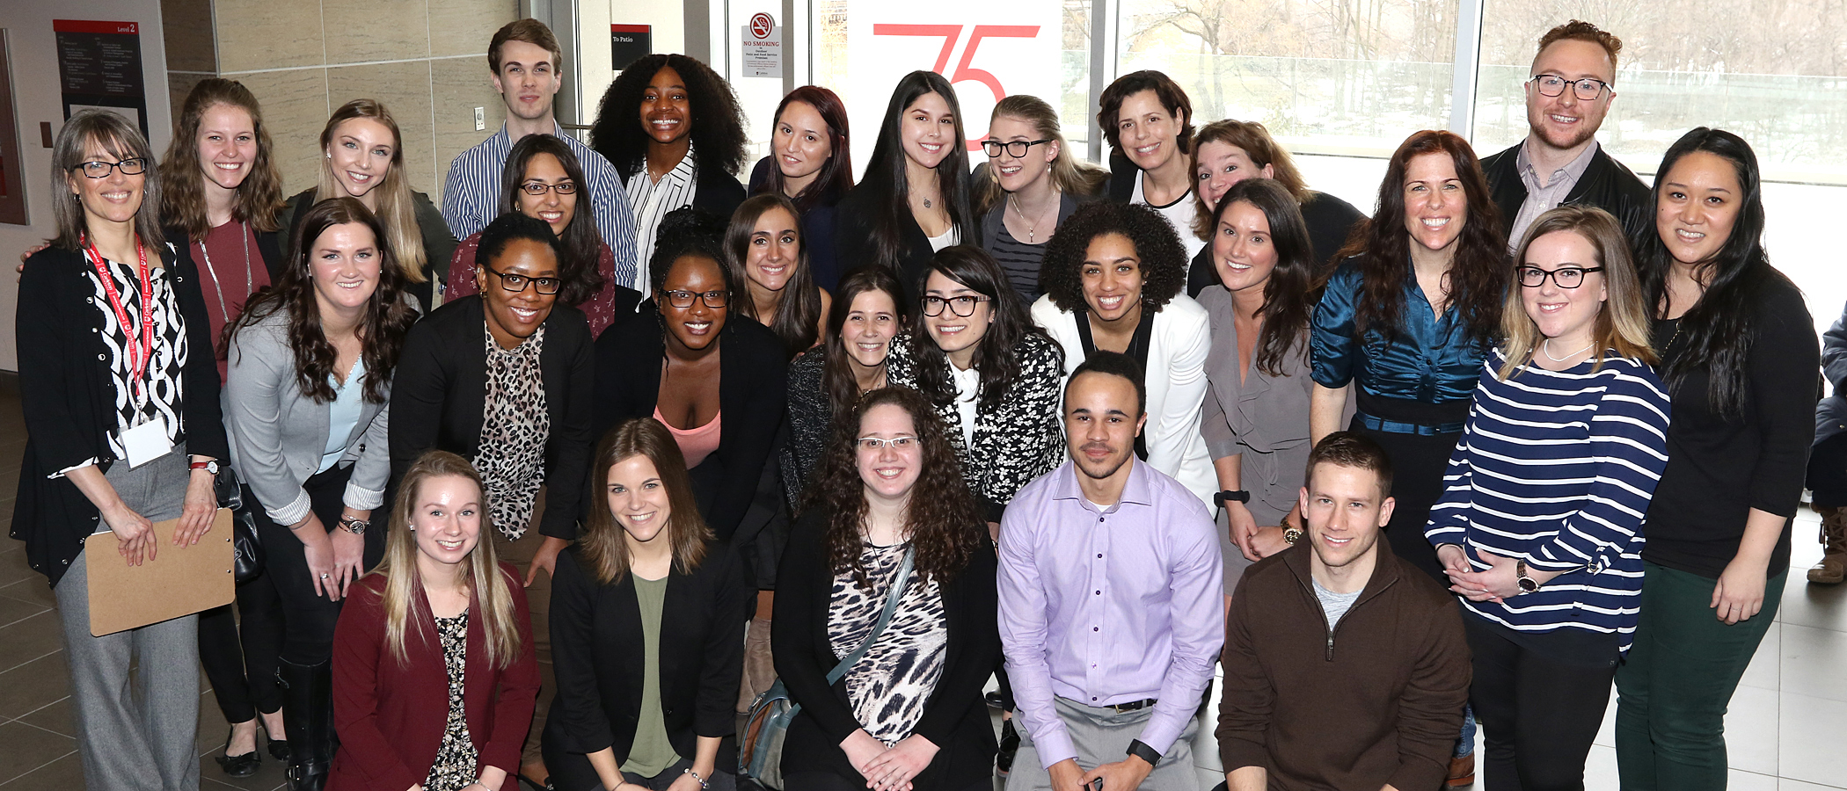
4th-Year: Honours Project
PSYC CGPA of 6.0 (6.5 to graduate), PSYC 3000, 4th-year standing
No application required
Fall-Winter & Summer registration available

Slide 21
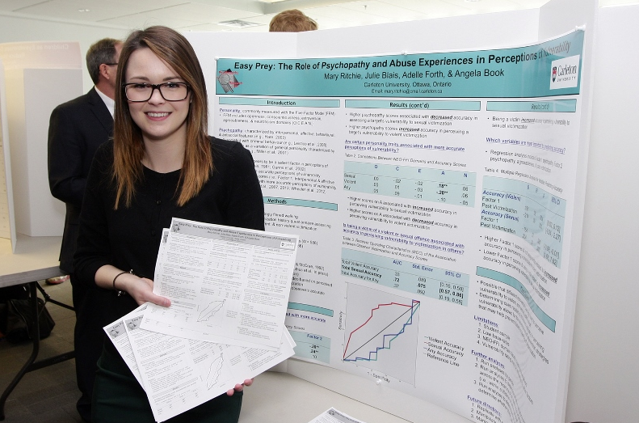
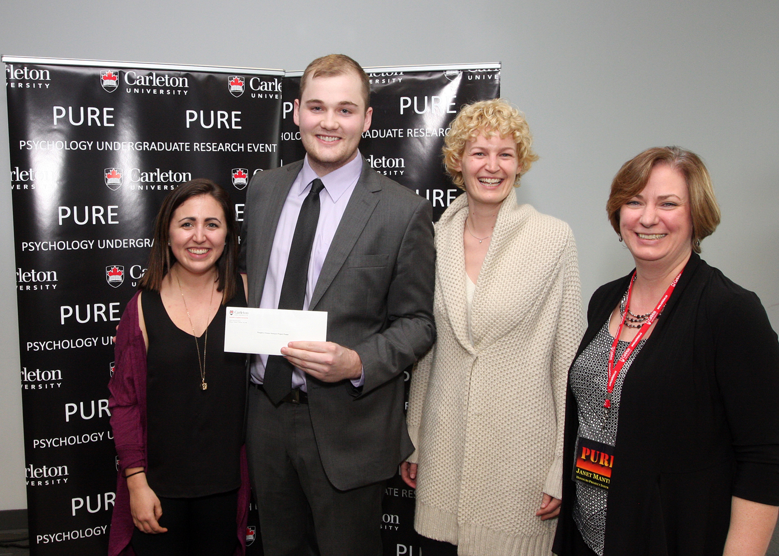
4th-Year: PURE
Psychology Undergraduate Research Event
April 13, 2018

Slide 22
Gaining Experience
Combine academic studies with experience in applied environments
Cultivate professional skills
Become more engaged with the planning of life after graduation and knowledge of potential career paths

Slide 23
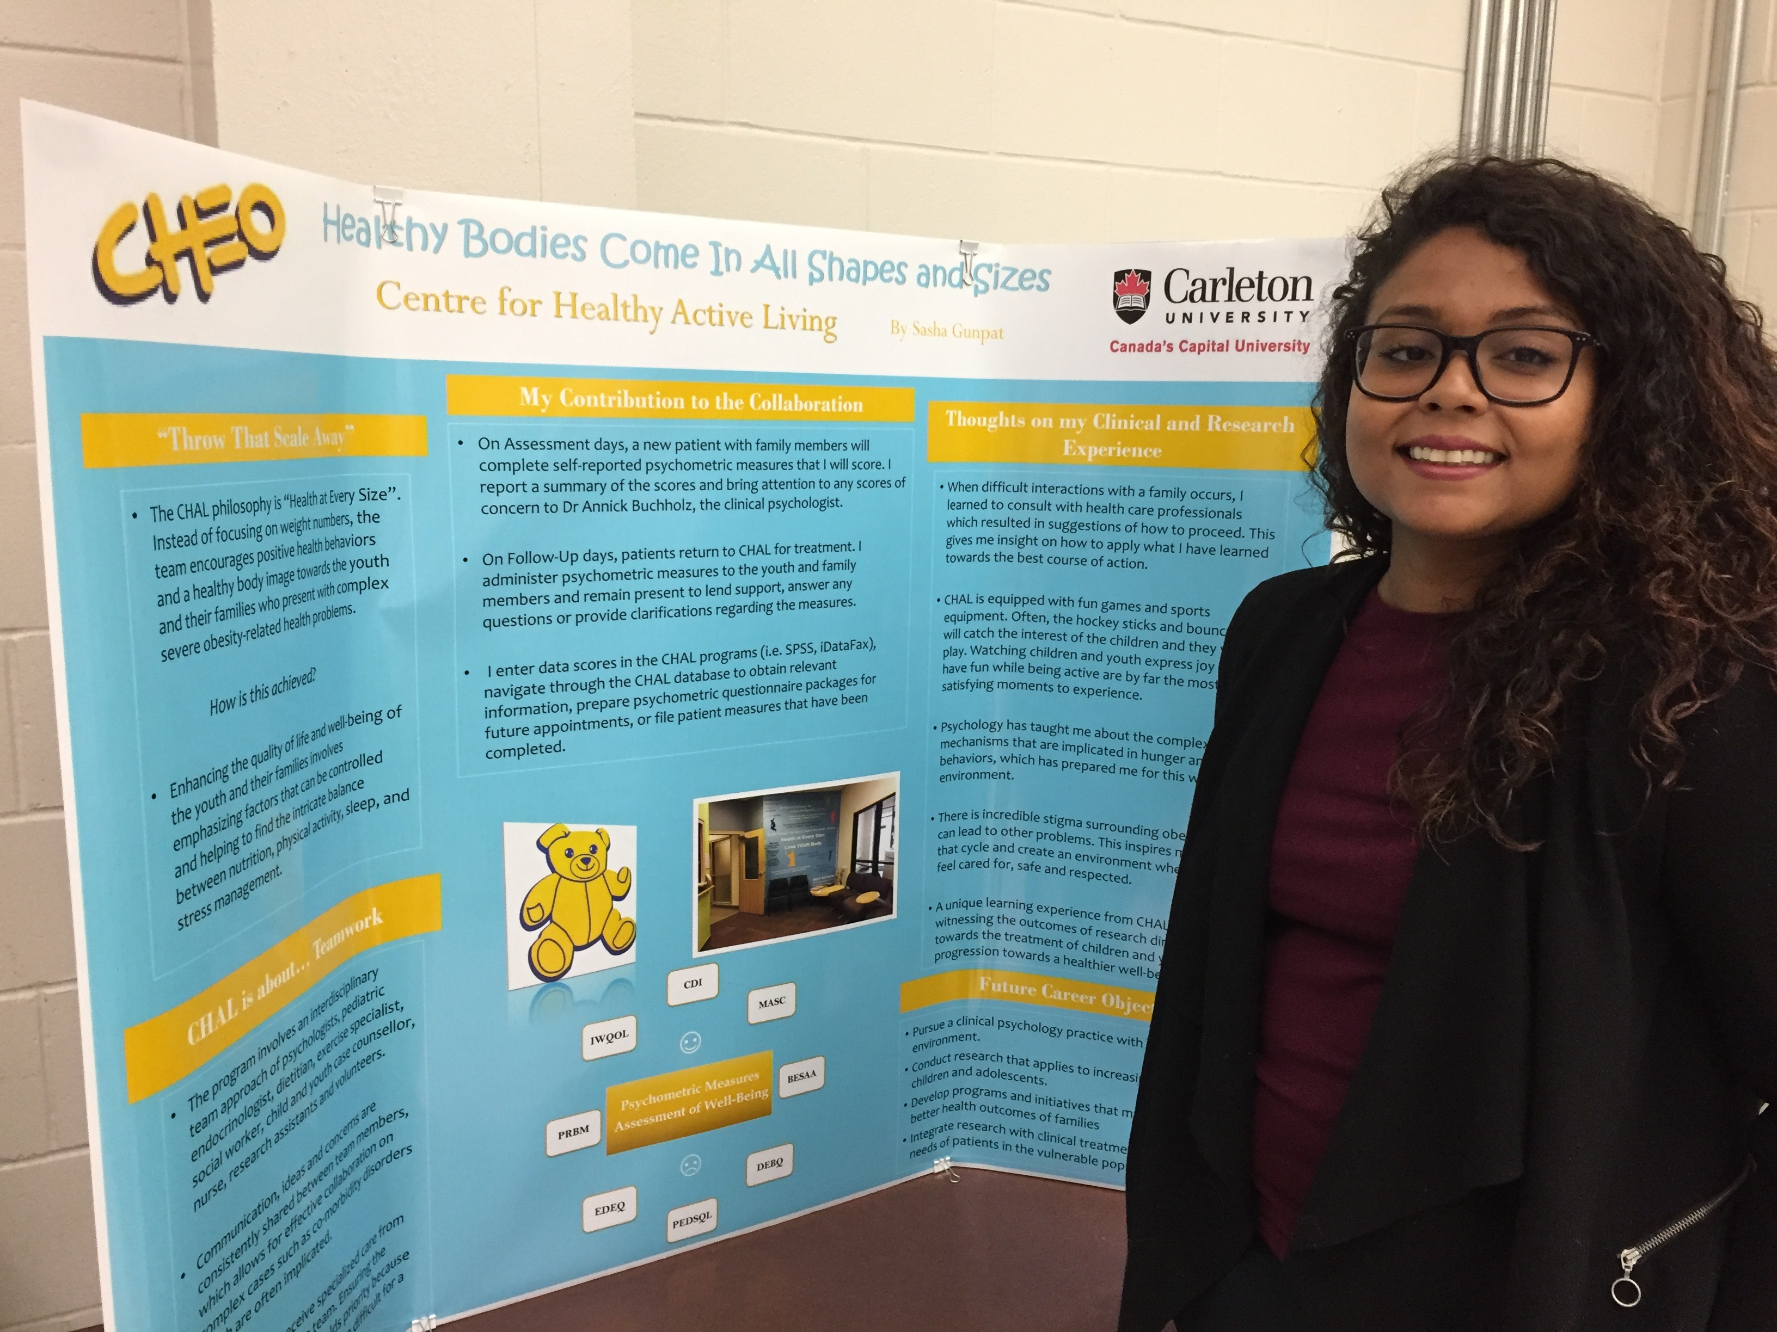
Practicum
PSYC 3901/3902 (0.5 credit): Practicum in Community Psychology
PRACTICON; Practicum Report
“The practicum provided some exposure into the mental health field and solidified that this is the right path for me.”

Slide 24
Practicum
…and more

Slide 25
Practicum
Many placements consistent with a PSYC program concentration
Practicum InfoPack
Applications start being accepted April 2, 2018
Prerequisite: 3rd-year standing in a PSYC program
Enrolment is limited

Slide 26
Volunteering in PSYC Lab
Gain experience with the research process
Work with a faculty member & fellow students
Earn Co-Curricular (CCR) credit

Slide 27
Gaining Experience
carleton.ca/psychology/experience

Slide 28
Academic Advising
Course selection, program requirements, audit
PSYC registration questions
Prerequisites, preclusions
Project vs. Thesis
Concentrations
Exchanges
And more!

Slide 29
Get in the Loop
Facebook.com/CUPsychology
@CU_Psychology
@Psychology.Carleton

Slide 30
PSYC Undergrad Office
B550 Loeb
psychology@carleton.ca (613) 520-2644
carleton.ca/psychology

