Slide 1
Ceramic Water Filter Design Optimization and Application in Rural Tanzania
Research by Robbie Venis, PhD student
Supervised by Dr. Onita Basu & Dr. Troy Anderson

Slide 2
The Need for a Clean Water Solution
In 2015, ~670m people without clean water; 540m are rural [1,2]
Tanzania has ~59m people, ~26m without clean water
~22m rural vs. ~4 m urban [1,2]
Centralized water infrastructure is expensive
Climate Change will only make things worse [4]
An Interim Solution: Point of Use Water Treatment Systems
FIGURE 1: CLIPART WATER DROP [5]

Slide 3
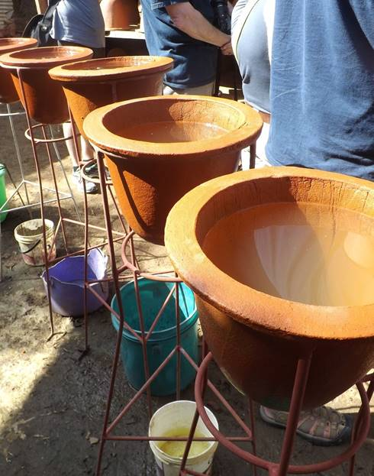
Ceramic Water Filters
Mixture of clay, firing material (FM), water, silver
After firing in kiln, FM burns away leaving pore network
Pores physically strip contaminants from water
Silver acts as secondary disinfectant
TEMBO are implementation Partner NGO
Safe Water Ceramics of East Africa are current producers and research partners
FIGURE 2: SAFE WATER CERAMICS OF EAST AFRICA’S MAJI SALAMAA FILTERS

Slide 4
3 Major Challenges
Users complain about slow flowrate
Filter breakage is leading reason for disuse in field [6]
Filter cost is too high
Currently $45 USD = 90 000 TSH = 200 GHS = 32 550 MWK
Silver accounts for ~40% of cost

Slide 5
A Holistic Approach to Problem Solving
Community Engagement
Practical Application
Scientific Inquiry
Community needs set the technological requirements
e.g. the need for a lower cost or higher flowrate
Observed phenomena emerge from more granular activities. Practical results lead to theoretical questions of why we see what we do
Illumination of scientific principles guiding filter performance creates opportunity for improving filters in the future

Slide 6
Research Plan
Five Stages:
Investigating the impacts of material parameters on turbidity and microbe removal absent of silver
Investigating the impacts of metal additive types and concentrations on microbe removal and release into effluent
Investigating material strength parameters and internal filter structures via destructive testing
Design optimization and data modelling
Field implementation and health monitoring

Slide 7
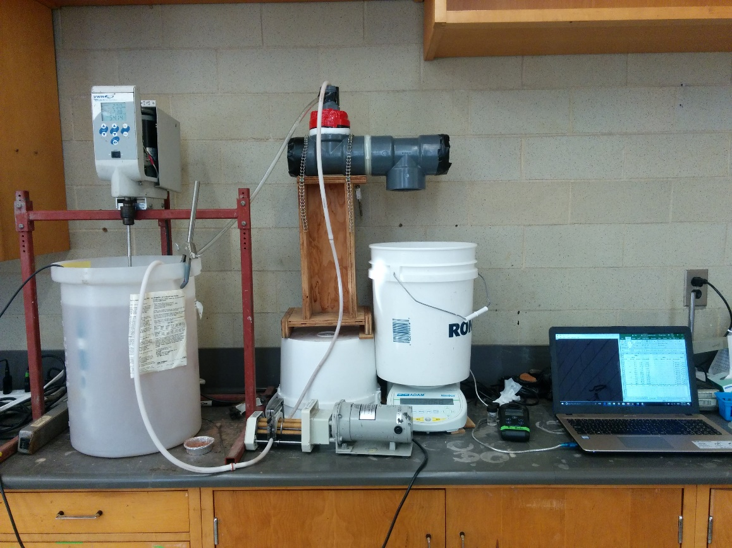
Laboratory Setup
FIGURE 3 - LABORATORY SETUP

Slide 8
Phase 1: Parameter Correlations
Parameter of Interest | Range of Study
Clay:Sawdust Ratio (C:SD) | 50:50, 44:56, 40:60, 36:64
Large:Small Particle Size Ratio (LP:SP) | 100:0, 60:40, 50:50, 60:40, 0:100
Thickness (cm) | 1, 1.5, 2, 2.5
Maximum Firing Temperature (~⁰C) | 650, 750, 850, 950
Outcomes of Interest:
Independent and combined (i.e. interactive) impacts on flowrate
Independent and combined impacts on LRV
Independent and combined impacts on MOR (Phase 3)
Relationship with porosity and dry density of filters

Slide 9
Phase 2: Parameters of Interest
Metal Additives:
Silver Nanoparticles (Ag-NP)
Colloidal Silver (Ag-C)
Silver Nitrate (AgNO₃)
Zinc Oxide (ZnO)
Cupric Oxide (CuO)
Mixtures
Water Quality Parameters:
Microbes (E. coli and/or Viruses)
pH
Oxidation-Reduction Potential (ORP)
Dissolved Oxygen (DO)
Temperature (T)
Turbidity
Fluoride Concentration (F⁻)

Slide 10
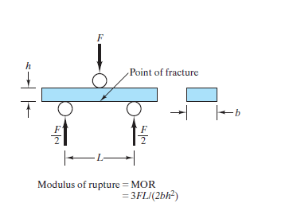
Phase 3: Destructive Testing
Scanning Electron Microscopy (SEM)
Modulus of Rupture
Lower Resolution
Porosity Uniformity
Pore size distribution vs. sawdust size
Higher Resolution
Metal-ceramic adhesion
Metal distribution with filter thickness
Energy Dispersion Spectroscopy (EDS)
Elemental composition changes
FIGURE 4: MODULUS OF RUPTURE TEST SCHEMATIC [7]
Tests: Saturated and Unsaturated

Slide 11
Phase 4: Field Implementation
1) Education Programming
High-School Workshops
Primary-School Engagement
Women’s Groups
Education Centres
Impacts of Education on Adoption
2) Health Monitoring
Diarrhea Cases at Health Centres
Severity of Diarrhea
More Details TBD
FIGURE 6: CLIPART HEALTH HEART [8]
3) Marketing/Sales Management
Local shop sales
Sales via Health Authorities
Sales via NGO
Impacts of Marketing/Sales Model on Filter Adoption
FIGURE 5: STUDENTS AT LONGIDO PRIMARY SCHOOL (PHOTO BY DR. TROY ANDERSON)

Slide 12
Thank you for your time

