Slide 1

The Future of Person Identification in the Digital World
By Mohamed Abdelazez

Slide 2
Who are you?

Slide 3




Slide 4



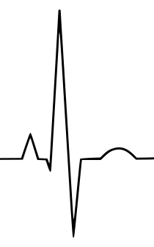

*******

Slide 5
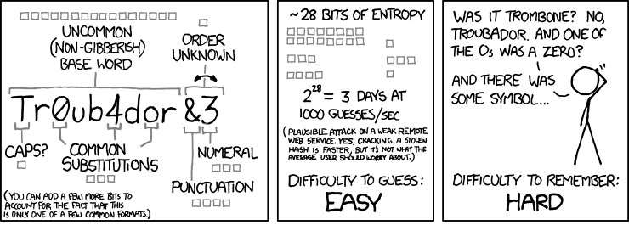
Passwords
*******
Source xkcd

Slide 6
Passwords
BBC
BBC
MP Nadine Dorries defends 'shared password' tweet
GQ
It Sure Looks Like Sean Spicer Tweeted a Secret Password to Something
Fox News
How Podesta got hacked: 'Password' email revealed in WikiLeaks dump

Slide 7
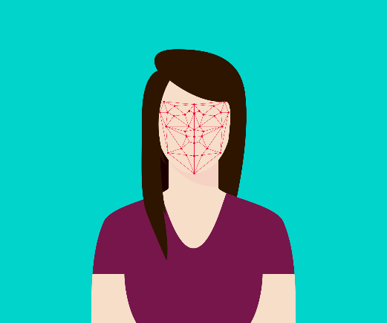
Biometrics
Universal Uniqueness
Permanence Collectability

Slide 8
Biometrics
BBC
Politician's fingerprint 'cloned from photos' by hacker
WIRED
Hackers Say They’ve Broken Face ID A Week After iPhone X Release
Global News
Smartphone fingerprint sensors could potentially be hacked

Slide 9


ECG
Notes:
Lena Biel, Örebro University, Örebro, Sweden

Slide 10



ECG
Icons from www.flaticon.com

Slide 11
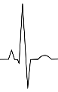
ECG
52 Subjects

Slide 12
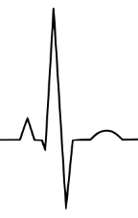
ECG
52 Subjects
✗

Slide 13
ECG
52 Subjects
✗

Slide 14
ECG
52 Subjects
✓

Slide 15
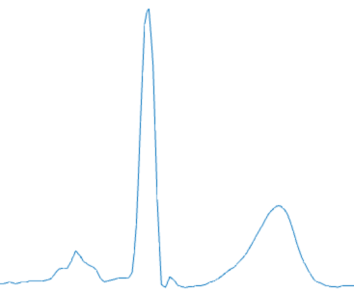
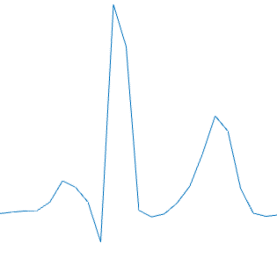
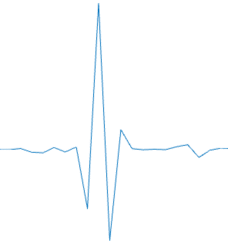
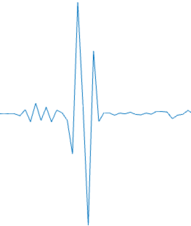
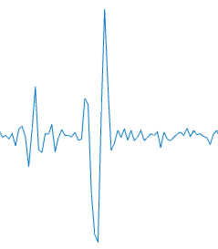
ECG
Wavelet Distance

Slide 16



ECG
84.6%
82.5%
74.2%

Slide 17
ECG

Slide 18
*******

Slide 19
The Future of Person Identification in the Digital World
By Mohamed Abdelazez

