Slide 1
House Keeping
Please turn off your video/microphone
Use the hand or chat feature to ask questions
The presentation will be posted on the intranet:
https://i.carleton.ca/registrar/information-session/
Notes:
Presentations were held on MS Teams – August 18th, 20th, 24th and 26th.

Slide 2
Introduction to Banner 9
Student System Support

Slide 3
Agenda
Menus
Buttons
Layouts & Appearance
Tool Bars
Messages
Errors
GREPORTs
BDM

Slide 4
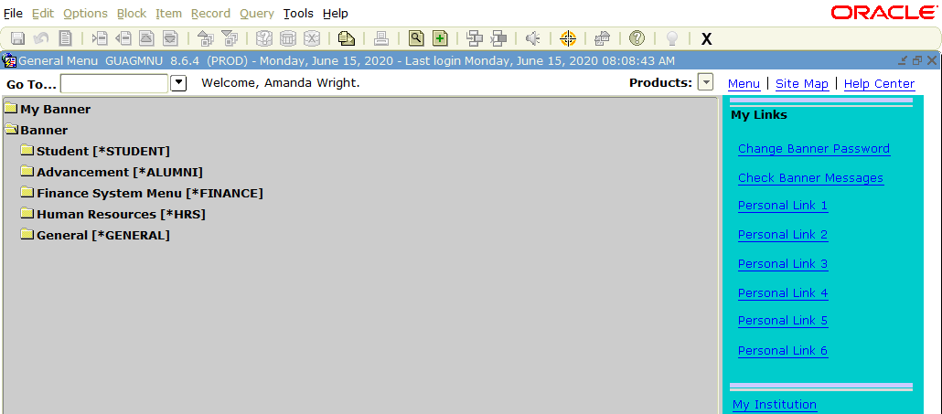
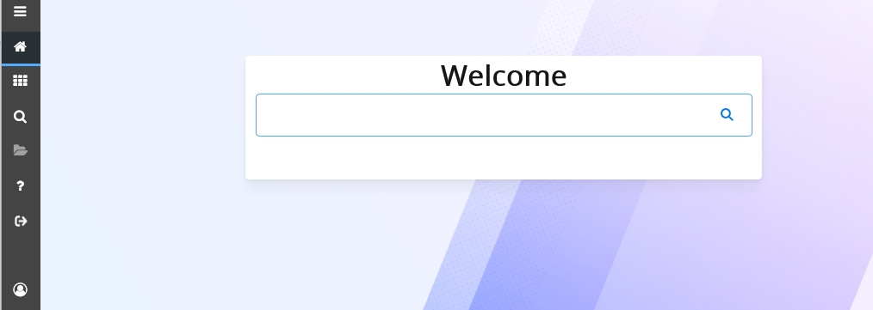
Banner 8 Banner 9
Notes:
Here is the home page of each version of Banner, old on top and new on the bottom
You will notice that there is a new fresher look
The 24 function buttons across the top are gone
The File, edit, options, etc, menu across the top is also gone
Not to fear, all of your functions are still accessible, just in a different way

Slide 5
Form Types
Custom Forms – SZA … are Carleton’s custom forms
Function remains the same
May find slight layout changes
Other forms are Baseline to the software package
Function remains the same
May find slight layout changes
Notes:
The past couple of years ITS and stakeholders have been working on the transition of the Banner Interface
Part of this transition involved transforming all of the custom forms Carleton uses. While we do have a large number of custom forms, we use a significant number of the baseline forms as well.
On the whole the functions of the forms remain the same but you might find some slight visual differences in layout of individual forms
The banner 9 application itself is visually different but it is simplified and more user friendly

Slide 6
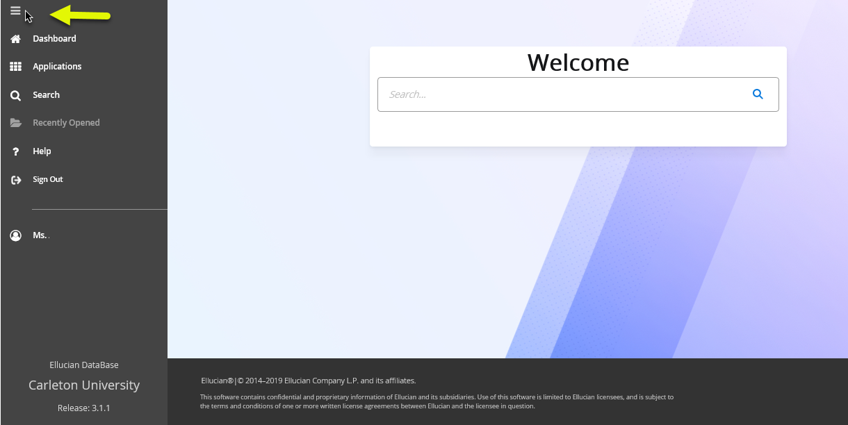
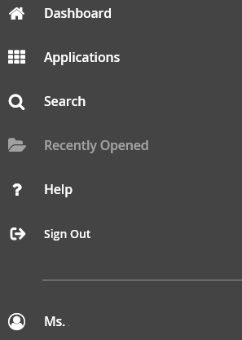
Side Bar Menu: Expand using the top icon
Dashboard
Return to welcome screen
Applications:
Access Banner Modules
My Banner List
Notes:
The new menu is in the form of a side bar menu that will always be on the left hand side of the screen
You can expand the side menu bar using the top icon → the three horizontal lines
When this menu expands you will see: Dashboard, Applications, Search, Recently Opened, Help, Sign Out and your profile
Search, Help and Sign out are self explanatory
Dashboard will return you to the main welcome screen if you are in a form
Applications will allow you to access the different banner modules to look for forms and you can access your preselected list of forms set as your “My Banner” list

Slide 7
Applications Menu
Notes:
Here we have a short video which shows you how the Applications menu expands
You can access the modules (Student, Alumni, Finance, Human Resources, General) – as is appropriate to your role
You can also access the “My Banner” forms you have set
To access forms you can type directly into the welcome box with either the name of the form, the acronym or description

Slide 8
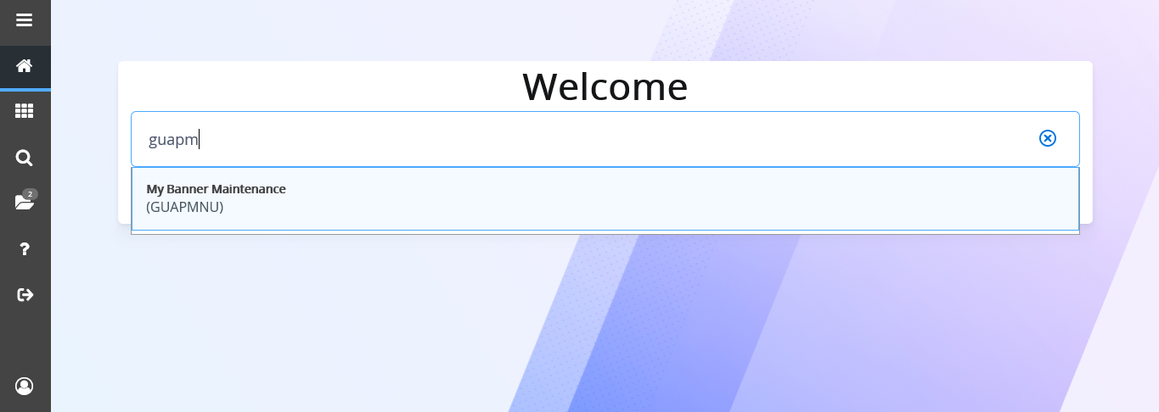
My Banner Menu: GUAPMNU
Type the name of the form directly in the welcome page search box.
GUAPMNU will take you to the form to make changes to the My Banner List
Notes:
This screenshot illustrates that when you begin to type the acronym of the form and the list will auto populate
You can type the whole acronym and press enter or select the item from the list

Slide 9
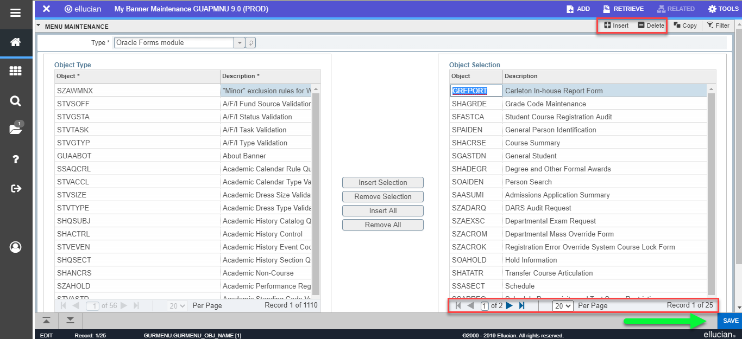
GUAPMNU
Insert/Delete items using the dedicated buttons
Expand line item views
Save button on all forms at the bottom right of the page
Notes:
You can see here some of the new features of Banner 9.
First there is not a long line of buttons or icons along the top or a menu like we saw on the banner 8 screen.
I’m going to point out a couple of features here and we will talk about a few of the other buttons in time.
Your “My Banner” list is populated with the forms you see on the right hand side. You can insert new forms by using the buttons in the middle or you can use the insert/delete buttons at the top of the block.
You can see that this My Banner list has 25 records but we are only viewing 20 records. You can use the play arrows to reach the next or last page, or you can adjust the number of records per page.
When you make changes and wish to save your changes, the save button is now at the bottom right of the screen

Slide 10
Menu Items
Banner Document Management Buttons
Add Documents
Retrieve Documents
Related Forms
Access forms related to current form
Tools Menu
Access other menu items (refresh, export, clear)
Block Menu: insert, delete, copy and filter records
Exit button
Notes:
Here are the standard buttons you will find in Banner 9
First we have the BDM (Banner Document Management) buttons to add/retrieve documents
Along this purple banner there is also the Related items menu and the Tools Menu
Second is the block Menu. Depending upon the type of form you are access you may find multiple of this menu as it is specific to the block of information that is being accessed.
You can use the block menu to insert, delete, copy and filter records
To exit a form, use the “X” button on the top left of the screen

Slide 11
Banner Document Management
Banner Document Management Buttons
Add Documents
Retrieve Documents
Notes:
The menu buttons for adding and retrieving documents from the BDM system are on the purple header line and are identified with Add and Retrieve
If you are a user of BDM, it will also be undergoing a separate transformation in the fall term and we will be reaching out to users about that as we get closer to that timeframe.

Slide 12
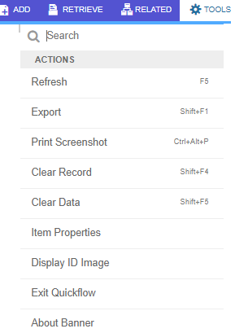
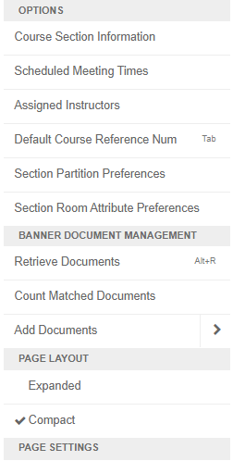
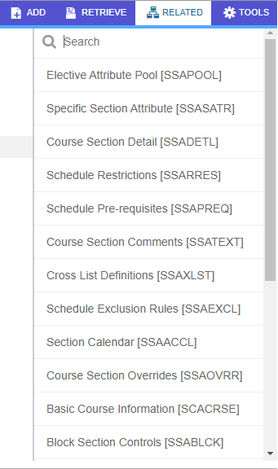
Tools Menu
Related Menu
Notes:
On the left and middle you can see an expansion of the Tools Menu.
From here you can access action items, such as clear record, clear data; You can access the options menu; Banner Document Management items or change the page layout.
The related menu on the right will show you a list of form that are related the form you are current accessing, if applicable. Not all forms have related forms.
First we have the BDM (Banner Document Management) buttons to add/retrieve documents
Along this purple banner there is also the Related items menu and the Tools Menu
Second is the block Menu. Depending upon the type of form you are access you may find multiple of this menu as it is specific to the block of information that is being accessed.
You can use the block menu to insert, delete, copy and filter records
To exit a form, use the “X” button on the top left of the screen

Slide 13
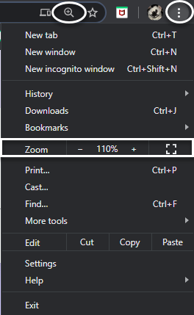
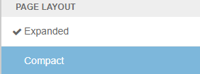
Page Zoom Level
Three ways to increase appearance of the screen:
CRTL button and “+” button on your keyboard
Use the address bar magnifying glass icon or the browser settings menu
Change page layout in the Tools Menu
Notes:
There are 3 ways you can change the size of the screen that you are viewing
Since banner 9 is run in the internet browser window you can make adjustments to the zoom level of the screen itself. This can be done using the keyboard buttons CTRL and the plus sign (located on the number pad) to increase, and CTRL and the minus sign to decrease the level of zoom.
This action can also be completed with the magnifying glass icon usually located next to the address bar.
You can also change how the screen appears to you with the Tools menu – the last item on the menu is Page Layout where you can choose from expanded or compact view.

Slide 14
Compact or Expanded View
Above is Compact View
Below is Expanded View
Both browsers are set to 100% zoom level
Notes:
With your browser zoom level at 100%, this is the difference between expanded view above and compact view below.
You can see the buttons and fields are larger as well as the purple menu bar
As discussed in the previous slide you can still adjust the size of these to be bigger or smaller with the zoom level of the browser window

Slide 15
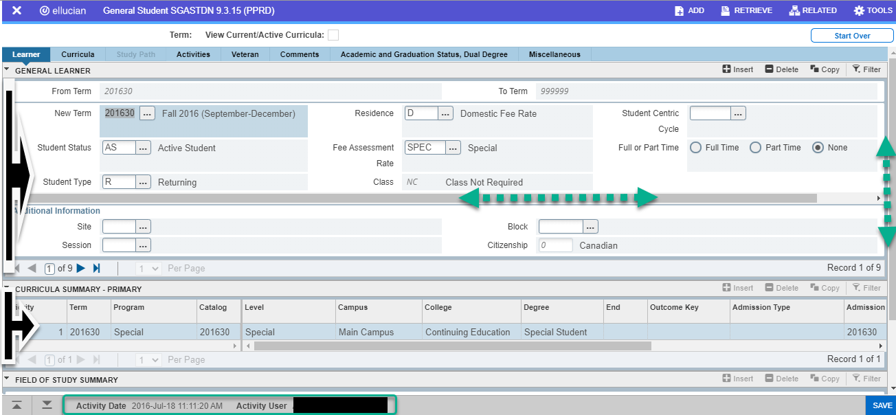
Information Blocks
Zoom level & form type will determine scroll bar placement
Each block can have its own horizontal and/or vertical scroll bar
If you are already in compact view, use “CRTL – “ on your keyboard to decrease browser zoom level to see more within frame of window
Status bar shows record date and user on bottom
Notes:
Your level of zoom and whether you are in compact or expanded view, will determine if you see horizontal and vertical scroll bars on blocks of information as well as a vertical scroll bar on the right that controls the page as a whole
Here you can see the first block of information has a scroll bar – if the browser window zoom level was decreased, the scroll bar would disappear as all the information would then be visible – but in smaller print
Use the zoom level to your comfort level but be aware the larger the screen is, the more scrolling you may have to do with the scroll bars
Status bar showing the date of the record and user who updated record is at the bottom of the screen

Slide 16
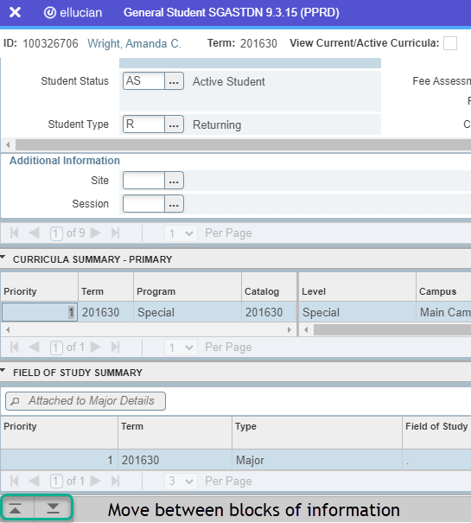
Navigate Information blocks
Use the Up/Down arrows on the bottom left of the screen to navigate between blocks of information
Notes:
Many forms have several blocks of information
You can access the next or previous block of information using the up/down arrows located at the bottom left of the screen; this may not be required on all forms – depending upon the function of the form you may just be able to click on a record in the block you need and perform functions

Slide 17
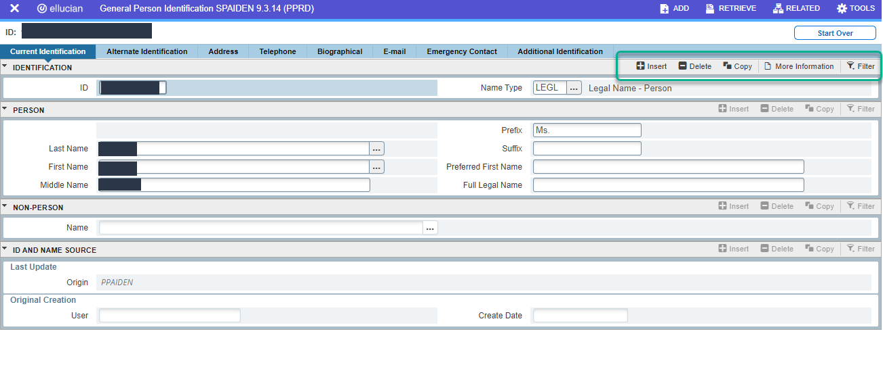
Modifying Records
Each block has its own record menu with insert, delete, copy and filter buttons.
Some blocks have a ‘more information’ button
Notes:
Each block has its own record menu with insert, delete, copy and filter buttons.
Some blocks have a ‘more information’ button

Slide 18
Ability to insert or delete records is based on your personal permissions or the function of the form
Not all blocks of information can be filtered, those that can, will show the filter button enabled (not greyed out)
Filter Feature
Select the parameters you wish to filter the records for
Available fields will be specific to the type of form being accessed
Notes:
When you search or filter you will be given the types of data that can be searched or filtered for
Enter the parameters available are determined by the form and will differ from form to form
Enter your parameters and select “go”
This filter function is replacement of the “execute query” function

Slide 19
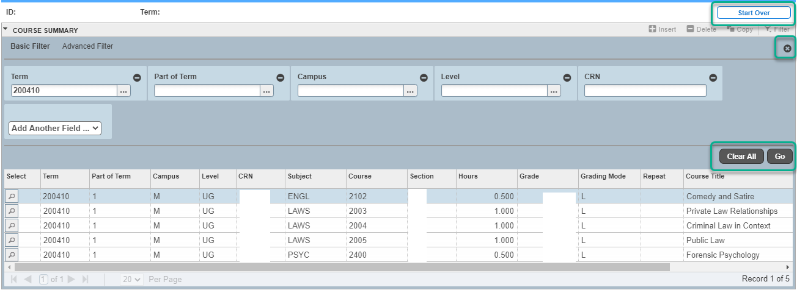
Use “X” to remove filter and view the unfiltered data
Use “Clear All” to change filter parameters
Use “Go” to execute filter request
Use “Start Over” to clear to return to the initial block to restart form (new ID/Term/CRN)
Button Functions
Notes:
Once you have entered your filter you will see your data below your filter
Use the X at the top of the filter to remove the filter
Use Clear all to restart the filter and enter different parameters – select Go with your new parameters entered
Use the Start Over button to return to the main form for the purpose of accessing a new record, for example a new student, a different term or different CRN – this is equivalent to Banner 8 ‘roll back’ feature

Slide 20
Form Comparison
Generally…
Order of fields remains the same
Labels remain the same
To search a field there is still a button which is now a box with three dots
After inserting the required ID/term/crn (key block fields) you select “Go” and the remainder of the form will populate
Notes:
Many forms require an input of key block information, this is information such as ID, term, CRN – the items that run the form
After input, you select Go and the remainder of the form will populate
If you need to search a key block, there is a new icon of three dots – this will open up search options and pick lists
“Go” is essentially the “next block” function

Slide 21
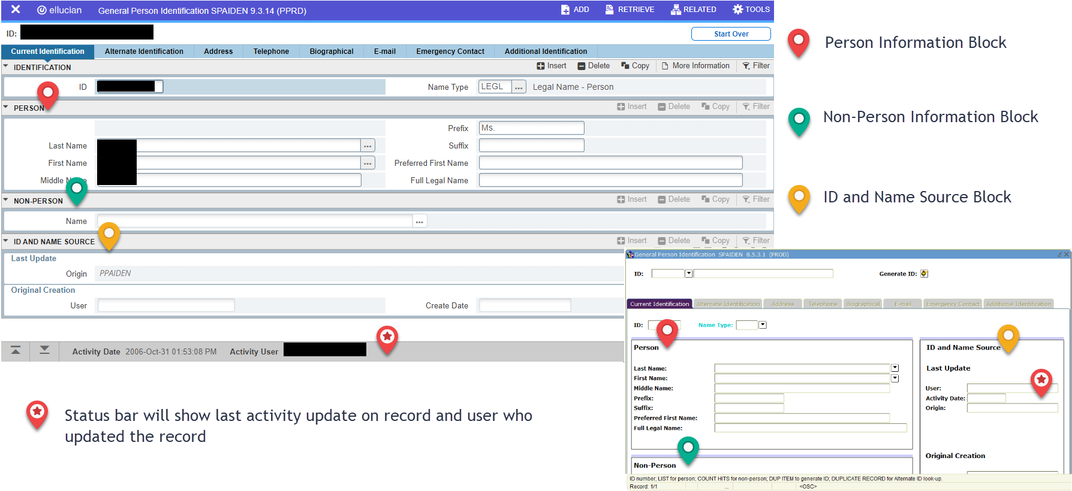
Horizontal Block Layout
Notes:
When your form is populated the information will be layered in horizontal boxes
Some of these may be in a slightly different order as in Banner 8 they were sharing vertical screen space
Here you will see the order of information is the key block (identification which you would have entered), Person information, Non-Person Information and the ID & Name source information
The right side image shows you the matching information in the Banner 8 format
A particular item of information may now be found in the activity bar on the bottom of the screen. Notably this information is the last activity on the record and the user information of who made that last update

Slide 22
Message Boxes
Information messages now appear on the top right of the page
Notes:
In Banner 8, information messages would appear as a dialogue box in the middle of the screen or as a message on the bottom of the screen which was easily unnoticed
Information messages now appear on the top right in a coloured box with the message

Slide 23
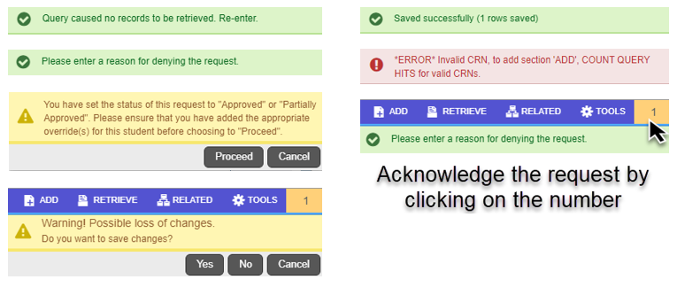
Message Boxes
Messages might be informational, errors or confirmations
Notes:
The kinds of messages you see will be dependant upon the form you are using
If the message prevents you from continuing to use the form, click the number box above the message to acknowledge the message – the message will disappear and you will be able to continue to use the form
Often you have to acknowledge the message to reach the “start over” button – which is the equivalent of “roll back” in Banner 8

Slide 24
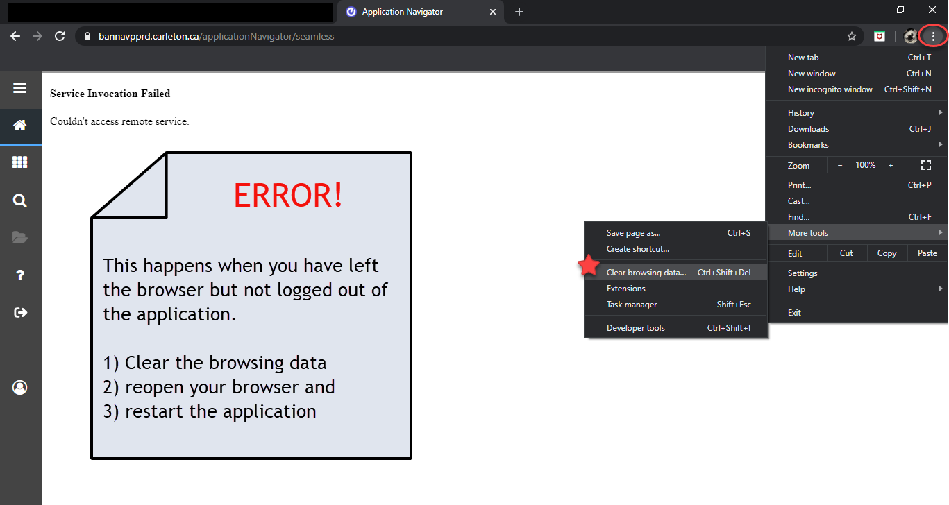
Service Invocation Failed
Use the browser menu to access tools > clear browsing data.
Notes:
Occasionally you might run into this issue
If you see the “service invocation failed” error – you can clear your browser’s cache and browsing history
After you have cleared the browsing history – restart your browser and re-open the application; the error should then be resolved
This is a known issue that the vendor is aware of
It is recommended to use incognito mode which is supposed to help with the issue
Remember to log out of banner rather than just closing the window

Slide 25
Logon Denied
Acknowledge message: Press “Ok”
Next prompt: Press “LOG OUT”
Re-open Banner link in “incognito mode” in Chrome
Re-type name and password to Log-in
Notes:
If you see a logon denied message > press ok and when prompted on the next screen to Log Out or Return Home; Select Log out
Re-open the banner link in “incognito mode” in Chrome and log in to banner again.
Provided you are typing the correct name and password the issue should be resolved.
Remember to log out of banner when finished rather than just closing the browser window
Also be mindful that if Chrome is auto-saving passwords that the correct password is being saved in the Duo log-in page for the username you are using

Slide 26
No changes with…
Carleton Central remains the same in content and layout – no changes have occurred
Reports accessed through GREPORT are not available in Banner 9
Banner 8 will continue to be available until a new reporting function is available in Banner 9
Continue to access GREPORT in Banner 8
Notes:
The change in how we access our data does not change what students see or do in Carleton Central > that is a separate system and is unaffected
For now and when Banner 9 is live, Banner 8 will still be available.
You will be free to use both Banner 8 and Banner 9 as you see fit –
Those of you who access reports from GREPORT will have to access reports from Banner 8 as they are not available in Banner 9
We are working with a vendor for reporting software that works with Banner 9 → the reporting features will provide us with more and better options for report making and data retrieval that we currently have with our GREPORT functions
Until we have a firm timeline for the new reporting tools; both Banner 8 and Banner 9 will be available, but we hope that you will familiarize yourself with Banner 9 when it is rolled out

Slide 27
Changes and moving forward…
Usable in multiple browsers
Chrome is recommended
Continue to access Banner 8/GREPORTs with Internet Explorer
Should use in “incognito mode” in Chrome
Documentation Updates
Banner Manual Updates
New video tutorials
Updated technical training presentations
Notes:
Banner 9 can be used in any browser but Chrome is recommended; using incognito mode
If you are accessing GREPORT in Banner 8, continue to use Internet Explorer to launch Banner 8
We are updating our documentation and videos
Moving forward we will be offering training to new employees or those in new roles, in Banner 9 and we can offer refresher group training depending upon interest
We are always available once you are in and using Banner 9 to answer questions and help!

Slide 28
StudentSystemSupport@cunet.carleton.ca
Thank you!
Feel free to reach out via email or MS Teams chat or call.

