Slide 1
DARS UG Audit: “Fun” Facts, Common Questions and Best Practices
Elizabeth Bruce/Lisa chow – Student Systems Support

Slide 2
“Fun” Facts
DARS:
Degree
Audit
Reporting
Software

Slide 3
“Fun” Facts What is DARS, anyway? DARS is an automated process for tracking a student’s academic progress towards completing an academic program by indicating what requirements are fulfilled and what requirements are outstanding.

Slide 4
“Fun” Facts:
Created in 1983 at Miami University

Slide 5
“Fun” Facts:
No, not that Miami. Miami University - Ohio

Slide 6
“Fun” Facts:
Created in-house to assist their students and eventually licensed to other institutions
Now owned by College Source who offer a suit of products and serve over 400 colleges and universities campuses predominately in the US and Canada
Also referred to as “u.achieve” audit

Slide 7
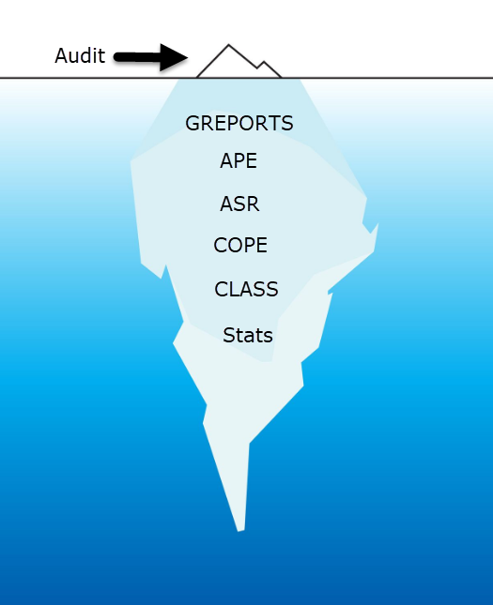
“Fun” Facts:
The actual audit is only one part of what we use DARS for:
All GREPORTS that use CGPAs or credits in a program (i.e. ranking, graduation)
APE
ASR
Processes such as COPE and CLASS
Data extracts for statistical purposes

Slide 8
Common Questions
Why isn’t my course sitting where it’s supposed to go?
Complicated question

Slide 9
Common Questions
Before we can answer that question, we need to understand the audit processing:
Audit works from the top-down. It tries to place courses in the first available place that they can sit
It does this while trying to respect all of the rules we have in place such as limits on double counting (for now) and the maximum number of 1000-level courses
Also has to respect the priorities of fulfilling the requirements and maximizing the CGPAs
Audit has three tries to “match” a course before placing it
When there are multiple places a course can sit and competing priorities the audit may not choose a placement we like

Slide 10
Common Questions
For example:
Bachelor of Arts Combined Honours in Human Rights and Law
Courses needed in the Law Major sit in Human Rights instead of moving down to Law
Why?
The Human Rights and Law majors can both use the same LAWS courses
Courses generally sit in first available spot, so LAWS get “stuck” in Human Rights and don’t move down to where they’re required
Solution:
Exceptions to move the courses
Course are acceptable or not acceptable in a requirement. We can’t set a “if not needed for this requirement go here” type of logic
Avoid overlapping requirements when ever possible

Slide 11
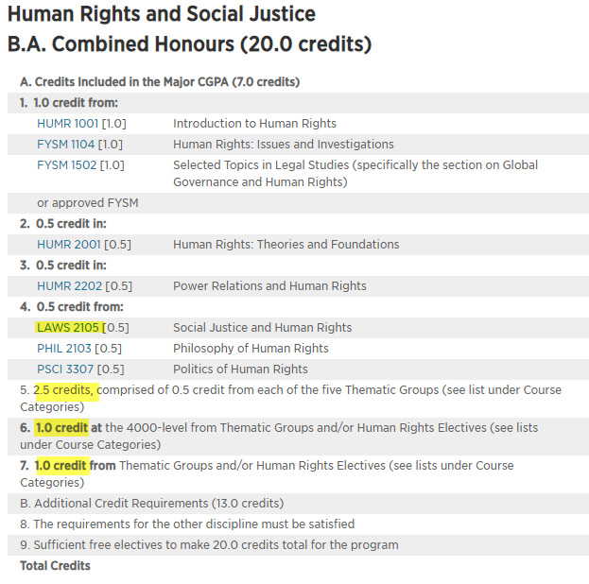
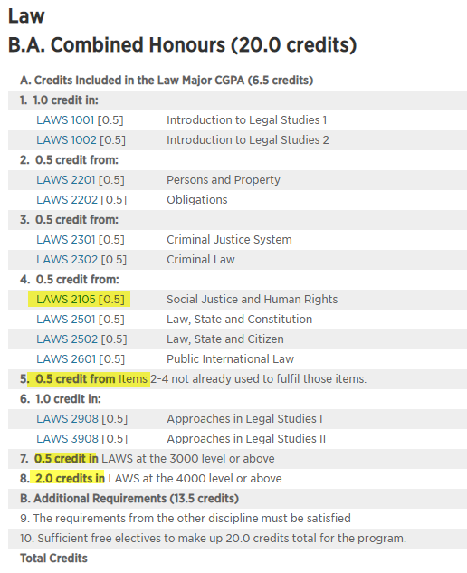
Notes:
Areas in yellow are where courses could overlap depending on the students registration choices

Slide 12
Common Questions
Why isn’t my course sitting where it’s supposed to go?
Overlapping requirements or competing priorities
Too many options decrease functionality
Excess courses blocking
If the student has extra courses sitting aside, they can be blocking a course from coming in depending on the grades
Too many 1000-levels courses
7.0 credit maximum
CURs, TRs, LOPs, SAT, EXCs being prioritized
These courses are viewed as “A++” on the audit and will be prioritized

Slide 13
Common Questions
Double counting limit (being remove for Fall 2021)
Majors and minors can share a maximum of 2.0 credits
Once this limit is reached no additional courses from the major will be used towards the minor
This issue is more predominate in multidisciplinary programs
Forfeited
If a course is sitting in forfeit it cannot be used towards the program
Generally a results of repeats or precluded courses
Prohibited
Number of programs have additional rules that prohibit particular courses from being used, for example:
Architecture Studio courses cannot be used for credit in BA History and Theory of Architecture
Students admitted into BCOMM with advanced standing will not receive credit for any grade below a C-

Slide 14
Common Questions
I do the same exception all of the time, is there anything that can be done about this?
“Undercoding”
Automatically allow a course to count in a requirement
Done for all students within particular calendar year(s)
Most commonly used for a similar requirements (i.e. MATH 1007 for MATH 1009) or for transition planning (new courses to old curriculum, old courses to new curriculum)
Curriculum change
Transparency - if the unit is always willing to accept a particular course add it to the calendar entry so it’s clear to other staff and students
Contact DARS team to discuss potential options

Slide 15
Common Questions
I don’t see the Combined Honours program I’m looking for in COPE/SZADARQ, is this combination allowed?
Most likely, almost all combined options can be added together
Exceptions are when the majors require overlapping requirements. If this is the case a specialized Combined version addressing the program has to be created
Example: Applied Linguistics and Discourse Studies + Linguistics = Linguistics and Discourse Studies
We build audits/Banner entries only when we’ve received a COPE request from a student.
AE team oversees COPE processing and is the best point of contact

Slide 16
Common Questions
I’d like to review a large number of audits, is there an easier way than printing them individually?
Batch audits (pre-pandemic process)
DARS team can print batches for particular student populations (i.e. all HBA-45 students with 4th year standing
We can also produce audits for a list of students you provide if you provide us with the following information:
Student number
Program Code (HBS-60, BPAPM-P2A)
Contact DARS team via email with request

Slide 17
Common Questions
I have a special topics course that it repeatable, can the audit allow it to count more than once automatically?
Yes, we can designate courses as automatically repeatable
However, it is up to the department to monitor to ensure that students do not register in the same topic and receive credit twice
Alternatively, repeated courses can be allowed to forfeit and handled via exception to avoid having to monitor registration

Slide 18
Common Questions
What’s the “real” grade on a CLP, CEX, LOP or EXC?
CLP=Current Letter of Permission and CEX=Current Exchange
These notations are the equivalent of “CUR”. If these notations appear on the audit it means the Registrar’s Office has not received a final transcript and finalized the credit
Some institutions (i.e. Athabasca) allow courses to be extended over a long period of time. It can be up to year before they are completed and the grade is received
LOP= Successful Letter of Permission and EXC=Successful Exchange
These courses have received a passing grade and the credit has been transferred by the Registrar’s Office. As these are transferred on a pass/fail basis a grade cannot be displayed on the audit
The student should be able to provide a copy of their host transcript is required. If there is an issue and this isn’t possible contact the Academic Evaluation team.

Slide 19
Common Questions
Who do I ask about audit issues?
Issues particular to a student – Academic Evaluations team
Global issues such issue discrepancy with all programs, undercoding, curriculum development, transition planning – DARS

Slide 20
Common Questions
Is audit training available?
Yes, individual training is available
Review audit basics and examples specific to the program you work with
Customized depending on questions and needs of user
Contact studentsystemsupport@carleton.ca or Liz/Lisa directly

Slide 21
Best Practices
KISS Principle
Keep It Simple and Straightforward
Whenever possible keep curriculum as simple and straightforward as possible
Avoid extra layers of complication unless truly necessary
If/When/But/Only if are statements that can lead to more complexity
Avoid having the same courses count for many areas
Be specific or give choice – try not to do both in the same requirement
Avoid variance from rules/regulations
Better for audit function and student understanding
Requirements not compatible with the system = exceptions
Notes:
Know this may be at the faculty level

Slide 22
Best Practices
Transition Planning
When curriculum changes are made the implications to both existing and new students need to be considered
For existing students:
If courses have been deleted what will they take as a substitute? How will these substitutions be actioned? Will there be a communication plan?
Is there an advantage to the new curriculum? If so, will calendar year changes be recommended? What is the plan to manage this?
If an existing student ends up in the “new” version of the program where will their courses fit? What exceptions or substitutions will be required?

Slide 23
Best Practices
Best practice for transition planning:
Have a documented plan
Work with the Registrar’s Office and DARS team to determine what assistance we can provide
DARS team can provide documentation for getting started and operational consultation
Have a communications plan for students and impacted staff (AAC)
Transition plans can also be included when new or edited curriculum changes are submitted via CourseLeaf

Slide 24
Best Practices
Substitution/Undercoding Tracking
If you are requesting background changes to the audit, compile what’s been asked for in one place for easy reference
Substitutions will stay in place until requested otherwise and will carry forward to future calendar years
If there’s been a lot of requests it can get confusing to figure out exactly what is being accepted and where

Slide 25
Coming in 2021…

Slide 26
Contact Us
Systems Support Team
studentsystemsupport@carleton.ca
Elizabeth Bruce
Elizabeth.Bruce@Carleton.ca
Lisa Chow
Lisa.Chow@Carleton.ca
Or via MS Teams chat or call

Slide 27
Questions?

