Slide 1
Information Technology Services
Tips and Tricks on how to you can work effectively from Home

Slide 2
Pajamas… Who would have thought, right?

Slide 3
Accessing IT Services from Home
What is the best way to access all the IT Services you once had from your office before Covid came into our lives?

Slide 4
With 100% certainty
using your home computer to Remote Desktop to your office computer is the best and easiest way to connect from home!!!
giving you access to your network drives, Banner, network and local printers and more.

Slide 5
Remote Desktop… whaat!!!?
Remote desktop is simply an application that allows you to connect to another computer, essentially allowing your home computer to act as a remote control to your office computer. Much like how the remote for your TV controls the TV itself.
the Remote Desktop application typically comes installed on most Windows Computers.
Microsoft makes a version for Apple products that works on most i-Thingys that can be downloaded from the Appstore.

Slide 6
So… what do I need to use RD
A windows computer (desktop/laptop) or Apple iMac or MacBook
Remote Desktop Application
Admin Privledges on Remote Computer or User Account added to the Remote Desktop Users Group on the Remote Computer. (ITS Service Desk can do this for you)
Cisco AnyConnect Secure Mobility Client (Fancy name for the VPN client… Fancy eh?)

Slide 7
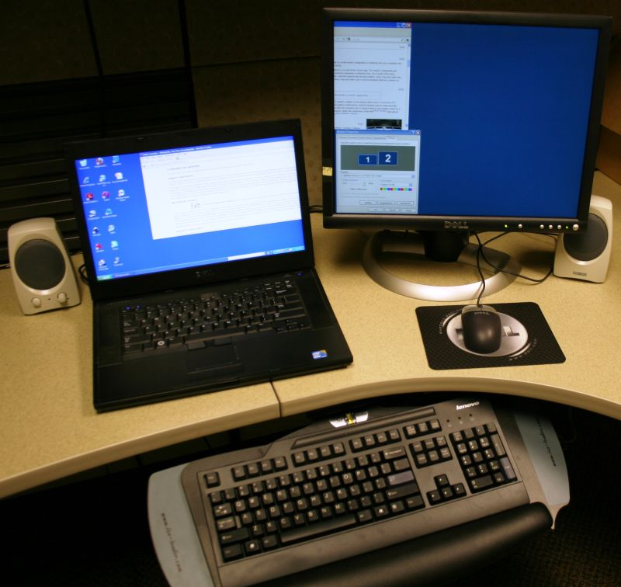
Two for the price of one!

Slide 8
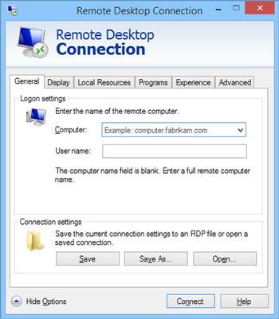
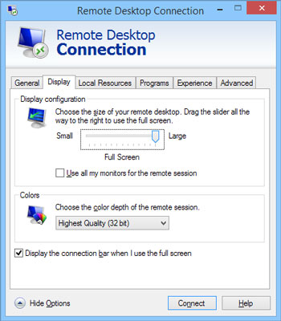
Yes! If you have dual monitors at work you can have them at home

Slide 9
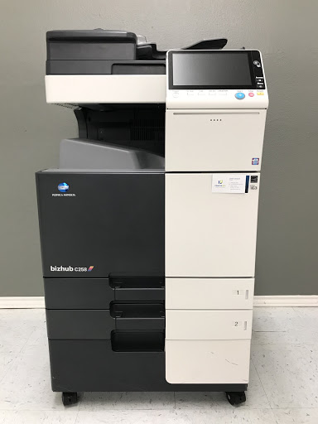
Hey now… what do we have here?

Slide 10
If you’re office happens to have a Konica Minolta Printer from The Print Shop with an installed FAX card…
There are a couple of features we have recently uncovered that might be of interest to you:
FAX to email…. Incoming FAX’s can be sent to a departmental email address as a .pdf attachment
Print to FAX (still in testing stage) will allow you to send a document you have on your desktop via FAX.

Slide 11
Dropped Connections
When we first started working from home I was experiencing a problem where either my remote desktop session would just seem to freeze or my vpn session would disconnect/reconnect. In either case closing/opening remote desktop would get me reconnected and I could just pickup where I left off. This however began to occur multiple times a day was getting to be a bit frustrating.
I ended up getting a really long CAT6 network cable and running it directly from my home router to my laptop. That virtually eliminated the problem.

Slide 12
If you ever connect and see this:

Slide 13
Call the ITS Service Desk
They can send a command to your computer that will restart the computer which will restore the normal look and feel that you’re used to.

Slide 14
Using Microsoft Teams with Remote Desktop
There is a way to make it work using Remote Desktop so that you can have video and microphone and not have to toggle between your home computer and your Remote Session

Slide 15
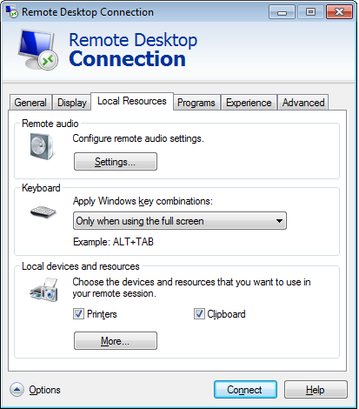
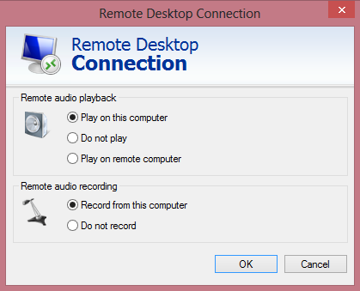
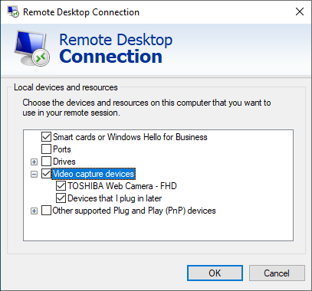
Speaker and Mic access with Remote Desktop and Teams

Slide 16
Settings needed to be changed in Teams

Slide 17
Whatever you do… don’t shutdown

Slide 18
It’s safe to do the following
Disconnect
disconnects the Remote Desktop session, but leaves you logged on your office computer
Sign out
Sign out will disconnect your from the Remote Desktop connection as well as logging you off your office computer
Restart
Restart will disconnect the Remote Desktop session, log you off and restart your office computer
Do not “Shutdown”, if you “Shutdown” it will power off your office PC, requiring someone to physically visit your office to turn it on.

