Slide 1
SSPI vs. SSPI-2: Which measure is a better predictor of sexual recidivism?
Melissa O’Donaghy & Kelly M. Babchishin
melissaodonaghy@cmail.carleton.ca
4th Annual Canadian Forensic Psychology Virtual Conference, February 9th, 2024

Slide 2
Research Team: Grace Culp, Rachael Zarbl, & Alexis Hinkson
Notes:
Before I move forward with my presentation, I would like to thank my colleagues Grace, Rachael and Alexis’ for their contribution to this project.

Slide 3
What is pedophilia?
Atypical sexual interest defined by persistent and ongoing sexual interest in prepubescent children (Seto, 2009)
Leading factor in the onset and maintenance of child sexual abuse (Seto, 2018)
Notes:
So what is pedophilia?
Pedophilia is an atypical sexual interest defined by persistent and ongoing sexual interest in prepubescent children.
Pedophilic interest has been identified as a leading factor in the onset and maintenance of child sexual abuse.
Given that atypical sexual interest is a strong predictor of sexual recidivism, it is an important factor to consider in the management of individuals with prior sexual offenses.

Slide 4
Methods to assess sexual interest in children
Self-report Pedneault et al. (2021)
Easy to administer
Inexpensive
Social desirability
Impression management
Notes:
There are several methods that can be used to assess sexual interest in children.
For instance, self-report measures which are easy to administer and inexpensive.
However, they are susceptible to social desirability and impression management.

Slide 5
Methods to assess sexual interest in children
Attentional or viewing tasks Babchishin et al. (2013)
Does not require direct questioning
Inexpensive
Easy to administer
Less researched
Notes:
There are also attentional or viewing tasks, where the strength of cognitive associations is assessed by comparing reaction times to different pairings of concepts.
This method has the advantages of not requiring direct questioning, it is inexpensive and also easy to administer.
However, it is less researched compared to other methods.

Slide 6
Methods to assess sexual interest in children
Phallometric testing
McPhail et al. (2019)
Costly
Invasive
Time consuming
No standardization
Objective quantifiable measure of sexual arousal
Large research base
Notes:
Another method commonly used is phallometric testing (which consists of measuring changes in penile erection in response to various stimuli to infer sexual arousal)
This method has the advantages of being one of the best objective quantifiable measure of male sexual arousal and largely researched.
However, it has been criticized as being costly, invasive, time consuming and having no standardization.
Regardless of measurement availabilities, multimethod assessments are preferred as they assist in minimizing validity limitations that are present across different types of measures

Slide 7
Screening
Scale for
Pedophilic
Interests
Seto & Lalumière (2001)
Notes:
Michael Seto and Martin Lalumière designed the SSPI in 2001, which is the Screening Scale for Pedophilic Interests.
It is a file-based measure designed to measure pedophilic interest based on victim and offense characteristics.
It is designed for men have a history of contact or non-contact sexual offenses and have victims aged 15 and younger.

Slide 8
SSPI Seto & Lamumière (2001)
SSPI-2 Seto et al. (2017)
Any boy victim(s)
More than one victim
Any prepubescent victim(s)
Any extra familial victim(s)
Any boy victim(s)
More than one victim
Any prepubescent victim(s)
Any extra familial victim(s)
Child pornography offence
2
1
1
1
1
1
1
1
1
Notes:
The SSPI is composed of four items: any boy victim, more than one victim, any prepubescent victim, and any extrafamilial victim.
Each of these items receive a score of either 0 (which is no) or 1 (which is yes), except for the first item (being any boy victim) which receives a score of 2, due to its strong correlation with phallometrically tested sexual interest in children.
In 2017, Michael Seto and his colleagues updated the SSPI and decided to incorporate an additional item: child pornography offenses (that decision was based on the growing evidence that men charged with child pornography offenses had stronger penile responses to children than men without child pornography offenses).
During this revision, they also found that the greater weight of the boy victim item in the SSPI was not actually necessary.
Given its recent development, only a few studies have explored the validity of the SSPI-2

Slide 9
Current Study
Goal: Examine the predictive validity of the SSPI and SSPI-2.
Predictive validity: how well the measure of interest can predict a future relevant outcome.
Notes:
The purpose of our study was to examine the predictive validity of the SSPI and SSPI-2.
Predictive validity refers to how well the measure of interest (in this case the SSPI and SSPI-2) can predict a future relevant outcome.

Slide 10
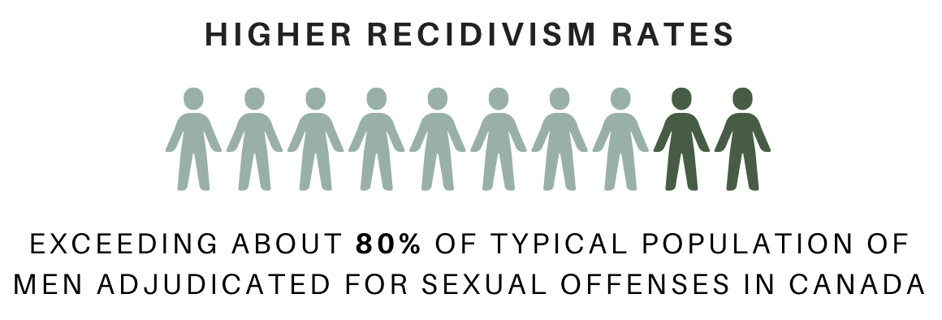
Method
Notes:
The participants came from all provincial regions of Correctional Services of Canada and were undergoing supervision from 1987 to 1997.
It is important to highlight that participants in this sample had higher recidivism rates (as assessed by the Static-99R), exceeding about 80% of the typical population of men adjudicated for sexual offenses in Canada.

Slide 11
Convenience sample from Hanson & Harris (2000)
Men convicted of at least one contact sexual offense in Canada
Removed all participants without any child victims under the age of 15 (n = 117)
Removed at least a minimum 5-year follow-up (n = 28)
Notes:
We used a convenience sample from Hanson & Harris (2000) that was comprised 409 men who were convicted of at least one contact sexual offense in Canada.
Following the inclusion criteria for the SSPI, we then removed all participants without any child victims under the age of 15 (n = 117) and
those who did not have at least a 5-year follow-up (n = 28).
Our final sample included 264 participants.

Slide 12
Ethnicity
Notes:
Here’s a depiction of the ethnicity of our sample. We can see that our sample was predominately White.
As for our analyses, a series of AUCs were conducted to index predictive accuracy of the SSPI compared to SSPI-2
And Delong test was used to determine whether the difference between two AUC’s was statistically significant

Slide 13
AUC for Recidivism Fixed 5-Year
SSPI
Any Sexual
Contact Sexual
Non-Contact Sexual
Notes:
First, we are going to take a look at the AUC values for recidivism at the 5-Year mark.
This graph displays the confidence interval bands centered on the AUC value for the SSPI.
The threshold for a meaningful predictor is .50 and above, which is marked by the horizontal red line.​
We can notice that for the none of the recidivism types reached the threshold of 0.50, meaning that the SSPI was not a successful predictor of sexual recidivism at the 5-year mark.

Slide 14
AUC for Recidivism Fixed 5-Year
SSPI
SSPI-2
Any Sexual
Contact Sexual
Non-Contact Sexual
Notes:
Now for the SSP-2, although the threshold of 0.50 was not reached for contact sexual and non-contact sexual recidivism, we can see that it was reached for any sexual recidivism: meaning that it was a successful predictor of any sexual recidivism at the 5-year mark.

Slide 15
AUC for Recidivism Fixed 5-Year
*
SSPI
SSPI-2
*
Any Sexual
Contact Sexual
Non-Contact Sexual
Notes:
A significant difference between the SSPI and SSPI-2 in recidivism is demonstrated by an asterisk.
We can see that there was a significant difference between both scales in any sexual and non-contact sexual recidivism, where the SSPI-2 was a better predictor than the SSPI.

Slide 16
AUC for Recidivism Fixed 20-Year
SSPI
Any Sexual
Contact Sexual
Non-Contact Sexual
Notes:
Now, we are going to take a look at the AUC values for recidivism at the 20-Year mark.
We can notice that for the SSPI none of the recidivism types reached the 0.50 threshold.

Slide 17
AUC for Recidivism Fixed 20-Year
SSPI
SSPI-2
Any Sexual
Contact Sexual
Non-Contact Sexual
Notes:
Same thing for the SSPI-2, meaning that both measures were not a successful predictor of sexual recidivism at the 20-year mark.

Slide 18
AUC for Recidivism Fixed 20-Year
SSPI
SSPI-2
*
Any Sexual
Contact Sexual
Non-Contact Sexual
Notes:
There was however a difference in predictive accuracy in non-contact reoffending, where the SSPI-2 was a significantly better predictor than the SSPI, but the effect size was smaller than at the 5-year mark.

Slide 19
Discussion
SSPI-2 better predictor than SSPI
Notes:
Although, the SSPI was never constructed to be a risk tool but rather designed to assess sexual interest.
We did in fact find that the SSPI-2 was able to successfully predict any recidivism at the 5-year mark, and that it was a significantly better predictor than the original version for any sexual and non-contact sexual recidivism. It was also a significantly better predictor for non-contact sexual recidivism at the 20-year mark.
Overall, the SSPI-2 proved to be a better predictor than SSPI, suggesting that addition of child pornography item improves its ability of predicting sexual recidivism.

Slide 20
Practical Implications
Notes:
Despite not being mentioned in this presentation, we found evidence of convergent validity, where the SSPI-2 was correlated with similar measures such as the PPG. We also found evidence of incremental validity, where to SSPI-2 added incrementally to other risk assessment scales in predictions of sexual recidivism (e.g., PCL-R)
In general, this study confirms that the SSPI-2 is a valid measure of sexual interest in children.
This could have practical implications for the assessment of pedophilic interests, where the SSPI-2 could be used when phallometric testing is not available. This measure has the advantages of not relying on self-report and being readily obtainable from official records.
Considering that those who score higher on the SSPI-2 exhibit greater pedophilic interests, the scale could be used for treatment prioritization.
The SSPI-2 could also be used to inform risk level of sexual criminality of men with sexual offences against children.

Slide 21
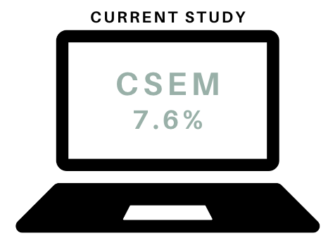
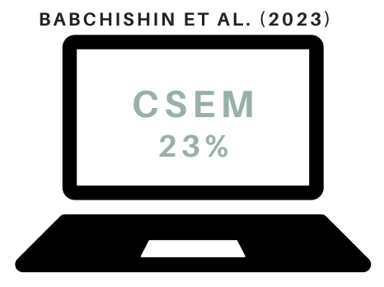
Limitations and Future Directions
n = 264
n = 1350
Notes:
The SSPI-2 has good predictive validity for sexual recidivism, especially non-contact sexual recidivism. One possible limitation is that evaluators wanting to combine the SSPI-2 with other measures of sexual interest may find it difficult given the SSPI-2 does not have standardized risk levels and therefore there would be no easy way to combine the SSPI-2 with risk tools.
Our study also included an older sample that were undergoing community supervision from 1987 to 1997.
7.6% participants had committed a CSEM offense in our study (child sexual exploitation material)
Whereas Babchinshin et al. (2023) found that within 1350 men who had a child-related sex offense, 23% had committed a CSEM offense
So, we would anticipate a more contemporary sample to have higher CSEM offense rates.
Given that CSEM reoffending was not assessed in this study, future research should explore applying the SSPI-2 to men with child pornography offences.

Slide 22
Thank you for listening!
Any questions?
melissaodonaghy@cmail.carleton.ca

