Slide 1
MSW Field Orientation
MSW Practicum II - SOWK 5607
Advanced Year
Summer Term 2023
Presented by: Allison Everett

Slide 2
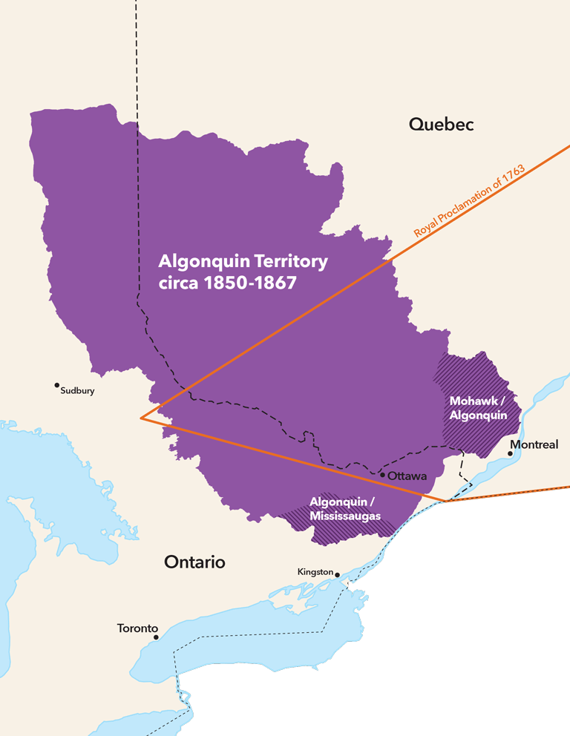
LAND ACKNOWLEDGEMENT
I would like to begin by acknowledging that the land in which Carleton University is located on is the unceded and unsurrendered territory of the Algonquin Anishnaabeg People. The Algonquin peoples have lived on this land since time immemorial.

Slide 3
MSW Practicum Coordinator
Allison Everett
Allison.everett@carleton.ca

Slide 4
Interim Practicum Administrator, Mehak Aziz
SSW.Practicum.Admin@cunet.carleton.ca

Slide 5
Your Practicum Team
You are assigned a Faculty Liaison who facilitates your seminar and follows you on placement
This is a faculty member who is responsible for your grading on placement and assembling all documentation for your file.

Slide 6
Your Practicum Team (cont’d)
Your Field Supervisor provides supervision and completes all your evaluations
Practicum Coordinator oversees the process and intervenes if difficulties arise
Your faculty liaison is your first point of contact, the link between the school and agency, and makes recommendations for grading

Slide 7
Practicum Office Hours
In the interest of setting appropriate professional and personal boundaries, please be advised that the Field team does not reply to emails in the evening or on weekends. We do, however, aim to respond to your email within 5 business days. We are eager to support your learning in your practicum. Please reach out the moment you have a query, so that a timely response can be provided. Thank you.
As this is a professional practice program we ask that all emails are written in a professional manner (i.e appropriate introductory salutations- Dear Allison, Hello Allison, Hi Allison etc)

Slide 8
Where to Find Information
MSW Practicum Hub
https://carleton.ca/socialwork/msw-practicum/
Student Forms and Manuals
MSW Practicum Manual
Field education policies and protocols
Practicum courses & course components
Sample learning contract

Slide 9
SOWK 5607: The Practicum Course
2.0 full credits of degree program
450 hours in the setting. As per new directives from the Canadian Association of Social Work Education, your seminar hours can now count towards your total field hours. Thus, students will only be required to complete 438 hours in the field.
*6 seminars - 2 hours each (Friday mornings)
1 extra hour of seminar (if needed) - 30 mins X 2
Faculty Liaison consultations (1 onsite, 1 telephone)
Written requirements, including evaluations and CUPortfolio page

Slide 10
Academic Prerequisites
Good academic standing in the MSW program
Completion of the following courses:
SOWK 5011 Social Justice Intensive
SOWK 5012 Research
Minimum of 2 credits of electives
Permission of School of Social Work
(Your application is your request for this permission)
Application due by January 10th, 2023

Slide 11
Practicum Courses: 4 Mandatory Components
Field Placement (450 hours) minus 12 hours of practicum seminars hours
Practicum Seminars (12 hours)
Standard Seminars (9:00 – 11:00 am on Fridays)
Supplemental Component (seminar ends at 11:30am)
Faculty Liaison Consultations
Written requirements
Learning Contract
Theory to Practice Assignment x2
Mid- and End-Point Evaluations
Record of Hours
CuPortfolio
Graded = Satisfactory/Unsatisfactory

Slide 12
Placement Dates (May vary by setting)
First day is Thursday May 4th, 2023
Last day is approximately Tuesday August 16th, 2023
4- 5 days/week (32 to 40 hours per week)
You will be on placement during reading week

Slide 13
FAQ
Do I have to find my own placement?
No, quite the contrary.
Students are strongly advised AGAINST soliciting placements directly with community agencies. Why?
Agency request
Direct contact can jeopardize placements for everyone.
Equitable process for all

Slide 14
Attendance & Absences Policy Section 9.7 of the MSW Practicum Manual
Field hours only accrue when you are in placement (not on stat holidays or sick days).
During reading weeks, students should remain in the agency and follow the agency calendar
Absence due to illness exceeding 2 days (see medical leave policy)

Slide 15
Summer 2023 Placement Delivery Options (See Practicum Hub, MSW Summer 2023 Messaging)
Designed to increase field placement capacity & options
Students are to rank the options on the MSW Practicum Application Form – due January 10th
^{Options:}
^{1. Matched by the School}
2. Place of Employment (new agency or place of employment)
3. Distance placement (new agency or place of employment)
*Deadline to express interest in a distance placement has passed

Slide 16
Summer 2023 Placement Delivery Option (See Practicum Hub, MSW Summer 2023 Messaging)
Matched by School
Matches based on students’ agencies/areas of interests and learning needs & the availability and criteria of field sites
Check Carleton email regularly!
3 days to confirm interest before option will be extended to other students
Provide tailored cover letter and resume for the specific position by the stated deadline
Matches occur with settings in Ottawa & immediate surrounding regions only

Slide 17
Summer 2023 Placement Delivery Option (See Practicum Hub, MSW Summer 2023 Messaging)
Place of Employment (Former or Current)
Criteria:
Must demonstrate you will be engaged in new work activities that allow you to develop new learning at a MSW level
Must meet field hour requirements
Can be paid OR unpaid
Appropriate placement supervision must be established
Setting must meet responsibilities of field sites
Workplace Placement Proposal due: February 24th

Slide 18
Summer 2023 Placement Delivery Option (See Practicum Hub, MSW Summer 2023 Messaging)
Distance Placement Criteria:
Must demonstrate that you will be engaged in placement activities that allow you to develop learning at a MSW level
Must meet field hour requirements
Can be paid OR unpaid
Appropriate placement supervision must be established
Setting must meet responsibilities of field sites
Distance Placement Proposal due: February 24th

Slide 19
Steps in setting up your placement
Submit Practicum Application Form (Due January 10th)
Place of Employment and Distance Proposal Form is due by February 24th (If you elect to be matched by the Scholl will need to inform the Coordinator by February 24th)
Coordinator sends to agency (student copied)
Remain in contact with Coordinator (throughout the process)
Attend interview with placement setting
Confirm the placement and complete paperwork (due approximately April 1st)
Ensure all pre-placement requirements are met (police check, etc.)
Register for the Practicum course
Notes:
All these steps are considered mandatory.

Slide 20
Where will you be matched? You will be asked for a cover letter
Cover letter requests will be made by the Coordinator between mid January to early February, and could extend beyond into March
This is how you will be informed of your first match.
Cover letter and resume returned to Coordinator to be sent out from the School
Applications are sent out to one agency only
If ‘turned back’, Coordinator will work with you on next steps and alternatives

Slide 21
The matching
Your resume and cover letter is sent by Coordinator (copy to you)
Student responsibilities:
follow up immediately to ‘close the loop’ and kindly inquire as to the possibility of an interview
Ongoing follow up as needed
You are expected to do multiple follow ups before asking for assistance – phone, email etc.
(Agencies react negatively when the School follows up)
*Remember, your application is only one of many priorities for the agency
Keep in touch with Coordinator. The coordinator needs to know:
Interview date
Difficulty making contact (after multiple attempts)
Inability to offer you a placement?
Placement offered and accepted?

Slide 22
Use Carleton email! Placement is a time-sensitive issue
Throughout, for consistency and professionalism, and to identify as a Carleton student.
Primary mechanism for communication.
Check often! You don’t want to miss this communication during the placement process.

Slide 23
Field realities that may impact you:
Placements are never guaranteed, but we enjoy very positive relationships with multiple organizations. Our timelines match the deadlines set by multiple organizations.
Increasing pressure on agencies to place students – there may be other candidates from other schools
‘Turn backs’ can and do happen due to unexpected changes in the setting
Need to balance proactivity (push) with the reality of the agency’s internal process. A slow response does not equal a poor placement or a lack of interest in the placement.

Slide 24
Field Realities that may impact you:
Some students will confirm early, some quite late. This is not a reflection of the quality of the placement. More likely the process of the agency and/or the style of the placement contact person.
Field Supervisors are not paid nor compensated. The pace of their work and their realities are also changing.
I rely on you to keep me aware of what’s happening, and we will plan a strategy together.
Try not to panic if your application seems to stall. Keep in touch with the Coordinator.

Slide 25
Large organizations, coordinators and trending organizations
Large organizations are increasingly assigning placement coordination to either a Human Resources professional, or a designated social work coordinator.
Students identify practice areas of interest in their application, but are not guaranteed matching in that area.
Flexibility is needed.
Timelines will be longer, due to multiple layers of process and interview. I.e. Internal committees, screening interviews, etc.
Detail on exact supervisor, previous experiences etc. may not be available to you prior to being connected with the agency.

Slide 26
Where interest from students exceeds availability
Where student interest is excessively high, multiple Carleton applications can be sent and screening will be done by the agency. This takes time.
You can choose to be part of this process, or simply choose another agency.
Students who are unsuccessful in agency screening will need to be flexible around settings but will be placed again once they are advised that their application is not proceeding.

Slide 27
Shared interests
Keep in mind that the school and you have shared interests.
We both want to see you placed in an efficient manner, as soon as possible, with minimal turn backs, in a rich context of practice learning.
We cannot control the factors that may impact your placement process
Some students will apply to 2-4 agencies. This is hard to predict, and if it is you, please be advised it is an expected part of what it takes to place MSW students in the current climate.
You will be well-supported to navigate the process and find your placement

Slide 28
Realities
Placements cannot be guaranteed
No field site is required to offer field placements to our students
No financial incentives
Offered on a voluntary basis – when an applicant meets the placement criteria & when agency resources enable student involvement & supervision
May consider applicants from multiple institutions & programs
Availability can change
Why do agencies partner with the School?
To support your education and the profession
Professional development
Students contribute new ideas, knowledge, skills & energy to the organization
May be part of recruitment strategy
If a placement cannot be established for any reason, we will work with you to identify your options for deferral & staying on track with your degree progression, wherever possible, through alternative course sequencing.

Slide 29
The Placement Interview
Know the organization and be able to identify your areas/programs of highest interest
Review website thoroughly!
A different kind of interview – you don’t have to qualify. Balance your strength with your needs as a learner.
Demonstrate openness to learning and how past experience/education will support you to enter this learning environment.

Slide 30
The Interview – hours etc.
You may be asked about start dates and end dates
“Do the math” and be ready to put forward a proposed plan for working your 450 field hours.
You are available Monday to Friday (excluding time spent in field seminars)
Fridays will be seminar and group work class until 2:30pm
Be clear about your availability – evenings, weekends, daytime hours, long days
It is important to identify any scheduling accommodations required in your application form that you submit to the Coordinator and again at interview

Slide 31
Preparing for placement – Summer Term 2023
450 hours “on-the-job” required
Thursday May 4th is the expected start date
Classes end Wednesday August 16th (13 weeks)
Additional week if needed, until August 23rd (14 weeks)
You need to work throughout reading week
Sick time does not count
Workday will vary: 7, 7.5, 8, 12 hours per day
Seminar hours now count towards your total field hours
Calculate Hours in Advance

Slide 32
Exceptions
Extensions due to illness, bereavement etc. are possible if needed, but will require approval by practicum coordinator and the Faculty of Graduate and Postgraduate Affairs.
Your faculty liaison will ask you to track hours throughout the placement.
This is not a trust issue, but for your own protection.
If you have concerns about achieving the full 450 hours, communicate directly with your liaison.
A very rigidly surveiled accreditation standard. There is no wiggle room on the 450 hours.

Slide 33
You’ve got an offer! Steps to Confirm:
Allison and the Practicum Adminstartor will email details once you have been offered and accept a placement.
An MSW Practicum Agreement Form and various insurance documents (ie. Health and safety coverage; COVID-19 training, etc) will need to be completed to finalize the placement.
It is the student’s responsibility to get forms to Supervisor, get signatures and return the forms to the School by the deadline provided (December 1st).

Slide 34
Forms the Practicum Administrator
Signed and scanned forms are ok, and can be emailed to SSW.Practicum.Admin@cunet.carleton.ca
The Practicum Administrator will let you know how to register for seminar groups

Slide 35
Pre-placement Requirements
Clarify and attend to all pre-placement requirements (police check, training, immunizations etc.)
This is your responsibility. Ask at your interview.
Mode of practicum (i.e in person, online or hybrid)
Additional training may be required (online)
Police record checks can be applied for online. Start the process ASAP. Letters to support (if needed) are available by emailing the Practicum Administrator at SSW.Practicum.Admin@cunet.carleton.ca

Slide 36
Don’t forget to register!
Students will be assigned to a section in which to register.
Please communicate directly with the Practicum Administrator to find out what section you should register in.
May 31st is last day to withdraw from a course with no notation on transcript. No fee adjustment, if applicable, if withdrawal occurs later than this date.

Slide 37
Seminar Summer 2023 Dates
Fri., May 12 9-11:00
Fri, May 26 9-11:30*
Fri., June 09 9-11:00
Fri., June 23 9-11:00
Fri., July 7 9-11:30*
Fri., July 21 9-11:00
*Supplemental Support component 11:00 – 11:30

Slide 38
A note about field supervisor requirements
Field component of the degree is part of the accredited curriculum
**CASWE Accreditation standards for field may impact on whether or not your chosen placement setting can be approved
MSW II field supervisors “will typically hold a BSW or MSW degree from an accredited School of Social Work”
Non-social work supervisors can be approved, but learning opportunity must be aligned with learning objectives (see manual)
All Faculty Liaisons are MSW social workers, and play a role in providing social work supervision if needed.

Slide 39
Matching Policies Section 4.2 of the MSW Practicum Manual
Students are permitted to apply to one setting at a time only. Once you apply to a setting, you will not be offered alternative options
Please fully review the placement information & website
In electing to apply, you are demonstrating your full commitment to proceeding with the setting
Students are not permitted to withdraw from a confirmed placement for another opportunity at a later time.
Notes:
Once you have accepted a placement, you are not permitted to change your placement setting.

Slide 40
Matching Policies Section 4.2 of the MSW Practicum Manual
Students are not to reach out to agencies to inquire about field placements unless permission has been received in advanced from a Practicum Coordinator
Specific request of field sites
To ensure a fair and equitable process for all students
Can jeopardize placement opportunities for that student and others

Slide 41
Practicum Coordinator
Student
Field capacity, policies and curriculum
Respond to applications
Oversee matching process
Send your application forward to agency & support placement process as needed
Provide forms & ongoing information
Link you with FL and seminars
Accommodations
Flexibility & openness to a range of settings
Check email regularly, prompt responses & ongoing communication
Research setting, tailor cover letter, proof-read, send in Word format. CU email only.
Prepare for interview (references)
Finalize placement
Read manual & term info

Slide 42
Learning Contract: Why?
Highlights that the purpose of the placement is the student’s learning
Basis for accountability
Evidence of learning relative to curriculum outcomes
Establishes baseline against which progress and development is measured.
Safeguards the student

Slide 43
The Learning Contract
Exemplar appears in MSW Manual
Template posted on Practicum Hub
Learning Contract is drafted by student once placement is confirmed
Within two weeks, consult with Field Supervisor, make adjustments and make available to faculty liaison.
Draft reviewed at on-site Consultation with Faculty Liaison and finalized shortly after

Slide 44
Integrate the qualitative feedback from SOWK 5001
The qualitative feedback on your practice development in 5001 (Interpersonal Practice in Social Work) will contain valuable information about your learning needs on placement.
You are strongly encouraged to integrate this feedback in your learning contract.
Interpersonal skills have relevance to all areas of practice
Research
Policy Practice
Community Development
Direct practice
Your faculty liaison will engage you in a discussion of how your practice learning needs can be addressed as part of your placement.

Slide 45
The Social Work Learning Contract
Objective | Task/Action | Evaluation
What is my learning goal? Consider these areas: Ethics and Values Organizational Context of Practice Community Context of Practice Social Work Knowledge and Skills Professional Identity and Philosophy of Practice | How will I accomplish this goal? What tasks will I do? What resources do I need? | Indicators What will I be able to do if I reach this goal? Evidence What task or product will demonstrate your learning?

Slide 46
Objective What is my learning goal? | Task/Action What tasks do I do? What resources do I need? | Evaluation Indicators? Evidence?
To learn how to conduct screening and assessments for substance abuse disorders

Slide 47
Objective What is my learning goal? | Task/Action What tasks do I do? What resources do I need? | Evaluation Indicators? Evidence?
To learn how to conduct screening and assessments for substance abuse disorders | To observe screening and assessments being conducted by staff To review screening and assessment forms and instruments used by agency To read best practices guidelines for screening and assessment of substance abuse disorders

Slide 48
Objective What is my learning goal? | Task/Action What tasks do I do? What resources do I need? | Evaluation Indicators? Evidence?
To learn how to conduct screening and assessments for substance abuse disorders | To observe screening and assessments being conducted by staff To review screening and assessment forms and instruments used by agency To read best practices guidelines for screening and assessment of substance abuse disorders | Identify the basic steps to screening and assessment for substance abuse disorders Identify common instruments used in assessing substance abuse disorders Identify key considerations in treatment matching Will conduct at least one screening and assessment during Practicum Will obtain feedback from supervisor to ensure my work is accurate and meets agency standards.

Slide 49
Why make a strong learning contract?
Your student evaluations (x2) will make direct reference to your learning contract
Invest in a good learning contract process in order to ease your process of self-evaluation

Slide 50
Theory-to-Practice Assignments and CuPortfolio
2 Reflective Journal Entries: 5 pages each
SOWK 5607 CUPortfolio Page
A summative collection of evidence of learning on placement
Required components, including a retrospective placement description and the final reflective paper
Evaluated by Faculty Liaison
Deadlines set by Faculty Liaison

Slide 51
SOWK 5607 CUPortfolio Page
A collection of evidence of learning on placement including identification of transferable skills and a final reflection on power and powerlessness in practice
Placement setting description is to be approved by field supervisor for sharing in closed intranet site for future students – to familiarize them with options in field
CUPortfolio Collection (end of program) created and saved at the end of placement.
Details in hard copy and digital format will be provided by faculty liaison.
Full details are located in MSW Practicum Manual, and technical instructions located on Practicum Hub website.
Example portfolis:
https://cuportfolio.carleton.ca/view/view.php?t=fkg80UjvPyOo7XuK5dt1
https://cuportfolio.carleton.ca/view/view.php?t=QXLV8b0OPm2JW5f6spyC
Evaluated by Faculty Liaison
Assessed for Content and Design/Communication

Slide 52
Portfolio Contents: Practicum II
Organization and practice setting description
Identification of transferable skill and competencies
Learning contract
2 excerpts from previous theory-to-practice assignments
Final Reflection on Power (400 words)
Creation of portfolio collection (entire program) and submission
Portfolios are assessed for Content and Design/Communication
Satisfactory/Unsatisfactory

Slide 53
Evaluation Forms
Mid-point and End-Point Evaluation forms for Students and for Field Supervisors are online.
Forms must be signed by you and field supervisor but can be signed, scanned and emailed to faculty liaison
Field Supervisor – uses template to give feedback on competencies, strengths and challenges, achievements and areas for development.
Student – Self-evaluation is guided by template and centers on the learning contract.

Slide 54
What field supervisors say they look for…
Students who:
Present themselves professionally
Are prepared – have researched setting & area of practice (demonstrated by application/interview)
Are able to speak about their relevant skills & experience
Demonstrates initiative – follows up / organized / able to answer questions about the placement requirements
Are enthusiastic and have a positive attitude
Are open to learning
Student’s learning interests in line with what the setting can offer
Self-directed – takes initiative for own learning

Slide 55
Finally
Letters to confirm your MSW degree are available from the School.
All final documentation must be submitted first, and grade recommendation by faculty liaison complete.
All requests to Mehak Aziz:
Letter to confirm degree
Letter to OCSWSSW (The College)
Letters are NOT provided unless you request them.

Slide 56
Questions?
You can reach me at Allison.everett@Carleton.ca

