Slide 1
Contract Instructor Orientation
Instructions:
1. Please mute mic
2. To contribute, raise a virtual hand or add your question/name to the chat
3. When recognized, enable mic & webcam, then ask your question
Take a moment to introduce yourself via the chat!
Fall 2024

Slide 3

Introductions
Lindsay Richardson (she/her) (LindsayRichardson@cunet.carleton.ca)
  Educational Technology Supervisor, TLS
Morgan Rooney (he/him)
(MorganRooney@cunet.carleton.ca)
  Educational Development Coordinator, TLS
Rlv.zcache.com

Slide 4

Agenda
5:30-5:45 – Introductions
5:45-6:00 – TLS Overview & Resources
6:00-6:20 – Small Group Discussions
6:20-7:00 – Group Questions
7:00-7:20 – Break
7:20-8:10 – Group Questions, con’t
8:10-8:30 – Parting Tips & Wrap Up
dare.org

Slide 5

Teaching and Learning Services

Slide 6



What we can offer you:
Connect with your teaching community
Use online resources to help you learn
Participate in workshops and training sessions
Consult with our team

Slide 7
Key Resources Available to You:
Online Orientation Resources page (carleton.ca/tls/events-and-programs/orientations)
Find a Teaching Mentor (carleton.ca/tls/events-and-programs/programs)
TLS Events page (carleton.ca/tls/events-and-programs/events)
TLS Training Programs (carleton.ca/tls/events-and-programs/programs)
One-Stop Shop: Course Consultations, Educational Technology Support, and more (tlssupport.carleton.ca)

Slide 8
Small Group Discussions
6:00-6:20pm

Slide 9

Small Group Discussions
Breakout Rooms (20 mins)
Chat with your peers
Topic: what aspect(s) of teaching your upcoming course is giving you the most concern?
Prepare to report back with a short list of your group’s top 3-5 concerns
chronicle.brightspotcdn.com

Slide 10
Group Questions
6:20-7:00pm

Slide 11

Group Questions
Time to share!
What issue(s) did your group discuss?
What solution(s) or suggestion(s) did your peers offer?
martech.org

Slide 12

Break Time!
General Inquiries:
tls@carleton.ca
Please be back in 20 mins
Brightspace Support:
Phone: 1-877-325-7778
tlssupport.carleton.ca
Zoom & All Other Ed Tech Support:
tlssupport.carleton.ca

Slide 13
Group Questions, con’t
7:20-8:10pm

Slide 14

Brightspace Training
Asynchronous Option:
  Sign up for the “Brightspace Basics Online” course (use the “Discover” tool on Brightspace)
  Work through the training modules
  Complete the Feedback Survey to confirm your completion
  One-time payment of $120, paid three times a year
D2l.com
Notes:
Direct link to the Brightspace course in Discover: https://brightspace.carleton.ca/d2l/le/discovery/view/course/204978

Slide 15
Group Questions
Let’s hear some other issues / questions your group discussed!
What issue(s) did your group discuss?
What solution(s) or suggestion(s) did your peers offer?
martech.org

Slide 16
Wrap Up
8:10-8:30pm

Slide 17

Parting Tips
“Top tips” from TLS facilitators
steelbone.co.uk

Slide 18


Key Take-Away
Use the Resources Available:
Online Orientation Resources
Teaching Mentors
Teaching Resources & Tips
Teaching Online & Hyflex
Notes:
Hyperlink: https://teachinginhighered.com/podcast/intentional-tech/

Slide 19
Key Take-Away
Key Contacts:
TLS (tlssupport.carleton.ca)
Resources for You/Students (carleton.ca/tls/events-and-programs/orientations)
CUPE 4600 (info@cupe4600.ca)
Notes:
Hyperlink: https://teachinginhighered.com/podcast/intentional-tech/

Slide 20
Key Take-Away
For EdTech:
Use Carleton-supported EdTech tools (e.g., Brightspace, H5P, Zoom)
Intentional Tech: let your Learning Outcomes drive the decisions around tech
Notes:
Hyperlink: https://teachinginhighered.com/podcast/intentional-tech/

Slide 21
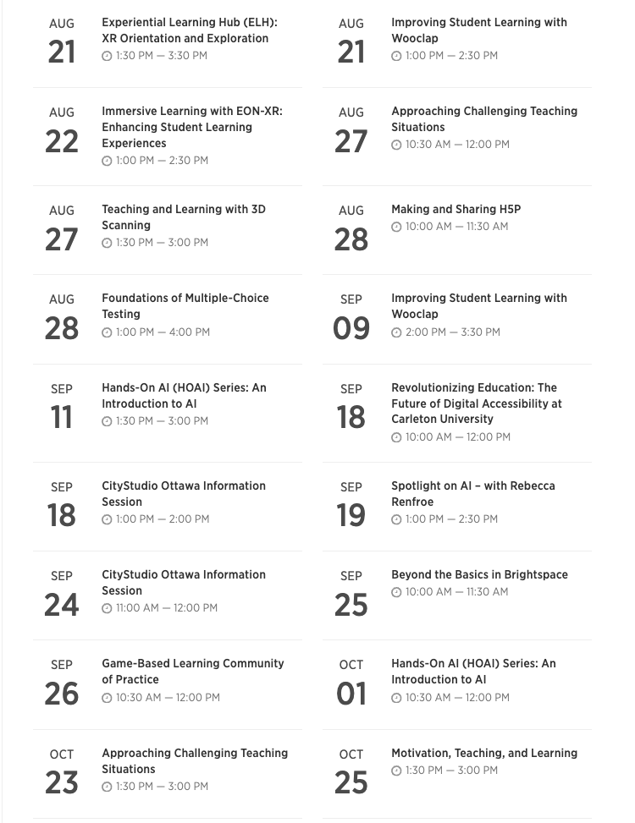
Upcoming Workshops
TLS webpage
carleton.ca/tls
Course Consultation Request form:
tlssupport.carleton.ca
Brightspace Support
tlssupport.carleton.ca

