Slide 1
Contract Instructor Orientation
Instructions: 1. Please mute mic
2. To contribute, raise a virtual hand or add your question/name to the chat
3. When recognized, enable mic & webcam, then ask your question
Take a moment to introduce yourself via the chat!
Spring 2025

Slide 3

Introductions
Dr. Lindsay Richardson (she/her) (LindsayRichardson@cunet.carleton.ca)
Educational Technology Manager, TLS
CI, Dept of Psychology
Morgan Rooney (he/him) (MorganRooney@cunet.carleton.ca)
Educational Development Coordinator, TLS
CI, Dept of English
Rlv.zcache.com

Slide 4

Agenda
5:30-5:45 – Introductions
5:45-6:00 – TLS Overview & Resources
6:00-6:20 – Small Group Discussions
6:20-7:00 – Group Questions
7:00-7:20 – Break
7:20-8:10 – Group Questions, con’t
8:10-8:30 – Parting Tips & Wrap Up
dare.org

Slide 5

Teaching and Learning Services

Slide 6



What we can offer you:
Connect with your teaching community
Use online resources to help you learn
Participate in workshops and training sessions
Consult with our team
Notes:
Hyperlinks to have handy:
https://carleton.ca/tls/events-and-programs/events/
Paul Menton Centre: https://carleton.ca/pmc/
https://carleton.ca/tls/
https://carleton.ca/brightspace/instructors/
Teaching Mentors: https://carleton.ca/tls/events-and-programs/programs/faculty-teaching-mentors/
Events Page: https://carleton.ca/tls/events-and-programs/events/

Slide 7
Key Resources Available to You:
Online Orientation Resources page (carleton.ca/tls/events-and-programs/orientations)
Find a Teaching Mentor (carleton.ca/tls/events-and-programs/programs)
TLS Events page (carleton.ca/tls/events-and-programs/events)
TLS Training Programs (carleton.ca/tls/events-and-programs/programs)
One-Stop Shop: Course Consultations, Educational Technology Support, and more (tlssupport.carleton.ca)

Slide 8
Course Design Fundamentals Workshops
Revisit the foundational principles of course design
Workshops usually offered multiple times a year
Next cohort: May 26 – June 20
Enroll any time: carleton.ca/tls/events-and-programs
Individual workshop registration: carleton.ca/tls/events-and-programs
Flexible structure (attend workshop when it suits you)

Slide 9
Core CDF Workshops
Elective CDF Workshops
Designing Learning Experiences from Scratch (May 26)
Learning Outcomes: Blueprints of Course Design (May 28)
Assessment Fundamentals (June 2)
The Power of Visual and Verbal Integration (June 4)
Incorporating Effective Online Activities and Communication Strategies into your Course (June 9)
Incorporating Activities into Smaller Lecture Classes (N/A)
Incorporating Activities into Larger Lecture Classes (June 19)

Slide 10

Course Design Fundamentals Program
Complete 5 CDF workshops (4 core and 1 elective)
To complete the workshop, you will:
Attend the workshop
Submit the post-workshop activity where you will apply the principles and strategies you learned in the workshop in the context of your course
Receive a constructive feedback from lead facilitators
+ Submit a Reflection Paper
carleton.ca/tls/events-and-programs/programs/
Letter of Completion

Slide 11
Small Group Discussions
6:00-6:20pm

Slide 12

Small Group Discussions
Breakout Rooms (20 mins)
Chat with your peers
Topic: what aspect(s) of teaching your upcoming course is giving you the most concern?
Prepare to report back with a short list of your group’s top 3-5 concerns
chronicle.brightspotcdn.com

Slide 13
Group Questions
6:20-7:00pm

Slide 14

Group Questions
Time to share!
What issue(s) did your group discuss?
What solution(s) or suggestion(s) did your peers offer?
martech.org

Slide 15

Break Time!
General Inquiries:
tls@carleton.ca
Please be back in 20 mins
Brightspace Support:
tlssupport.carleton.ca
Zoom & All Other Ed Tech Support:
tlssupport.carleton.ca

Slide 16
Group Questions, con’t
7:20-8:10pm

Slide 17

Brightspace Training
Asynchronous Option:
Sign up for the “Brightspace Basics Online” course (use the “Discover” tool on Brightspace)
Work through the training modules
Complete the Feedback Survey to confirm your completion
One-time payment of $120, paid three times a year
D2l.com
Notes:
Direct link to the Brightspace course in Discover: https://brightspace.carleton.ca/d2l/le/discovery/view/course/204978

Slide 18
Group Questions
Let’s hear some other issues / questions your group discussed!
What issue(s) did your group discuss?
What solution(s) or suggestion(s) did your peers offer?
martech.org

Slide 19
Wrap Up
8:10-8:30pm

Slide 20

Parting Tips
“Top tips” from TLS facilitators
steelbone.co.uk

Slide 21


Key Take-Away
Use the Resources Available:
Online Orientation Resources
Teaching Mentors
Teaching Resources & Tips
Teaching Online & Hyflex
Notes:
Hyperlink: https://teachinginhighered.com/podcast/intentional-tech/

Slide 22
Key Take-Away
Key Contacts:
TLS (tlssupport.carleton.ca)
Resources for You/Students (carleton.ca/tls/events-and-programs/orientations)
CUPE 4600 (info@cupe4600.ca)
Notes:
Hyperlink: https://teachinginhighered.com/podcast/intentional-tech/

Slide 23
Key Take-Away
For EdTech:
Use Carleton-supported EdTech tools (e.g., Brightspace, H5P, Zoom)
Intentional Tech: let your Learning Outcomes drive the decisions around tech
Notes:
Hyperlink: https://teachinginhighered.com/podcast/intentional-tech/

Slide 24
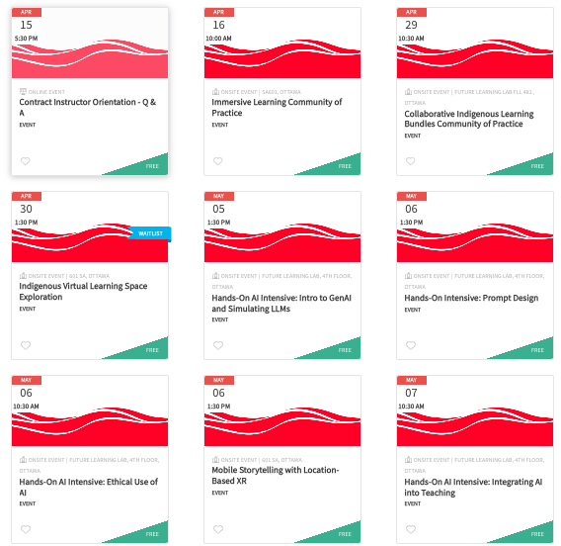
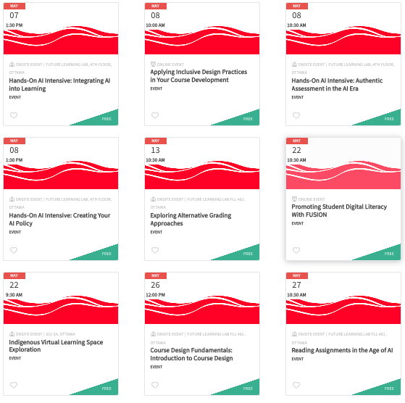
TLS webpage carleton.ca/tls
Brightspace Support tlssupport.carleton.ca
Course Consultations tlssupport.carleton.ca

