Slide 1
Contract Instructor Orientation
Winter 2022
Instructions: 1. Please mute mic & disable webcam
2. When you want to contribute, type
“question” or “comment” in the Chat box
3. When recognized, enable mic & webcam,
then ask question or make comment
Online Resources page for New CIs carleton.ca/tls/events-and-programs/orientations
Take a moment to introduce yourself via the chat!

Slide 2
Carleton University acknowledges the location of its campus on the traditional, unceded territories of the Algonquin nation.

Slide 3
Introductions
Jaymie Koroluk (jaymie.koroluk@carleton.ca)
Assistant Director, Teaching Excellence and Innovation
Elspeth McCulloch (elspeth.mcculloch@carleton.ca)
Assistant Director, Digital Learning
Frank Heney (frank.heney@carleton.ca)
Supervisor (Acting), Educational Technology
Ryan Kuhne (ryan.kuhne@carleton.ca)
Special Projects, Educational Technology
Kim Loenhart (kim.loenhart@carleton.ca)
Supervisor (Acting), LMS Transition Project
Maristela Petrovic-Dzerdz (maristela.petrovicdzerdz@carleton.ca)
Supervisor, Instructional Design
Morgan Rooney (morgan.rooney@carleton.ca)
Educational Development Coordinator

Slide 4
Agenda
5:30-5:45 - Introductions
5:45-6:00 - TLS Overview & Resources
6:00-7:00 - Questions
7:00-7:20 - Break
7:20-8:20 - Questions, con’t
8:20-8:30 - Wrap Up

Slide 5
Teaching and Learning Services
The same, but different!

Slide 6
What we can offer you:
Connect with your teaching community
Use online resources to help you learn
Participate in workshops and training sessions
Consult with our team

Slide 7
Key Resources Available to You:
CIO Online Resources page (carleton.ca/tls/events-and-programs/orientations)
Teaching Online & Hyflex (carleton.ca/tls/teaching-online)
Course Consultation Request Form (carleton.ca/tls/course-consultation)
TLS Technical Support (tlssupport.carleton.ca)
Brightspace Instructor Support (carleton.ca/brightspace)
TLS Events page (carleton.ca/tls/events-and-programs/events)
Teaching Blogs (carleton.ca/tls/blog)
Find a Teaching Mentor (carleton.ca/tls/events-and-programs/programs)
Email: tls@carleton.ca
TLS Training Programs: carleton.ca/tls/events-and-programs/programs

Slide 8
Course Design Fundamentals Workshops
Revisit the foundational principles of course design
Workshops usually offered three times a year
next round: February 15th – March 1st
registration: carleton.ca/tls/events-and-programs/events
Flexible structure (attend workshop when it suits you)

Slide 9
Core CDF Workshops
Elective CDF Workshops
Designing Learning Experiences from Scratch
Learning Outcomes: Blueprints of Course Design
Assessment Fundamentals
Learning Effectively with Multimedia Instruction
Incorporating Effective Online Activities and Communication Strategies in your Course
(Incorporating Activities into Smaller Lecture Classes)
(Incorporating Activities into Large Lecture Classes)

Slide 10
Course Design Fundamentals Program carleton.ca/tls/events-and-programs/programs/
Complete 5 CDF workshops (4 core and 1 elective)
To complete the workshop, you will:
Attend the workshop
Submit the post-workshop activity where you will apply the principles and strategies you learned in the workshop in the context of your course
Receive a constructive feedback from lead facilitators
+ Submit a Reflection Paper
Letter of Completion

Slide 11
Questions
6:00-7:00pm

Slide 12
Questions
In advance of this session, you had the chance to review materials provided on the carleton.ca/tls/events-and-programs/orientations website
For the first half of our session, we’d like to see what questions you have about:
Your Union (CUPE 4600)
Policies & Procedures
Resources for You/Students
Online Teaching, Ed Tech
F2F, HyFlex Teaching
Other
To participate, just type “question” or “comment” in the Chat menu, then enable mic/webcam when called upon to contribute
cdn.psychologytoday.com

Slide 13
Issues We Could Explore
I used to do XXX in cuLearn: (how) can I do that in Brightspace?
What do I do for course readings/textbooks?
What should be / has to be in my syllabus?
How do I deal with requests for accommodations (LoAs)?
What do I do if I think I have an academic integrity case on my hands?
What's a Brightspace? Where do I get started?
What benefits do I have as a CUPE 4600 member? How do I access/take advantage of those?
I teach in XXX department. What student services are most relevant for my students?
Should I do a ‘regular’ exam online, or a take-home? When do I have to decide?

Slide 14
Issues We Could Explore
Should I design my course as synchronous or asynchronous, or some mix thereof?
If synchronous, do I use Zoom? BigBlueButton? Teams? Other?
What suggestions do you have for ways to make sure students are engaging with weekly lessons?
I want to have my students do XXX… do we have any ed tech tools to help me to do that?
What ed tech tools do you think are mostly likely to help me in the current moment/situation?
What does a good communications strategy for an online course look like?
What are your top tips for first time instructors & instructors teaching online for the first time?
I’m overwhelmed and don’t know where to begin… help!

Slide 15
Break time!
General Inquiries:
tls@carleton.ca
Please be back in 20 mins
Brightspace Support:
Phone: 1-877-325-7778
tlssupport@carleton.ca
Zoom & All Other Ed Tech Support:
tlssupport@carleton.ca
Image: Pixabay

Slide 16
Questions, con’t
7:20-8:20pm

Slide 17
Questions, con’t
In advance of this session, you had the chance to review materials provided on the carleton.ca/tls/events-and-programs/orientations website
For the first half of our session, we’d like to see what questions you have about:
Your Union (CUPE 4600)
Policies & Procedures
Resources for You/Students
Online Teaching, Ed Tech
F2F, HyFlex Teaching
Other
To participate, just type “question” or “comment” in the Chat menu, then enable mic/webcam when called upon to contribute
cdn.psychologytoday.com

Slide 18
Issues We Could Explore
I used to do XXX in cuLearn: (how) can I do that in Brightspace?
What do I do for course readings/textbooks?
What should be / has to be in my syllabus?
How do I deal with requests for accommodations (LoAs)?
What do I do if I think I have an academic integrity case on my hands?
What's a Brightspace? Where do I get started?
What benefits do I have as a CUPE 4600 member? How do I access/take advantage of those?
I teach in XXX department. What student services are most relevant for my students?
Should I do a ‘regular’ exam online, or a take-home? When do I have to decide?

Slide 19
Issues We Could Explore
Should I design my course as synchronous or asynchronous, or some mix thereof?
If synchronous, do I use Zoom? BigBlueButton? Teams? Other?
What suggestions do you have for ways to make sure students are engaging with weekly lessons?
I want to have my students do XXX… do we have any ed tech tools to help me to do that?
What ed tech tools do you think are mostly likely to help me in the current moment/situation?
What does a good communications strategy for an online course look like?
What are your top tips for first time instructors & instructors teaching online for the first time?
I’m overwhelmed and don’t know where to begin… help!

Slide 20
Extra Resources

Slide 21
Building a Teaching Team
Working with Your TA(s)

Slide 22
Defining the Role of the TA
Meet before start date to set expectations and organize your roles
What is the scope of their responsibilities (tutorials, grading, labs, discussion groups)?
What are the learning outcomes of the course?
How often would you like to meet with your TA(s), and via what medium? Is your TA(s) able to work on campus this Fall, or online only? Contact your department for questions on TA Assignments to your course
Share syllabus and grading rubrics
Do they attend the synchronous component of course?
Should they hold office hours?
Will you provide feedback on their performance?
Have either of you ever delivered a course online before?
Be explicit in your expectations!

Slide 23
Building a Team in an Online Environment
1. TA as professional:
previous teaching experience
previous TA assignments
previous experience with online learning technology & recommendations
2. TA as invaluable conduit
reports to you on how course is being received and students’ access to internet and technology, can suggest alternatives
reaches out to students uncomfortable/isolated by online format
3. TA as creator of learning activities
utilizes online tools to create discussion forums, virtual office hours, break-out groups, virtual labs; moderating synchronous presentations; answering emails; monitoring Brightspace discussion threads

Slide 24
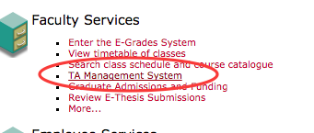
Getting Started: Assigning Duties
Every TA must have their duties assigned to them & recorded centrally via the TA Management System
CUPE 4600 Unit 1 Collective Agreement (14.03)
Full TAship = 130 hrs (per term)
… But ideally, that “assignment of duties” form is something that is produced after meeting to discuss.

Slide 25
Resources for Your TA(s)
TA Support website: https://carleton.ca/tasupport/
TA Central Hub: training & resources (in Brightspace) TAs can be enrolled by contacting: samantha.shortt@carleton.ca
TA Pedagogical training workshops: TAs register through Carleton Central as of Sept. 2021
Workshop topics include: Navigating learning technologies such as Brightspace and Zoom, TA Basics 101, Grading and Feedback, EDI (equity, diversity and inclusion), Running tutorials (for online and in-person classes), Difficult situations

Slide 26
Wrap Up

Slide 27
Key Take-Away
Use the Resources Available:
Teaching Mentors
TLS website -- blogs, WTMOC, CIO online resources
Teaching Online & Hyflex
Quick Guide to TLS Resources for Teaching Online

Slide 28
Key Take-Away
Key Contacts:
TLS (tls@carleton.ca)
CUPE 4600 (info@cupe4600.ca)
Resources for You/Students (carleton.ca/tls/events-and-programs/orientations)

Slide 29
Key Take-Away
For Online Teaching:
Consider asynchronous options
Develop a communications plan
Involve/engage students

Slide 30
Key Take-Away
For Ed Tech:
Use Carleton-supported Ed Tech (Brightspace, Kaltura Capture, BigBlueButton, Zoom)
Let your Learning Outcomes drive which tech you do/don’t adopt

Slide 31
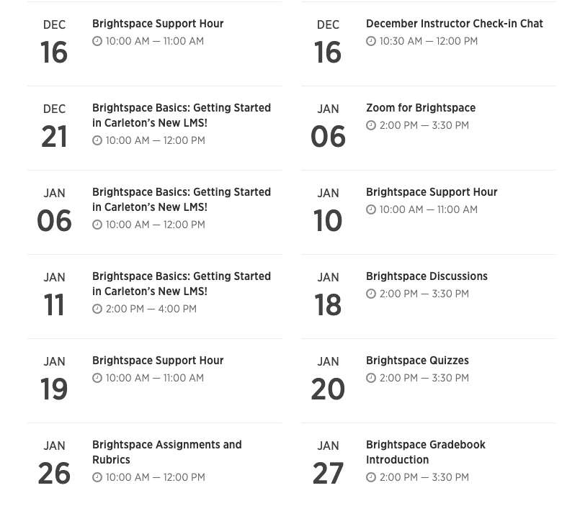
Upcoming Workshops
Online Resources page for New CIs carleton.ca/tls
Contact Info:
tls@carleton.ca
Teaching Online & Hyflex
carleton.ca/tls/teaching-online
Welcome to My Online
Classroom series carleton.ca/tls

