Slide 1
New Faculty Orientation: Q & A
Summer 2021
Instructions: 1. Please mute mic & disable webcam
2. When you want to contribute, type
“question” or “comment” in the Chat box
3. When recognized, enable mic & webcam,
then ask question or make comment
Take a moment to introduce yourself via the chat!
Online Resources page for New Faculty carleton.ca/edc/nfo

Slide 2
Carleton University acknowledges the location of its campus on the traditional, unceded territories of the Algonquin nation.

Slide 3
Introductions
Jaymie Koroluk (jaymie.koroluk@carleton.ca)
Assistant Director, Teaching Excellence and Innovation
Elspeth McCulloch (elspeth.mcculloch@carleton.ca)
Assistant Director, Digital Learning
Frank Heney (frank.heney@carleton.ca)
Supervisor (Acting), Educational Technology
Kim Loenhart (kim.loenhart@carleton.ca)
Supervisor, LMS Transition Project
Maristela Petrovic-Dzerdz (maristela.petrovicdzerdz@carleton.ca)
Supervisor, Instructional Design
Morgan Rooney (morgan.rooney@carleton.ca)
Educational Development Coordinator
Ashley Thompson (ashley.thompson@carleton.ca)
Educational Development Facilitator

Slide 4
Agenda
10:00-10:15 - Introductions
10:15-10:25 - TLS Overview & Resources
10:25-10:40 - Introduction to Ed Tech
10:40-11:55 - Questions, con’t
11:55-12:00 - Wrap Up

Slide 5
Teaching and Learning Services
The same, but different!

Slide 6
What we can offer you:
Connect with your teaching community
Use online resources to help you learn
Participate in workshops and training sessions
Consult with our team

Slide 7
Key Resources Available to You:
NFO Online Resources page (carleton.ca/edc/nfo)
Transitioning to Online Teaching (carleton.ca/teachinglearning)
Course Design Consultations (carleton.ca/teachinglearning)
Brightspace Instructor Support (carleton.ca/brightspace)
TLS Events page (carleton.ca/edc/events)
Teaching Blogs (carleton.ca/edc/blog/ )
Find a Teaching Mentor (carleton.ca/edc/faculty-and-instructors/faculty-teaching-mentors/)
Email: tls@carleton.ca

Slide 8
Introduction to Ed Tech
10:25-10:40

Slide 9
What Are Ed Tech Tools?
Ed Tech = Educational Technology suite of tools
teaching and learning related software and hardware platforms
extends learning environment beyond the physical classroom to the online space
enables an improved, more engaging learning experience, when used well

Slide 10
Recommendations for Tool Use
Focus on the teaching issues you're solving
Define the course and task learning objectives
Find the tool that fits your objectives and content
Set expectations for tool use
For yourself: How will you interact with the tool? What can students expect from you?
For your students: How much technical engagement is required? What is expected from students?

Slide 11
Why Use Licensed Tools?
Support: Contact edtech@carleton.ca for assistance
Training: Attend TLS workshops to learn the tools (TLS) Events page
Advanced features: You can do more with enterprise accounts
Access: TLS staff can help you troubleshoot and test
Consistency: Students learn the tools and there is less in-class support needed
Integrated: All licensed Ed Tech tools are integrated into Brightspace
Privacy and security: assessments have been completed and tools have met provincial/federal regulations
Accessibility: (AODA) requirements have been tested and met

Slide 12
Ed Tech Tool Suite
Brightspace is Carleton's digital learning hub
Extensive course tools are built into Brightspace
Third-party tools plug in (i.e., Zoom, H5P, BigBlueButton etc.)
Learn more about Carleton Ed Tech tools at: https://carleton.ca/edc/faculty-and-instructors/educational-technology/

Slide 13
Welcome to Brightspace!
Login to the LMS: visit carleton.ca (under the JumpTo menu) or by visiting brightspace.carleton.ca
Brightspace replaces cuLearn (old LMS) in May 2021; all courses hosted on Brightspace in May 2021; cuLearn for content-retrieval only
Brightspace 24/7/365 support via phone, email and chat from directly within your course Help menu; TLS Support continues for consultations
Visit the Brightspace Support Sites for help docs: carleton.ca/brightspace
5 years of cuLearn content have been migrated
Online training workshops and consultations are available:
TLS Events page carleton.ca/edc/events
Course consultation request form: carleton.ca/edc/course-design-express-intake-form/

Slide 14
What can you do in Brightspace (LMS)?
Assignments
Discussions
Quizzes
Grading
Group Collaboration
Surveys
Intelligent Agents
Email/Communication
Online training workshops are available:
Register on the TLS Events page carleton.ca/edc/events

Slide 15
Go to the Carleton website https://carleton.ca and connect through the JumpTo menu or login directly from a web browser at https://brightspace.carleton.ca

Slide 16
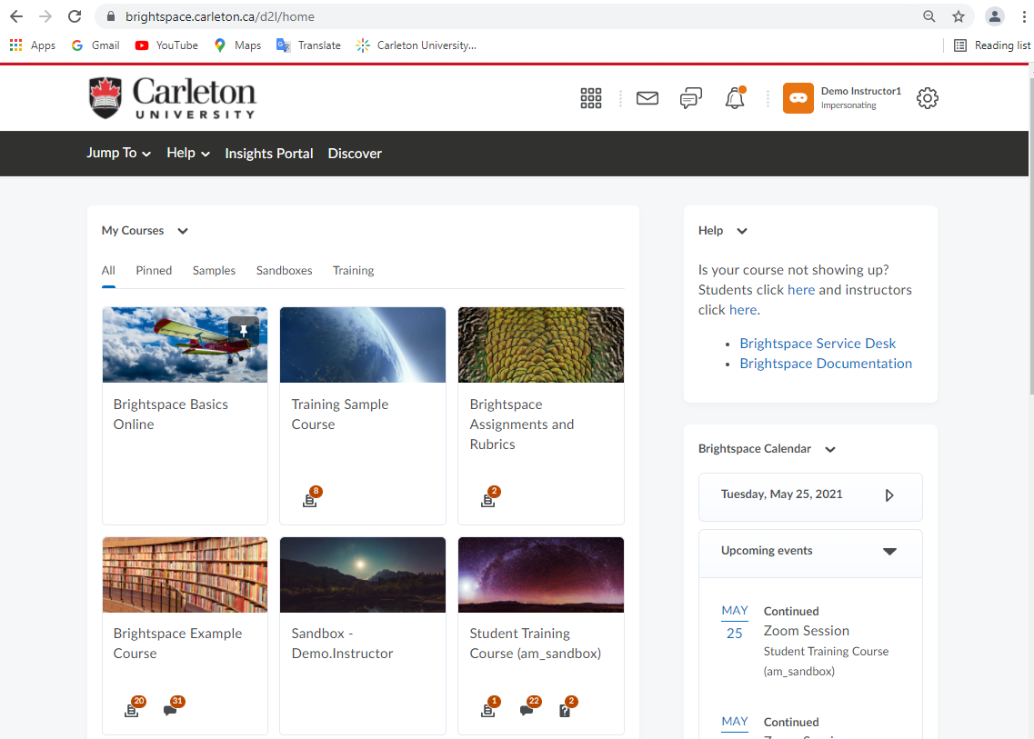
Login using your MC1 Credentials
Use on any device
24/7/365 Support available
Ed Tech course consultations: tlssupport@carleton.ca
Updates monthly: See the What’s New with Brightspace? support page

Slide 17
Web Conferencing:
Zoom & BigBlueButton
Full integration with Brightspace – Use Zoom and BBB for online web conferencing in your course
Meet online – Synchronous, virtual class sessions, group work, presentations, & office hours
Collaborate – online polling, shared chat, breakout rooms
Create recordings – provide asynchronous access to your sessions for maximum flexibility
Resources and Support – Zoom at Carleton webpage and BigBlueButton Support Site; email tlssupport@carleton.ca

Slide 18
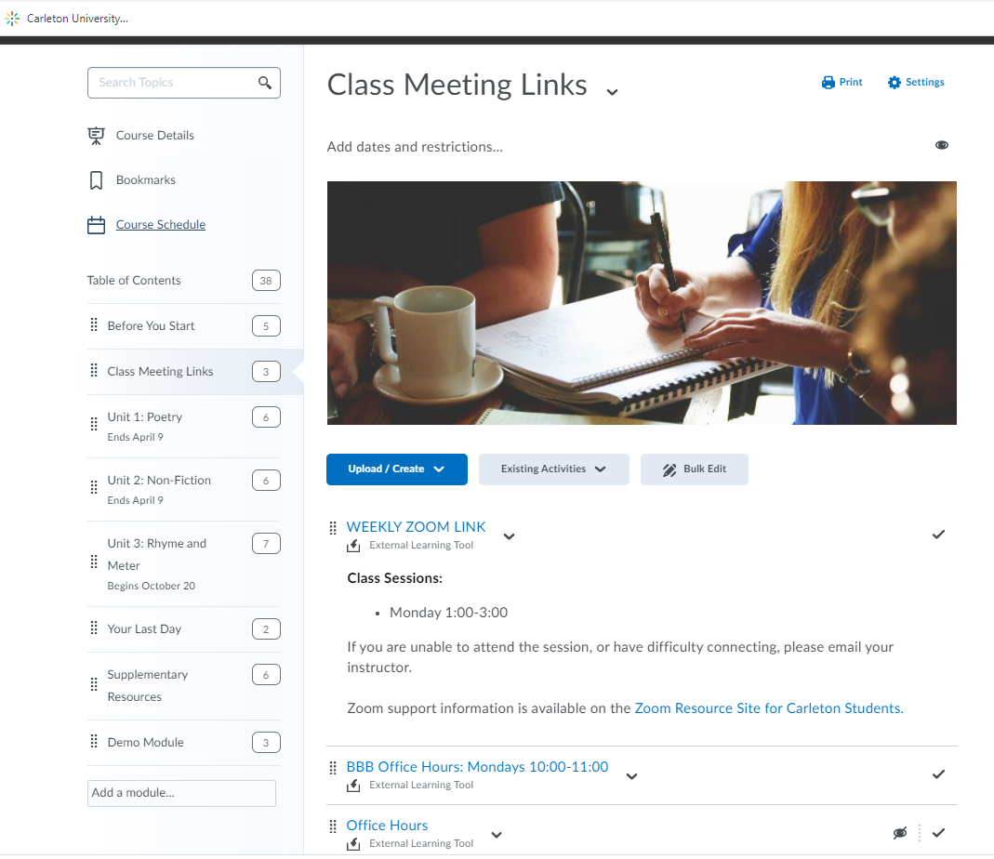
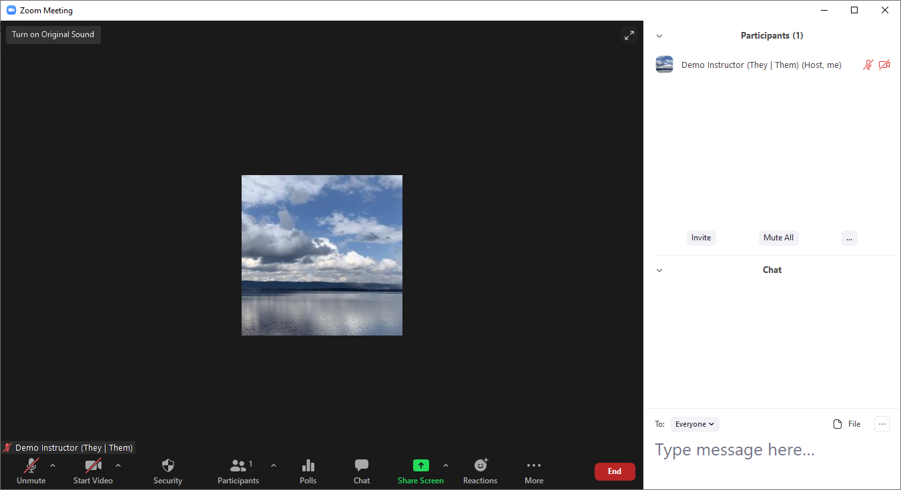
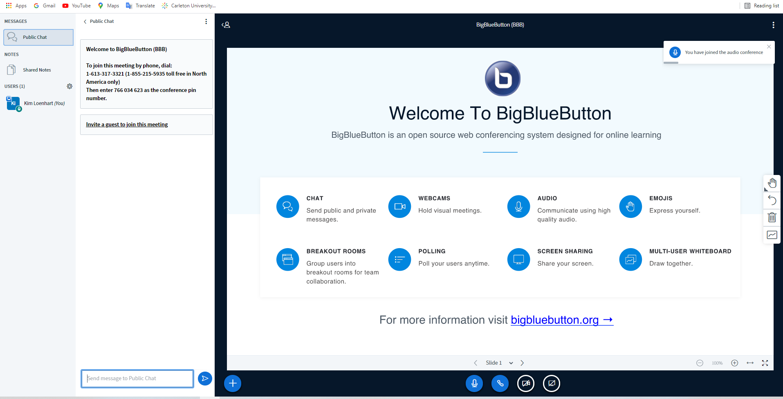

Slide 19
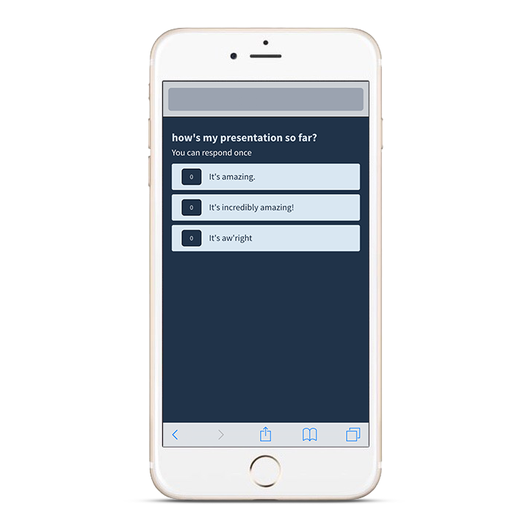
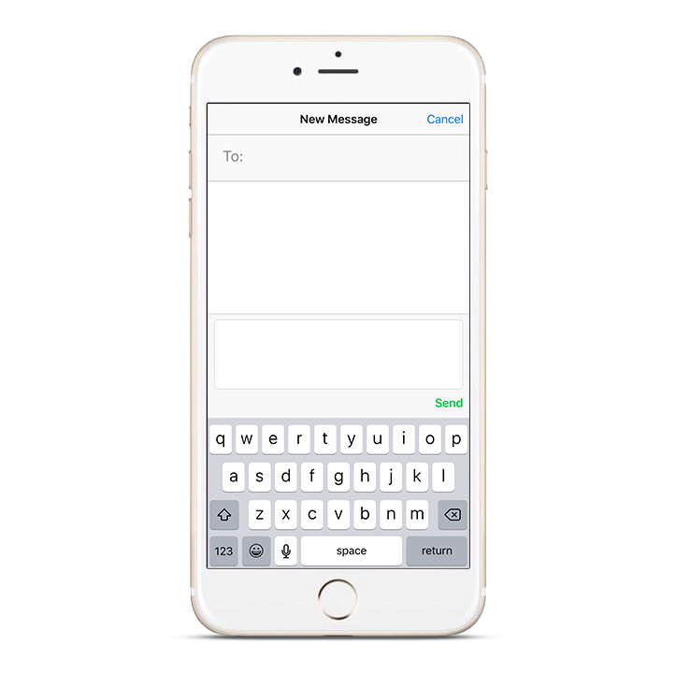
Poll Everywhere
Pollev.com/Demo
Engaging teaching: Host online polls, surveys, and competitions for your content
Easy to use – Students respond using their devices (phone, tablet, laptop)
Instant Feedback – Responses display in graphs and visualizations in real time (synchronously)
Integrates with Brightspace – Poll responses are exportable; integration can be enabled in Brightspace (coming in July)
Support available: edtech@carleton.ca
37607

Slide 20
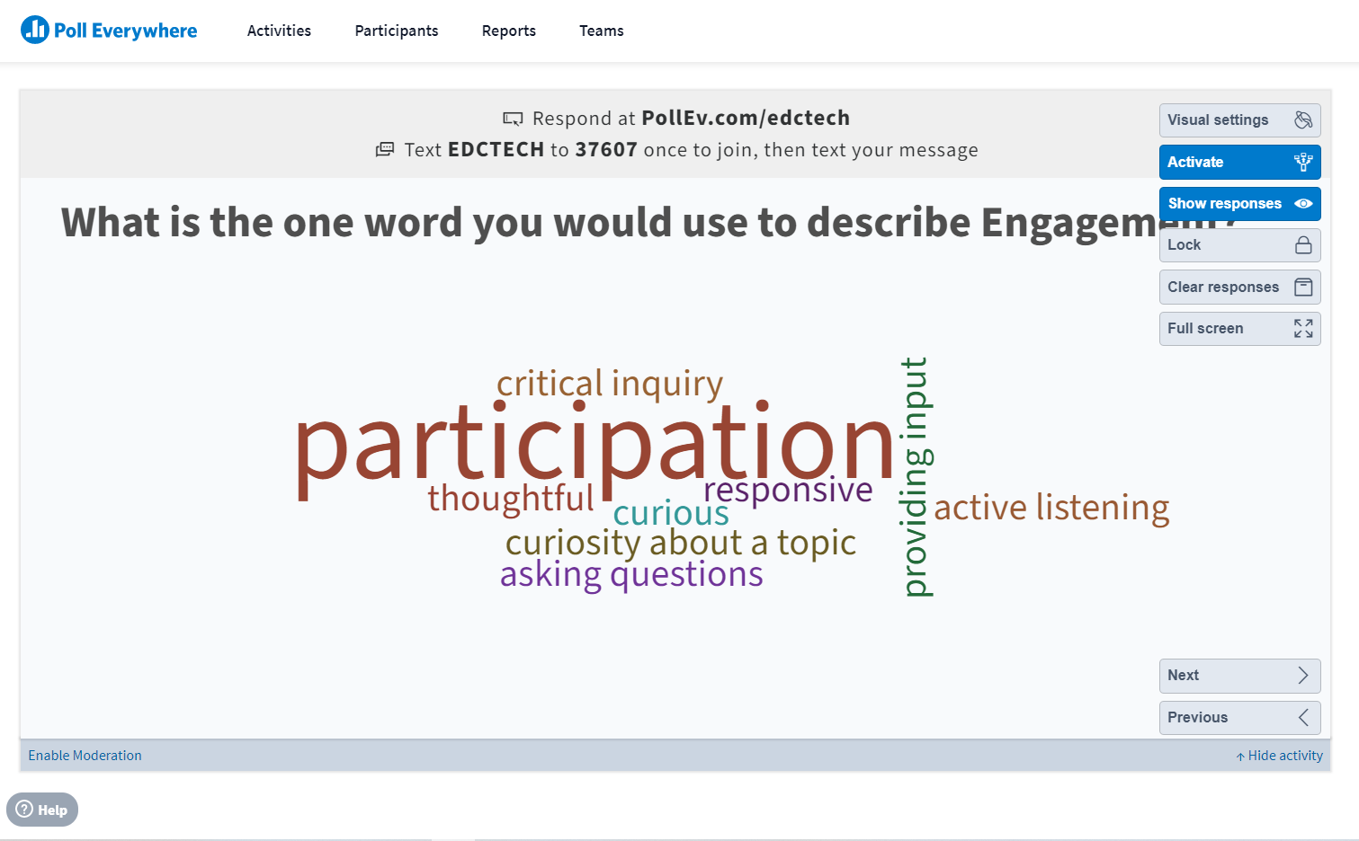
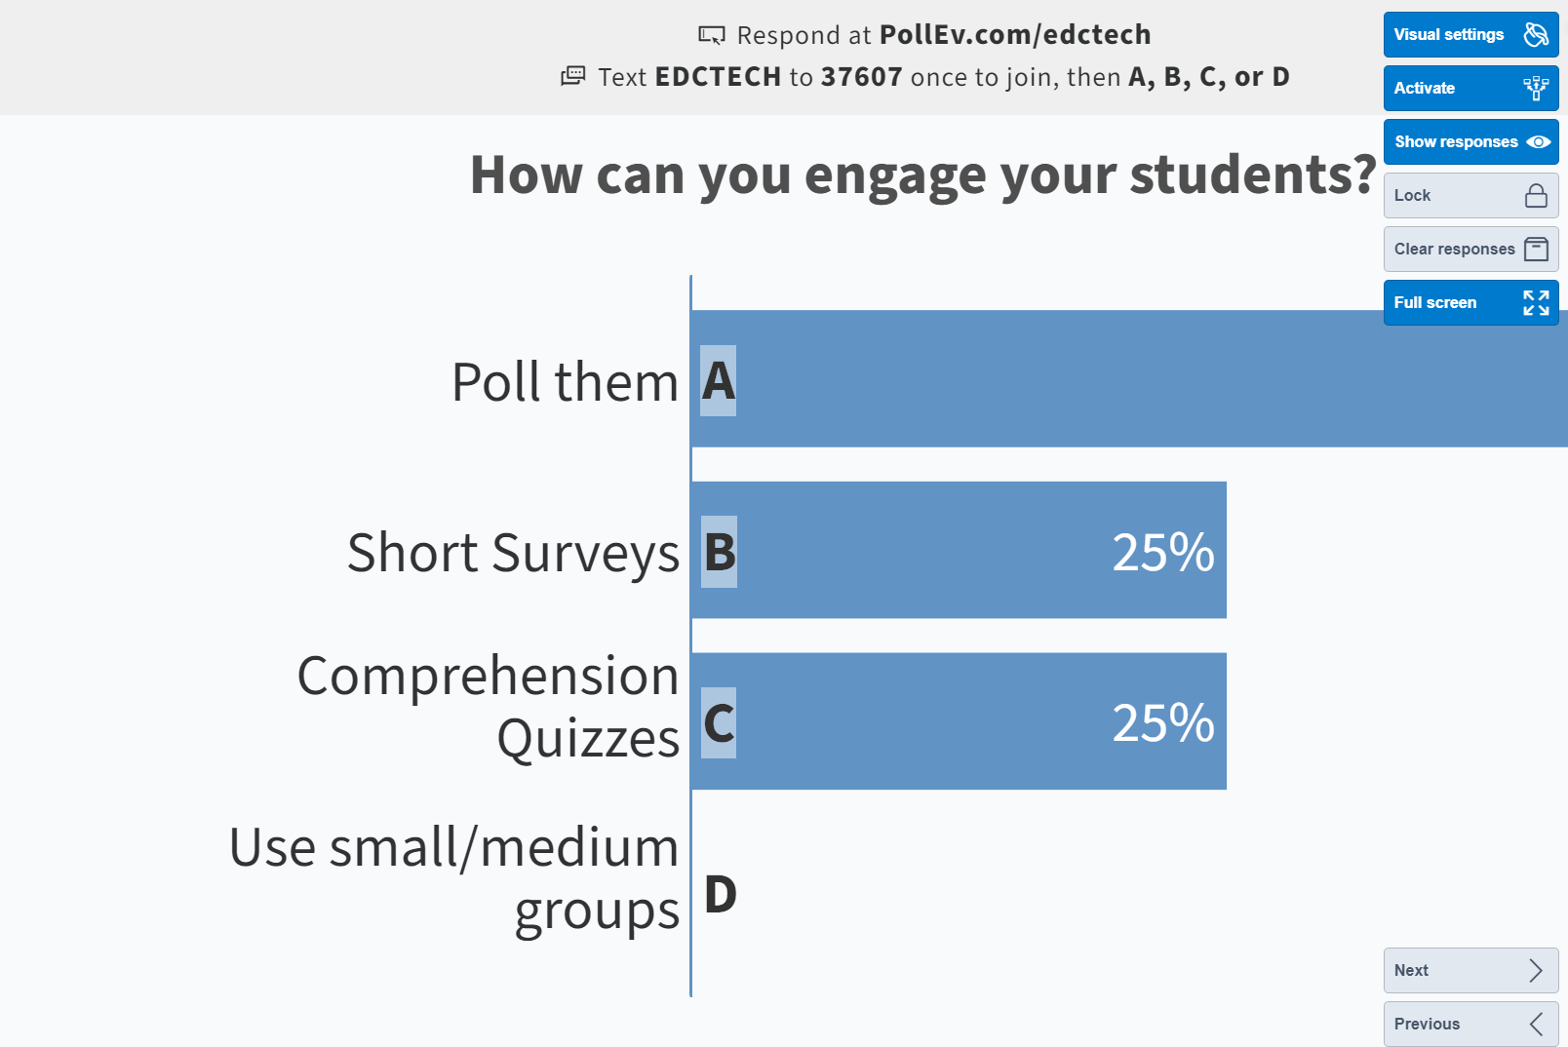
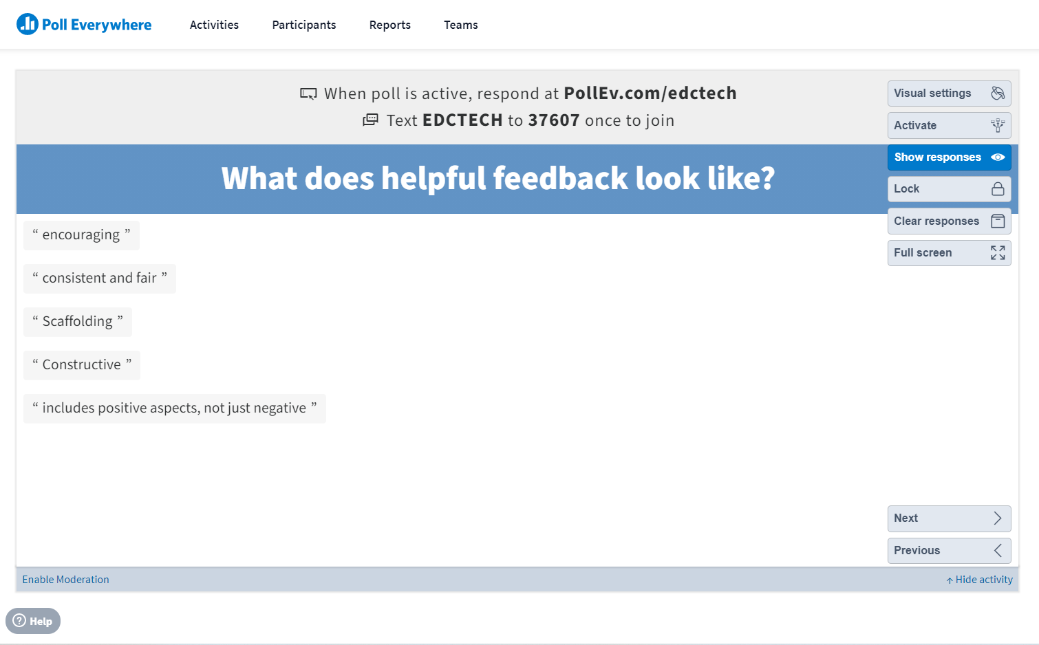
Interactive Teaching with Poll Everywhere
Suggestions for use:
Initiate discussion about content
Break up lectures and build engagement
Assess understanding and check knowledge
Practice midterm/final exam questions
Check in with students and get feedback

Slide 21
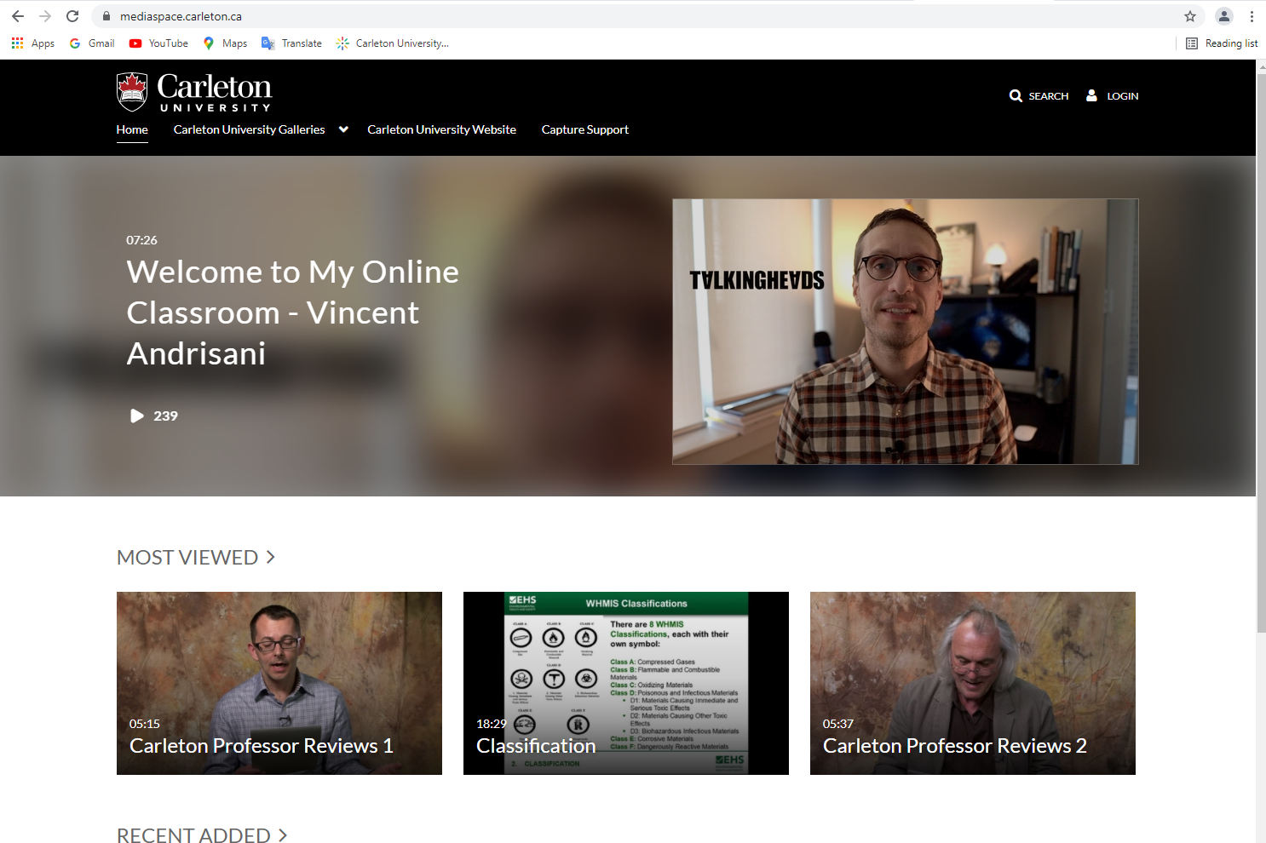
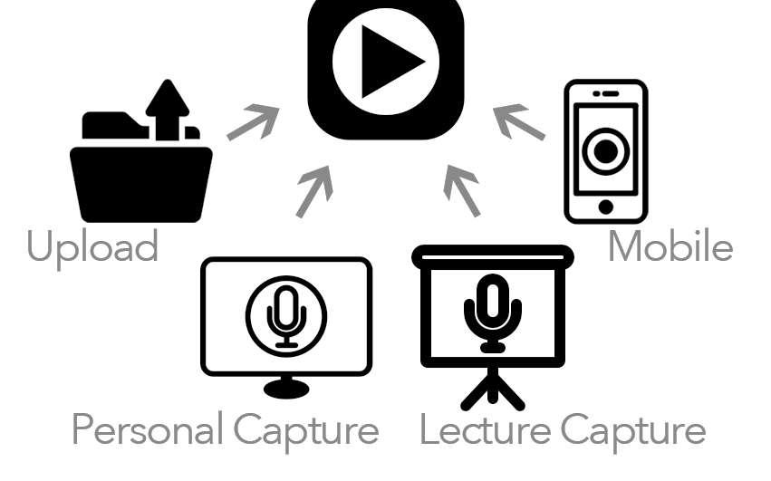
Kaltura & Mediaspace
Kaltura: Screen recording solution for video creation
Mediaspace: Cloud-hosted, media server; accessible directly within Brightspace; upload Kaltura content or your own media files. Check out our Brightspace channel!
Mediaspace.Carleton.ca

Slide 22
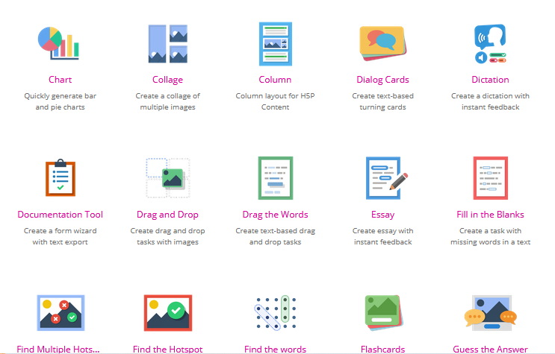
H5P Interactive Content
Build interactive engagements with content
Workshops available: intermediate to advanced
35 Different activity types to choose from
Ideal uses = formative assessment and content exploration
Self-enrol in the H5P Showcase Course in Brightspace (under the Discover tab)!

Slide 23
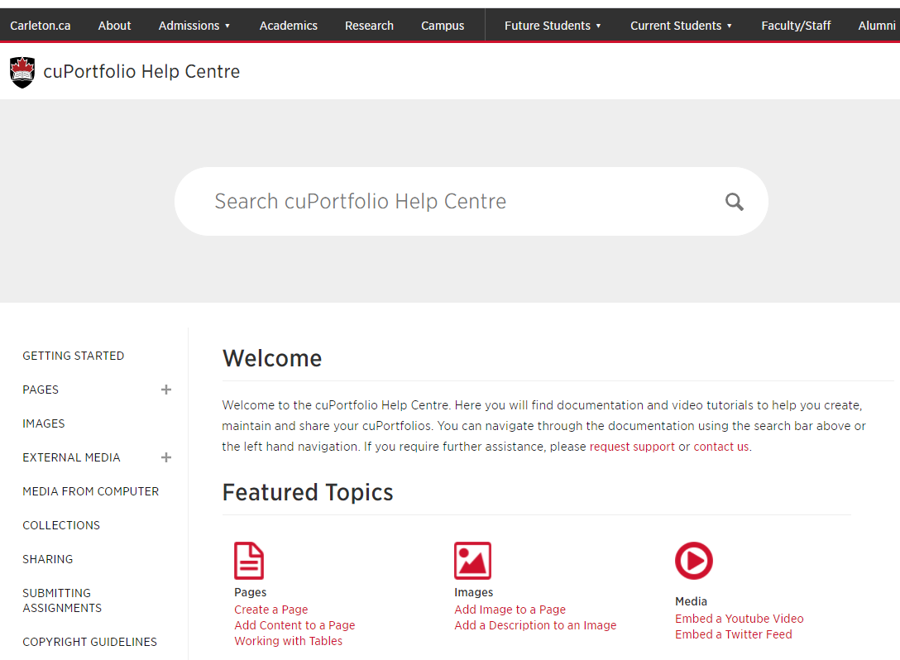
cuPortfolio
ePortfolio system integrated into Brightspace assignments
Experiential learning tool
Students curate artifacts to document, reflect and connect their learning
Articulate competencies, provide evidence, develop their identity, share their learning
Supports multimedia file types (images, videos, files, interactive content)
Support: edtech@carleton.ca or https://carleton.ca/cuportfoliosupport/help

Slide 24
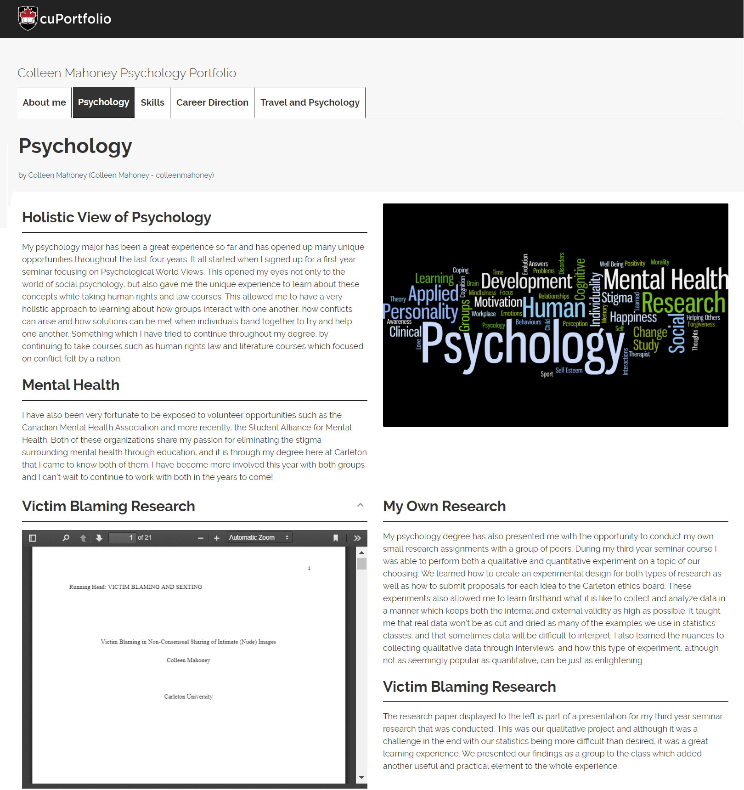
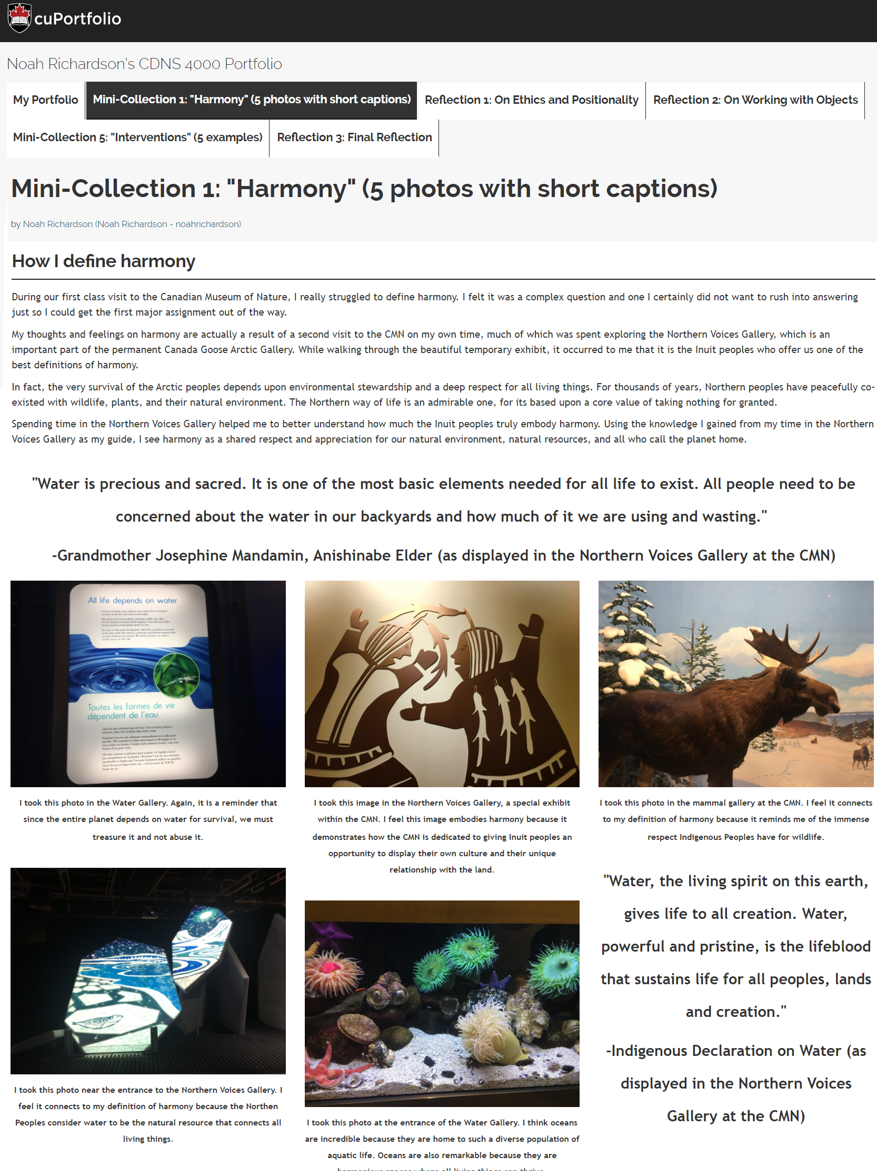

Slide 25
Attend Ed Tech Training Workshops: https://carleton.ca/edc/events/ Contact 24/7/365 Brightspace Support: link is available directly within your course Help menu Connect with the Ed Tech Team edtech@carleton.ca (Third party tools) tlssupport@carleton.ca (Brightspace) Request a course consultation with TLS Carleton.ca/brightspace/migration Brightspace Support Site Carleton.ca/brightspace
Ed Tech Resources

Slide 26
Questions
10:40-11:55

Slide 27
Questions
In advance of this session, you had the chance to review materials provided on the carleton.ca/edc/nfo website
For the first half of our session, we’d like to see what questions you have about:
Policies & Procedures
Resources for You/Students
Online Teaching, Ed Tech
Other
To participate, just type “question” or “comment” in the Chat menu, then enable mic/webcam when called upon to contribute
cdn.psychologytoday.com

Slide 28
Issues We Could Explore
I used to do XXX in cuLearn or a different LMS: (how) can I do that in Brightspace?
What should be / has to be in my syllabus?
How do I deal with requests for accommodations (LoAs)?
What do I do if I think I have an academic integrity case on my hands?
What's a Brightspace? Where do I get started?
What do I do for course readings/textbooks?
I teach in XXX department. What student services are most relevant for my students?
Should I do a ‘regular’ exam online, or a take-home? When do I have to decide?

Slide 29
Issues We Could Explore
Should I design my course as synchronous or asynchronous, or some mix thereof?
If synchronous, do I use Zoom? BigBlueButton? Teams? Other?
What suggestions do you have for ways to make sure students are engaging with weekly lessons?
I want to have my students do XXX… do we have any ed tech tools to help me to do that?
What ed tech tools do you think are mostly likely to help me in the current moment/situation?
What does a good communications strategy for an online course look like?
What are your top tips for first time instructors & instructors teaching online for the first time?
I’m overwhelmed and don’t know where to begin… help!

Slide 30
Wrap Up

Slide 31
Key Take-Away
Use the Resources Available:
Teaching Mentors
TLS website -- blogs, WTMOC, NFO online resources
Transitioning to Online Teaching
Online Teaching Resource Guide

Slide 32
Key Take-Away
Key Contacts:
TLS (tls@carleton.ca)
Course Consultations
Resources for You/Students (carleton.ca/edc/nfo)

Slide 33
Key Take-Away
For Online Teaching:
Consider asynchronous options
Develop a communications plan
Involve/engage students

Slide 34
Key Take-Away
For Ed Tech:
Use Carleton-supported Ed Tech (Brightspace, Kaltura Capture, BigBlueButton, Zoom)
Let your Learning Outcomes drive which tech you do/don’t adopt

Slide 35
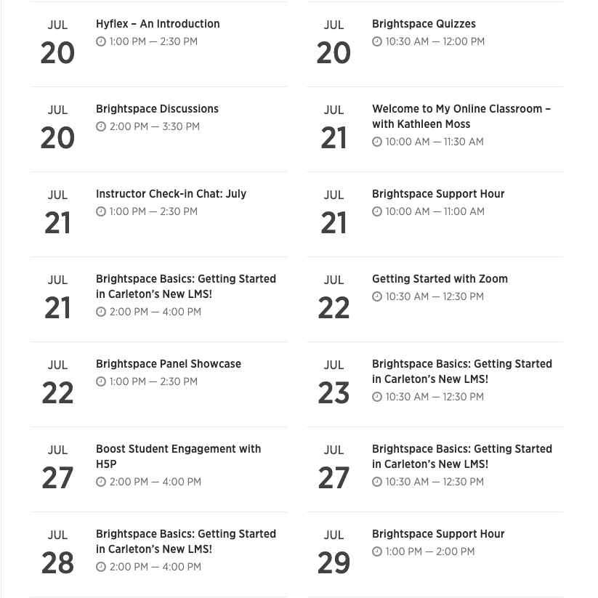
Upcoming Workshops
Online Resources page for New Faculty carleton.ca/edc/nfo
Contact Info:
tls@carleton.ca
edtech@carleton.ca
Transitioning to Online Teaching carleton.ca/teachinglearning
Welcome to My Online
Classroom series carleton.ca/edc

