Slide 1
Orientation to Teaching & Learning at Carleton University

Slide 2
Introductions
Name
Dr. Morgan Rooney
Educational Development Coordinator, TLS
Adjunct Research Professor & Contract Instructor, Department of English
Rlv.zcache.com

Slide 4
Overview
Policies and Procedures—Part 1: Assessment
Policies and Procedures—Part 2: FIPPA, Copyright, Course Outline
Policies and Procedures—Part 3: Accommodations, Academic Misconduct
clipartart.com

Slide 5
Policies & Procedures: Part 1
Assessment

Slide 6
Term Work
Early Feedback (Reg. 5.3)
First 25 teaching days; first 40 teaching days at the latest
No summative tests/exams (+15%) during last two weeks of term (Reg. 4.1)
For specific dates, review the Academic Year webpage calendar.carleton.ca/academicyear

Slide 7
Due Dates – Term Work & Exams
Term work due by the last class of term (Reg. 5.2)
All final exams held during the officially scheduled exam period
Not (usually) required (except in Engineering)
Check with your chair or undergraduate supervisor
For specific dates, review the Academic Year webpage calendar.carleton.ca/academicyear

Slide 8
Exam Options
Fixed Duration within Range
Means: fixed duration (max. 180 mins), exam accessible for a range of hours/days
Conducted: online only
Eligibility: all F2F & online/hyflex courses
Range
Means: no fixed duration, exam accessible for a range of hours/days*
Conducted: online only
Eligibility: all F2F & online/hyflex courses
Fixed Duration
Means: fixed same-day start & end time (max. 180 mins), proctoring options
Conducted: F2F or online
Eligibility: all F2F & online/ hyflex* courses

Slide 9
Exam Proctoring
In-Person Fixed Exams: instructor (& TAs, if relevant) proctors, with support from SES (i.e., additional proctors)
Online Fixed Exams: Carleton has online proctoring options (live – BigBlueButton; automated - CoMaS), but:
Requires an application & a statement in the syllabus
Applications due very early (i.e., at the start of term)
So, consider implementing alternatives to timed, synchronous exams (take home exams, term projects, exams with higher-order tasks/questions)
Fixed Duration within a Range & Range Exams: no proctoring options

Slide 10
Extensions & Deferrals – Term Work
Extensions for term work beyond a normal deadline and/or the Senate deadline (end of term – i.e., deferrals) are handled by instructors at your discretion (Reg. 4.4)
Before end of term whenever possible
For due dates past the end of term, assign a grade of 0 for assignment(s), & submit grade as is to E-Grades; submit a ‘change of grade’ request afterwards
Registrar’s Office has no role in this process

Slide 11
Extensions and Deferrals – Exams
Deferrals for centrally-scheduled exams, by contrast, are managed by the Registrar’s Office (Reg. 4.3)
Student initiated: form
300 Tory Building, registrar@carleton.ca
Instructor has no role in this process (beyond preparing the exam)

Slide 12
Grading: 12 Point System
A+ 12
A 11
A- 10
B+ 9
…
C+ 6
…
D+ 3
…
F 0
Equivalent 100-point system
A+ 90-100 C+ 67-69
A 85-89 C 63-66
A- 80-84 C- 60-62
B+ 77-79 D+ 57-59
B 73-76 D 53-56
B- 70-72 D- 50-52
F 0-49
The Undergraduate Calendar, Reg. 5.4

Slide 13
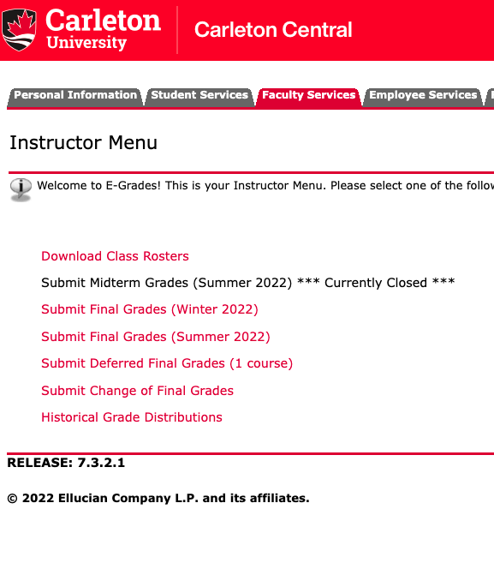
Final Grade Submission
E-grades in Carleton Central
10 calendar (not business) days after exam
Submitted by instructor
Approved by Chair and Dean before release to students
‘Change of grade’ submissions made here as well

Slide 14
Policies & Procedures: Part 2
FIPPA, Copyright, Course Outline

Slide 15
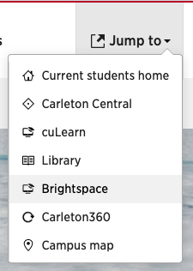
Confidentiality – FIPPA
Third parties (even parents!) (Reg. 2.3)
NO information, even if student is a minor
Communication (Reg. 2.3)
ONLY through official Carleton emails (student@carleton.ca)
Grades are confidential (Reg. 2.3)
Don’t post in public areas or give assignments to friends
Use Brightspace

Slide 16
Copyright
Asserting copyright over your own materials: add language to syllabus
Respecting the copyright of others:
When in doubt, give credit
Links > hosting files
Carleton Library, ARES system
Sample language: My lectures and course materials (including all PowerPoint presentations, handouts, videos, and similar materials) are protected by copyright. I am the exclusive owner of copyright and intellectual property of all course materials. You may take notes and make copies of course materials for your own educational use. You may not allow others to reproduce or distribute lecture notes and course materials publicly for commercial purposes without my express written consent.

Slide 17
Course Syllabus
Description, assessment info (%ages & due dates), policies, weekly schedule, accommodations statements, any dept requirements
Needs to be accessible to students 1 week in advance of the start of the term (Reg. 5.2)
Course Syllabus
Checklist
Accommodations Statements

Slide 18
Policies & Procedures: Part 3
Accommodations, Academic Misconduct

Slide 19
Accommodations
Letters of Accommodation (LoAs)
Start of term
Process
Considerations
Request deadlines
For specific dates, review the Academic Year webpage calendar.carleton.ca/academicyear
Info about Ventus: carleton.ca/ventushelp/ventus-faculty-portal-overview/ Login portal: ventus.carleton.ca/instructor

Slide 20
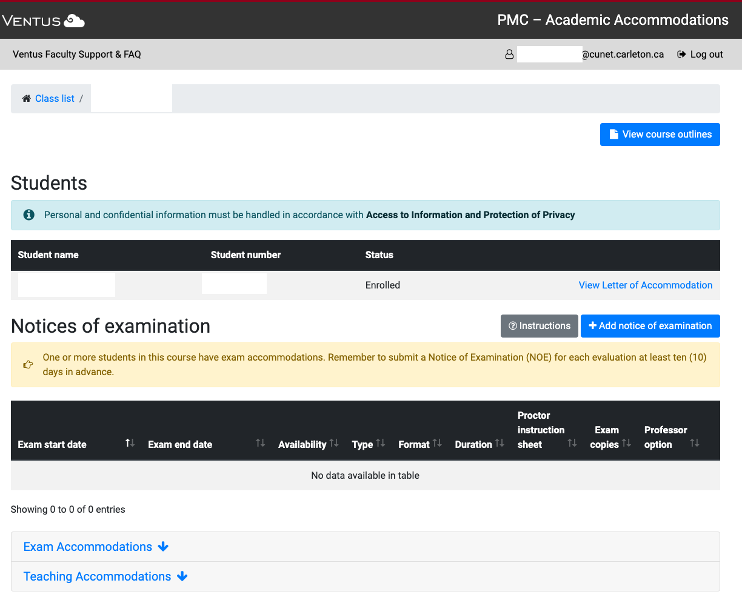
Accommodations

Slide 21
Academic Misconduct
Promoting a culture of AI
Detecting
Reporting → Process
Centralized
Instructors do NOT assign marks or determine penalties for plagiarized work
Communicating to students
The AI Policy
AI Resources for Instructors

Slide 22
Academic Misconduct
Related Resources:
Faculty Forms, Guides, Instructions:
FASS: Academic Integrity Memo Template carleton.ca/fass/about/resources/
FPA: FPA Teaching Regulations handbook, carleton.ca/fpa/documents/
Sprott: consult the Sprott intranet – sprott.carleton.ca/faculty-research/faculty-services
Science: Email your Associate Dean (Undergraduate Affairs)
FED: Email your Associate Dean (Student Success)
The Academic Integrity Policy: carleton.ca/registrar/cu-files/academic-integrity-policy/ The Instructor’s Guide to Academic Integrity: carleton.ca/studentaffairs/wp-content/uploads/Academic-Integrity-Instructors-Guide.pdf

Slide 23
Welcome to Carleton!
Be sure to bookmark the Orientation Resources page (carleton.ca/tls/orientations)
For 1-on-1 Brightspace support: tlssupport.carleton.ca
For 1-on-1 course consultations: carleton.ca/tls/course-consultation/

