Slide 1
Orientation to Teaching & Learning at Carleton University

Slide 2
Introductions
Name
Dr. Morgan Rooney
Educational Development Coordinator, TLS
Adjunct Research Professor & Contract Instructor, Department of English
Rlv.zcache.com

Slide 4
Overview
Policies and Procedures—Part 1: Assessment
Policies and Procedures—Part 2: FIPPA, Copyright, Course Outline
Policies and Procedures—Part 3: Accommodations, Academic Misconduct
clipartart.com

Slide 5
Policies & Procedures: Part 1
Assessment

Slide 6
Term Work – Regulations
Early Feedback (Reg. 5.3)
First 25 teaching days; first 40 teaching days at the latest
No summative tests/exams (+15%) during last two weeks of term (Reg. 4.1)
For specific dates, review the Academic Year webpage calendar.carleton.ca/academicyear

Slide 7
Term Work & Exams – Due Dates
Term work due by the last class of term (Reg. 5.2)
All final exams held during the officially scheduled exam period
Not (usually) required (except in Engineering)
Check with your chair or undergraduate supervisor
For specific dates, review the Academic Year webpage calendar.carleton.ca/academicyear

Slide 8
Tests & Exams – Scheduling
In-person Tests:
Requests for in-term tests scheduled outside of class time: i.carleton.ca/mec/exam-data-collection/
Requests for in-term tests scheduled during class time for PMC students: ventus.carleton.ca/instructor/
Exams (in-person or online):
Request through your department for formal exam periods (December, April, June, August) – see The Academic Year (calendar.carleton.ca/academicyear/)

Slide 9
Tests & Exams – Deliverables/Types
In-Term Exams (Midterm, Quiz, Test, etc.):
In-Person Paper Exams: instructor supplies paper copies; can be printed in-house within your department and brought to the exam site directly, or reproduced and delivered by SES for a fee. Go to i.carleton.ca/mec/exam-data-collection/ to submit your exam details or notify them if you will handle printing independently. For in-person digital exams, use the link to inform SES and select the service applicable to you.
Online Exams: Submit your exam (i.carleton.ca/mec/exam-data-collection/) for SES to set up in Brightspace, conduct a review of the settings, and/or apply PMC accommodations (ventus.carleton.ca/instructor/).
Hybrid Exams (include both paper and online elements): e.g., a paper exam for some questions + the use of Brightspace for multiple-choice questions

Slide 10
Tests & Exams – Deliverables/Types
End-Term Exams:
SES provides paper copies for in-person exams, including for PMC students. Instructors collect for marking at the designated site. SES delivers exams completed by PMC students to the instructor’s department the next business day.
For in-person digital exams or online exams, instructors can opt in for any of the following services offered by SES: exam build on Brightspace, exam setting review, and/or PMC accommodations set up.

Slide 11
End-Term Exams – Services, Deadlines, Fees
SES sends an exam memo 1~ month before course outlines are due, outlining all of the services, deadline to request, and associated fees
Information about fees can be found here: i.carleton.ca/mec/exam-services-services-and-late-fees/
Questions? Email examinations@carleton.ca

Slide 12
Exam Duration Types
Duration Type | Definition | Eligible Exam Type
Fixed Duration | Fixed same-day start & end times (max. 180 mins) | In-person Paper*, In-person Digital*, and Online
Range | No fixed duration, exam accessible for a range of hours/days | Online
Fixed Duration within Range | Fixed duration (max. 180 hours), exam accessible for a range of hours/days | Online
*Note: online/hyflex courses must indicate on the course outline if an in-person exam will be required

Slide 13
Exams – Day-Of Supports
Site Office (for in-person fixed exams)
Virtual Site Office (upon request for online fixed exams)
SES Exam Support Network* (for all exam options during business hours)
carleton.ca/ses/exam-support/
Live chat support or submit a service ticket: carleton.ca/ses/help/
Toll-free call lines:
1-877-557-2930 (Canada – USA)
1-613-518-2601 (Outside Canada/USA)
*Note: SES provides extended support during peak midterm season & all formal exam periods

Slide 14
Exams – Day-Of Supports
E-Proctoring (for in-person digital and online exams): request e-proctoring (i.carleton.ca/mec/e-proctoring/e-proctoring-application-form/) for a fee. Ensure that the e-proctoring statement (carleton.ca/ses/e-proctoring/e-proctoring-course-outline-template/) is included in your course outline.
Distance Exam Service: a service for students who can’t write their exam on-campus (i.e., those enrolled in online courses with an in-person test requirement, varsity athletes with travel schedules, or anyone with an extenuating circumstance). If students are +160 km away from Carleton on exam day, they can find more information here (carleton.ca/ses/distance-exams/). This can be included in your course outline if it meets your course requirements.

Slide 15
Term Work – Deferrals
Extensions for term work beyond a normal deadline and/or the Senate deadline (end of term – i.e., deferrals) are handled by instructors at your discretion (Reg. 4.4)
Before end of term whenever possible
For due dates past the end of term, assign a grade of 0 for assignment(s), & submit grade as is to E-Grades; submit a ‘change of grade’ request afterwards
Registrar’s Office has no role in this process

Slide 16
Exams – Deferrals
Deferrals for centrally-scheduled exams, by contrast, are managed by the Registrar’s Office (Reg. 4.3)
Student initiated: form
300 Tory Building, registrar@carleton.ca
Instructor has no role in this process (beyond preparing the exam)

Slide 17
Carleton’s Grading Scheme
A+ 12
A 11
A- 10
B+ 9
…
C+ 6
…
D+ 3
…
F 0
Equivalent 100-point system
A+ 90-100 C+ 67-69
A 85-89 C 63-66
A- 80-84 C- 60-62
B+ 77-79 D+ 57-59
B 73-76 D 53-56
B- 70-72 D- 50-52
F 0-49
The Undergraduate Calendar, Reg. 5.4

Slide 18
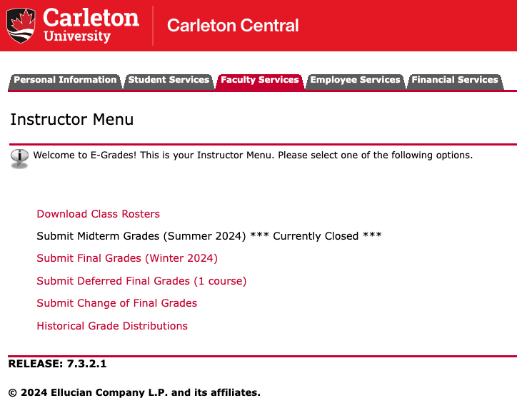
Final Grade Submission
E-grades in Carleton Central
10 calendar (not business) days after exam
Submitted by instructor
Approved by Chair & Dean before release to students
“Change of grade” submissions made here as well

Slide 19
Policies & Procedures: Part 2
FIPPA, Copyright, Course Outline

Slide 20
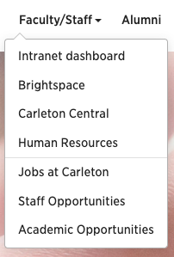
Confidentiality – FIPPA
Third parties (even parents!) (Reg. 2.3)
NO information, even if student is a minor
Communication (Reg. 2.3)
ONLY through official Carleton emails (student@cmail.carleton.ca)
Grades are confidential (Reg. 2.3)
Don’t post in public areas or give assignments to friends
Use Brightspace

Slide 21
Copyright
Asserting copyright over your own materials: add language to syllabus
Respecting the copyright of others:
When in doubt, give credit
Links > hosting files
Carleton Library, ARES system
Sample language: My lectures and course materials (including all PowerPoint presentations, handouts, videos, and similar materials) are protected by copyright. I am the exclusive owner of copyright and intellectual property of all course materials. You may take notes and make copies of course materials for your own educational use. You may not allow others to reproduce or distribute lecture notes and course materials publicly for commercial purposes without my express written consent.

Slide 22
Course Syllabus
Description, assessment info (%ages & due dates), policies, weekly schedule, accommodations statements, any dept requirements
Needs to be accessible to students 1 week in advance of the start of the term (Reg. 5.2)
Course Syllabus
Checklist
Accommodations Statements

Slide 23
Policies & Procedures: Part 3
Accommodations, Academic Misconduct

Slide 24
Accommodations
Letters of Accommodation (LoAs)
Start of term
Process
Considerations
Request deadlines
For specific dates, review the Academic Year webpage calendar.carleton.ca/academicyear
Info about Ventus: carleton.ca/ventushelp/ventus-faculty-portal-overview/ Login portal: ventus.carleton.ca/instructor

Slide 25
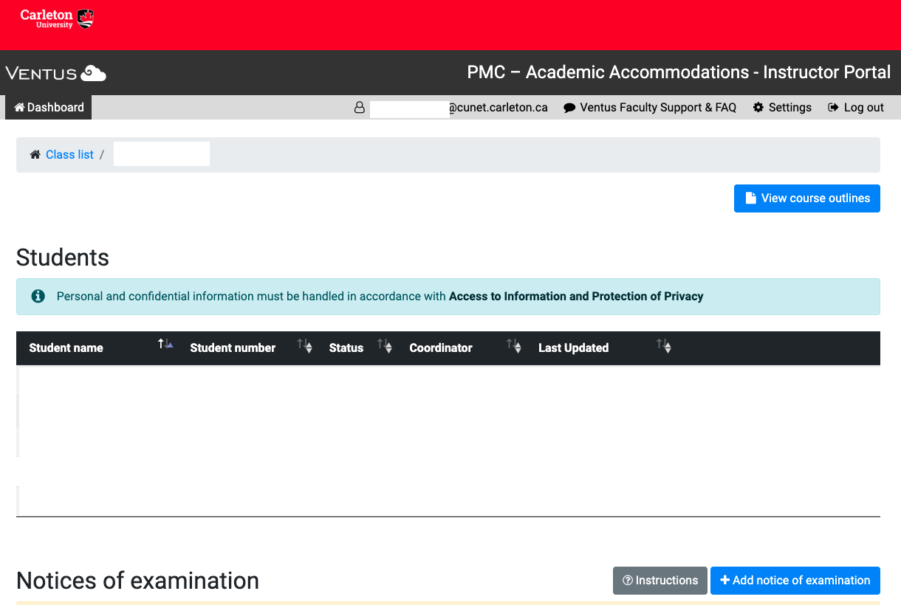
Accommodations

Slide 26
Academic Consideration Policy
Students can request ‘academic consideration’ (informal accommodations for short-term issues) via a form
Extenuating circumstances = beyond the student’s control, impact their ability to attend to academic obligations, and could not have been prevented
Consider adding parameters around students’ access to such consideration, in consultation with your Chair/Dean
Read about the Policy: carleton.ca/registrar/academic-consideration-coursework/
Info for Faculty: i.carleton.ca/registrar/academic-consideration-policy/

Slide 27
Academic Misconduct
Promoting a culture of Academic Integrity
Detecting
Reporting → Process
Centralized
Instructors do NOT assign marks or determine penalties for plagiarized work
Communicating to students
The Academic Integrity Policy
Academic Integrity Resources for Instructors

Slide 28
Academic Misconduct
ChatGPT / AI Tools
Instructors have latitude to authorize or disallow use of ChatGPT / AI Tools
Instructors should not rely on AI detection tools as the sole source for any Academic Integrity allegation
For more ideas & strategies, consult the Working Group Report → AI in Teaching at Carleton: Opportunities and Challenges

Slide 29
Academic Misconduct
Faculty Forms, Guides, Instructions:
FASS: Academic Integrity Memo Template, carleton.ca/fass/faculty-resources/#teaching_resources
FPA: FPA Teaching Regulations, carleton.ca/FASS-FPA-teaching-regulations
Sprott: consult the Sprott intranet –i.carleton.ca/sprott/teaching-resources-forms/
Science: ODSIntegrity@carleton.ca, Detecting & Reporting Academic Misconduct, science.carleton.ca/faculty-staff/academicintegrity/
FED: Email your Associate Dean (Student Success)
Related Resources:
The Academic Integrity Policy: carleton.ca/secretariat/wp-content/uploads/Academic-Integrity-Policy-2021.pdf The Instructor’s Guide to Academic Integrity: carleton.ca/studentaffairs/wp-content/uploads/Academic-Integrity-Instructors-Guide.pdf

Slide 30
Welcome to Carleton!
Be sure to bookmark the Orientation Resources page (carleton.ca/tls/orientations)
For 1-on-1 Brightspace support: tlssupport.carleton.ca
For 1-on-1 course consultations: tlssupport.carleton.ca
modoyoga.com

