Slide 1
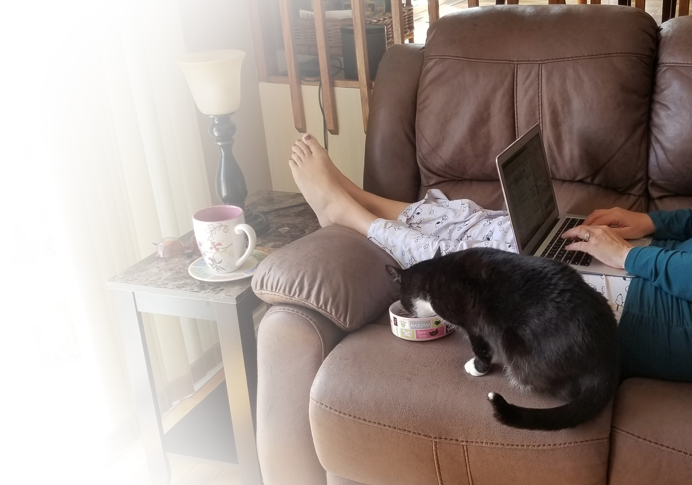
Education in Pyjamas:
How I learn to design, use, and love online courses
Ali Arya
School of Information Technology
Carleton University

Slide 2
Highlights
Dress for the occasion! No pyjamas ☺
  Frame of mind is important and it is not just about clothes.
Pandemic or no pandemic, online courses can help.
  Priorities: accommodation and compassion vs. academic expectations
Online courses are not “less work”.
  Neither designing nor running. And they still need interaction.
Flexibility, clarity, and usability are the key things to remember.
You can do it!

Slide 3
What I’ve done
eCampus Ontario grant in 2016
BIT-1400 and 2400, computer programming
  Motivated by the need for summer courses
  Summer 2017, first fully online sections
Other courses in later years
  Hybrid model
  Using elements of online design (such as reflection)

Slide 4
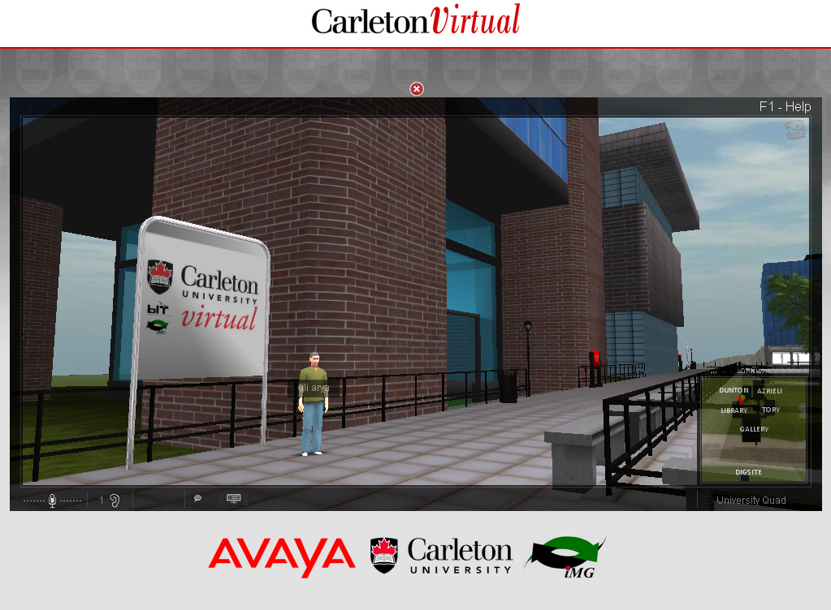
Learning Spaces in Virtual Reality
Used in some CU courses
Current research
Needs a separate conversation

Slide 5
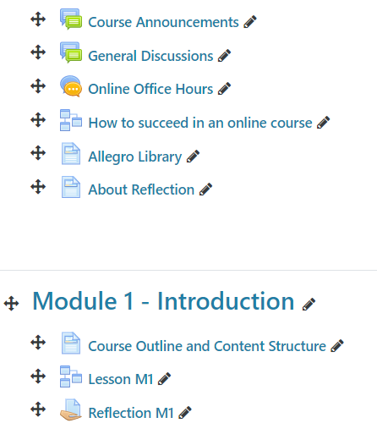
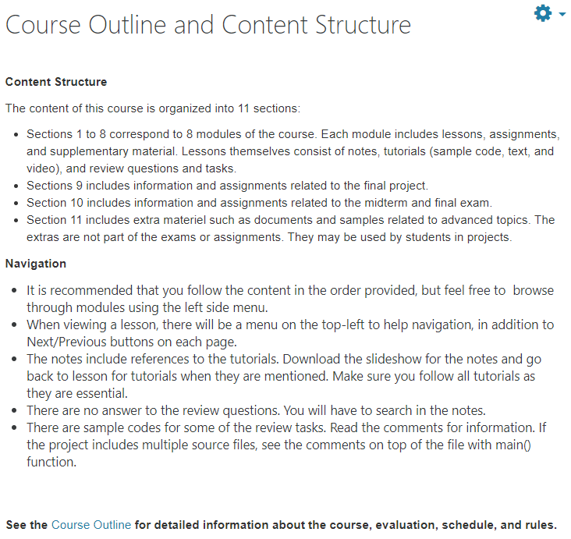
BIT-1400, Introduction to Programming

Slide 6
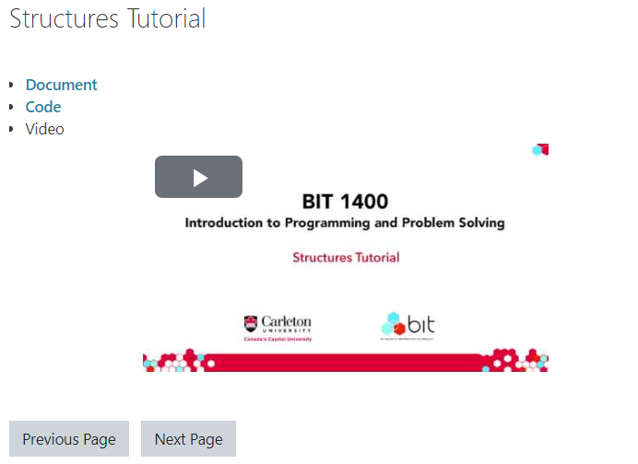
BIT-1400: Lessons
Summary and Slides (Lecture Notes)
Tutorials: Document, Code, Videos
Self Assessment Questions

Slide 7
Reflection
Learning by sense-making is an extension of “learning by doing”.
Part of the course interaction (active learning)
Helpful for both online and in-person courses.
  Think about your expectation and experience of the first lesson in BIT-1400. Review the Reflective Questions as a guideline, and submit a reflection. It can be as long as you feel necessary, and may answer as many of the sample questions, or discuss other reflective questions you may have. This is an individual assignment but feel free to talk with your friends to get "questions" or ideas of what to discuss. Make sure the "answers" are yours.

Slide 8
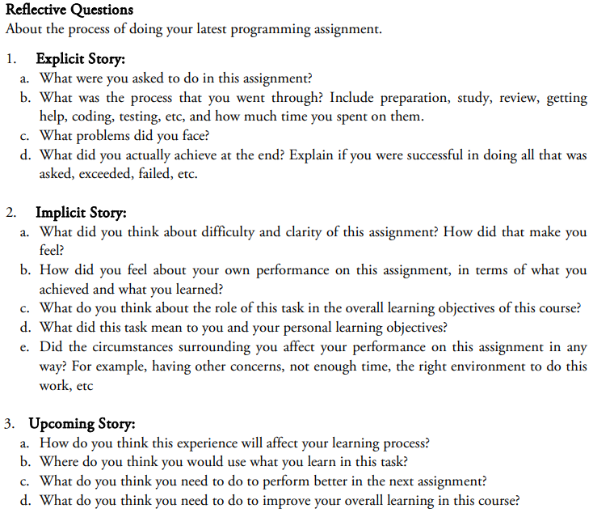
Reflection needs to be learned

Slide 9
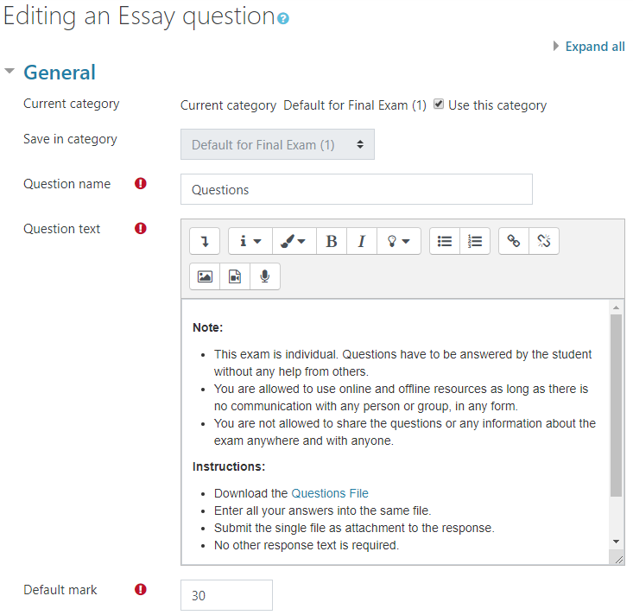
Exams:
Trusting Your Students
(and other options)

Slide 10
Communication
Regular (at least weekly) course announcements
  Reflect on the past week; review the current/upcoming ones
Discussion board (quick responses and participation marks)
Online office hours
Timely feedback on assignment and response to emails
Anonymous midterm survey

Slide 11
What I learned
Online course is not a face-to-face course uploaded to a website.
  Digital design vs. digitized design
You need to rethink (1) learning outcomes (and priorities), (2) how to assess, (3) what content to use, and (4) how to deliver.

Slide 12
What I learned
Murphy’s Law: Anything that can go wrong, will go wrong.
  Prepare for problems instead of trying to avoid them.
  Involve students in your design and test process.
Technical support is more than two lines in the course outline.
If you thought it was hard to engage students in the class …
  Be proactive and innovative. Use different methods of interaction.
Define your (and students’) priorities and what needs to be done for them.

Slide 13
What I learned
Education needs to be personalized. Flexibility (format and tasks)
You are not there to explain. Clarity (content)
Students need to think about material, not the website Usability (navigation)
Don’t bore students with too much synchronous work.
  It is supposed to be self-paced.
Some key decisions: interaction and evaluation

Slide 14
During the Pandemic
Accommodation and compassion above academic goals
Lower the expectations and consider what is essential.
  For yourself and students.
Don’t assume students are mentally and physically available.
Make the course extra flexible.
For interactions, asynchronous is ok; limited synchronous.

Slide 15
Some things to avoid (especially during the pandemic)
Making an online copy of your offline course
Having long synchronous sessions or videos
Setting fixed schedules
Assuming video replaces interaction
Assuming interaction means video conferencing
Expecting students to be always available
Forgetting that students are people with social and emotional needs
  More likely to happen when you don’t see them

Slide 16
Flexibility
Material content and format
  Offer a variety of available formats
Learning objectives and priorities
  Required vs optional; what to do to get by
Tasks and assignments
  Options; extensions
Communication and presentation methods
  Synchronous vs. asynchronous; short elements to choose at own pace

Slide 17
Clarity
Home page
  Netiquette
  Course structure
  Expectations
  How to get help
Clear syllabus
  Typical instructor, textbook, grading, policies, etc
  Learning outcomes and expected work
  Prioritization
  Module description
  Tech needs
  Academic misconduct
  Office hours and other support
  Time zone
  Accommodations
  Support services

Slide 18
Usability (Don’t Make Me think!)
Consistency (internal and external)
Accessibility
Visual clarity and appeal
Readability
Findabilty (categories, labels, buried content, etc)

Slide 19
Active Learning and Interaction
Student-faculty Interaction (online course is not correspondence course)
  Feedback (both ways)
  Discussion forum
  Announcements
  Online office hours
  Peer teaching
Student-student Interaction
  Group projects
  Peer teaching and mentoring
  Discussions (synchronous and asynchronous)
  Peer review
Student-course Interaction
  Tutorials (multimedia)
  Quizzes
  Reports and Reflections
  Simulations and Hands-on Experiences

Slide 20
Evaluation
You can have a single file with all questions or use online exam tools.
You can apply IT restrictions or make it like a take-home exam.
You can have randomly assign the order of question per student.
You can have projects or exams.
But at the end of the day, you got to trust the students. They can find a way to cheat if they want to.

Slide 21
Some Available Tools
cuLearn or any CMS we move to
Zoom/Skype/Teams/Connect
Discussion tools like Piazza
Video capture/edit tools like OBS Studio, Camtasia, and Kaltura
  OBS can capture and broadcast (live stream) to YouTube
Communication tools like Discord, Slack, and Workplace.com
Social Media

Slide 22
About Using Slides
Use a widescreen format.
Be consistent with the look-and-feel.
Use quality images but beware of copyright.
Avoid too much text.
Make them accessible.
Be mindful of time per slide.

Slide 23
About Making Videos
Break long topics into short videos (e.g. 5-10 minutes tutorials)
Make sure recording yourself adds value before doing it.
Use an attractive background and good lighting.
Pay attention to soundscape and narrator voice.
Use a decent microphone (see template by Jim Davies, Cog Sci).
If using overlaying a presenter video on top of slides (picture-in-picture), then account for the occluded area in slides.
Practice, repeat, and edit your audio/video recordings!

Slide 24
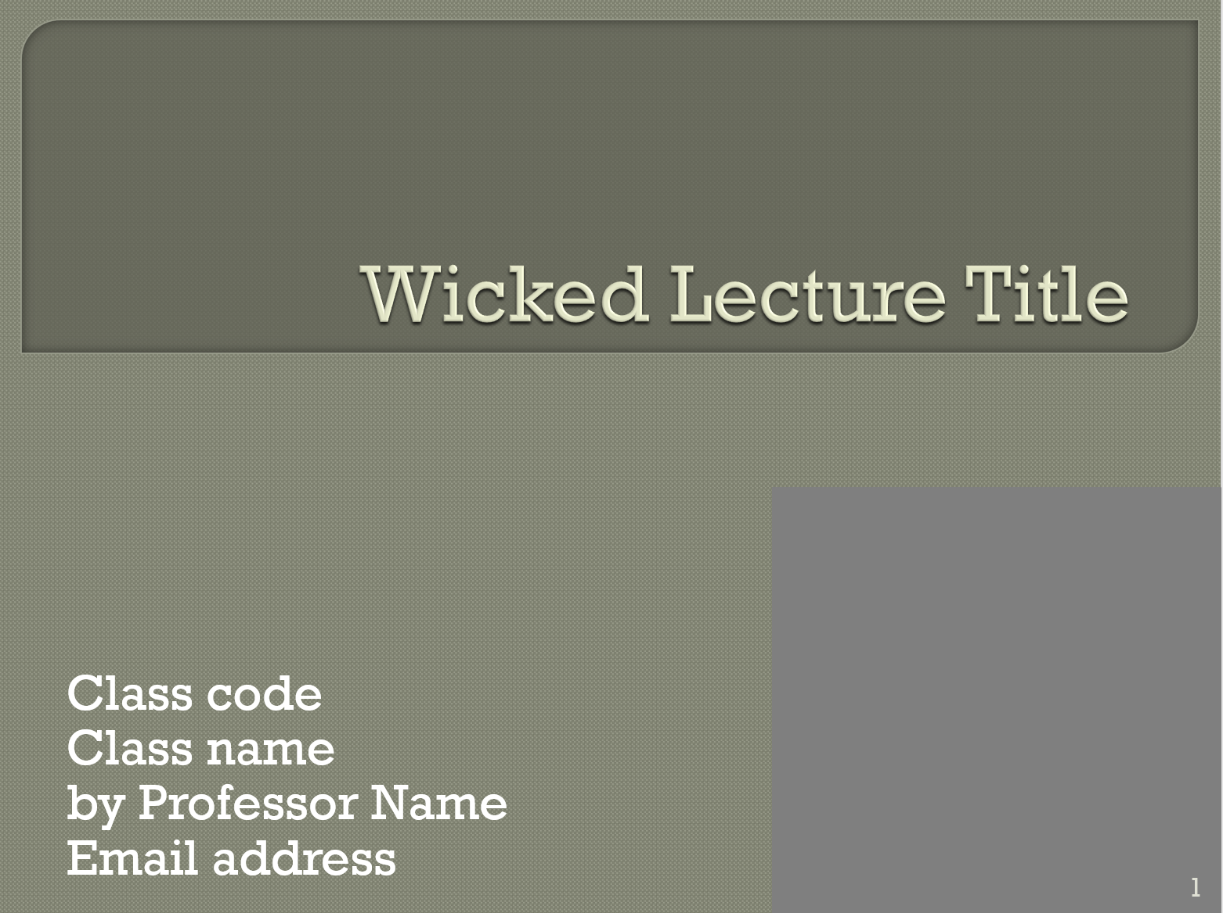
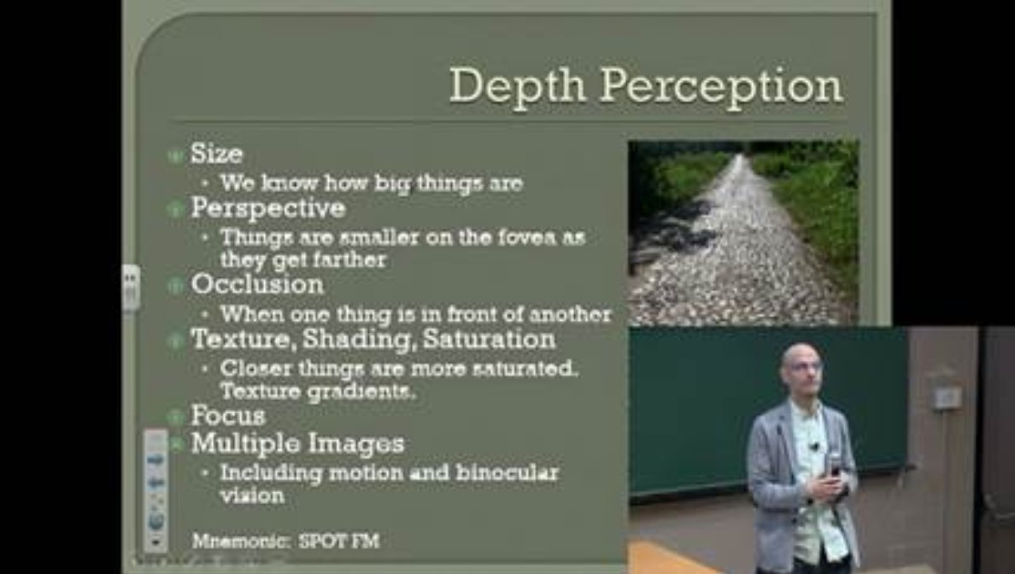
Picture-in-Picture Slide Template
(by Jim Davies https://carleton.ca/edc/2016/blog-slide-presentation-tips/)

Slide 25
References
U Illinois: https://citl.illinois.edu/citl-101/online-strategy-development/develop-or-revise-an-online-course/online-course-in-a-box
UC Davis: https://canvas.ucdavis.edu/courses/34528/pages/developing-an-online-course

