Slide 1
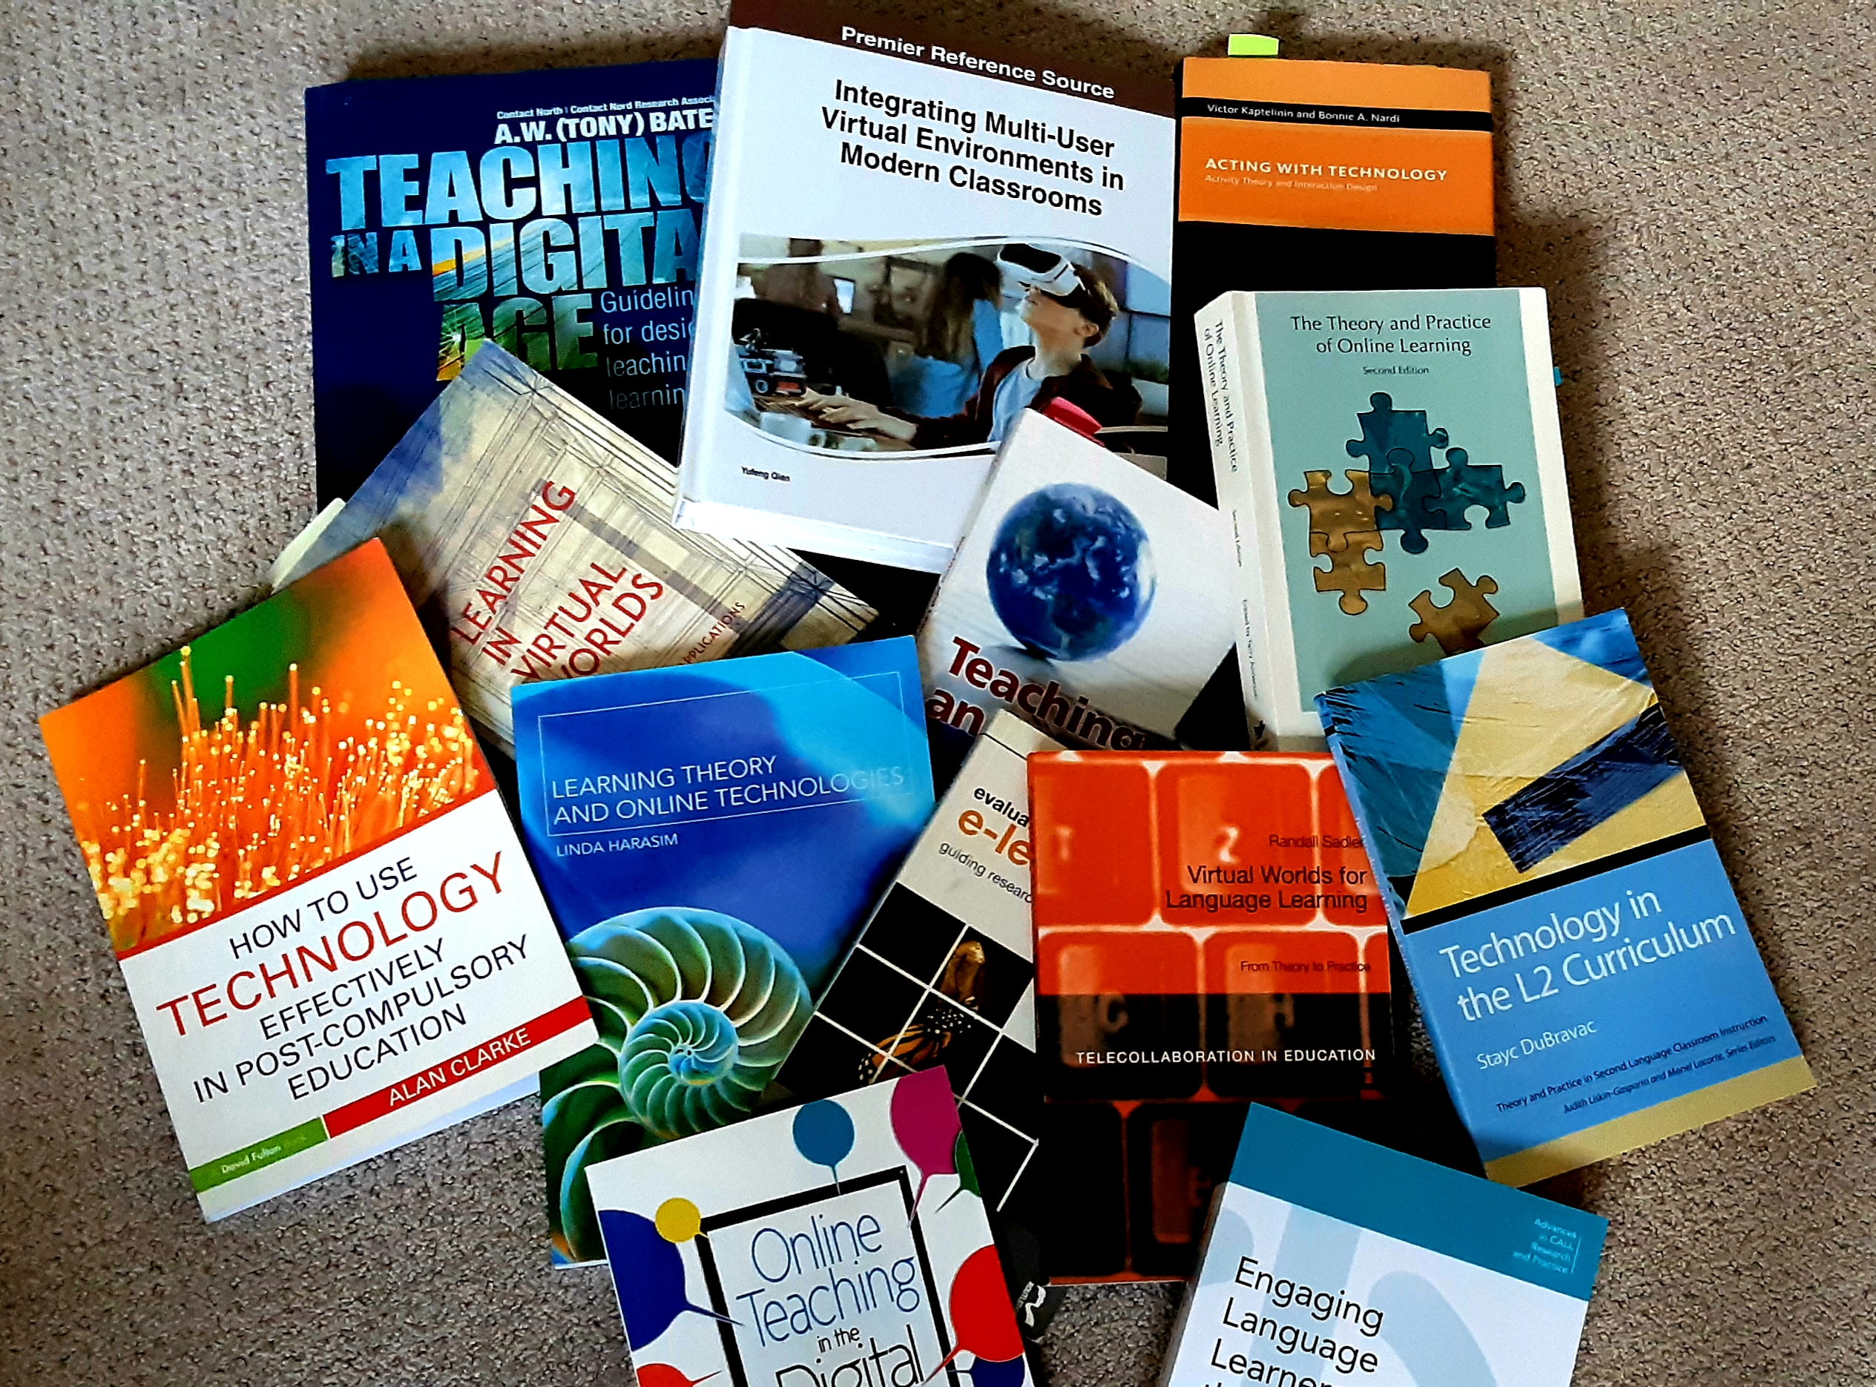
Notes:
Hello and thank you for joining me for this moderated, online panel on online teaching. In the moderated session, I will share my experiences, demo some my online courses and tools, and answer some of your questions in hopes to help alleviate panic and apprehension.
My name is Peggy Hartwick and I am an instructor in SLaLS and my primary responsibility is teaching EAP, but I am also a lecturer for a first year Intro to applied linguistics – language matters – a fully online course.
I have taught at Carleton for close to 20 years now and, believe it or not, have been experimenting with some form of online learning or learning with technology for almost most of that time. In fact, this curiosity with online and technology enhanced learning led me to pursue a PhD of which the focus was investigating the affordances of online learning spaces, such as:
LMSs - like WebCT and cuLearn - for delivery of content and instruction in a fully online and blended mode
3D immersive learning environments
ePortfolio as an integrative pedagogy
and, most recently, H5P as a tool for skill-based instruction
I want to stress that there is a full pedagogy behind the design, implementation, and maintenance of teaching a course online – teaching that is engaging, supportive, and promotes critical thinking, sense of community, learning, and fair assessment. Planning an effective online course is hard, it takes time – and you don’t have the luxury of time to prepare. In this vein, be kind to yourself, don’t try to do too much, keep it simple and be consistent.
I would argue that many students will still need the structure and community that is part of a face to face classroom and so, if possible, provide some opportunity for synchronous (or asynchronous) interactions.
Remember that teaching and learning online differs significantly from traditional classroom teaching. Ask for help, use the tools that EDC is making available – the online course design express is brilliant and worth investment of time now… don’t strive to be a perfectionist, it’s ok to make mistakes.

Slide 2
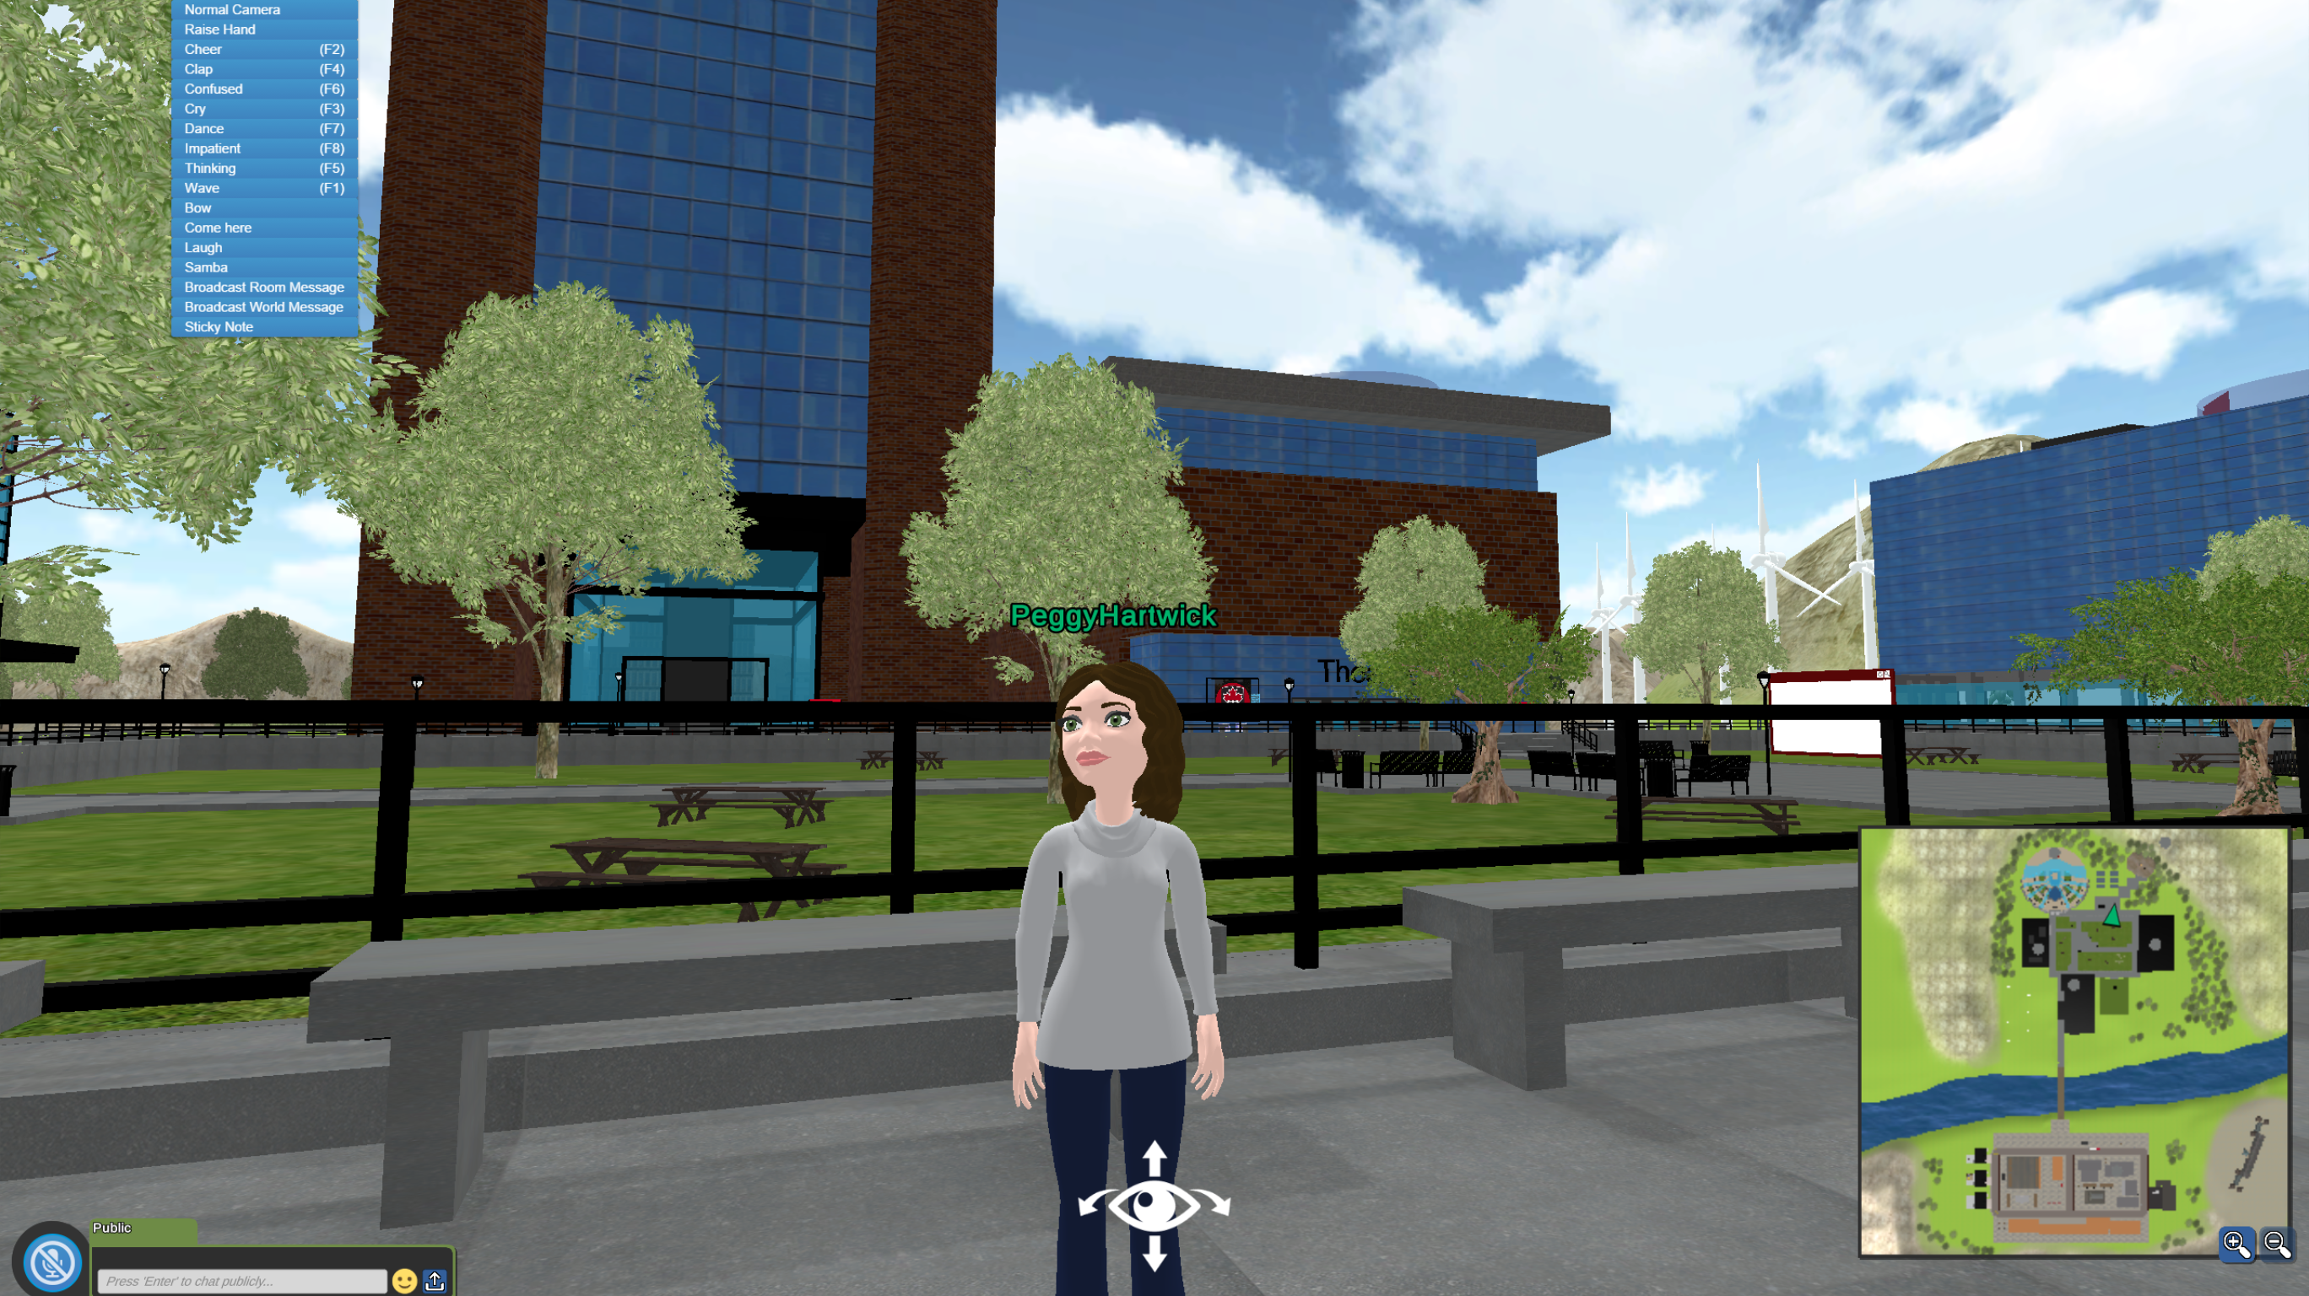
Notes:
Why the fascination with Online and blended delivery?
I guess my first experience with ‘online’ or ‘blended’ learning was almost 20 years ago now – at that time, I couldn’t even tell you what synchronous/ asynchronous learning was. I remember my kids were pretty little and it was March break and I wanted to be ‘out of the classroom’ for at least one class so that I could join my husband and kids at my parents where they could ski – I was pretty motivated… not in your situation where you don’t have a choice right now.

Slide 3
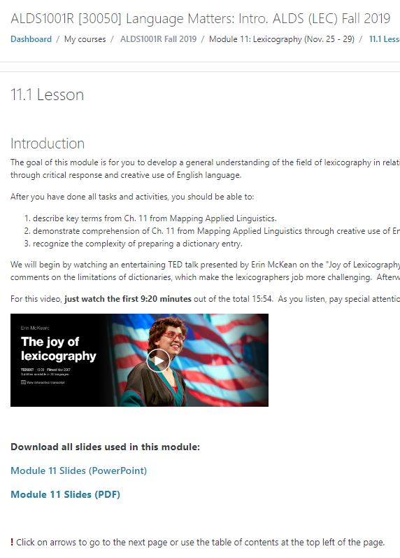
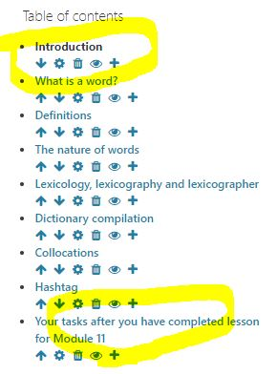
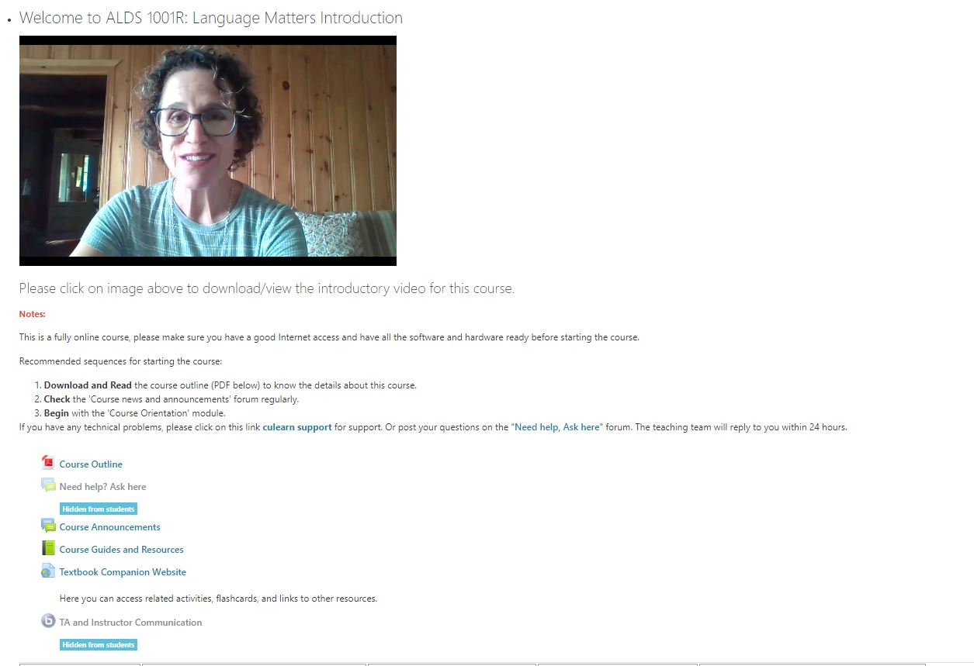
cuLearn
Notes:
Which courses have I taught online and which tools on cuLearn and other?
ALDS 1001 fully online and ESLA (blended) – all levels and in which I employed the following tools in cuLearn
Lessons
Data base tool
Kaltura/ video and audiocasts
Q & A forums
ePortfolio assignment
Chats
Quizzes
Assessment/ marking guide

Slide 4

Consider these…
Make it meaningful
Pedagogy not the tool
Simplicity of structure and design
Consistence of structure and design
Opportunities to engage – synchronous or asynchronous
Weekly accountability → student and instructor
Expectations
Asking for help or using available resources
Give yourself time-off from online!
Practice
Enroll in EDC’s COURSE DESIGN EXPRESS now!
Notes:
It was Patrick Lyons – who was helping me in designing my first online class who said not to complicate it, don’t make it too long, be reasonable in my expectations.
For your students and during this pandemic, mastery of online tools will vary, things online may take longer, require different learning curves, different access to technologies, technologies don’t always work as planned. Your course will not be the only thing important in your students’ lives

Slide 5

Challenges and perks
Time
Multi modality
Out of sight….
Adapting based on changing student needs
Technology
Screen time
Synchronous options
Emails

Slide 6

Students’ perspective
Consistency
Group work
Manageable assessment or options - is it worth it?
Smaller components versus 3-hour lectures
Zoom or BBB sessions = timely feedback
Situations vary
Notes:
Varying situations: working, children, no private workspace, weak or limited internet, limited access to technology or shared devices, emotional well-being, technically un-savvy

Slide 7
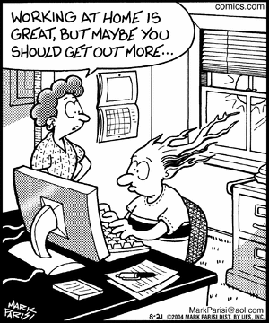
Source Credit: https://www.pinterest.com/pin/358247345338480406/
Notes:
What should you be prepared for?
Wow, you need to keep this simple and don’t put too much pressure on yourself or your students. You don’t have the luxury of pre-planning that most of us have had in past
Keep tasks simple, keep instructions simple
The harder it is for you, the harder it is for students
Don’t expect what works in classroom, will work online – these are different spaces

Slide 8

Consider
What will you use as your environment/ technology BE COMFORTABLE start simple
  Chat
  Lesson
  Kaltura - captioning
  Uploading slides/ posting slides
  Zoom/ skype/ BBB?
  Accessibility
What will you use as resources/ content?
  Library resources?
  Carleton’s bookstore – online orders and rentals?
  Open source
  Guests?
Keep communication open/ synchronous if possible
  Forums and Data bases on cuLearn
  Email policies – turn around time and availability
  Weekly audiopost
Assessment practice and frequency
  Learning outcomes
  Online quizzes
  Online assignments
  Rubrics and marking guides
Notes:
Consider these as you participate in the panel… reiterate what Ann Trepanier and Maristela from the EDC Course Design Express

Slide 9
Session plan
Q & A ongoing
Demo ALDS 1001 and preferred tools
Demo ESLA 1900 and preferred tools
Demo 3D
Demo H5P
Notes:
Next up, I will demo some of the tools/ features/ and layout that I have used in cuLearn?
What are you teaching spring/ spring and summer
How many students?
Consistent layout
Database
Forum
Lesson (importance of narrating)
Marking guides
Consistent layout
ePortfolio
H5P

Slide 10
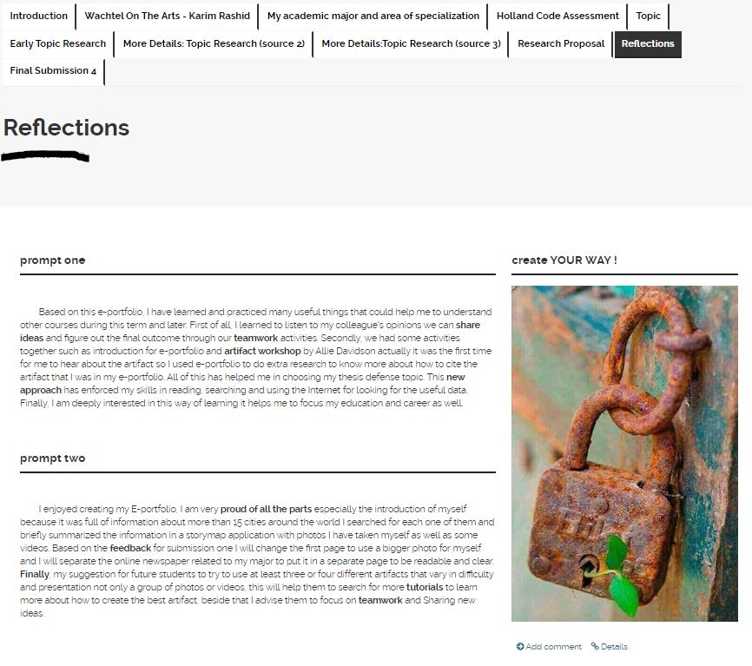
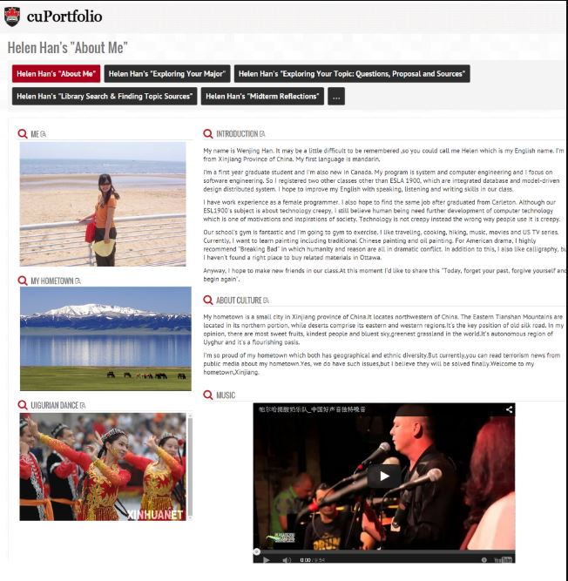
cuPortfolios

Slide 11
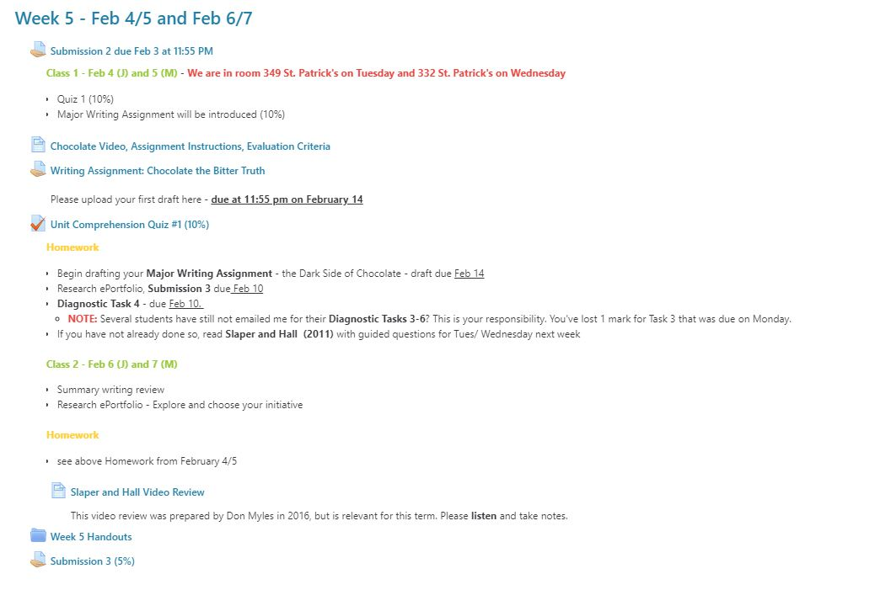
cuLearn

Slide 12

