Slide 1

Welcome to my online classroom
Julie McCarroll ~ ESLA Instructor

Slide 2

About esla
English as a Second Language for Academic Purposes (ESLA)
3 levels: Beginner, Intermediate, Advanced
6 hours instruction per week
Academic language and skills
Capped at 20 students (online) / 30 students (f2f)
Students may study concurrently in degree programs

Slide 3

session agenda
Initial course set up
  cuLearn → Brightspace
  Design options in Brightspace
  Student feedback & advice
Assignments, Quizzes, Grades
  What I like …
  What I don’t like …
  What I’ve learned …

Slide 4
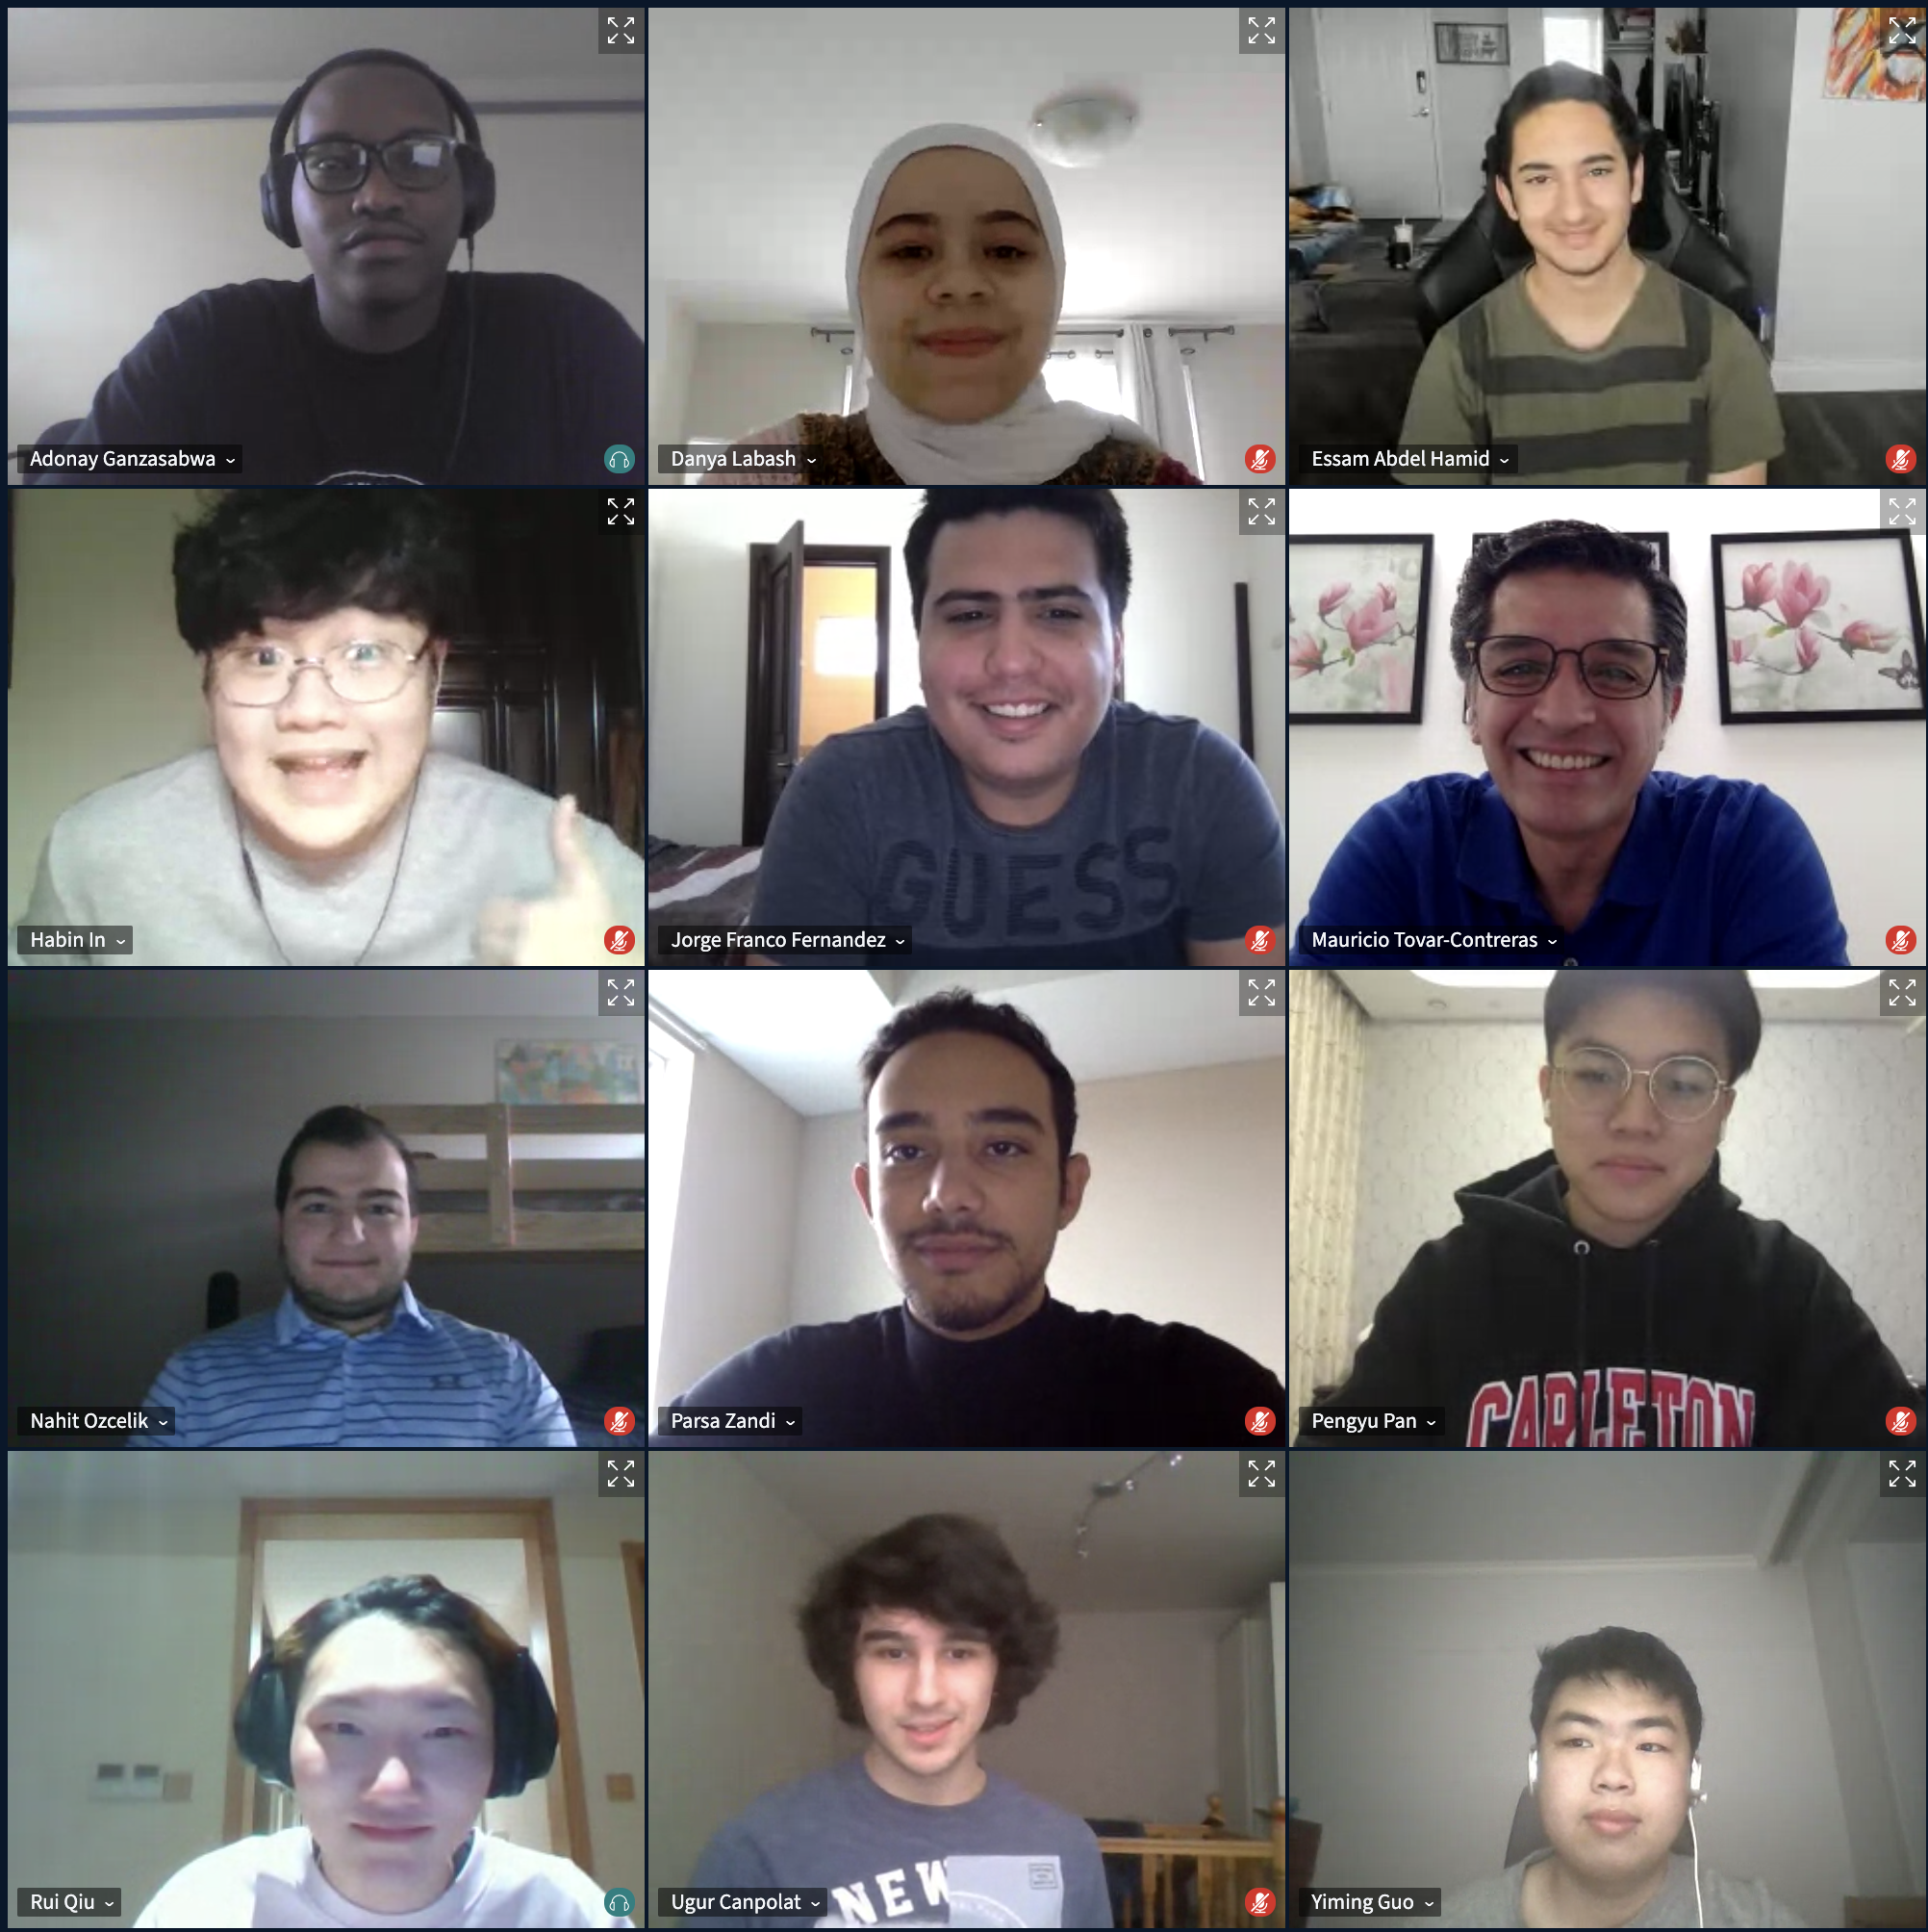
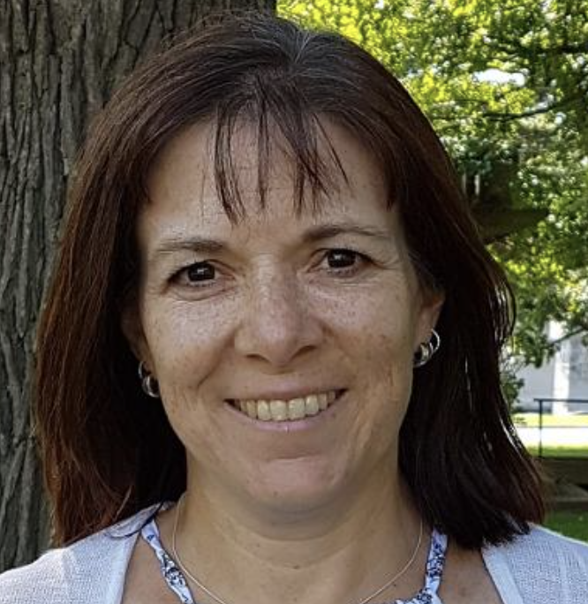
With thanks to
Tracy Hodgson-Drysdale
Winter 2021 ESLA 1900 N Students
(+ several missing / camera shy students)

Slide 5


1. Course design culearn → brightspace

Slide 6
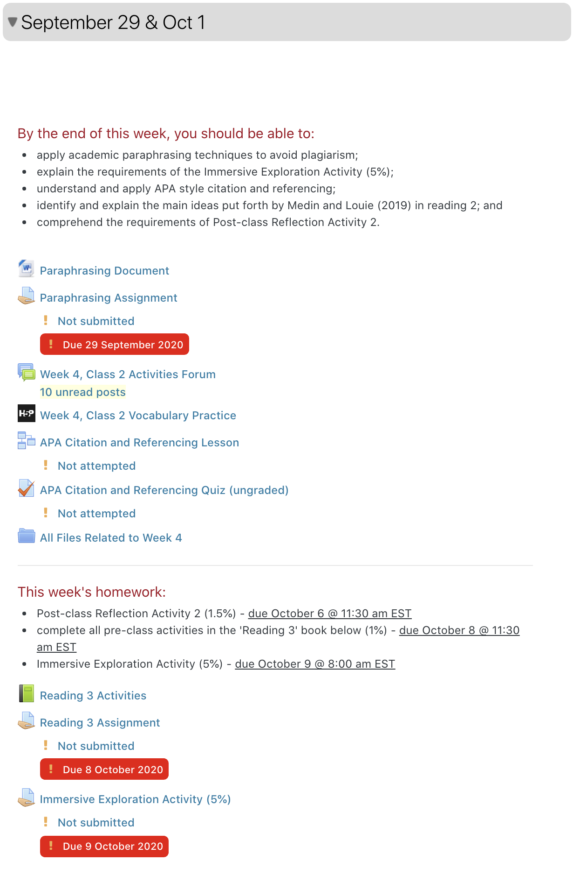


Culearn
Fall 2020 – Sept & Oct
“The way everything is so nicely organized and I always know exactly where to go to get what I need”
“Culearn was really organized. I can find all homework and assignments easily. “
________________________________________________
“More detailed course arrangements, every day, every week.”
“not clear enough when it comes to Homeworks, assignments”
“if the homework had a "what to do" where to find the article and just more details included before attending the HW instead of just being explained during classes it would be better”
“The categories can be simplified and specified”

Slide 7
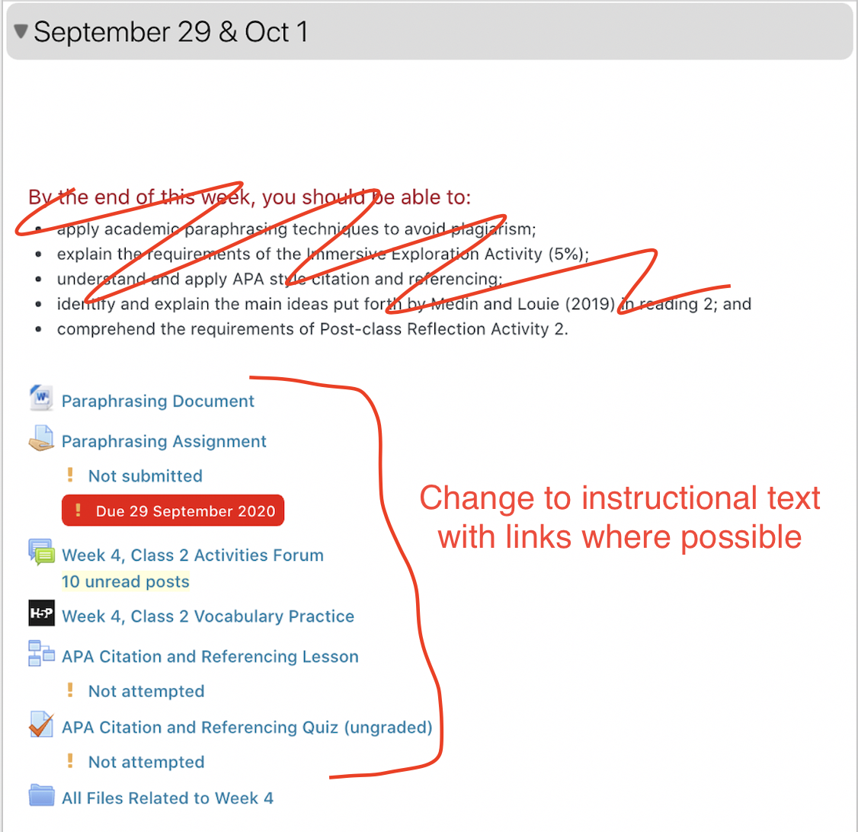
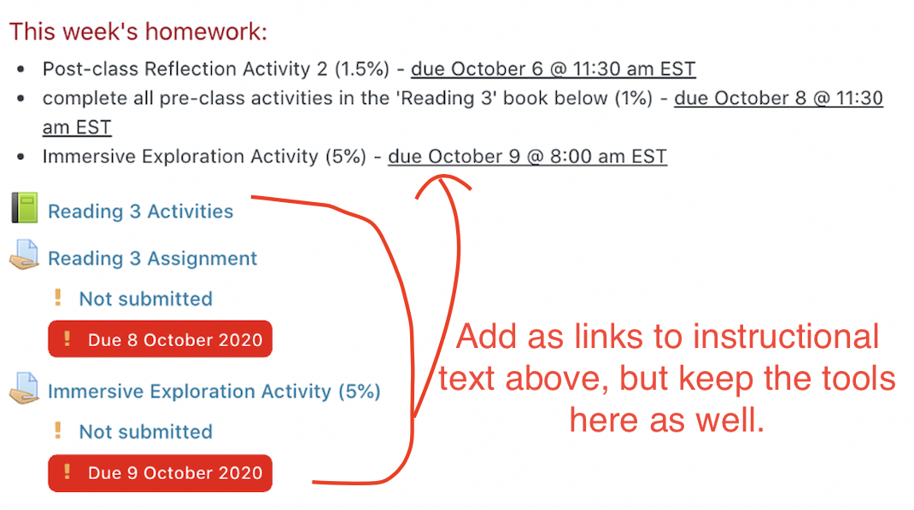
Feedback from tls – fall 2020 reading week

Slide 8
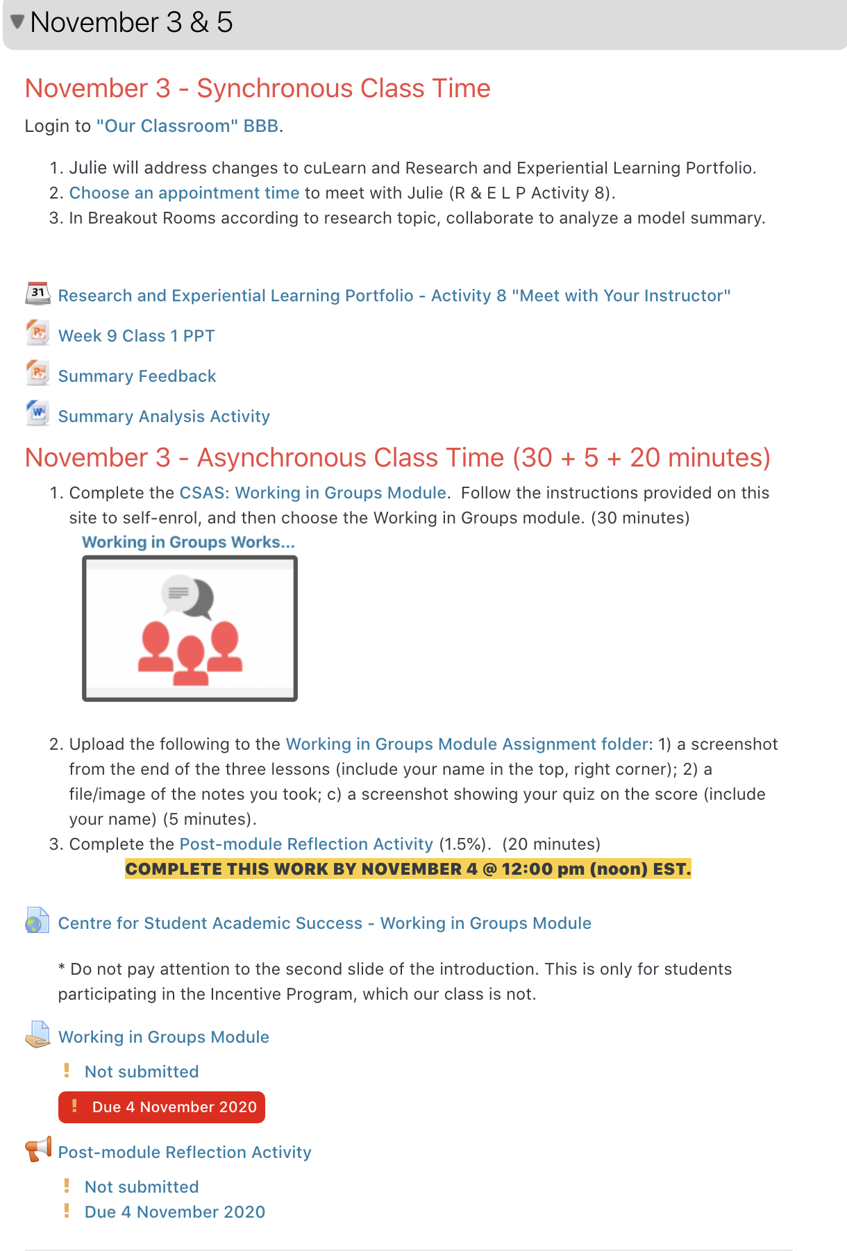
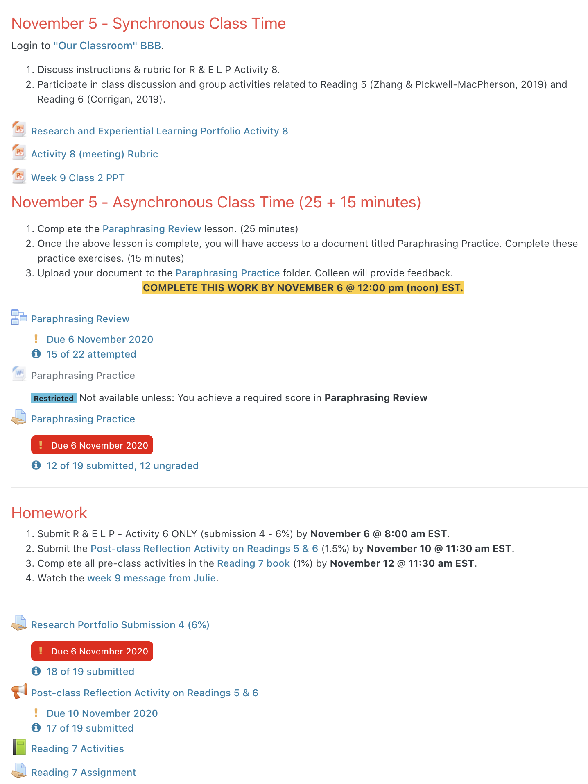
Fall 2020 – Nov & Dec

Slide 9
Culearn
Fall 2020 – NOV & DEC
“I liked the instructions since they helped me with preparing materials before the synchronous class time.
I have also seen that the learning outcomes part has disappeared. I think it was giving me a better experience after adding specific information for the class schedules.”
________________________________________________
I have to scroll down the page to the specific homework category every time I open the ESLA page from the Dashboard of my courses.

Slide 10

The move to brightspace

Slide 11

The Move to brightspace
Brightspace
Conduct needs analysis
Explore Brightspace design options
Consider existing resources
Select templates
Create consistent and simple modules

Slide 12
Let’s look at my course in brightspace

Slide 13
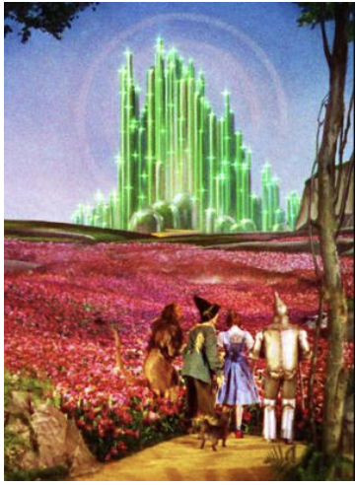
Exploit design options in brightspace
“behind the curtain”
Source: https://www.pinterest.ca/amerlinus/emerald-city-of-krysta/

Slide 14

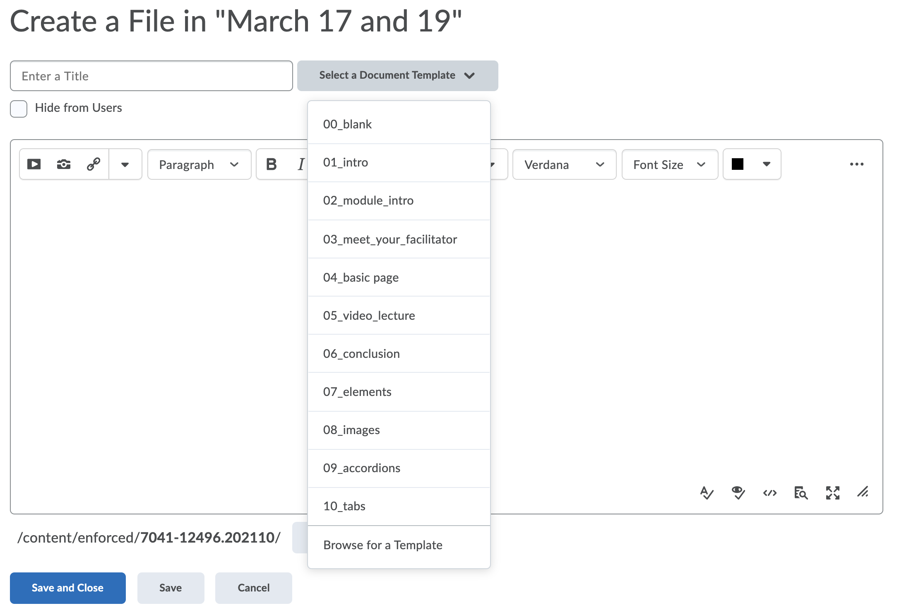
select templates
Upload/Create
Create a File
Choose from the 10 templates available
OR
Create a hybrid by copying and pasting
OR
Browse for a Template to copy one you already have

Slide 15

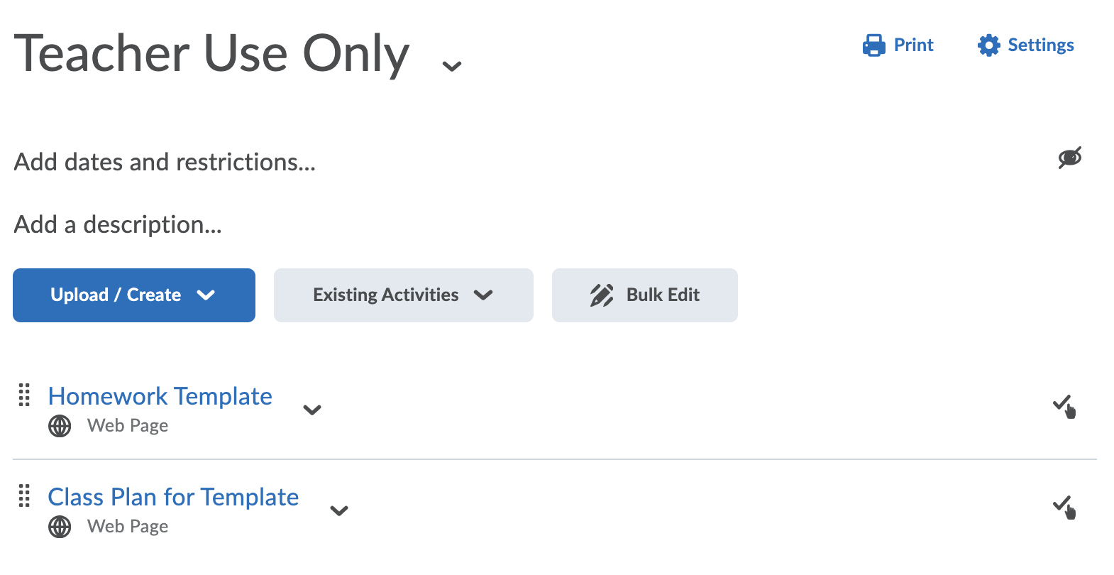
create consistent & simple modules
Save blank templates in a hidden “teacher only” module
Use template in student modules and fill in content
  Upload / Create
  Create a file
  Select a Document Template
  Browse for a Template
  Check, add and rename

Slide 16

Student feedback on brightspace

Slide 17
General Organization of Brightspace
“I am satisfied with the overall layout of the course in Brightspace.” | 11/13 (85%) of students agree or strongly agree
“The daily class plan (synchronous and asynchronous components) are clear and easy to follow.” | 11/13 (85%) of students agree or strongly agree
“The weekly homework page is clear and easy to follow.” | 11/13 (85%) of students agree or strongly agree
“I like that links to assignment folders, readings, workshops, etc. are embedded directly in the weekly plan/homework pages.” | 11/13 (85%) of students agree or strongly agree
How do you access BBB? | 7/13 (54%) through the BBB link in the Course Essentials module 6/13 (46%) through the BBB link in weekly class pages

Slide 18
Student comments – brightspace in general
“I like the clean design of the website and how things are organized.”
“The platform is so user friendly and fast.”
“I like that links to assignment folders, readings, workshops are embedded directly in the weekly plan/homework pages.”
“It gives me [the] class schedules in a big homepage box. I just have to pick one of the boxes inside to check my class assignments and other related information. Compare to Brightspace, cuLearn was more like a bookshelf with different folders. I have to find what I want without any clues of images and colours (just words).”
“It’s dynamic and interactive, I’m very clear on what I need to do.”
“It’s so organized and easy to navigate.”
“It’s colorful.”

Slide 19

QUESTIONS?

Slide 20



2. Assignments, quizzes, grades

Slide 21
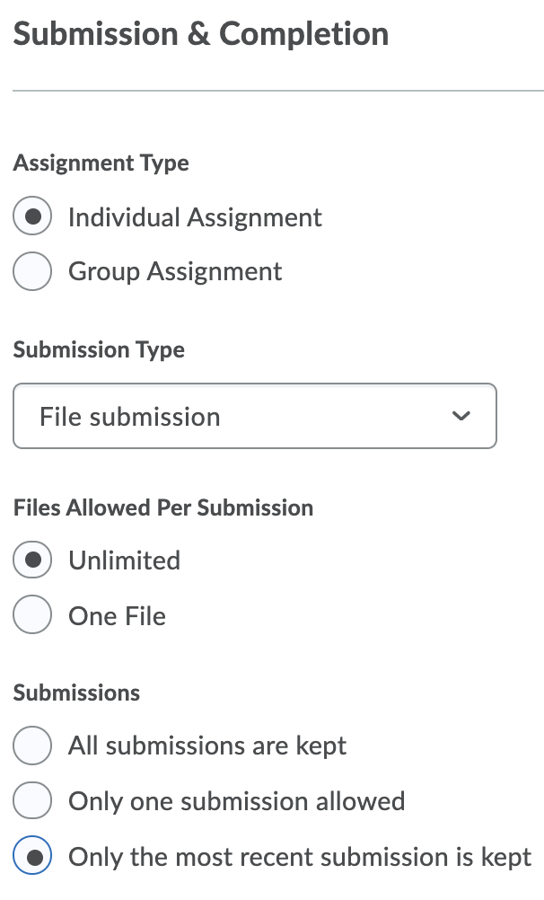
Assignments in brightspace
WHAT I LIKE
Feedback options
  Annotations
  Audio message
  Demo: Peggy’s submission
Easy rubric set up
WHAT I DON’T LIKE
Audio is limited to 1 minute
WHAT I’VE LEARNED
When setting up assignment, choose ‘unlimited files’ & ‘only the most recent’.
  students can upload a different file in case they make a mistake.

Slide 22
Feedback & Grades
“With respect to feedback on assignments, I like when Julie records a short audio message.” | 11/13 (85%) of students agree or strongly agree
“With respect to feedback on assignments, I like when Julie uses annotation tools to mark up my assignment.” | 11/13 (85%) of students agree or strongly agree
“With respect to feedback on assignments, I like when Julie provides extensive written feedback.” | 11/13 (85%) of students agree or strongly agree
“With respect to feedback on assignments, I find the rubrics clear and easy to understand.” | 8/13 (62%) of students agree or strongly agree

Slide 23
Student comments - assignments
“In case I made a mistake in uploading a file I can't undo it .”
“I like that links to assignment folders, readings, workshops are embedded directly in the weekly plan/homework pages.”
“I sometimes had problems uploading files.”
“There is no specific list of homeworks in order.”
Notes:
Problem: Make a mistake and can’t undo it.
Solution: Choose unlimited files to allow students to go in and upload a different file in case they make a mistake. Then choose, only keep the most recent if you actually only want one file uploaded.
Problem: Sometimes I have problems uploading files.
Solution: Brightspace will not accept files with names that include:
certain characters (” * / : < > ? \ | –).
2 consecutive periods (..)
a lengthy file name (>100 characters)
unprintable characters (like spaces)
In fall 2021 semester I will add a module with assignments in order. Some students commented that they like having multiple avenues to reach things (e.g., BBB). I will add a module for Assignments, etc. that lists all in addition to weekly class plan and homework pages.

Slide 24
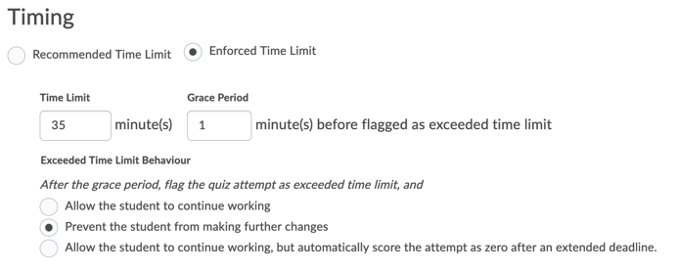
QUIZZES in brightspace
WHAT I LIKE
WHAT I DON’T LIKE
No automatic submission
Grace period
Limited questions
  Missing cloze, drag and drop, multichoice
No “description” question like in cuLearn.
WHAT I’VE LEARNED
Grace period
  Settings – no changes after time. Pop up box → prompts submission.
Add a “section”
Notes:
Grace period doesn’t seem to provide additional time. It’s a warning when students reach near the end of quiz.
cuLearn → BS migration guide for questions https://carleton.ca/brightspace/instructors/quiz-question-migration-guide/
Submit a quiz on a student’s behalf https://documentation.brightspace.com/EN/le/quizzes/instructor/submit_in_progress_quizzes.htm

Slide 25
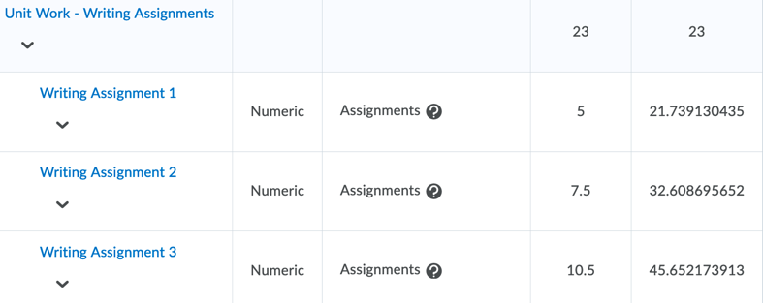
GRADES in brightspace
WHAT I LIKE
Brightspace gives warnings if your totals don’t add to 100
WHAT I DON’T LIKE
REMEMBER: connect assignments, quizzes, etc. to grades
WHAT I’VE LEARNED
cuLearn vs. BSpc weighting
  Challenge: different weights for assignments.
  Solution: “distribute weights by points”
Notes:
Weighting is different from cuLearn. In cuLearn, if I created a category with two assignments in it each worth 10%, I would weight them at 10. In BS, the weight would be 50 (each assignment is worth 50% of the weight in that category).
This becomes challenging: when different assignments have different weights and when decimal points are …..
SOLUTION: In edit – choose distribute weights by points across all items in the category

Slide 26
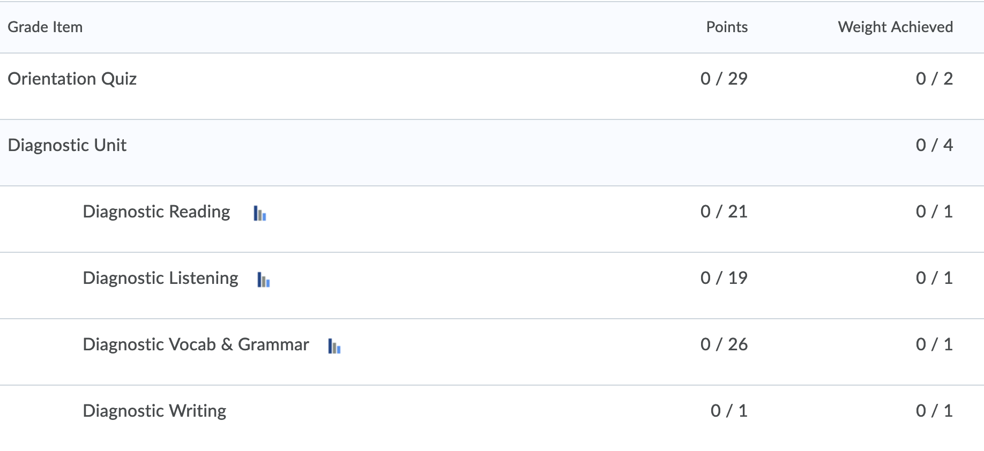
Grade calculation → Jan to Feb
  Manually add your score ➗ 46.5% = your percentage

Slide 27
Feedback & Grades
“The grade book is well set up and easy to navigate.” | 6/13 (46%) of students agree or strongly agree

Slide 28
Student comments - grades
“There isn't a main class progress indicator (percentage wise) to see if I'm above the passing limit or not.”
“The grade book will be better if it is designed in another way where the overall grade calculated..”
“The grade book are clear enough to calculate all the marks.”
Notes:
BS defaults to not show a running total since “Grades are not considered final until approved by Dean and Chair”. Check with your department for policies on this.
I handled this by periodically providing a running total to students and instructions on how to manually calculate their grades.
If your department allows you to show a running total of student grades, consult with a TLS expert to ensure that your set up is correct. There are a few things happening behind the scenes that you want to confirm with an expert.

Slide 29
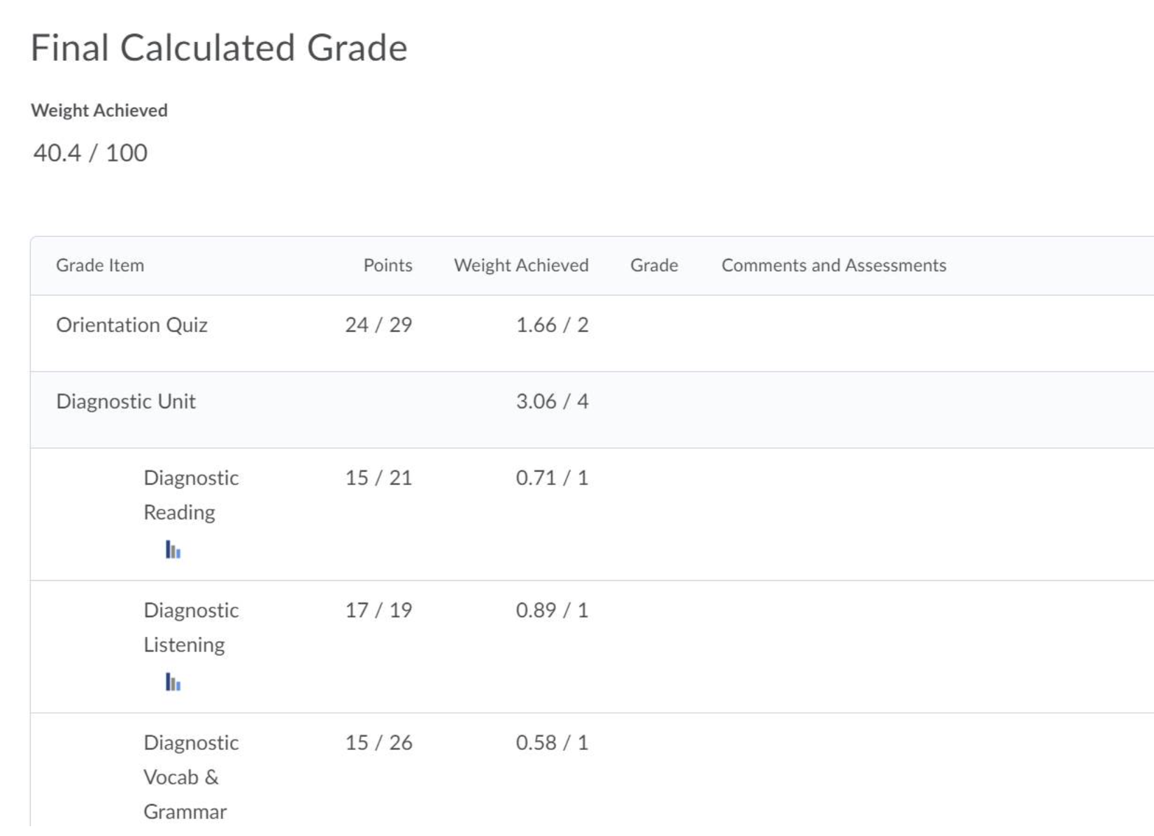
Grade Calculation → march – April
Ask Chair → protocol for your department
  If permitted to show running total, contact TLS for help setting this up
SLaLS Instructors:
  David Wood has given us permission to share/not share a running total as we see fit
  Your score (weight achieved) ➗ 46.5% = your percentage

Slide 30
QUESTIONS?

